Slide 1
Facility Online Manager (FOM)

Slide 2
Creating Your User Account

Slide 3
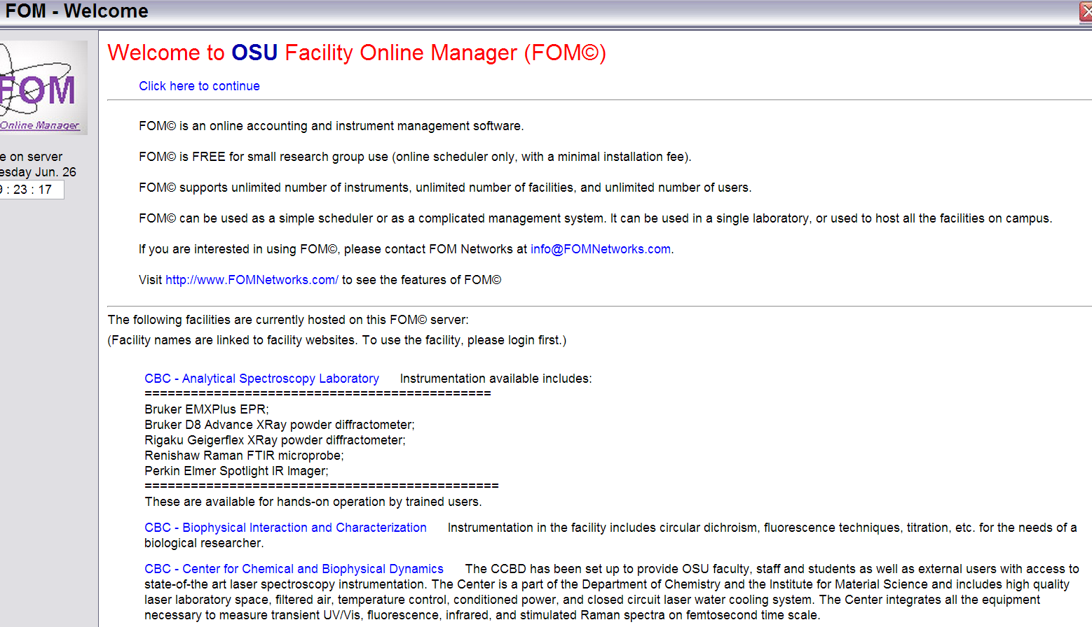
Welcome Page

Slide 4
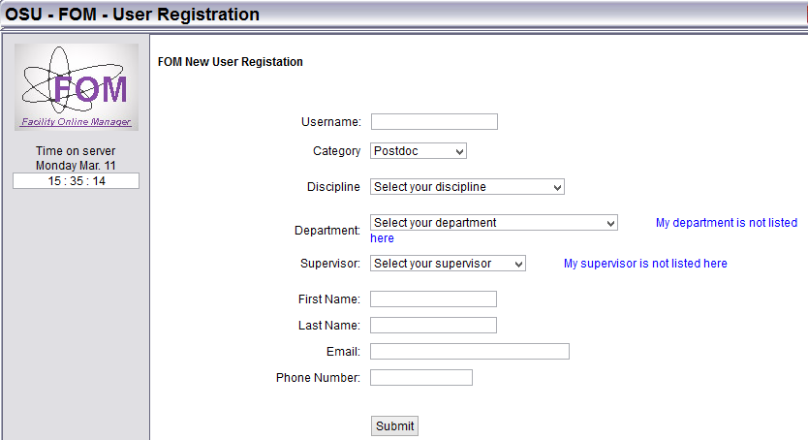
Adding a User Profile

Slide 5
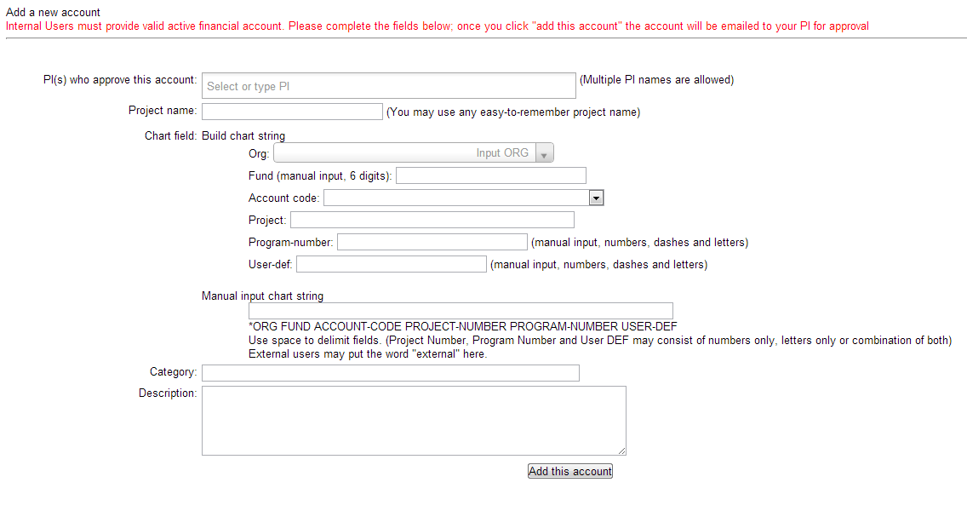
Add Chartfield (Account Info)

Slide 6
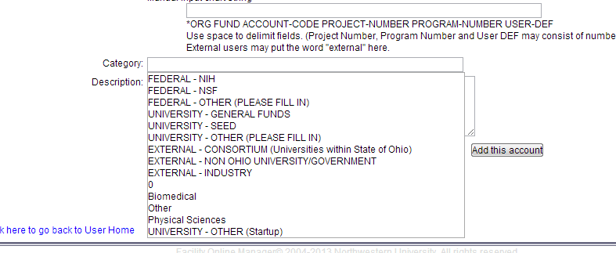
Chartfield information continued

Slide 7
After setting up your FOM user account, validation will be sent to your PI (Principal Investigator) and Business Manager.
Once they have approved your project usage, you will receive an e-mail confirming your user account has been set up.
Once you receive this email, you account has been activated. Your instrument access level must be set up, which a CEMAS staff member will do so.

Slide 8
Requesting Instrument Training

Slide 9
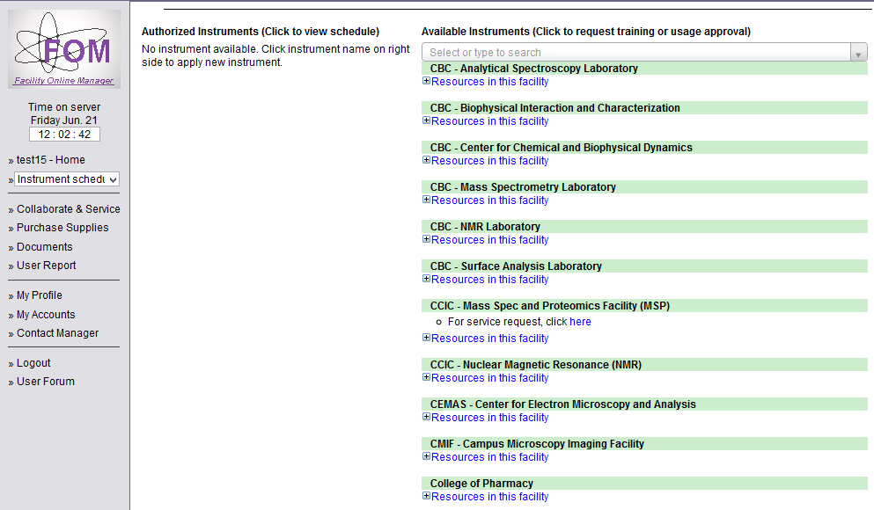

User Home Page

Slide 10
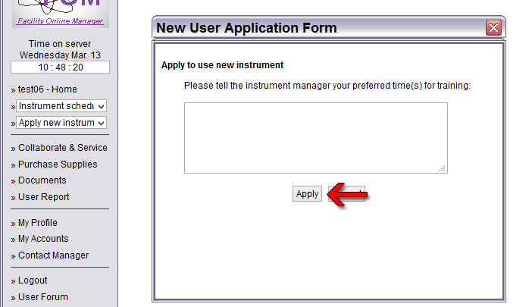
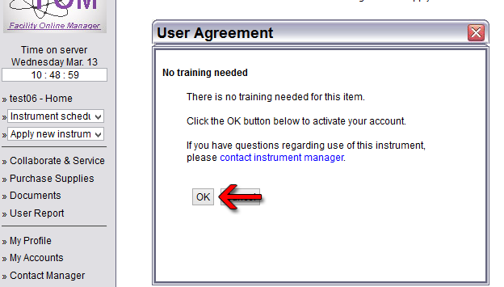
Users Messages

Slide 11
Reserving Instrument Time

Slide 12
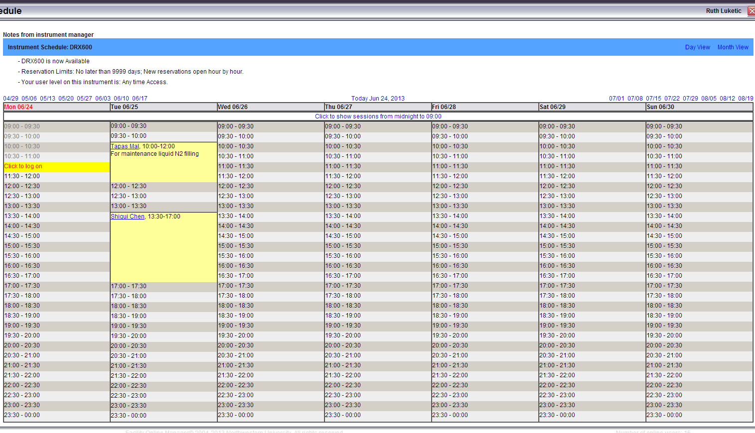
Scheduling Instrument Time

Slide 13
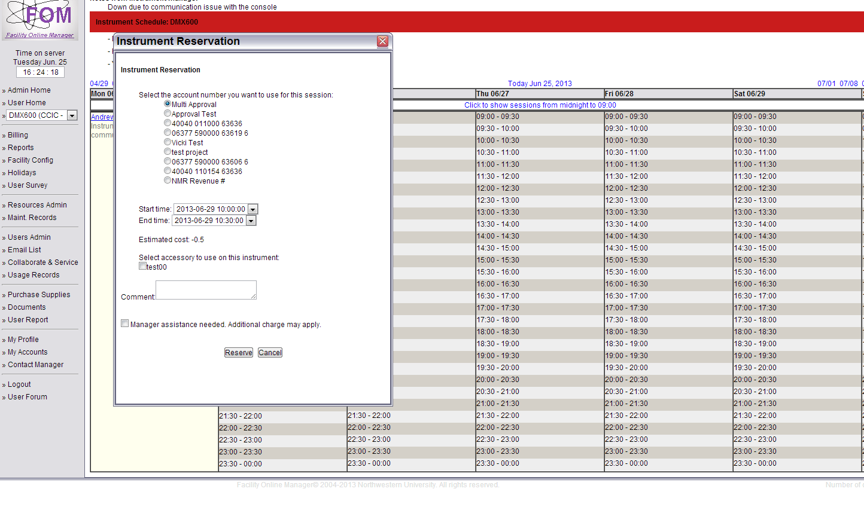

User Chooses Pre-approved Chartfield

Slide 14
Logging In/Out of Your Reservation

Slide 15
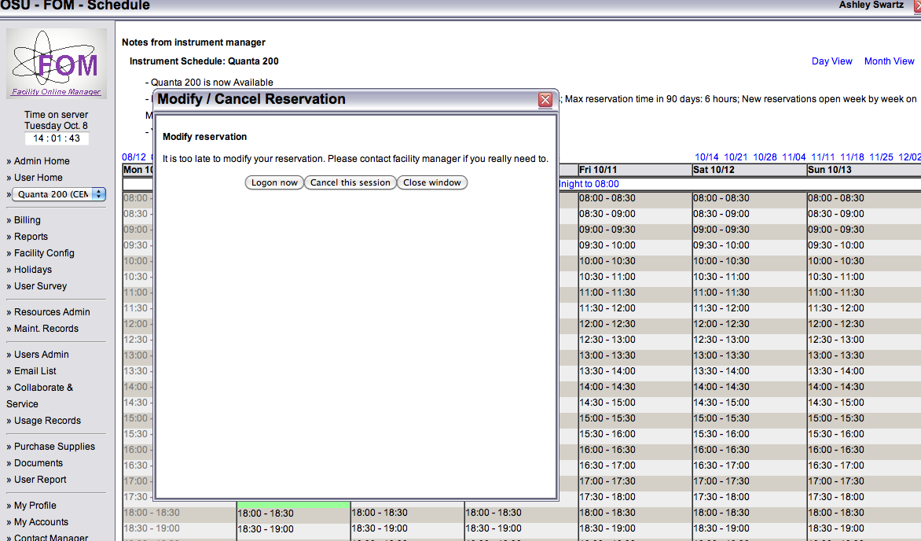
Logging In

Slide 16
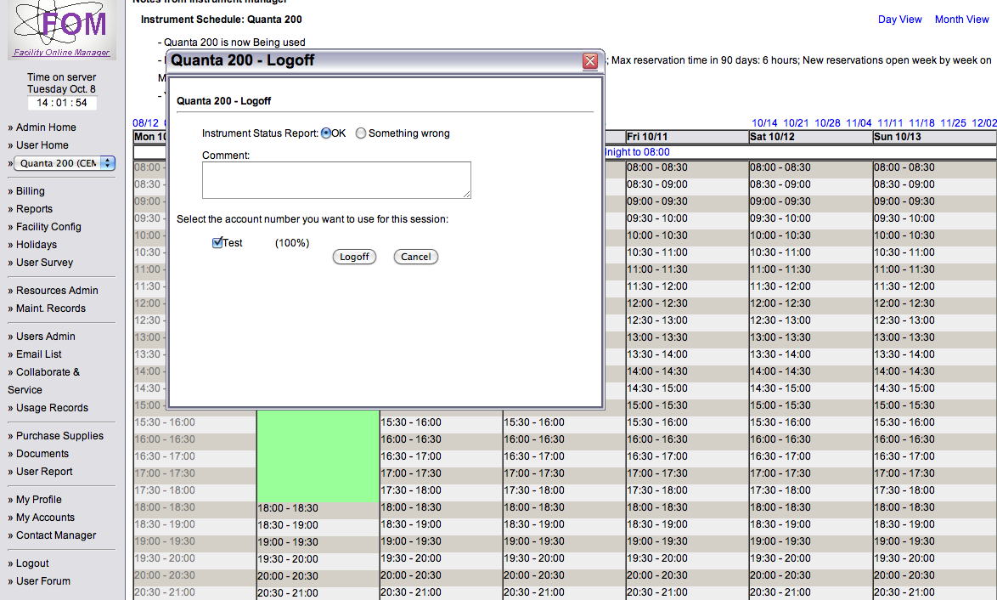
Logging Out

Slide 17
Viewing Your Access

Slide 18
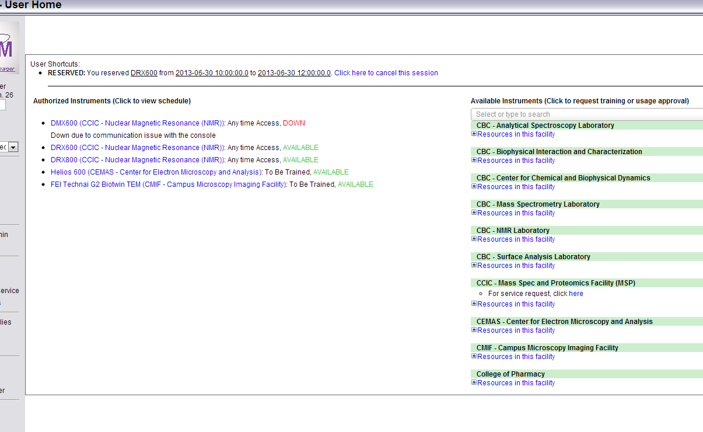
User Home Page with Access

Slide 19
Canceling Your Session
* You will receive a reminder e-mail 24 hours before your session. You will be charged a cancellation fee if there is a no-show or you cancel after 12 hours prior to your scheduled time.

Slide 20
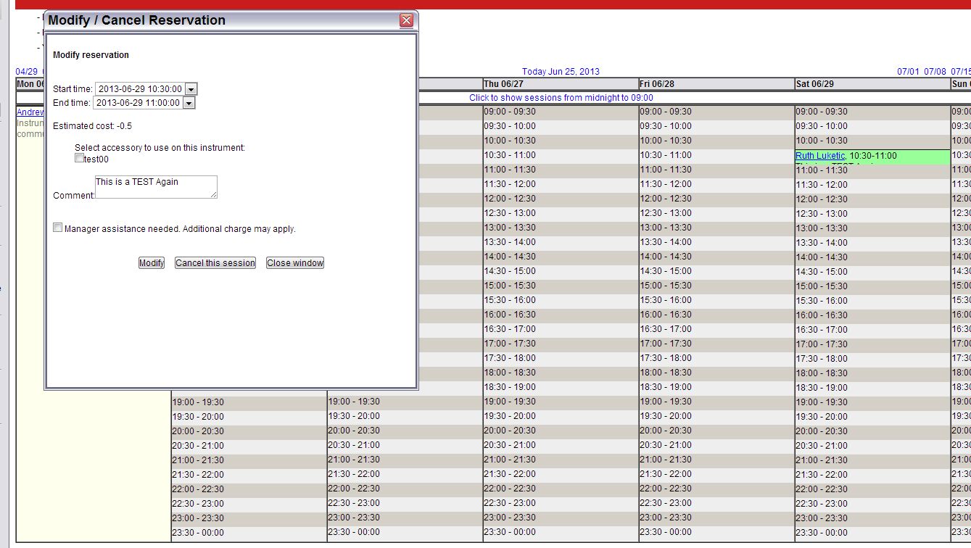
User Scheduling Page

Slide 21
Contacts
Henk Colijn (colijn.1@osu.edu)
CM200
CM12
Tecnai
XRD
Cameron Begg (begg.4@osu.edu)
Quanta
Sirion
ESEM
Daniel Huber (huber.83@osu.edu)
Helios
Nova
Robert Williams (williams.2156@osu.edu)
Titan I
Titan II
Libby Steele (steele.704@osu.edu)
Billing
Ashley Swartz (swartz.202@osu.edu)
Facility Access
FOM Questions/Concerns

