Slide 1
Ge-SpMM in Julia
Presentation by: Andrew Osterhout
Implementing Algorithm from: https://arxiv.org/pdf/2007.03179.pdf

Slide 2
What is it
A General algorithm for Sparse Matrix Multiplication, with optimizations for CUDA GPUs
Implemented using Compressed Sparse Row (CSR) for sparce matrix. (https://scipy-lectures.org/advanced/scipy_sparse/csr_matrix.html)
Optimizations proposed:
Parallel Caching into SM level shared memory.
“Register Coaxing”
Loop Unrolling.

Slide 3

Compressed Sparse Row (CSR)
Compresses Matrix into 3 Arrays
indPtr: Contains 2 adjacent “pointers” to the start and end of values a row’s values.
colInd: Contains the column index for corresponding value in vals.
vals: Contains all non-zero values from the matric linearized in row major order.
$$A=\left[\begin{matrix}0 & 0 & 0 & 4 \\ 0 & 0 & 7 & 0 \\ 9 & 0 & 11 & 12 \\ 0 & 14 & 15 & 0\end{matrix}\right] ⇒ A_{CSR}=\left\{\begin{aligned}A_{rowPtr}=\left[1, 2, 3, 6, 8\right] \\ A_{colInd}=\left[4, 3, 1, 3, 4, 2, 3\right] \\ A_{vals}=\left[4,7,9,11,12,14,15\right]\end{aligned}\right.$$
*note: Index values are in math/Julia form (start at 1 not 0)

Slide 4

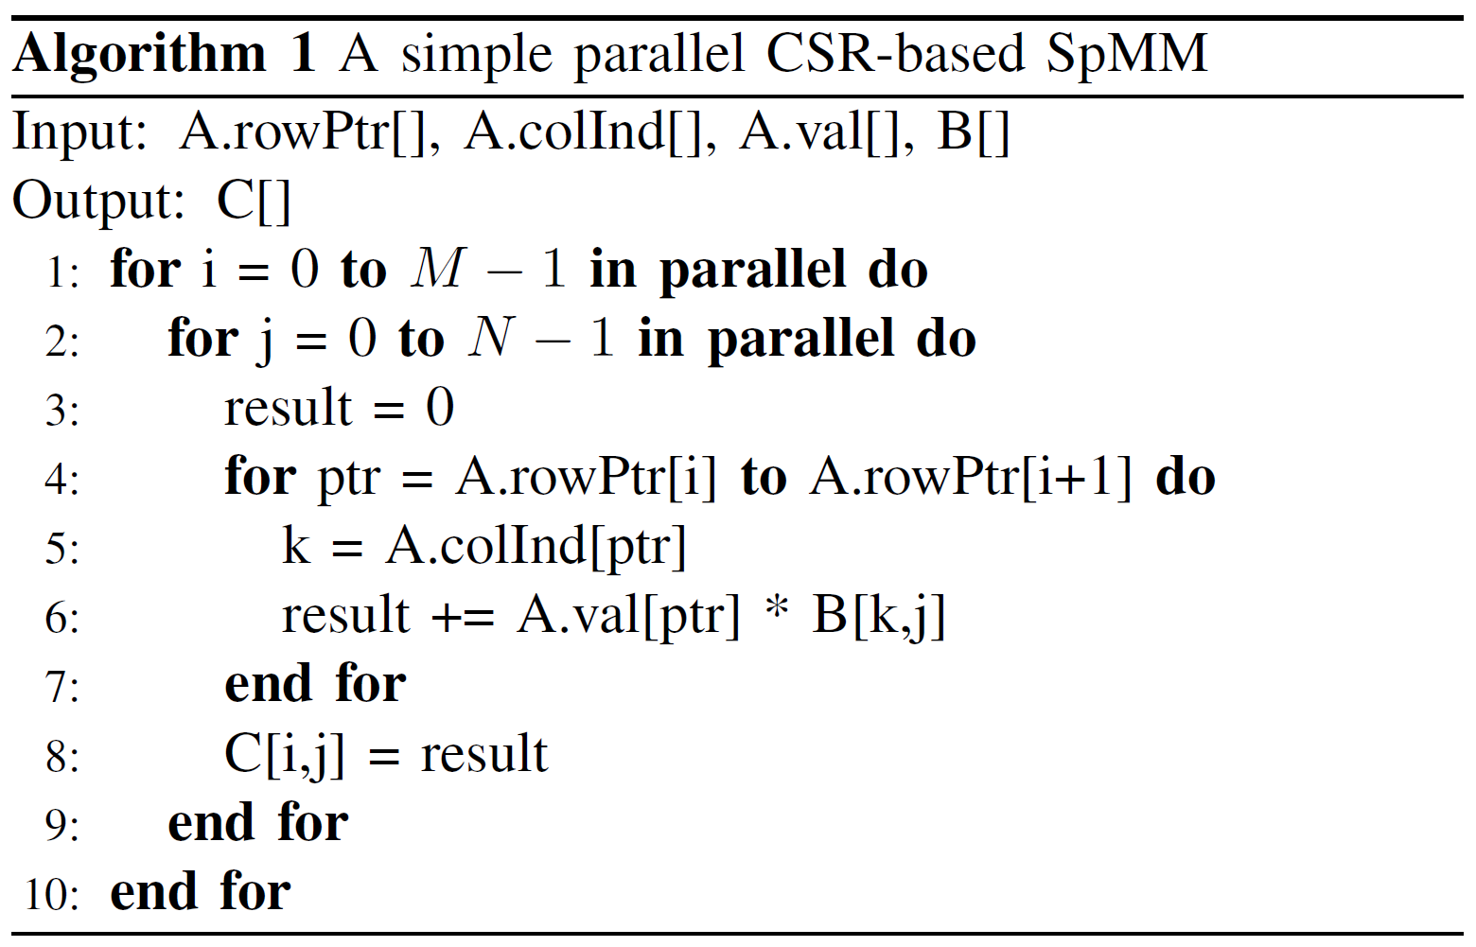
General Sparse Matrix Multiply w/ CSR:
Loop through every cell of resulting matrix (C), in row major order. (ln 1 & 2)
Loop through every value in corresponding row in A (CSR), indicated by the values in A.rowPtr (ln 4)
Multiply with coorosponding value of B (row=i & col indicated by value in A.colInd). Aggregate as a sum. (ln 5-6)
Store in appropriate value of C.
Credit: Ge-SpMM

Slide 5
My Linear Julia implimentation
First coded it linearly to best understand the process, and make sure I knew how to handle Julia’s Array indexing (start at 1)
"""
A linear/singlethreaded version of the Ge-SpMM algortihm (meant for CPU not GPU)
_(algorithm 1 in [the paper](https://arxiv.org/pdf/2007.03179.pdf))_.
"""
function SpMM_lin(M, N, rowPtr, colInd, val, B)
C = Matrix{Float64}(undef, M, N)
for i in 1:M
for j in 1:N
result = 0
for ptr in rowPtr[i]:(rowPtr[i + 1] - 1)
k = colInd[ptr]
result += val[ptr] * B[k,j]
end
C[i,j] = result
end
end
return C
end #? function SpMM_lin(N, M, rowPtr, colInd, val, B)

Slide 6
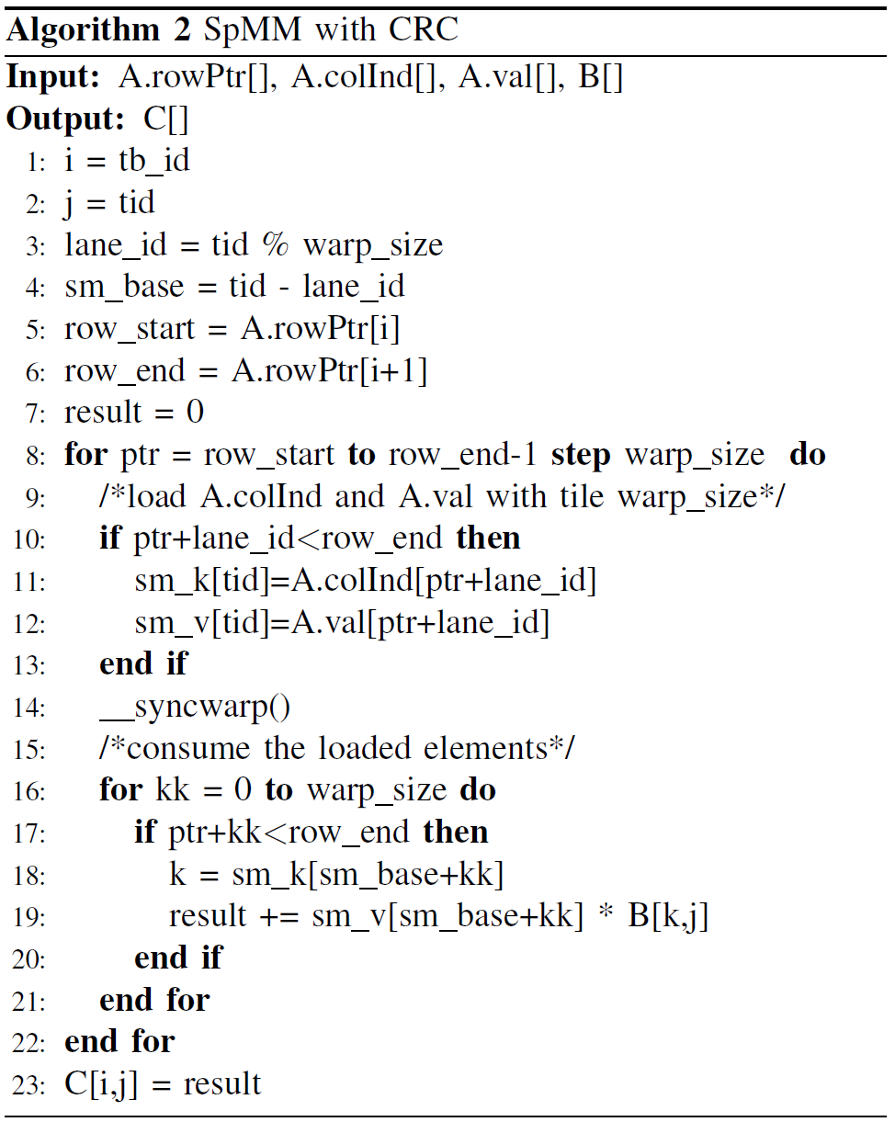
Ge-SpMM on CUDA
Parallelize the outer i & j loops from Alogo 1.
Utilize shared memory for efficiency (ln 9-13)
Each warp is responsible for one row of the resulting matrix.
Performing shared memory cache and calculations in 32x1 wide blocks.
Credit: Ge-SpMM

Slide 7
Implementing in Julia (p1)
Issues:
Arrays Start at 1*
No pointers
Shared Memory Differences
Even Less Documentation
Papers Algorithm was too generic for the inexperienced
Best to show you.

