Slide 1
HackBama
Hacker Bootcamp and CTF event.

Slide 2
CTF Event
Team
Server
Battleground
Notes:
Write up on event

Slide 3
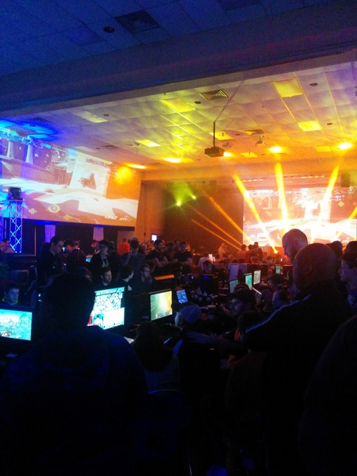
Capture the Flag (CTF) is a special kind of information security competitions.
There are three common types of CTFs:
Jeopardy
Attack-Defence
mixed
Notes:
Capture the Flag (CTF) is a special kind of information security competitions.
There are three common types of CTFs:
Jeopardy
Attack-Defence
mixed
Jeopardy-style CTFs has a couple of questions (tasks) in range of categories. For example, Web, Forensic, Crypto, Binary or something else. Team can gain some points for every solved task. More points for more complicated tasks usually. The next task in chain can be opened only after some team solve previous task. Then the game time is over sum of points shows you a CTF winner. Famous example of such CTF is Defcon CTF quals.
Well, attack-defence is another interesting kind of competitions. Here every team has own network(or only one host) with vulnerable services. Your team has time for patching your services and developing exploits usually. So, then organizers connects participants of competition and the wargame starts! You should protect own services for defence points and hack opponents for attack points. Historically this is a first type of CTFs, everybody knows about DEF CON CTF – something like a World Cup of all other competitions.
Mixed competitions may vary possible formats. It may be something like wargame with special time for task-based elements (like UCSB iCTF).
CTF games often touch on many other aspects of information security: cryptography, stenography, binary analysis, reverse engineering, mobile security and others. Good teams generally have strong skills and experience in all these issues.
HackBama’s CTF game incorporates all three types. Competitors will be given pieces of hardware which they must put together to form a computer. Then which create an operating system and stand up communication/networking to connect it to the battleground. Where the competitors try to control and take over simulated computers.
You’ll then begin in the virtual battlegrounds.
HackBama CTF is a kind of game, and there are levels to attain. When you find a new piece of software, or a new login; a system message from an account called Operator will inform you of your progress. You’ll also gain access to more commands and system resources.
These days, the guest account is disabled by default in Windows and other operating systems, but in times gone by, it was considered a courtesy to grant such access to anyone who may need temporary use of your computer.
To help remote guests log in, the account usually had no password. Enter the username guest and press ‘enter’, and you’ll log straight into the remote host’s guest account. The guest account is limited in what it can do, and the aim in hacking is always to gain the best system privileges possible because this gives the best access and control. Press Ctrl-D to log out of the remote host and you’ll be returned to the battlegrounds central server.
It’s time to cross the line into the world of real hacking by ‘illegally’ gaining a privileged account on a host. Find more tools and gain more access. Establish footholds onto the network controlling parts of the network, while keeping others out!

Slide 4

You’ll then begin in the virtual battlegrounds.
Login
Explore
Locate
Pivot
Control
Defend
Notes:
You’ll then begin in the virtual battlegrounds.
HackBama CTF is a kind of game, and there are levels to attain. When you find a new piece of software, or a new login; a system message from an account called Operator will inform you of your progress. You’ll also gain access to more commands and system resources.
These days, the guest account is disabled by default in Windows and other operating systems, but in times gone by, it was considered a courtesy to grant such access to anyone who may need temporary use of your computer.
To help remote guests log in, the account usually had no password. Enter the username guest and press ‘enter’, and you’ll log straight into the remote host’s guest account. The guest account is limited in what it can do, and the aim in hacking is always to gain the best system privileges possible because this gives the best access and control. Press Ctrl-D to log out of the remote host and you’ll be returned to the battlegrounds central server.
It’s time to cross the line into the world of real hacking by ‘illegally’ gaining a privileged account on a host. Find more tools and gain more access. Establish footholds onto the network controlling parts of the network, while keeping others out!

Slide 5
Embedded Device
Team
Server
Servers get and ethernet connection to the battleground.
Points are gained for keeping services running.
Teams may attack each other's servers.
Teams may patch flaws in services.
New services may be distributed during the course of the event.
Teams will have to proxy through server to attain battleground points.

Slide 6

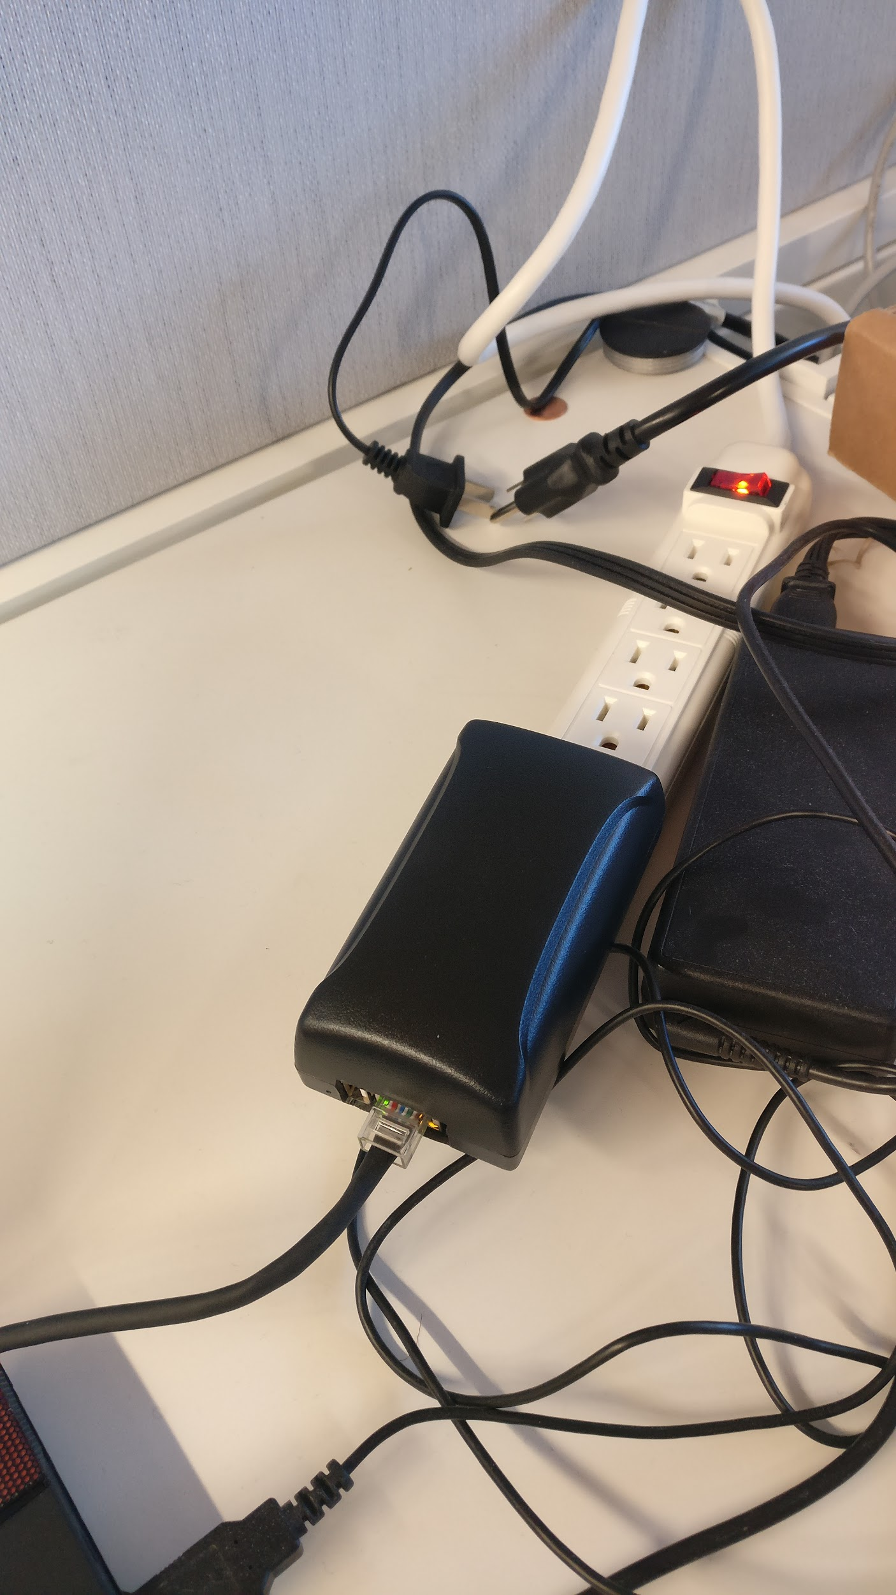
Build Your own IOT device.
Hardware specification
H2 Quad-core Cortex-A7 H.265/HEVC 1080P.
·Mali400MP2 GPU @600MHz
512MB DDR3 SDRAM
10/100M Ethernet RJ45 POE is default off.
Onboard WIFI
XR819, IEEE 802.11 b/g/n
Supports external board via 13 pin header
USB 2.0 HOST,
26 Pins Header, compatible with Raspberry Pi B+
13 Pin Header, with 2x USB, IR pin, AUDIO(MIC, AV)

Slide 7
Course Outline integrates with CTF
hardware assembly
Linux kernel
Embedded OS
Setup & Maintenance
Hardware Reverse Engineering
Software Reverse Engineering
Penetration Testing Methodology
Programming Basics

Slide 8
Class#1
Hardware Assembly
Learn the components of an embedded system.
how to assemble the embedded system
How to solder
Make your own custom IOT device
Discus ways that system can be expanded to do more.

Slide 9
Class#2
Linux Kernel
What is the Kernel?
How to compile a system specific kernel for better system performance.
How to apply a kernel patch.
How to edit the kernel.
Hardening the kernel against cyber threats.

Slide 10
Class#3
Setting up the operating system on your embedded system.
Getting access to the embedded system
Making updates to the system
How to compile a program
Installing services

Slide 11
Class #4
Configuration, maintenance and hardening.
How to configure common services.
How to maintain a linux system.
How to lock things down to protect your system from threats.

Slide 12
Class #5
Hardware reverse engineering basics
This will be cover the basics of how to glean information about unknown systems.
Hardware component visual identification.
gaining access or pulling software via programming and testing ports.
bypassing hardware protective measures.
chip decapping

Slide 13
Class #6
Software Reverse Engineering
Course on malware reverse engineering
Dissecting the code
Analysing traffic

Slide 14
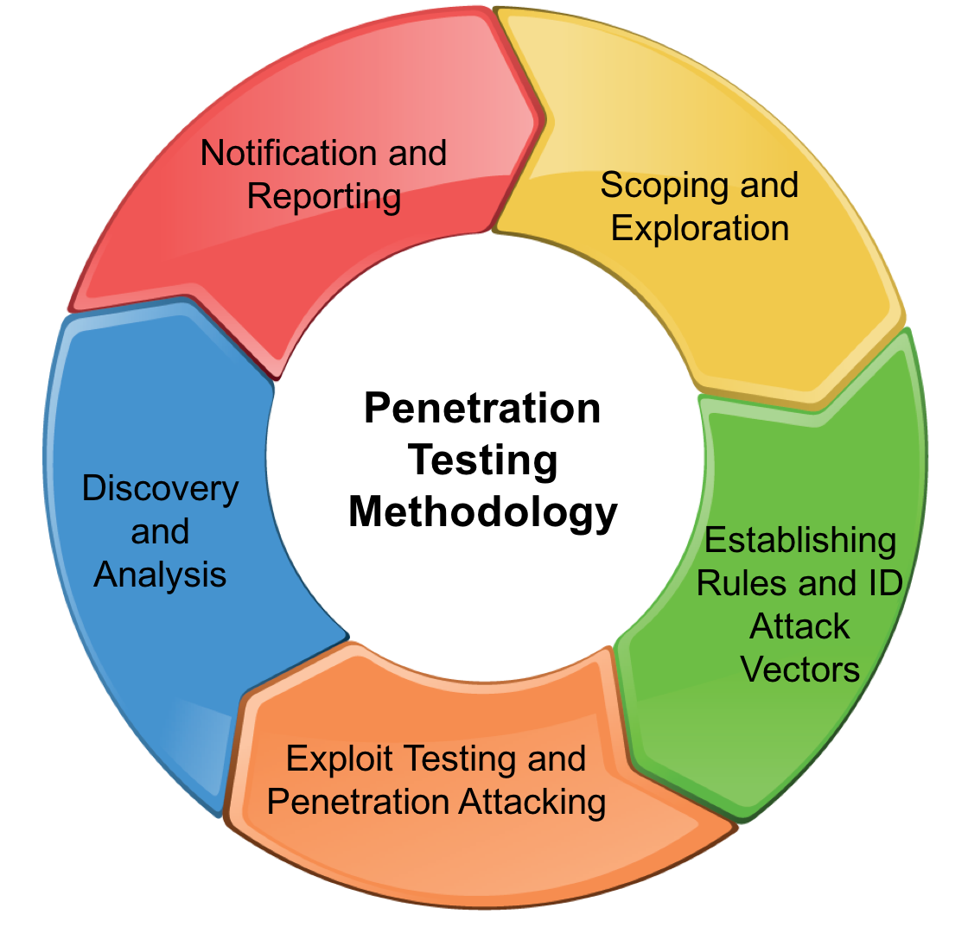
Class #7
Penetration Testing Methodology

Slide 15
Class #8
Essential Skills Needed and Why
Programming
Databases
Researching
Tools
Networking
Problem-Solving Skills

