Slide 1
CPM2 / CPNext: cyclic-peptide PPI-inhibitor pipeline
Status report and hand-off
A candid evaluation of pipeline quality. What it can show, where it is weak, what is queued.
Adrian Cipriani -> Niklas, Martin
Period: 2026-04-13 to ongoing. Informal hand-off briefing.
Scientific spine: negative-control MD batch (benchmarks/md_20260528_negcontrols).

Slide 2
The question, and the pipeline
Can interface-mimicry seed competitive cyclic-peptide PPI inhibitors?
- Goal: design head-to-tail / disulfide cyclic peptides that block four protein-protein interfaces.
- Targets: MDM2/p53, Bcl-xL/Bad, 14-3-3/Cdc25C, CypA/HIV-capsid.
- Premise: borrow the backbone geometry of a known interface, then redesign the sequence.
cPEPmatch
geometric backbone match to interface
Boltz-2
fold-validate complex (ipTM, pLDDT, RMSD)
ProteinHunter
sequence refinement (LigandMPNN + Boltz)
->
->
Epistemic flag: Pipeline computes geometry + model confidence, not a thermodynamic score. Affinity is assessed only later, by offline MD/MMGBSA on a shortlist.

Slide 3
What the pipeline can show: the triage funnel
MDM2/p53 v1 run as the worked example (data/runs/mdm2_p53_v1_...).
37 cPEPmatch backbone matches
37 Boltz-2 folded poses (ipTM 0.83 to 0.96)
148 ProteinHunter refined designs
3 shortlist advanced to MD / MMGBSA
- Inspection layer: marimo triage view (ipTM vs peptide-drift plane, sized by pLDDT) plus a per-design drilldown.
- Enriched per-design table adds topology (head-to-tail / monocyclic / bicyclic), cPEPmatch fit-RMSD, peptide drift, and a topology audit that flags designs built with the wrong cyclization vs the DB.
- Shortlist picks the best cyclic design per topology family, so MD spends GPU only on a few coverage-spanning candidates.

Slide 4
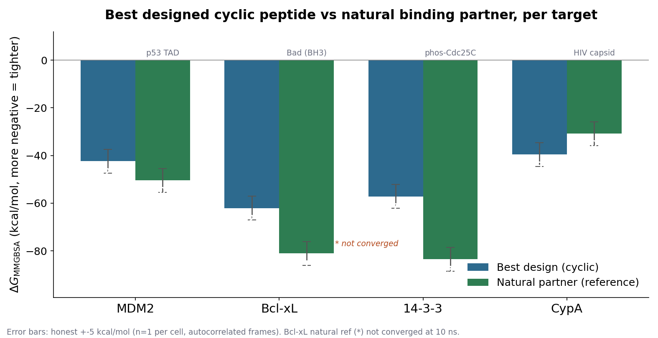
Designs vs natural partners: MMGBSA per target
Best designed cyclic peptide against the cognate natural binder.
- Natural partner wins
- for 3/4 targets: MDM2, Bcl-xL, 14-3-3.
- CypA is the exception
- design -39.6 vs nat -30.8.
- (but see slide 6).
Epistemic flag: Error bars are honest +-5 kcal/mol, not the MMPBSA-printed 0.5 to 0.9 (frames autocorrelated, n=1). Differences within ~5 kcal/mol are noise. Bcl-xL natural ref not converged at 10 ns.

Slide 5
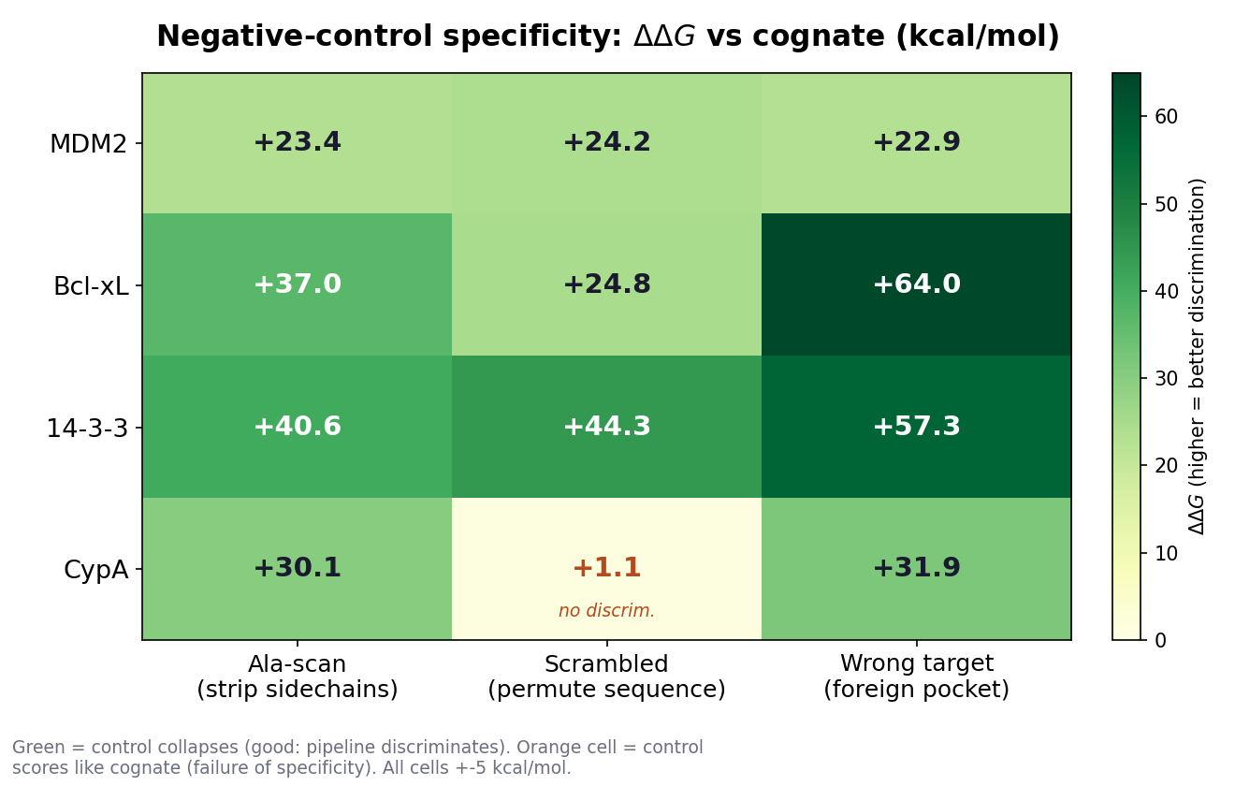
Negative-control specificity matrix
The centrepiece: does the score discriminate sequence and target identity?
- 3/4 targets discriminate
- both sequence (Ala-scan, scrambled collapse +23 to +44) and target (wrong-target ddG +23 to +64; Bcl-xL and 14-3-3 reach near-zero absolute dG, MDM2 anecdotal due to high SE).
- Pipeline is not just rewarding any peptide in a pocket: sidechains and target identity both matter.
- CypA scrambled does NOT collapse (+1.2).
- That single orange cell is the honesty finding (next slide).
Epistemic flag: All cells +-5 kcal/mol. MDM2 wrong-target had high SE (1.3, did not equilibrate in foreign pocket): anecdotal. MDM2 scrambled overstates effect (CYX->ALA bug dropped a disulfide).

Slide 6
The honesty finding: CypA is composition-driven
A surprising negative result, reported as found.
CypA: a randomly permuted version of the design scores identically to the design (scrambled ddG = +1.2 kcal/mol, within noise).
The CypA win is composition-driven shape complementarity, not a sequence-specific binding hypothesis. The cognate dG is real, but the design's specific sequence contributes essentially nothing.
- Bcl-xL is partially composition-driven: scrambled retains ~60% of binding (scrambled +24.8 vs Ala-scan +37.1).
- MDM2 and 14-3-3 do show sequence specificity (scrambled collapses hard, +24 and +44).
- Implication: 'pipeline ranks design > scrambled' is target-dependent, not a universal property.
- Follow-up queued (most important): repeat CypA scrambled with 3 RNG seeds to test if +1.2 is reproducible.
Epistemic flag: n=1 trajectory per cell. The +1.2 could be a one-off; the 3-seed repeat is the decisive test and is not yet run.

Slide 7
Does the cheap score predict the physics?
ipTM (Boltz confidence) vs MMGBSA dG. The question we cannot yet answer.
- We would like ipTM to rank designs the way MMGBSA does, so the cheap stage can pre-screen.
- Right now we cannot say whether it does.
- Only 3 designs per target went to MD (12 total in the overnight batch; no alternates). Too few for a per-target Spearman ipTM-vs-MMGBSA.
- ipTM range across the MDM2 designs is narrow (0.83 to 0.96): little spread to correlate against.
- With n this small, any Spearman rho is dominated by noise. Reporting one would be over-claiming.
- Honest verdict: under-powered. The correlation question is deferred to the stratified experiment (slide 8).
Epistemic flag: No ipTM-MMGBSA correlation is reported because n per target is far too small (3 to 5) and the ipTM spread is narrow. An honest rho needs the n=15 stratified design (queued).

Slide 8
What is still unclear, and what is queued
Designed and submitted on Slurm. Results pending, no outcomes yet.
Queued on Slurm (running, results pending)
- cPEPmatch fit-RMSD sensitivity (MDM2/p53): does seed geometric quality propagate to final design quality, or does ProteinHunter rescue anything? Decision criterion fixed in advance.
- ProteinHunter convergence-at-100 (match18_3av9): does the LigandMPNN <-> Boltz loop reach a self-consistent fixed point, or is it a greedy ipTM hill-climb (the 2024 anti-pattern)? 4 independent seeds.
No results yet. Outcomes not fabricated here.
Needed for an honest verdict (not yet run)
- n=15 designs per target with stratified ipTM sampling: the only honest way to estimate Spearman rho for ipTM vs MMGBSA.
- 100 ns production runs for the per-target winners + natural refs (bronto cannot deliver these; needs the firefly cluster).
- Block-averaged / proper standard errors to replace the misleading MMPBSA sqrt-of-frames SE.
- MMPBSA-proper (PB, not GB-only) as a second independent solvation model on the winners.
Epistemic flag: Slurm jobs are designed and submitted; no numbers exist yet. Everything in the right card is identified but unrun.

Slide 9
Limitations and epistemics
Where the numbers are soft, stated plainly.
- n = 1 trajectory per MD cell. The printed MMPBSA SE (0.5 to 0.9) assumes independent frames; true SE is roughly 3 to 10x larger.
- Treat every per-cell error bar as +-3 to 5 kcal/mol. Any ddG within ~5 of zero is noise.
- Force-field artefacts: 3odi cyclosporin reference unusable (6/11 N-methylated residues defeat GAFF); excluded, not a result.
- Bcl-xL natural reference (Bad) not converged at 10 ns (RMSD still rising, dG drifts ~4.8 kcal/mol): an under-confident floor, recompute at 100 ns.
- MDM2 scrambled control degraded by a CYX->ALA mutagenesis bug (lost a disulfide), so its ddG overstates the sequence effect.
- Scoring is GB-only (igb=5), not PB. Wrong-target pose is a heuristic pocket pushout, not a re-dock (orientation arbitrary).
- Upstream design (per 2026-04-23 critique): Stage 3 optimizes Boltz ipTM, a confidence proxy, not a thermodynamic quantity.
Epistemic flag: These are not hedges added for the talk; each is sourced from the negative-control final report Caveats section.

Slide 10
Verdict and recommendation
Honest, not promotional.
The pipeline is internally consistent and discriminating, but the designs are NOT yet competitive with natural binders on dG.
Natural partners beat the designs for 3/4 targets; the one apparent CypA win is composition-driven, not sequence-specific.
- What is solid: the negative-control matrix shows the score discriminates sequence and target for MDM2, Bcl-xL, 14-3-3.
- What is not: absolute affinity vs natural binders, the CypA specificity failure, and whether ipTM predicts MMGBSA (under-powered).
- Recommendation: before scaling up, (1) resolve the cheap-score-vs-physics question with the n=15 stratified runs, (2) get 100 ns + proper SE on the winners via firefly, (3) treat CypA as a cautionary case, not a hit.
- Strategic context (critique 2026-04-23): the interface-mimicry premise is defensible and testable; the current operationalization (greedy ipTM, GB-only screen) is the weak link, not the idea.
Epistemic flag: Verdict rests on n=1 MD with +-5 kcal/mol bars and one un-converged reference. Direction is robust; exact magnitudes are not.

