Slide 1
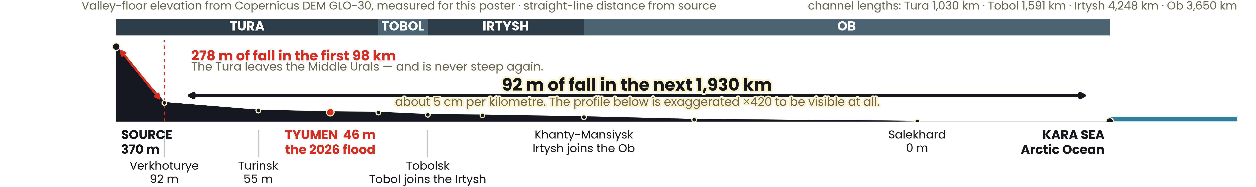
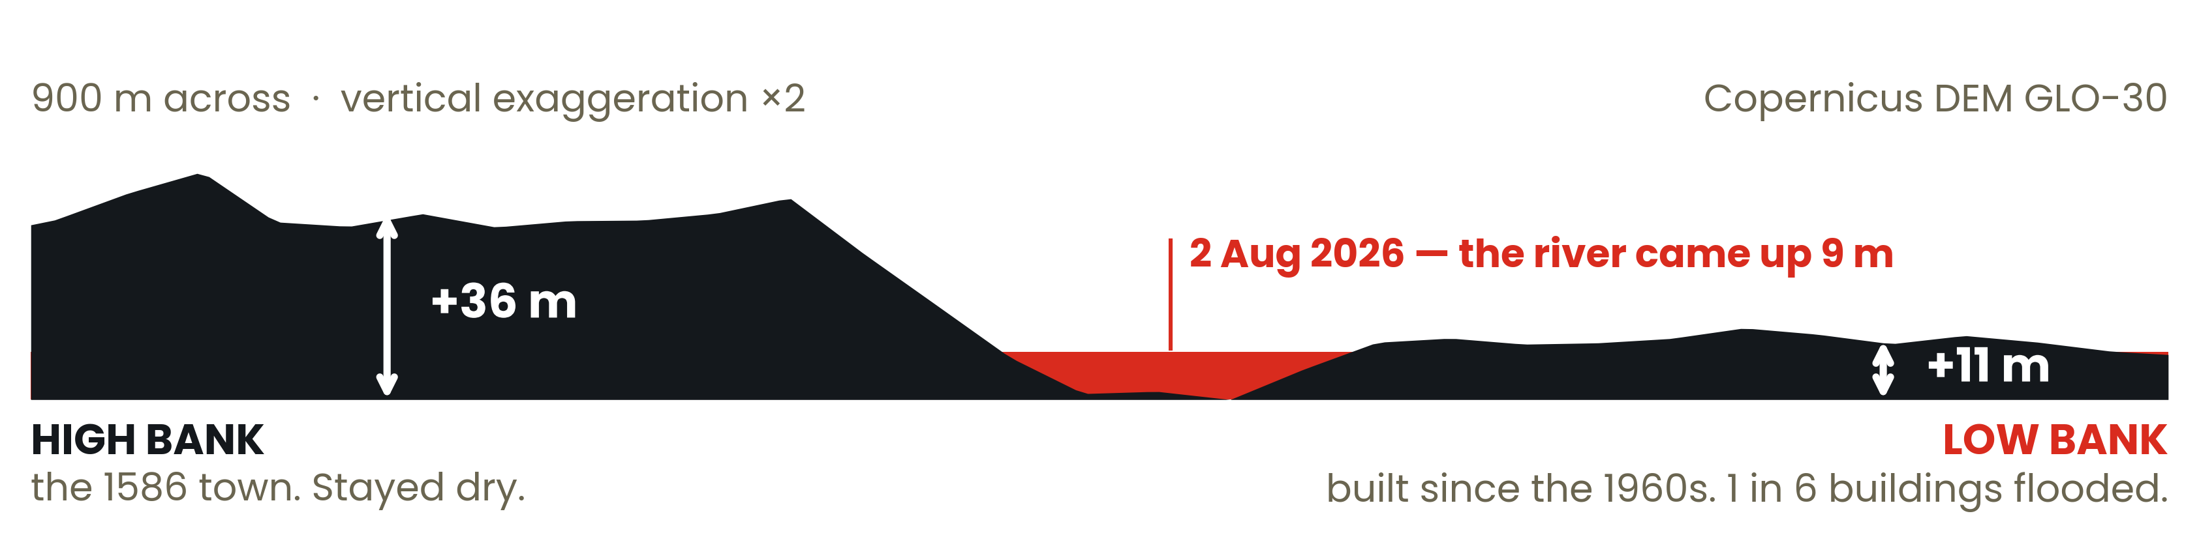
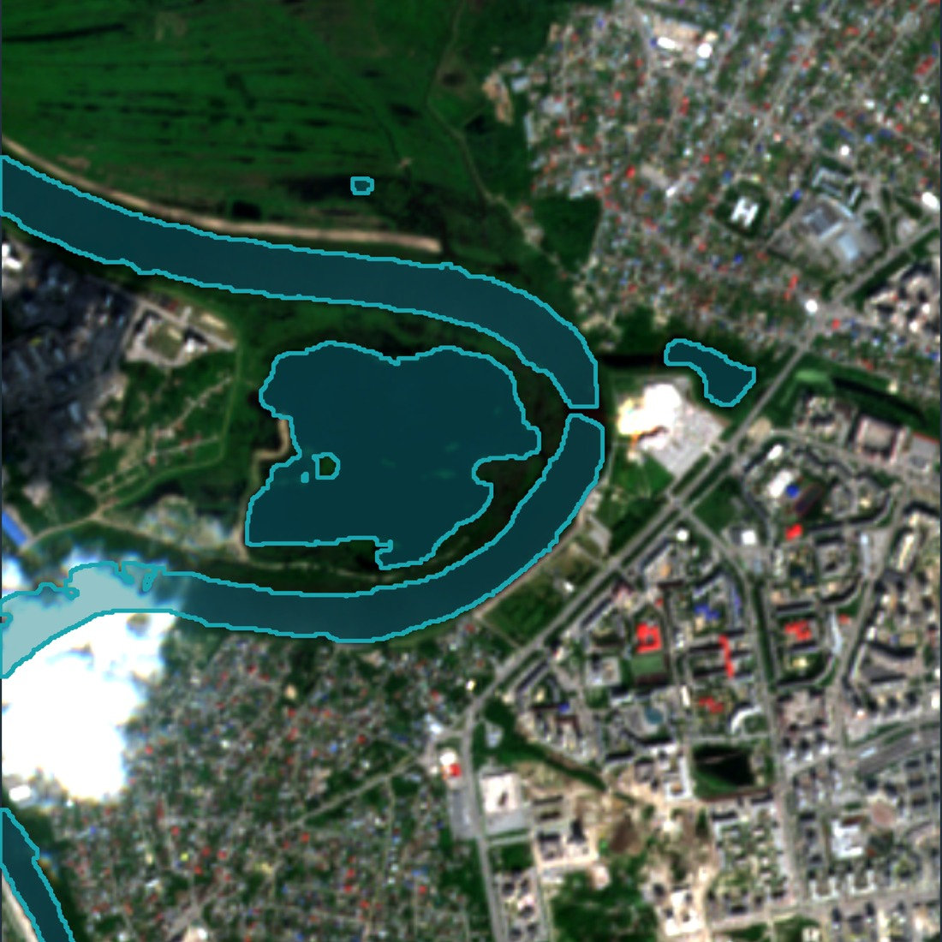
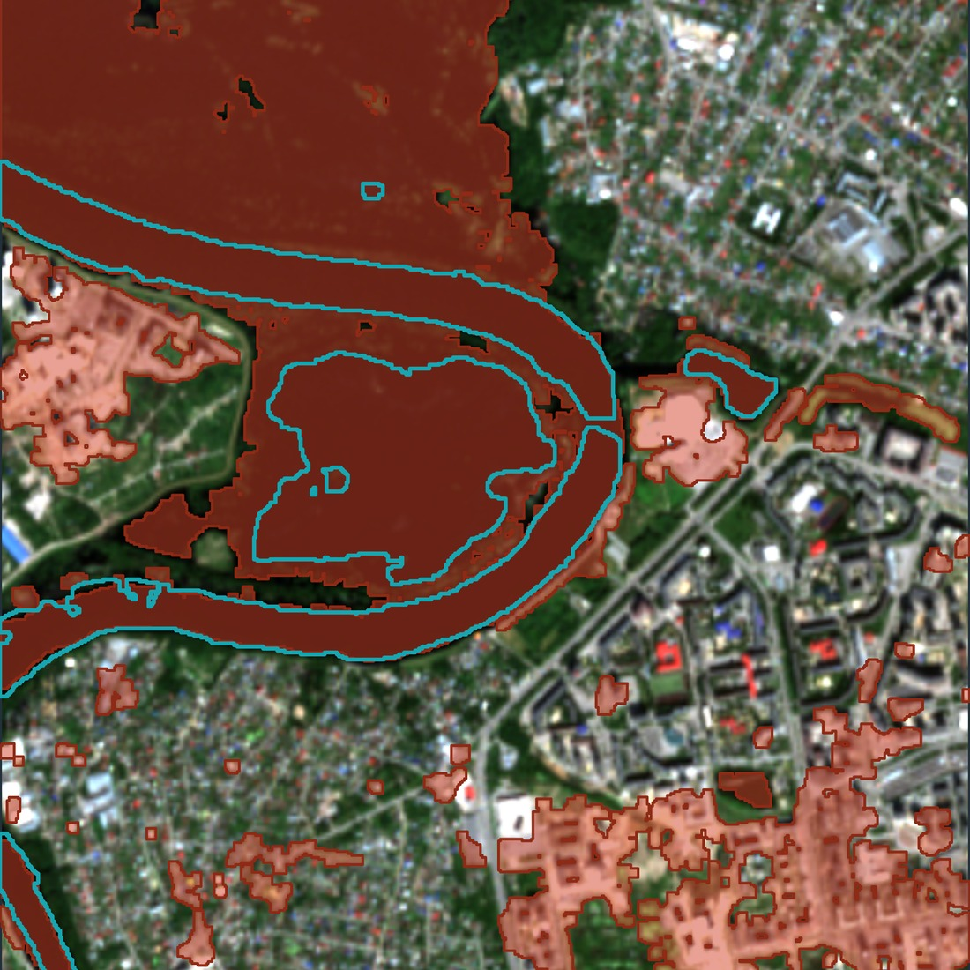
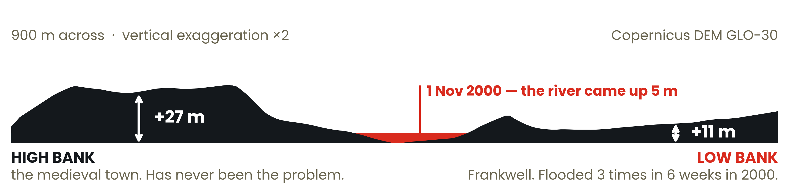
RGS YOUNG GEOGRAPHER OF THE YEAR 2026 · FROM SOURCE TO SEA · KEY STAGE 5
NOWHERE
TO GO
The Tura rises at 370 m in the Ural mountains and reaches the Arctic through the Tobol, the Irtysh and the Ob. It does four-fifths of its falling in the first 98 km. After that it drops five centimetres per kilometre — so when the water rises it cannot run away downstream. It spreads. That is why half of Russia’s marshland is here, and why Tyumen went under in August 2026.
SASHA OSTRIAGIN
Bromsgrove School
TYUMEN
Oldest Russian city in Siberia, 1586.
TURA
Tyumen’s river. 1,030 km, from the Urals.
TOBOL
The river the Tura runs into. 1,591 km.
IRTYSH
4,248 km, from China. Takes the Tobol.
OB
3,650 km more, to the Arctic Ocean.
WHAT THE GRADIENT BUILDS
Steep upper course: vertical erosion cuts a V-shaped valley. Once the gradient collapses, lateral erosion takes over — the river meanders and widens a floodplain, then abandons it. Those are the river terraces Tyumen is built on.
WHY SO MUCH OF IT DROWNS
With almost no slope the channels cannot clear meltwater or rain: half of all the marshland in Russia is in this basin. The Ob also flows north, so meltwater from the thawing south meets 2 m of ice and spreads up to 50 km sideways.
WHO WANTS THE WATER
27 million people; two-thirds of Russia’s oil and gas. Flat ground allows just one dam on 3,650 km of Ob. Upstream, China’s Irtysh–Karamay canal takes 2.5 km³ a year from the longest transboundary tributary on Earth, with no treaty.
WHAT HAPPENED AT TYUMEN
Rain on the headwaters in the Ural mountains. Seven hundred kilometres downstream the Tura rose for three weeks and peaked at 897 cm on 2 August 2026 — a record summer flood. I filled sandbags on the low bank for two days, then mapped it from Sentinel-2.
1 in 6
buildings flooded on the low bank, against 1 in 250 on the high bank. Nine times as many people were in the water.
18 JUNE
137 ha
29 JULY
415 ha — tripled
Tyumen’s low bank sits 11 m above the river.
So does Frankwell, in Shrewsbury.
WHAT COULD HAPPEN HERE
The Severn at Shrewsbury has the same shape as the Tura at Tyumen: a medieval town on the high bank, and a district on the low bank that floods. Same section, different country.
6.3m → 8m
English properties in areas at risk of flooding today, and by mid-century on the Environment Agency’s own projection — one property in four.
What the two sections say. Height above the river predicts flooding better than any line on a map, and it costs nothing to measure — the elevation data is free, global and open. The question is not whether a river floods, but how far above it we are building, and where the next river terrace up begins.
Method. Copernicus DEM GLO-30 elevations; flood extent from Sentinel-2 L2A using MNDWI (Xu 2006) constrained by elevation and connectivity to the channel. Imagery and elevation data © European Union / ESA, free and open licence; every map and section here is my own work from them. Sources: Britannica; WWF/TNC Freshwater Ecoregions of the World; Eurasian Development Bank 2025; Environment Agency NaFRA 2024. Full list in the repository.

