Slide 1
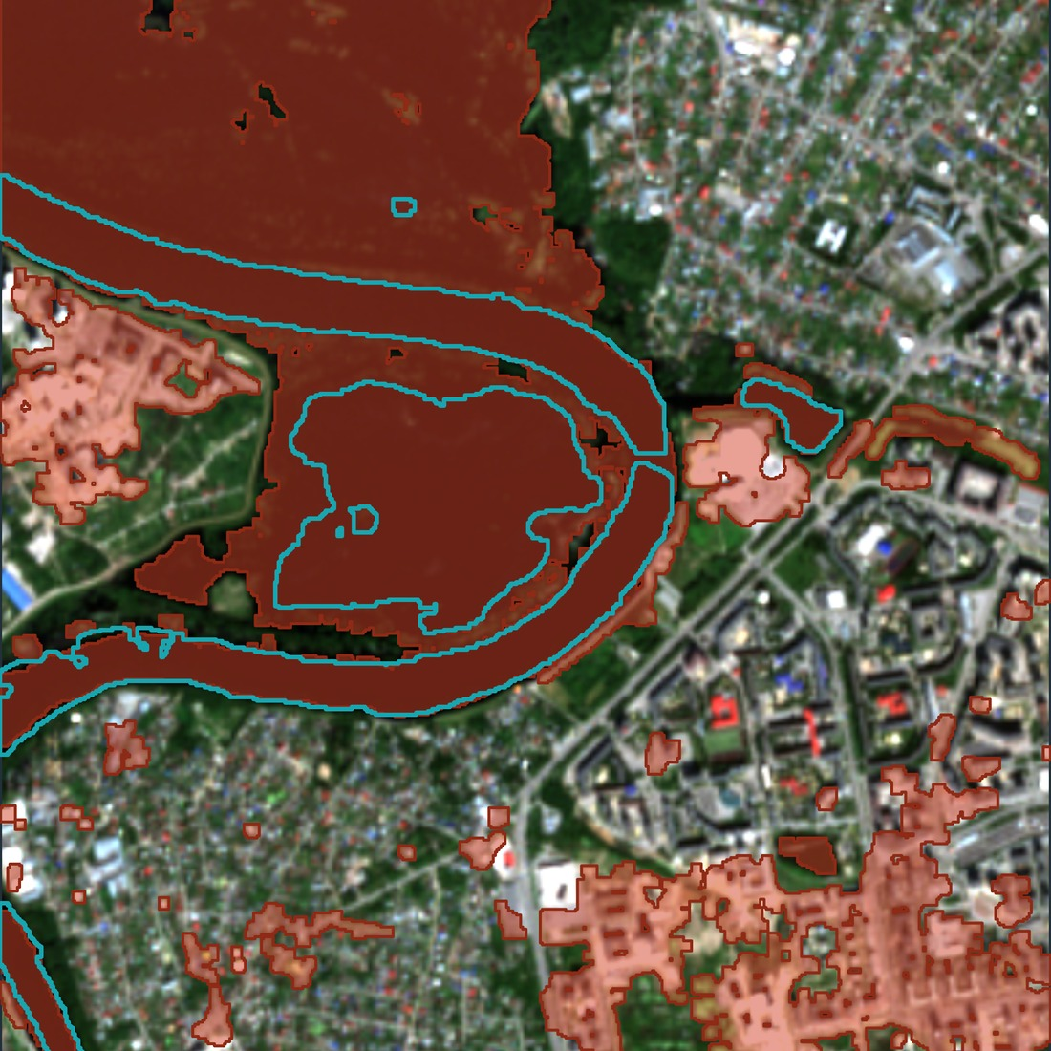
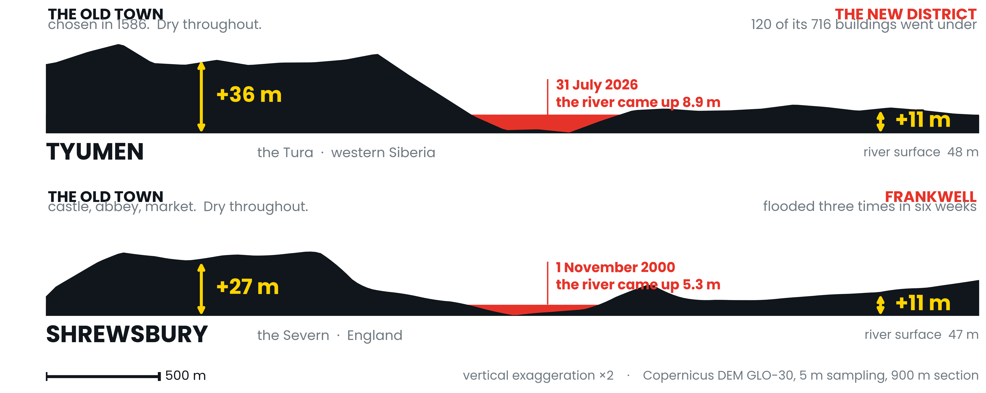
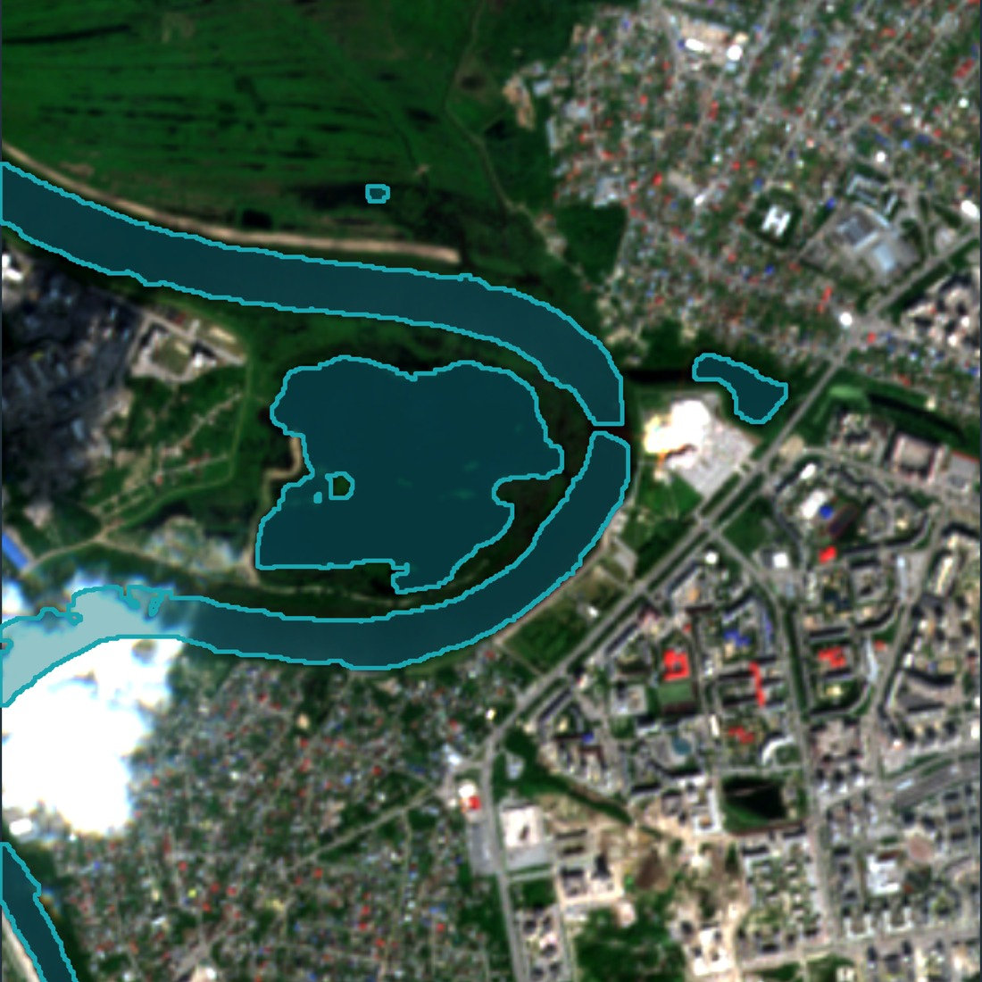
RGS YOUNG GEOGRAPHER OF THE YEAR 2026 · FROM SOURCE TO SEA · KS5
THE GROUND
REMEMBERS
Every old river town in Britain stands where it does because somebody once read the ground and worked out where the water goes. We have spent a century building on the parts they left alone. In July 2026 a Siberian city found out what that costs — so I measured it, and cut the same section through Shropshire.
The Tura at Tyumen,
29 July 2026
TWO TOWNS, 4,205 KM APART, CUT TO THE SAME SCALE
Sasha Ostriagin · Bromsgrove School
4,205
km apart
The two low banks match to within a metre.
Nobody coordinated this. Two river towns, five centuries and four thousand kilometres apart — and the ground their founders refused sits at almost exactly the same height above the water, as does the ground their descendants later accepted. Read the section and you can see the decision, and the drift away from it.
The Tura tripled. A record 8.9 m rise put 281 hectares of dry land under water — 40 km of road on the low bank against 11 km on the high — and almost all of the damage fell on the side the founders had left empty.
1 in 6
buildings flooded, low bank
1 in 250
buildings flooded, high bank
9×
more people in the water
40 km
of road under water
18 JUNE 2026
137 ha of water
29 JULY 2026
415 ha of water
!
THE OLD RULE HELD FOR 440 YEARS. THEN IT DIDN'T.
The 2026 peak climbed onto the second terrace — ground raised above the floodplain, built on in the belief that it stood clear — and it went under for the first time in living memory. Four centuries of siting logic is not a boundary but a threshold, and a record flood is what finds it.
SO WHAT DOES THIS MEAN HERE?
Shrewsbury's gauge board at the Welsh Bridge starts at 47.0 m above sea level; the highest water ever recorded there, in 1795, stood 5.70 m up it. The medieval town, 27 m up, has never been the problem. Frankwell, eleven metres up, flooded three times in six weeks in 2000.
6.3m → 8m
properties in England in areas at risk of flooding today, and by mid-century on the Environment Agency's own projection — one property in four.
Free satellite imagery, a free 30 m elevation model, a few hundred lines of Python. Any town in Britain can be sectioned this way in an afternoon. The question is not whether a river floods, but how far above the water we are building now.
TURA
TOBOL
IRTYSH
OB
KARA SEA
SEVERN
BRISTOL CHANNEL
Tyumen's gauge zero sits 48.5 m above sea level, and the water that came over the embankment still has the Tobol, the Irtysh and the Ob to cross before it reaches the Arctic. Two continents, one habit: keep the oldest streets up on the bank, then build downhill.
Method. Sentinel-2 L2A (10 m), 18 June and 29 July 2026. MNDWI (Xu, 2006) constrained by elevation and by connectivity to the channel. Terrain: Copernicus DEM GLO-30, 5 m sampling.
Limits. GLO-30 is a surface model — rooftops, not bare earth — so no flood depth is modelled for Shrewsbury. The Tyumen figures are a lower bound: the image precedes the peak.
Sasha Ostriagin, Bromsgrove School. I filled sandbags on the north bank for two days as the water came up. Code, data and QGIS project are public.
Sources: Copernicus (ESA) · OpenStreetMap · WorldPop · Shropshire Council Welsh Bridge gauge board · Environment Agency NaFRA 2024.

