Slide 1
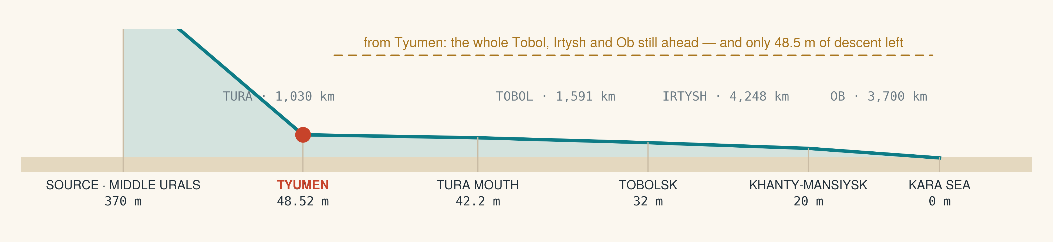
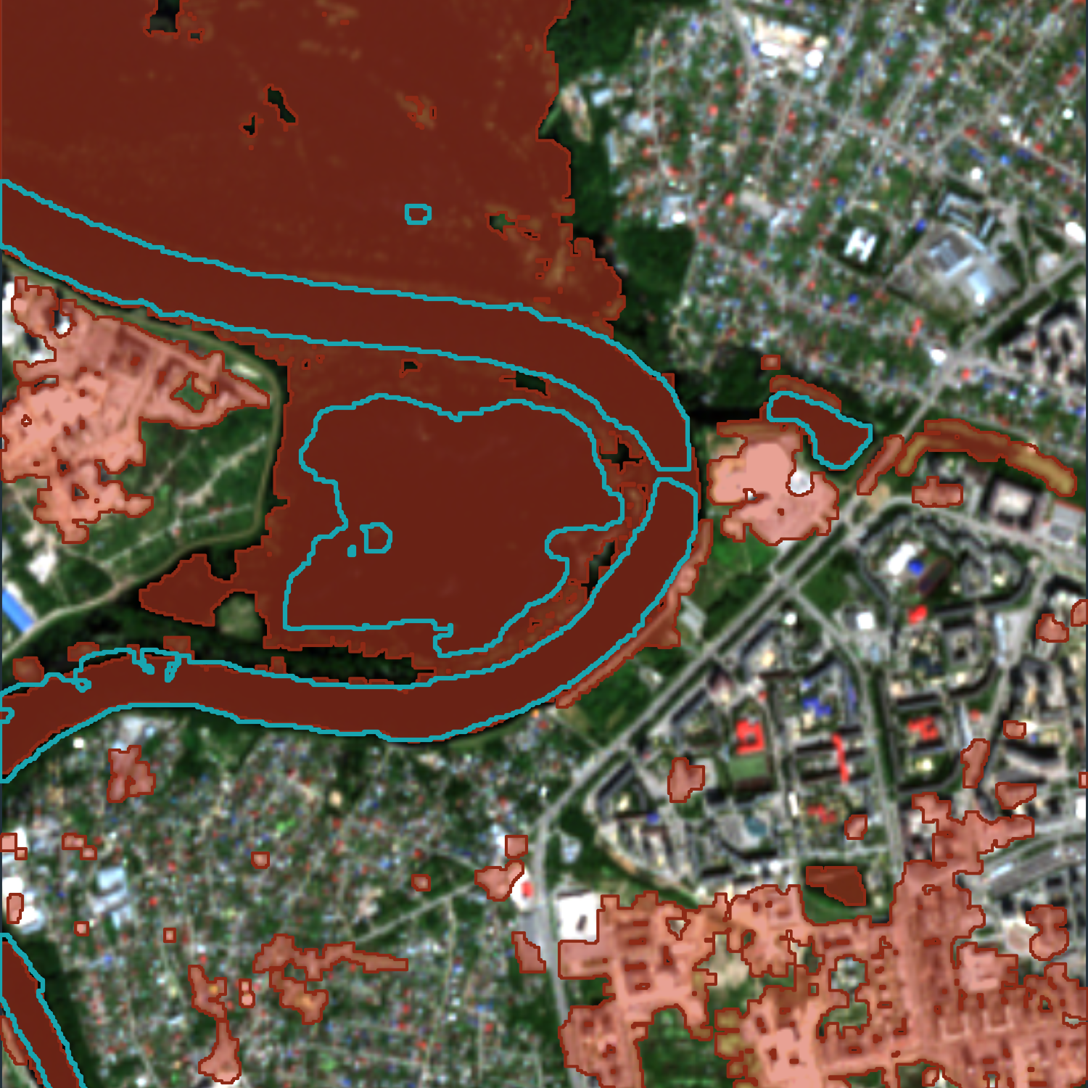
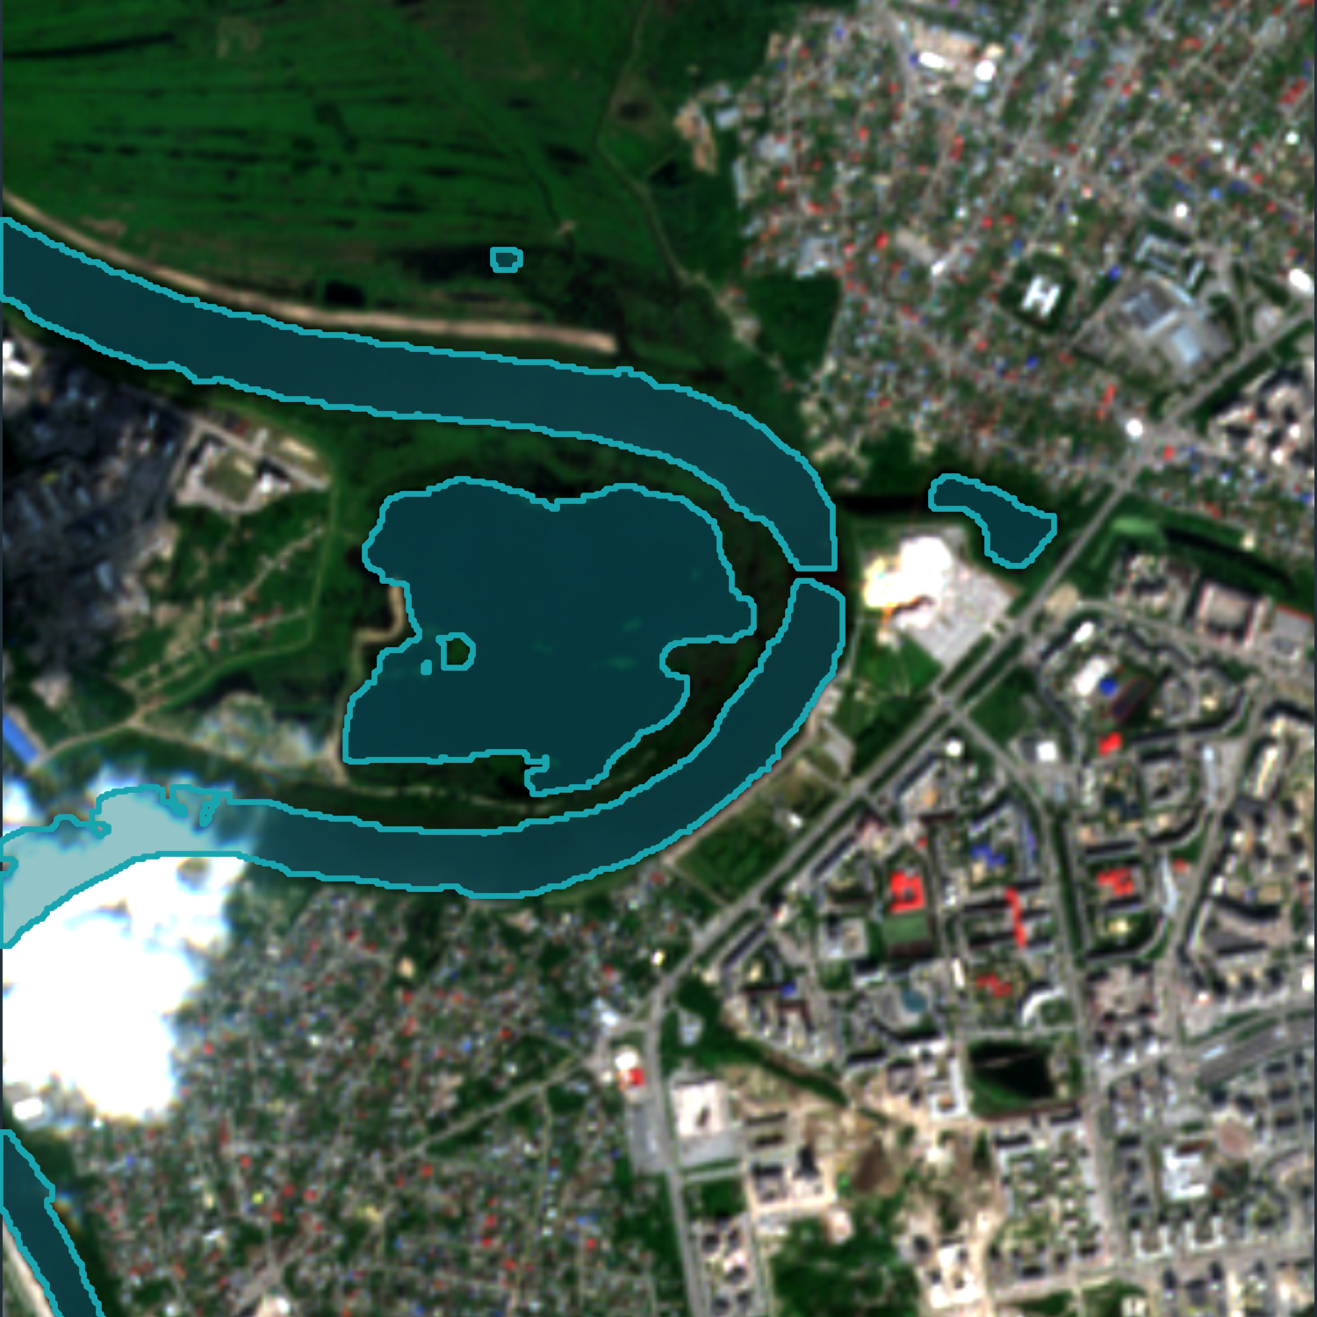
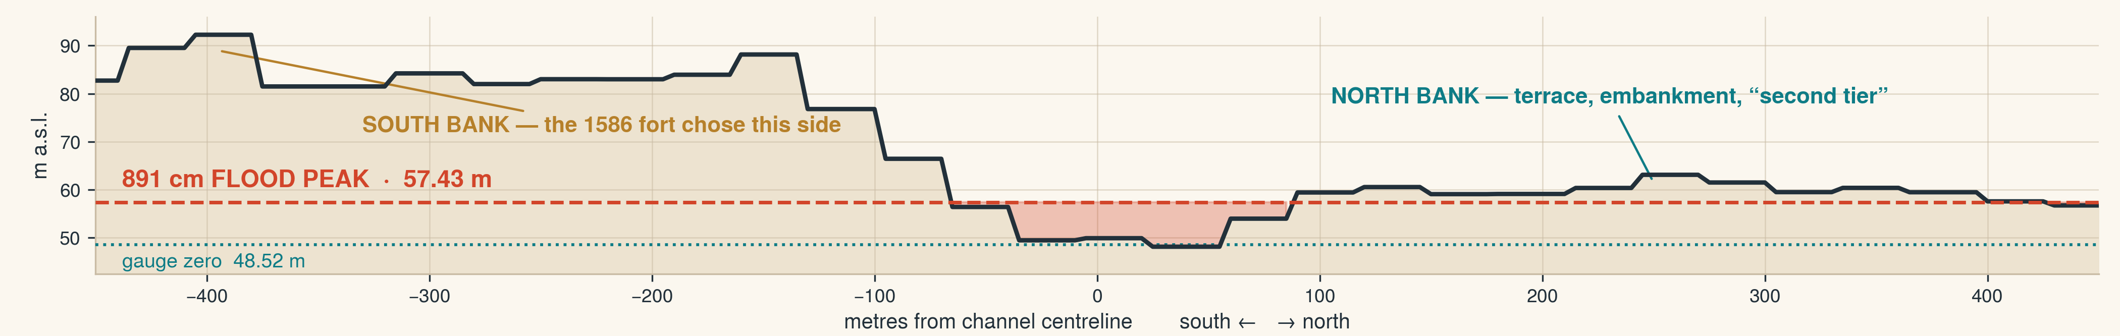
FROM SOURCE TO SEA · YOUNG GEOGRAPHER OF THE YEAR 2026 · KEY STAGE 5
SASHA OSTRIAGIN
Bromsgrove School
THE HIGH BANK
Tyumen was founded in 1586 on the steep southern bank of the Tura and left the low
northern bank alone. Every old town chose a side of its river.
Four hundred and forty years on, does that choice still decide who floods?
2,000 KILOMETRES TO FALL 48 METRES
TWO DAYS BEFORE THE PEAK
what Sentinel-2 saw over 2.9 km of the Tura
3×
the river's footprint
at the peak
18 JUNE 2026 · BEFORE
The gauge read 891 cm on 31 July — the highest ever recorded there.
Water was mapped with MNDWI and then constrained by terrain, so a pixel counts as flood only where the ground also lies below the flood level and connects to the channel.
The 29 July pass is two days before the peak — every number here is a lower bound.
29 JULY 2026 · FLOOD
Orange: water on 29 July. Teal: the normal channel.
On the north bank the flood is across the streets.
NOW TURN THE RIVER NINETY DEGREES
TWO BANKS, FOUR HUNDRED METRES APART — FORTY TIMES THE RISK
North bank: 391 ha flooded, ~5,080 people
South bank: 24 ha flooded, ~560 people
The south bank holds six times more buildings — almost none went under.
A THRESHOLD, NOT A BOUNDARY
The north-bank “second tier”, never flooded in living memory, went under too. The 1586 logic is not a wall — it is a gradient, and 2026 found its height.
16.8%
of north-bank buildings
flooded (120 of 716)
0.4%
of south-bank buildings
flooded (18 of 4,437)
THIS IS NOT ONLY A SIBERIAN PROBLEM
Tewkesbury's settlers used the “natural rises in the land” to avoid flooding — the modern town around the abbey flooded in 2007. Shrewsbury's medieval core sits in a defensive meander that now holds water against it. 6.3 million English properties are in flood-risk areas today; potentially 8 million — one in four — by mid-century.
METHOD Sentinel-2 L2A 18 Jun & 29 Jul 2026 · MNDWI constrained by Copernicus DEM GLO-30 · OSM · WorldPop | CREDITS Copernicus/ESA · © OpenStreetMap contributors · WorldPop · Environment Agency NaFRA 2024

