Slide 1
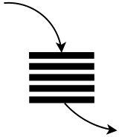

Take jobs from the Provean queue, submit them to the cluster, and monitor their progress.
Take jobs from the homology modelling queue, submit them to the cluster, and monitor their progress.
HTTP(s) requests:
submit new jobs
check job status
etc...
Python 3.5 asyncio + aiohttp
event loop
Take jobs from the results queue, and send a "Job Complete" email only if all mutation jobs are finished.
Take jobs from the mutation queue, submit them to the cluster only if the provean and homology model jobs are finished, and monitor their progress.
Notes:
If you are familiar with Node.JS, this will not be new. This is how Node does everything.

