Slide 1
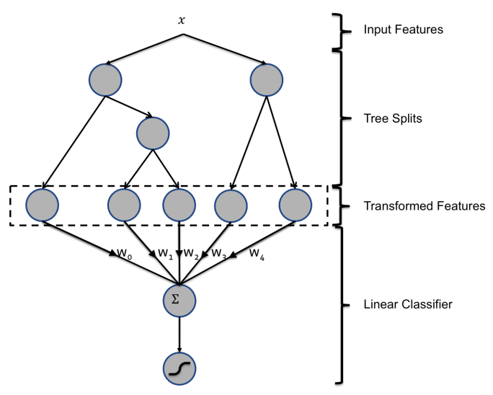
Train to predict mutation deleteriousness.
Train to predict mutation ∆∆G.

