Slide 1
openQA in QAM
Veronika Svecova
QA Engineer for Software Maintenance
vsvecova@suse.com
For Internal Use Only

Slide 2
Agenda
  What is openQA
  Test dissection
    Code
    Needles
    Logs
  openQA in QAM
    Aggregate tests
    Single incidents
    Kernel / kGraft testing
  Results & review
    Issue/FR tracking
  Automation extension activities
  Resources, documentation, contacts
For Internal Use Only

Slide 3
Testing phases
  Installation tests
  Bug fix verification / new feature validation
  Regression testing
For Internal Use Only

Slide 4
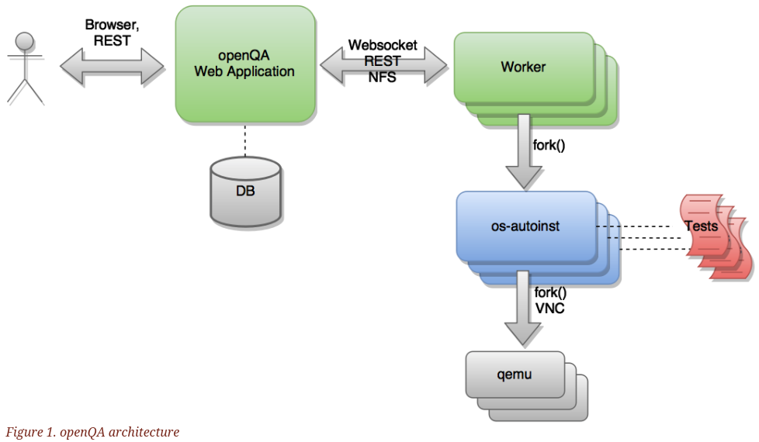
openQA
Automated testing framework
Simulates user behavior
http://open.qa/docs/
For Internal Use Only

Slide 5
openQA at SUSE / openSUSE
Tumbleweed / Factory / Leap
https://openqa.opensuse.org/
Product QA
QA Maintenance
https://openqa.suse.de/
For Internal Use Only

Slide 6
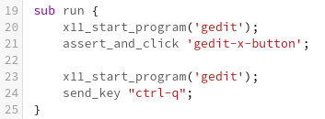
What makes a test
Test code
Needles
  .png image: Screenshot
  .json file: Matching areas + tag(s)
Logs, assets, video
For Internal Use Only

Slide 7
openQA in QAM
Job groups:
  Single incident tests
  Aggregate tests
  Kernel incidents
Products:
  SLE 12 GA, SP1, SP2, SP3, SP4
  SLE 15
  CaaSP
  HA / HPC
  SES
For Internal Use Only

Slide 8
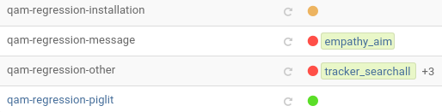
Results and review
Results
  Green: passed
  Amber: softfailed
  Red: failed
  Purple: incomplete
Review
  Restart
  Badges
  Comments: issues, bugs
  Review bot
Issues, feature requests
https://progress.opensuse.org/
For Internal Use Only

Slide 9
Automation extension activities
Effort to improve regression testing automation coverage for packages on which we spent most time:
https://pes.suse.de/QA_Maintenance/Automation_Progress_Tracking_in_QAM/

Slide 10
Resources
General:
https://confluence.suse.de/display/maintenanceqa/OpenQA+in+QAM
http://open.qa/docs/
Deploy:
https://confluence.suse.de/display/maintenanceqa/Create+an+openqa+instance
https://confluence.suse.de/display/maintenanceqa/Full+openQA+deployment
https://confluence.suse.de/display/maintenanceqa/Hello+world+of+OpenQA+tests
Write your first test:
https://confluence.suse.de/display/maintenanceqa/Hello+world+of+OpenQA+tests
https://confluence.suse.de/display/maintenanceqa/Before+you+start+with+openQA+tests
http://open.qa/api/testapi/
Review docs:
https://confluence.suse.de/display/maintenanceqa/How+to+Review+openQA+Tests

Slide 11
Contacts
IRC: #qam-auto
For test plan review:
Petr Cervinka (pcervinka) - pcervinka@suse.cz
Martin Pluskal (plusky) - mpluskal@suse.cz
Veronika Svecova (vsvecova) - vsvecova@suse.cz

Slide 12
Questions?

Slide 14


