Slide 1
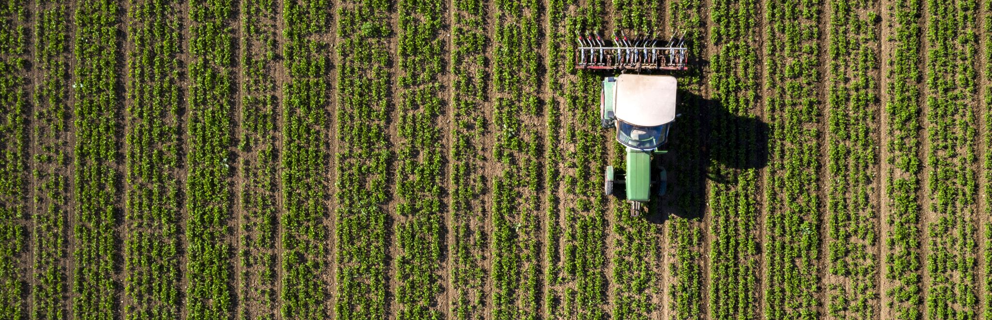
CROP GUARD AI
Philly Codefest 2024

Slide 2

Team Members
Darshit Rai – dr3264@drexel.edu
Aman Ostwal – ago34@drexel.edu
Saurabh Sawant – sss448@drexel.edu
Jai Vaidya – jv625@drexel.edu
Apurva Deshpande - aad368@drexel.edu

Slide 3
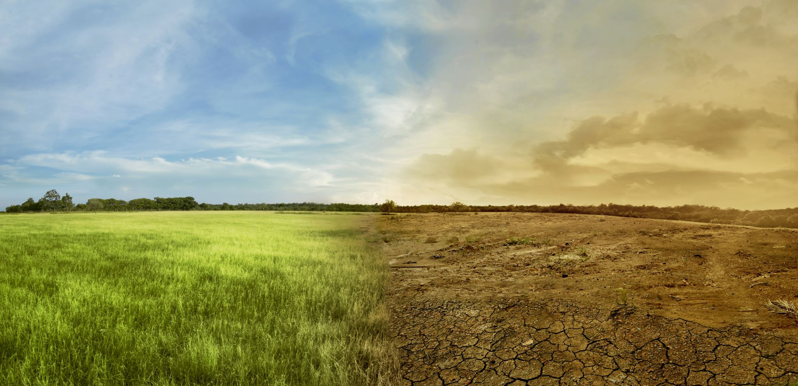
Problem Statement
Limited Insights from Traditional Methods: Traditional farming practices rely heavily on historical data and generalized weather forecasts, which may not offer precise insights into localized conditions affecting crop health and risk of spoilage.
Financial Risks: Crop spoilage caused by unexpected weather events such as temperature fluctuations, excessive rainfall, or prolonged droughts can result in substantial financial losses for farmers, impacting their livelihoods and sustainability.
Inadequate Mitigation Strategies: Without accurate and localized risk assessments, farmers may struggle to implement effective mitigation strategies to protect their crops from weather-related damage, leading to increased vulnerability to losses.
Need for Proactive Management: There is a critical need for a solution that enables farmers to proactively manage risks associated with crop spoilage by providing real-time data and actionable insights specific to their farming locations.
Empowering Farmers: By leveraging advanced technologies such as artificial intelligence (AI) and data analytics, a solution like CropGuardAI can empower farmers with the knowledge and tools necessary to make informed decisions, optimize harvests, and minimize potential losses.
Revolutionizing Farming Practices: CropGuardAI aims to revolutionize farming practices by bridging the gap between traditional methods and modern technologies, offering a comprehensive and tailored approach to risk management in agriculture.

Slide 4
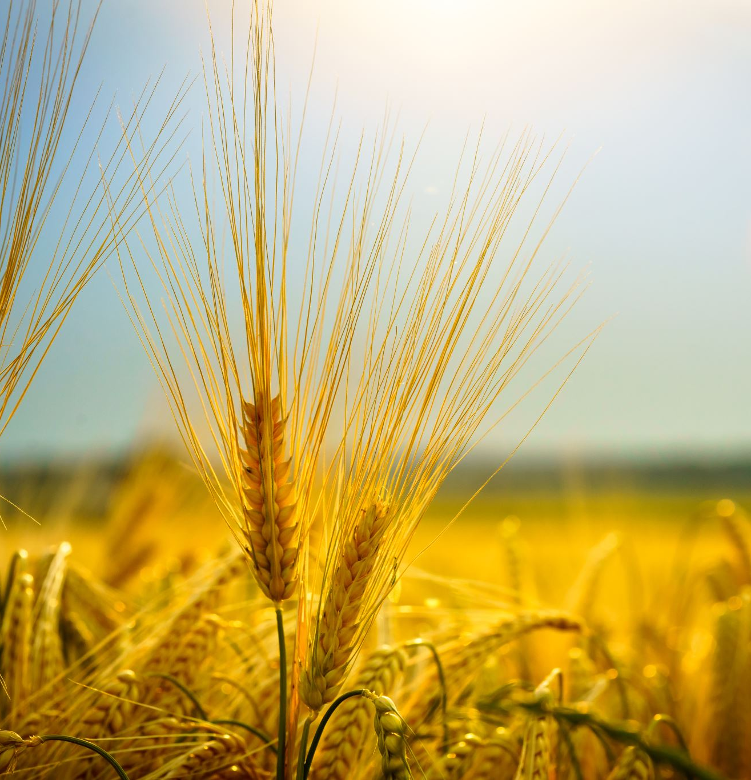
Solution overview
User-Friendly Interface: CropGuardAI offers a simple, user-friendly interface accessible via web or mobile devices. Farmers can easily input their state and crop type to receive tailored risk assessments.
Regional Weather Analysis: The core functionality of CropGuardAI lies in its ability to analyze real-time regional weather data. This includes temperature patterns, precipitation levels, humidity, and other relevant weather metrics.
Crop-Specific Risk Assessment: By combining weather data with crop-specific algorithms, CropGuardAI provides farmers with detailed risk assessments for their particular crop type. Whether it's sensitive fruits, vegetables, or grains, the system calculates the likelihood of spoilage based on current and forecasted weather conditions.
Predictive Insights: Farmers receive predictive insights into potential spoilage risks over a defined period, such as the next week or month. This allows for proactive decision-making, such as adjusting irrigation, applying protective measures, or altering harvesting schedules.

Slide 5

Architecture
For frond-end, we used HTML, CSS
Python, JavaScript for backend
Regression for premium estimation.
Classification for determining risk levels.
Decision-making models for providing insurance advice.

Slide 6

Challenges and Future Improvements
Challenges
Seasonal Dynamics: Crop growth and health vary significantly across different seasons, making it essential to capture seasonal dynamics in synthetic data. This includes factors like planting and harvesting timelines, growth stages, and susceptibility to weather-related risks at various stages.
Geographical Diversity: Agricultural conditions can vary widely based on geographical locations, including climate zones, elevation, and regional weather patterns. Synthetic data generation must consider these geographical factors to simulate realistic scenarios for different farming regions.
Validation and Accuracy: One of the significant challenges in creating synthetic data is ensuring its accuracy and validity. Validation processes are essential to verify that the synthetic data closely aligns with real-world observations and can effectively simulate scenarios relevant to crop management and risk assessment.
Future Scope
Enhancing AI/ML models with more data.
Expanding to other insurance-related applications.
Integrating with more data sources for improved accuracy.
Handling a wide range of crop types and weather conditions.

Slide 7

Thank you

