Slide 1
Book1
File created on: 12/12/23 3:59:35 pm GMT-5

Slide 2
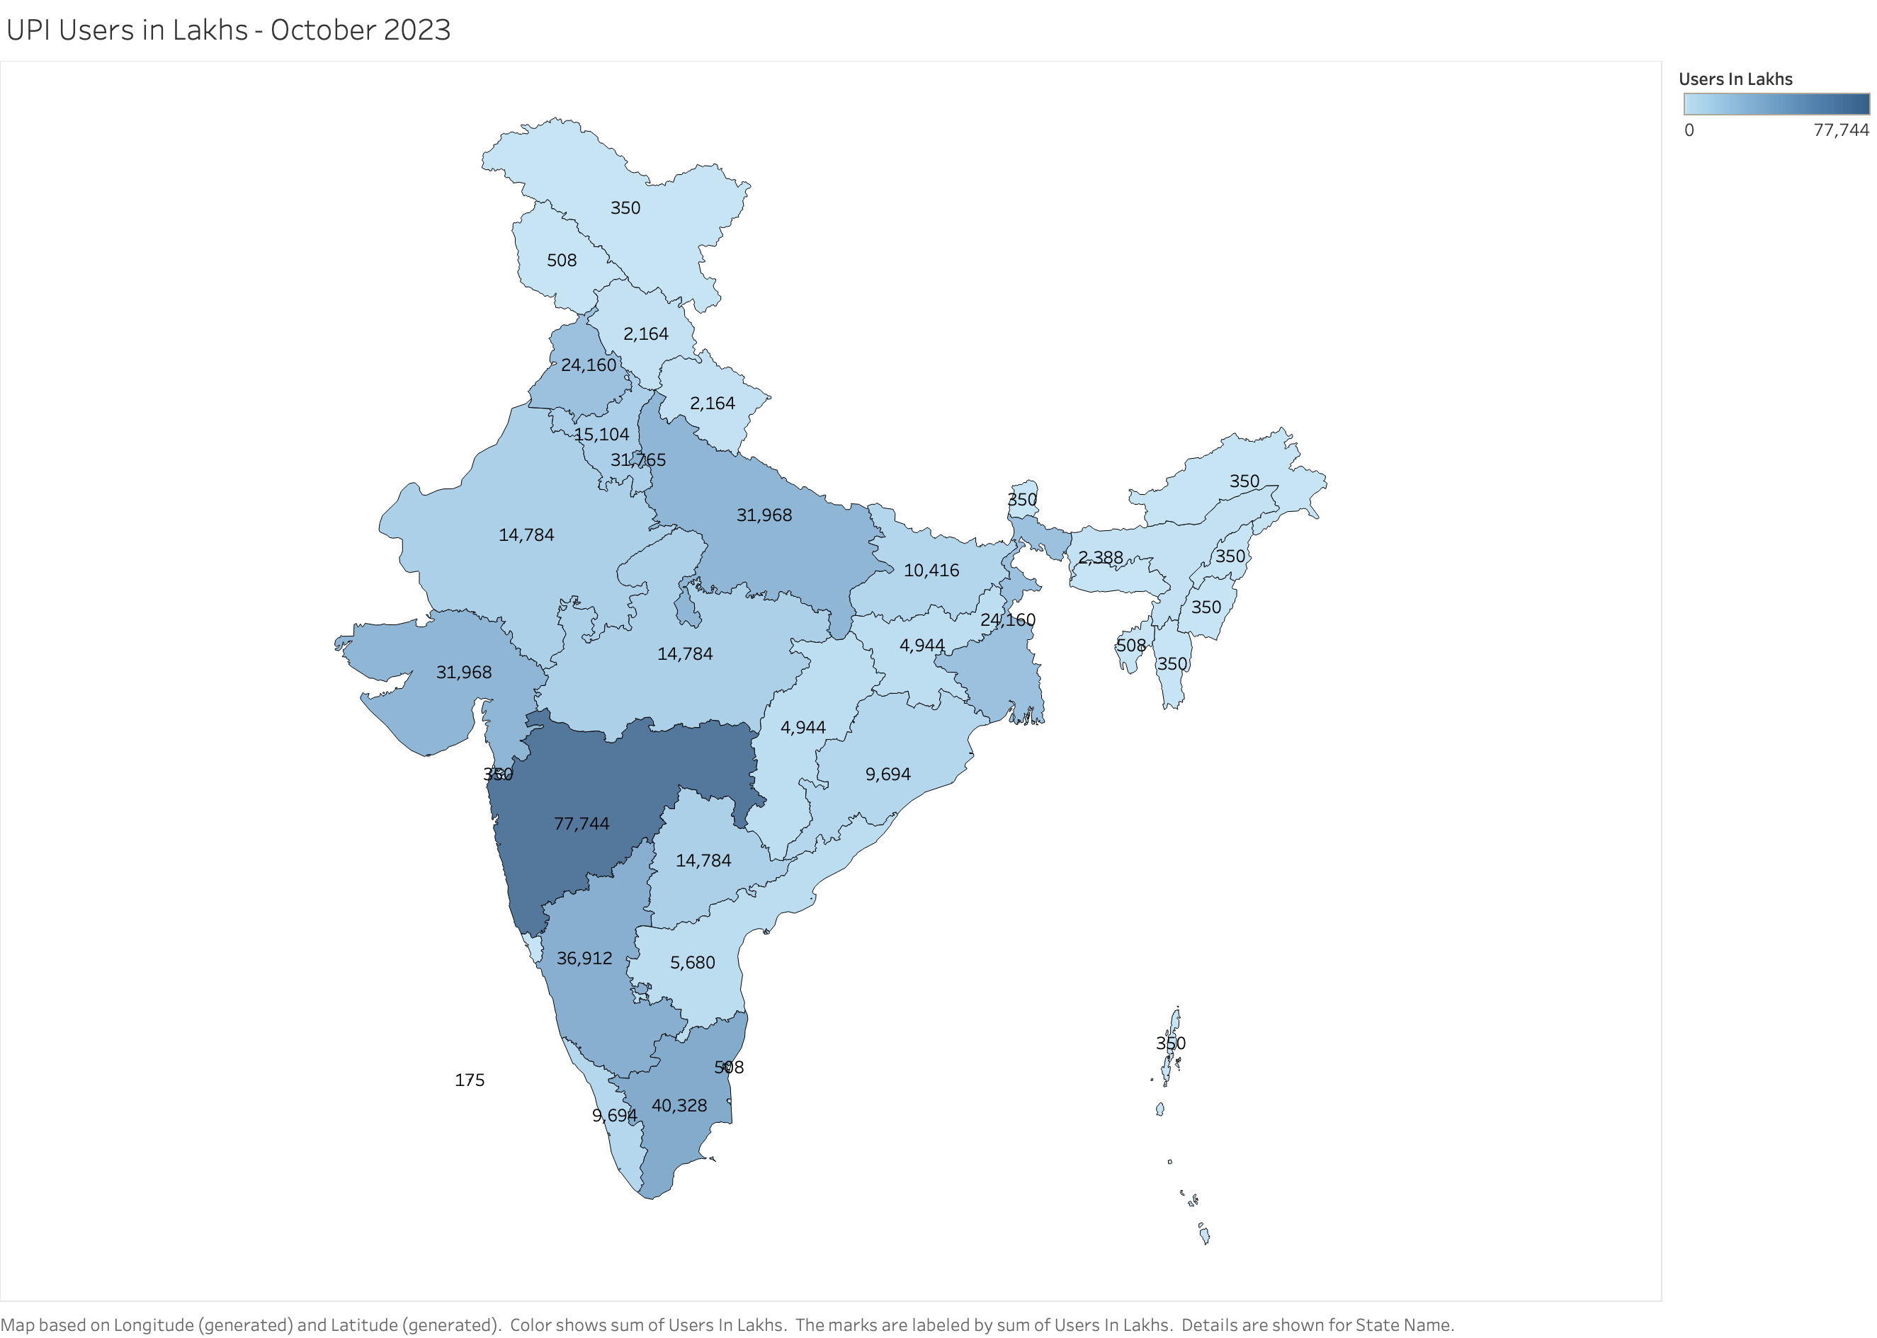

Slide 3
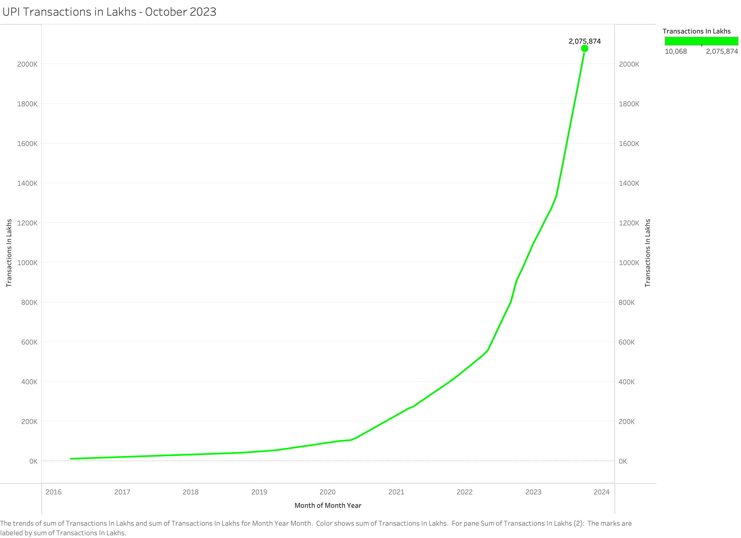

Slide 4
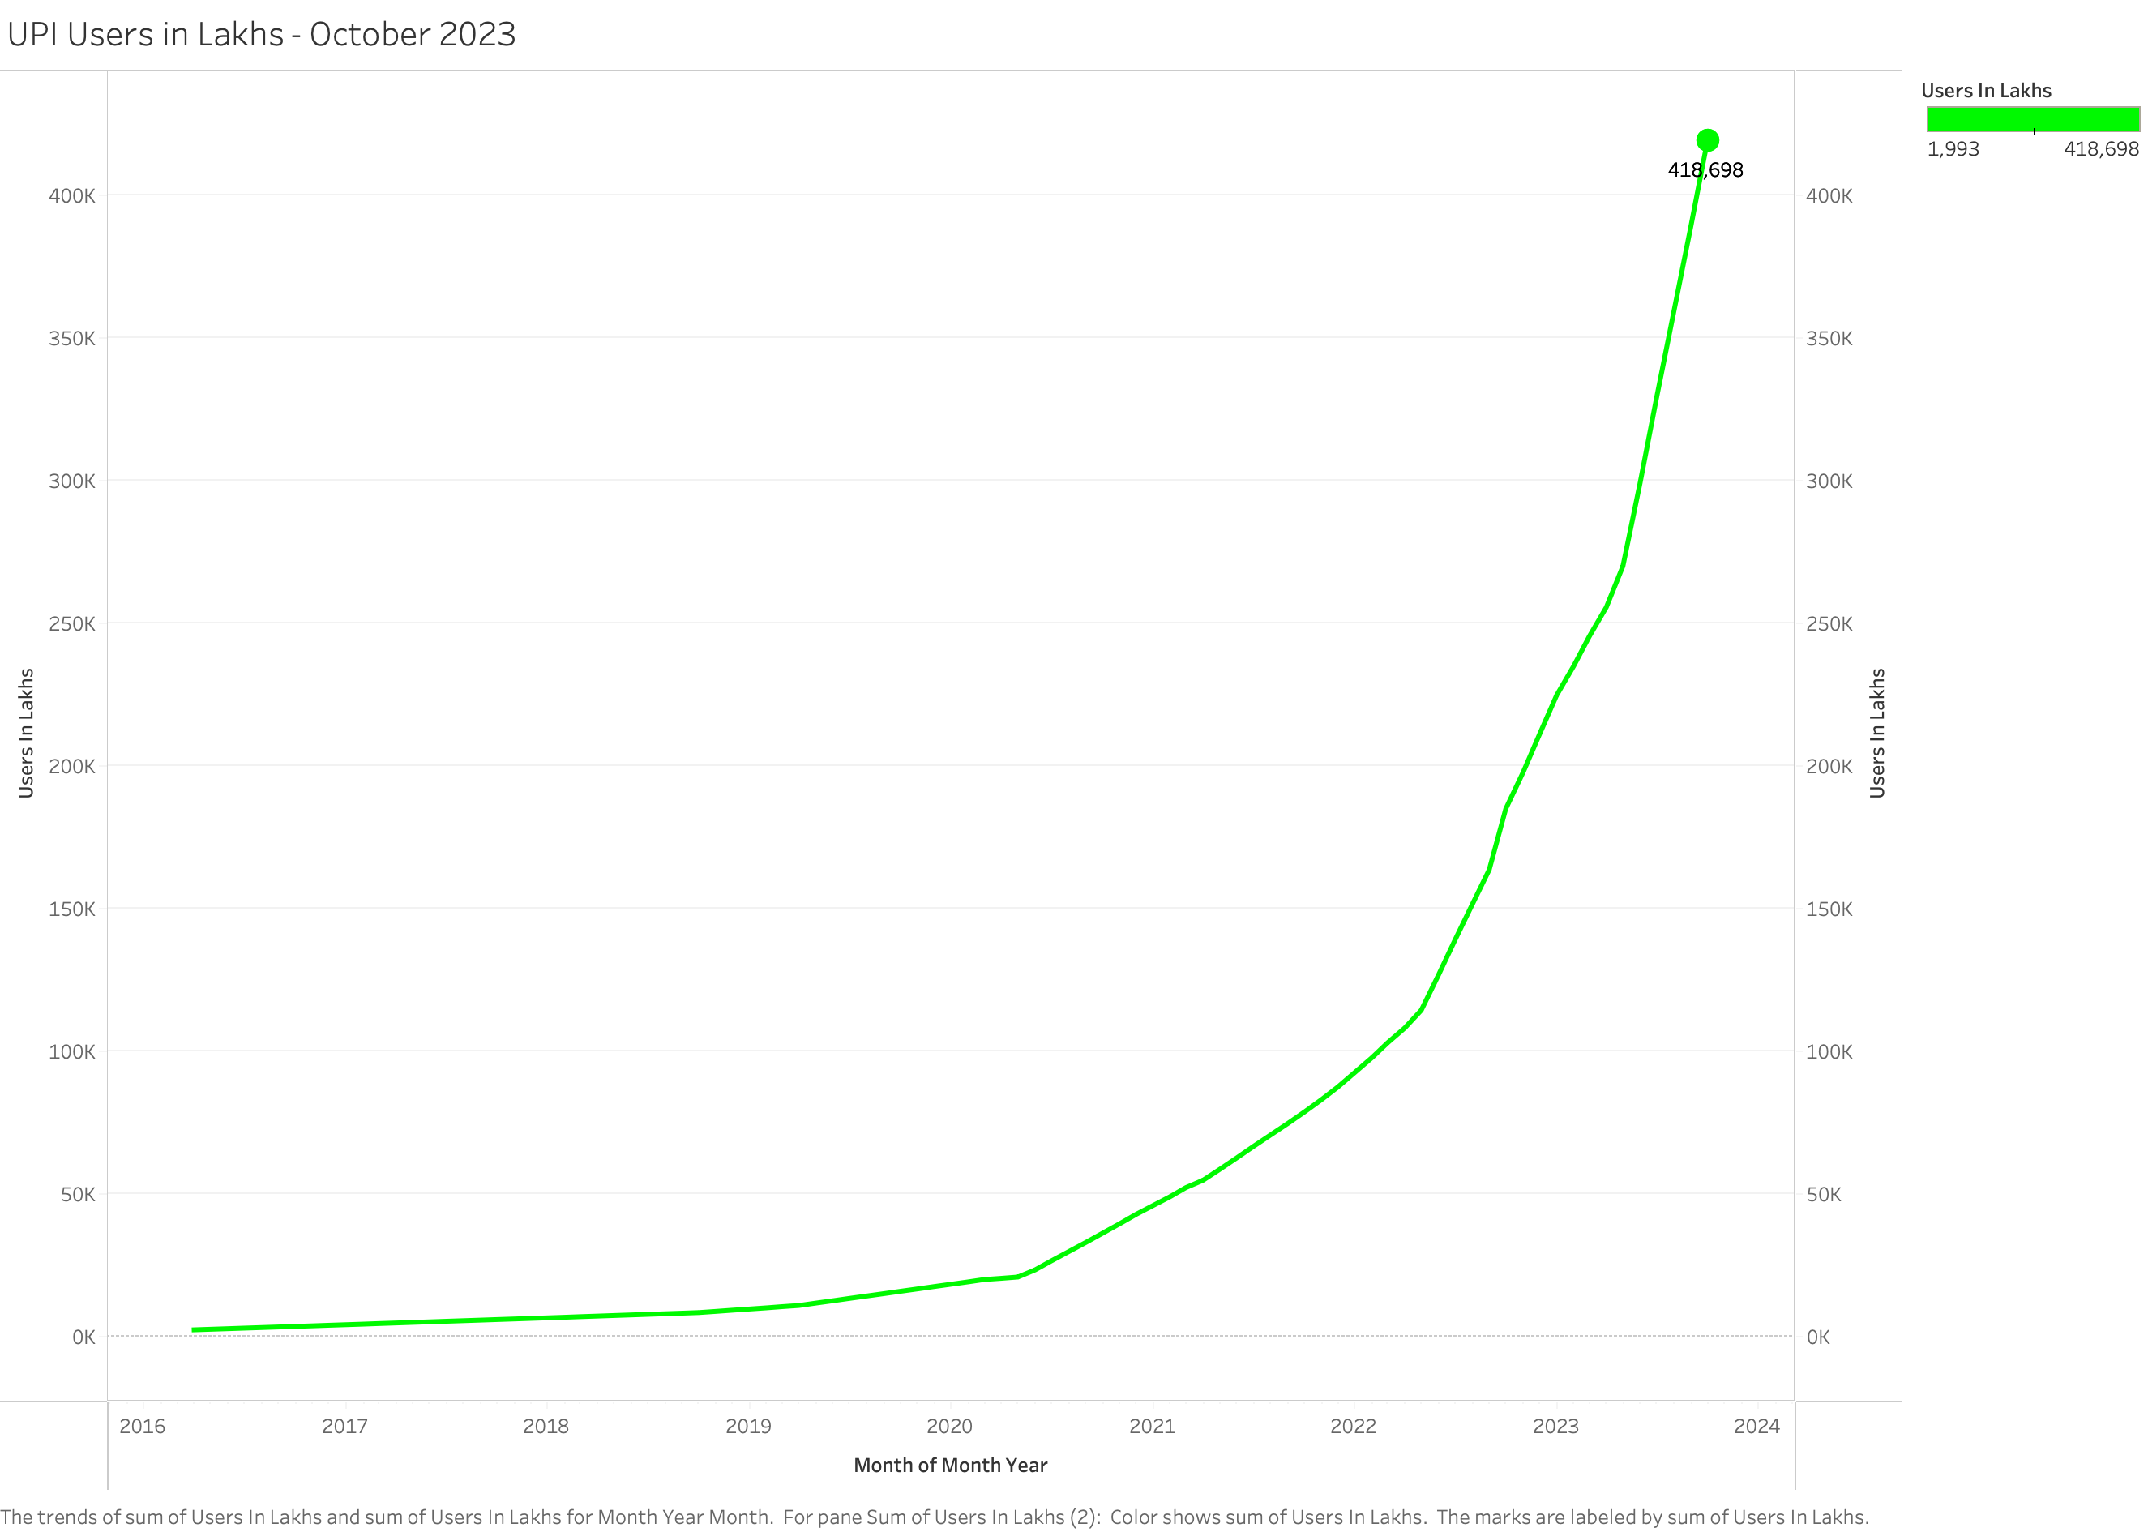

Slide 5
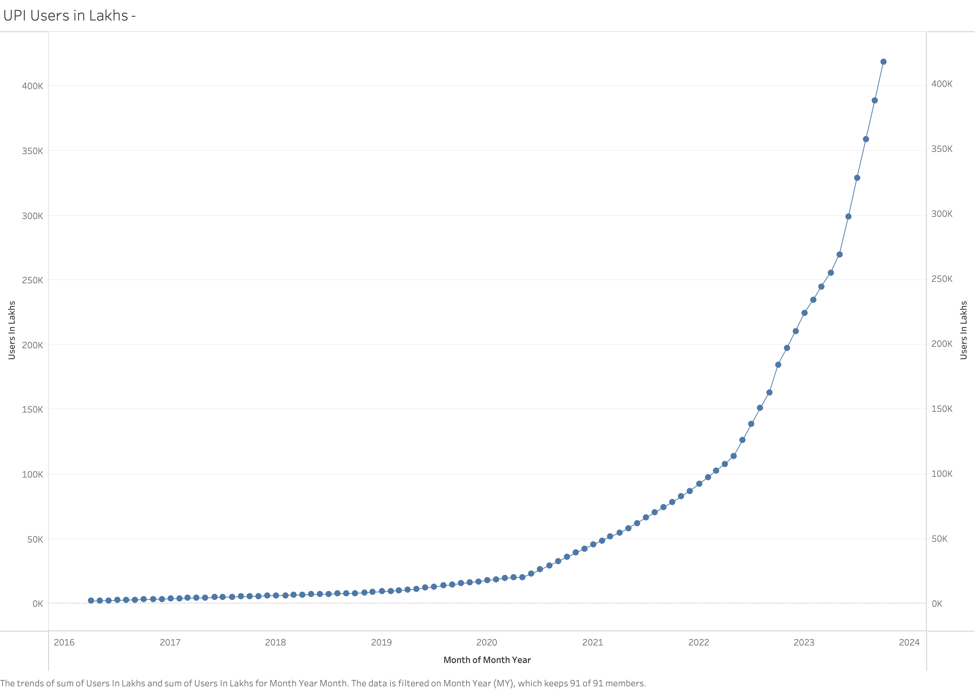

Slide 6
