Slide 1
Introduction to the UNIX Environment
Class 22
Notes:
Instructor:
Introduction to the UNIX operating system. Logging on to the UNIX system.

Slide 2
Agenda
Preparation and Concepts
UNIX
Red Hat Linux
UNIX Commands
File Editing
Accessing Linux
PDFs & Printing
Notes:
Instructor:
The goals of today’s class are:
Introduce the UNIX environment
Learn how to enter the environment in this classroom

Slide 3
Preparation
Assignment:
Read Class_Notes_1281H.pdf
Watch the video: PRE_22_Unix_VIDEO
Understand the following:
UNIX commands for:
- Copying files | - Clearing command window
- Deleting files | - Changing directory
- Displaying directory contents | - Displaying file contents
Notes:
Instructor:
This slide is to serve as a reminder regarding the specific assignments students completed as preparation for today’s class.
Assignment:
Read Class_Notes_1281H.pdf pgs. 11-22
Watch the video: PRE_22_Unix_VIDEO

Slide 4
Concept Comprehension
Notes:
Instructor:
Concept Comprehension pie charts come from PRE B22-1 2014. Results have been consistent year to year.
This is an opportunity to ask students about the things they understand the best and the least from the preparation material. Based on the data, students have the most questions regarding UNIX commands to display the contents of a file, display the contents of the directory, and changing the directory. These commands will be reviewed during this lecture.
You may want to ask what some of these commands were – ls, rm ,cp, cd, more, type, less, clear. Which ones they think will be most useful

Slide 5
UNIX
Written by programmers for programmers at AT&T Bell Labs
Traditionally a “command line” user interface
Still common
Many variants available
Notes:
Instructor:
Most people are familiar with PCs which run some version of the Microsoft Windows operating system.
UNIX is another widely used operating system which also comes in many flavors. It is used primarily on engineering workstations. For those who have heard of Linux, this is another version or flavor of UNIX.
UNIX was originally written BY programmers FOR programmers at Bell Labs. It often and still is the operating system of choice for high-performance engineering workstations. The original user interface is a simple UNIX command line, although programmers have since then developed graphical user interfaces, or GUIs. Since the UNIX environment is more open to development by outside sources, then commands can be cryptic or strange at times, based on what the programmer named his or her program.

Slide 6
Red Hat Linux
A “UNIX-like” environment
Adds a graphical user interface
We will mostly use the UNIX command line
Some commands a bit cryptic or strange
Notes:
Instructor:
The UNIX operating system was conceived and created by Ken Thompson and Dennis Ritchie at AT&T Bell Labs in 1969 and released in 1970. UNIX was widely adopted, copied, and modified by academic institutions and businesses due to its availability and portability. Other UNIX-like operating systems were developed over the years but were either too expensive for private users or did not attract enough development effort leaving systems incomplete. In 1991, Linux began as a personal project of Linus Torvalds, a Finnish student who set out to create a new operating system kernel that would be free to everyone. Linus was just 21 at the time.
Much of the work on Linux is performed by the community. Programmers from all around the world that use Linux share their suggested improvements to those who maintain Linux. Various companies have also helped with the development of the kernels as well as writing the body of auxiliary software. Companies do profit from Linux, despite it being freely available. Companies like Dell, IBM, and Hewlett-Packard validate, use, and sell Linux on their own servers. Another company is Red Hat, Inc. which is an American multinational software company providing open-source software products to the enterprise community. As of March 2016, Red Hat is the second largest corporate contributor to the Linux kernel.
We will use this UNIX-like variant called Red Hat Linux.
In Linux, we will use the simple text-based command line for much of the work in this class.
Sources:
https://en.wikipedia.org/wiki/History_of_Linux
https://en.wikipedia.org/wiki/Red_Hat

Slide 7
Examples Using Commands
To delete a file called “Apples.dat”
>> rm Apples.dat (Note: case sensitive!)
To create a new directory called “Students”
>> mkdir Students
To copy a file called “Morin.dat” from the current directory to the new directory
>> cp Morin.dat ./Students/Morin.dat
To list contents within a directory
>> ls
Notes:
Instructor:
Commands that are shown in the video include:
ls – list contents of directory
ls -l – lists contents of directory with more information (file size, date created, etc.)
clear – clears contents of window
man – getting help on other commands
mkdir – creating a new directory
cd – change directory
pwd – present working directory, shows path of current directory
This is a good time to point out that students do not actually need to type >> in the command line. This is to indicate the prompt of the command line (where students will start typing commands). Spacing is important when typing in the command line. For example, to make the new directory called “Students”, there must be one space between the command (mkdir) and the name of the new directory.

Slide 8
Editing Files in Linux
gedit
Recommended
Similar to script file in MATLAB
Other editors
vi
nano
Notes:
Instructor:
At this point, students have experience writing script files in MATLAB. This is a good opportunity to make a comparison to MATLAB. Similar to how we writing our programs in a script file for MATLAB, we will be using an editor, most likely gedit, to write our programs in Linux.
Important information about other editors:
vi – always available, steep learning curve, lean, key stroke driven, recommended only if experienced
emacs – formats/colors code, not always available, powerful but takes time to get comfortable with it

Slide 9
Using Linux
Each student has two accounts for ENGR 1281.0xH
Windows, Linux
Same username and password for both
You can use your computer (e.g., Word, Excel, etc.) and access Linux concurrently
Notes:
Instructor:
While in this class you actually have access to two different computer systems and have two separate accounts. The one we will use the most actively for C/C++ programming will be Linux. Students will need to log in to Windows first, and then into Linux. You also have an account to login to the PCs in HI324. After the quarter is over these accounts will be deleted, so if you want to keep any information stored on these accounts be sure to save it to a disk before the quarter is over.

Slide 10
Accessing Linux: PC or Mac
Install Pulse Secure VPN (if you haven't already)
Install FastX3
Run Pulse Secure VPN
Run FastX3
Installation instructions for Pulse and FastX3 on Carmen > Resources > Classroom Resources

Slide 11
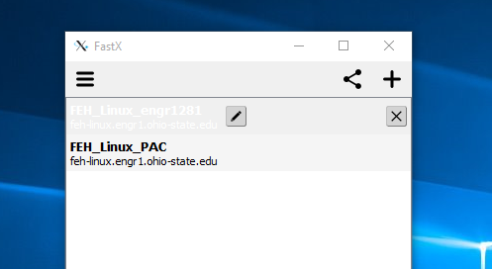
Configuring Linux
Click on the “+”
Select “SSH”

Slide 12
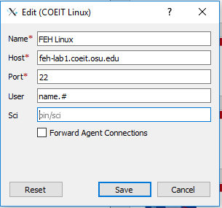
Configuring Linux
Name: FEH Linux
Host:
feh-lab.coeit.osu.edu
User: name.# – lowercase
Click “Save”

Slide 13
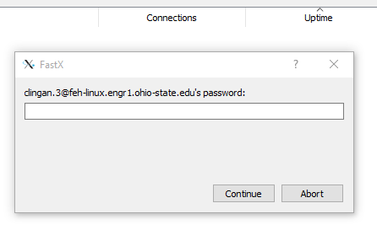
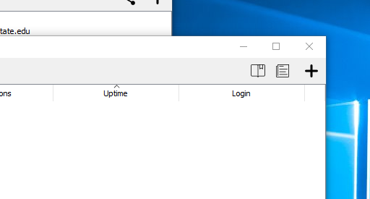
Starting Linux
Enter your password
Click “Continue”
When the password box disappears, click the “+”
Notes:
Instructor:
Students might get a warning dialog the first time they attempt to connect to Linux. They can select OK and continue on.

Slide 14
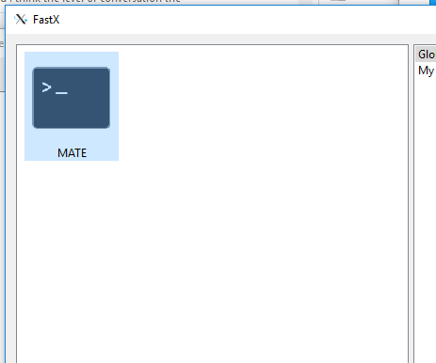
Starting Linux
Select MATE
Click “OK”

Slide 15
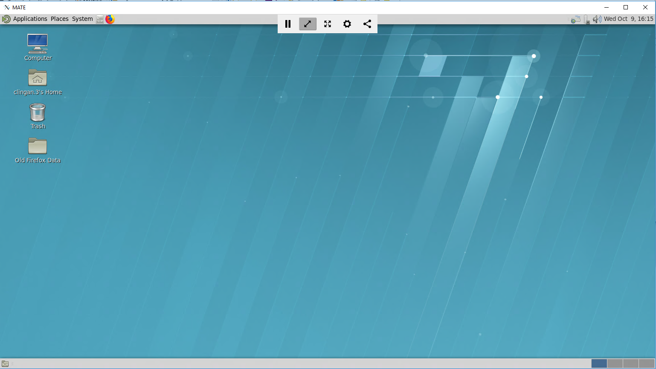
Opening Screen in Linux
Notes:
Instructor:
At this point, all students should be logged in to Linux. You may use the upcoming slides to show students the environment and some of the features. You may choose to conduct a demo instead through logging into Linux on your computer. You may choose to use a combination of the slides and a demo. The choice is up to you. The goal is just to expose students to the Linux environment and get them familiar with the features they will use.

Slide 16
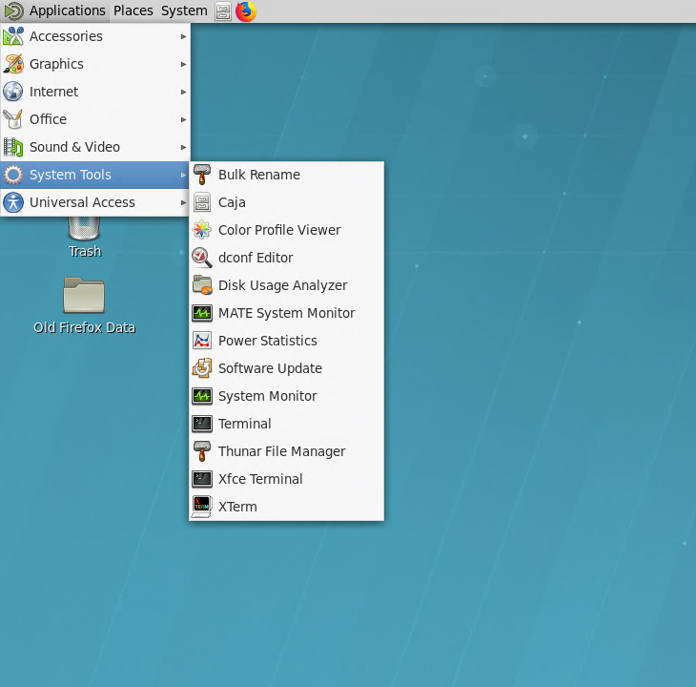
Starting a Linux Terminal Window
Select Terminal

Slide 17
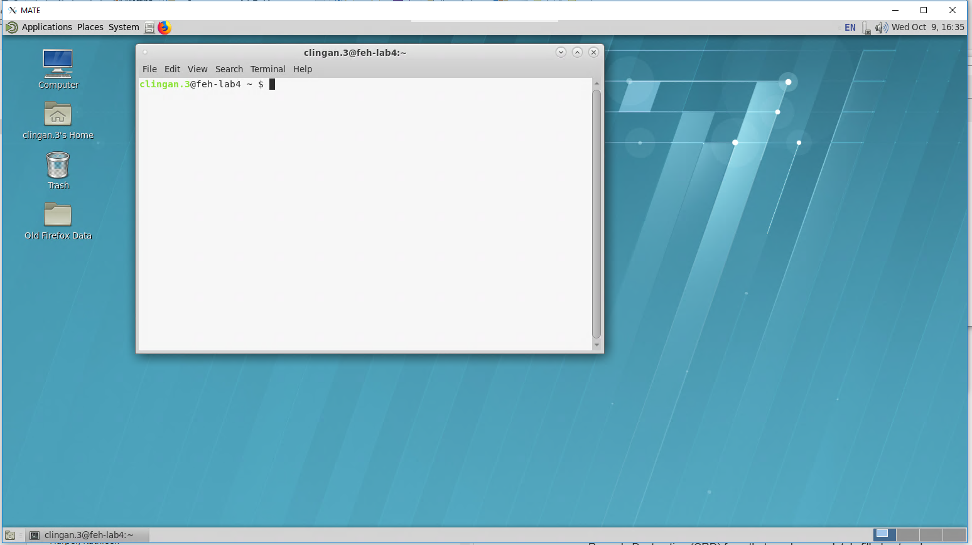
Starting a Linux Terminal Window
Command
Editor - gedit
Notes:
Instructor:
This is another opportunity to remind students that they will write their programs in the Linux editor just like they wrote their programs in script files when using MATLAB.

Slide 18
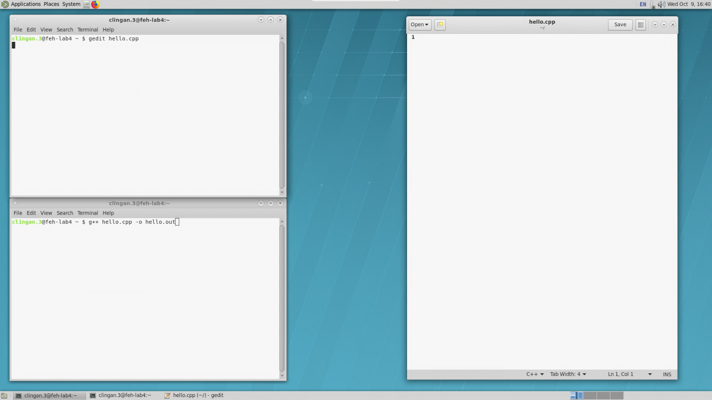
Terminal and Editor Windows
1. Use this terminal to run the editor "gedit"
This is gedit. Enter your code here.
When your code is ready to test, save the file.
4. Compile and run your program here.
Notes:
Instructor:
Point out that it is helpful to organize your windows in a useful way. One window operates the editor, another can be used to compile and run your programs. Students will want to organize these windows in such a way so that it makes their work easier, and not more difficult. For example, if all the windows are stacked on top of each other, it is difficult to know which one will be used as the command line and which one will be running the editor window.

Slide 19
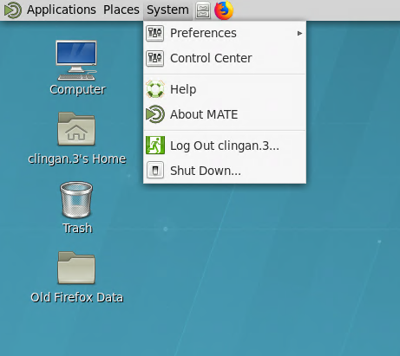
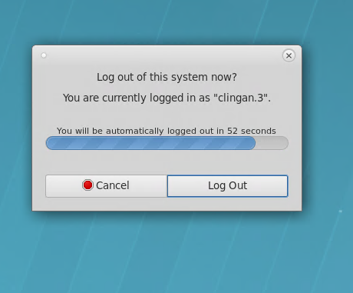
Logging Off from LINUX
1. System > Log Out
2. Log Out
Notes:
Instructor:
It is important to stress to the students that it is critical to log out of Linux and not just to close the window. There can be problems down the road if many students are not logging off. If students want access to Linux without encountering problems in the future, it is imperative that students log out.

Slide 20
Compiling and Running
Compiling
>> g++ source_file.cpp –o run_file.out
>> g++ APP_C22_1.cpp –o APP_C22_1.out
Running
>> ./run_file.out
>> ./APP_C22_1.out
Notes:
Quick reminder on how to compile a program and run it from the command line. General form followed by an example. FYI, output file doesn’t have to be last in the list, but it does need to immediately follow the –o flag.
This is what students should do when creating/testing/debugging their code
Extension is not required, but using .out helps keep things straight. Students must not use .cpp as the extension for the executable otherwise the compiler will overwrite the original source code. The original source will then cease to exist. Students might be able to retrieve an autosave file if there’s one in the directory that ends in ~. No guarantee the file will exist and, even so, how many changes will have been made since the last time it was saved.
May need to remind students that the >> represent the command line prompt. They are not to enter >> themselves.

Slide 21
Creating and Examining PDFs
Create PDF from other files
>> app2pdf fileA.cpp fileB.txt finalAB.pdf
Run program, collect output, create PDF
>> app2pdf @file1.cpp file1.pdf
Examine PDF
>> evince file1.pdf
Notes:
>> app2pdf file1.cpp file2.txt final.pdf – creates a single PDF named final.pdf from file1.cpp and file2.txt. app2pdf is not limited to two files and can accept other file types, too, among them .pdf and .docx.
>> app2pdf @file1.cpp file1.pdf – creates a single PDF named file1.pdf. The @ preceding file1.cpp means that file1.cpp will be compiled/assembled/linked/run. Its terminal window output will be collected and included in the PDF. Again, other files and file types can be included. If an output file generated from running the program is also specified, it should follow @file1.cpp in the list since the output file might not necessarily exist until after the source code has been compiled and run.
Remember, from a compilation standpoint, app2pdf when used with @ is designed to be used when the program is in a working state.
In the event the program is not executing properly, app2pdf can still be used to generate a PDF from the source code.
The PDFs aren’t required to have .pdf or .PDF as an extension, but app2pdf requires it in order to recognize it as a PDF. So, if you want to include a PDF in your list of files, it needs to have .pdf or .PDF as its extension. If not app2pdf won’t know how to handle it.
>> evince file1.pdf – is like Acrobat Reader. You can use it from the command line to open and check the PDF.

Slide 22
Copying and Editing APP_C22_1
Copy APP_C22_1 into your directory
>> cp
/share/EED/class/engr1281/students/c/ Class_22/Application/APP_C22_1.docx
APP_C22_1.docx
>> libreoffice APP_C22_1.docx
Notes:
The cp command in the slide appears on three lines because of space limitations, but in the terminal window would be part of a single statement with each part separated by one or more spaces.
cp <SPACE> /share/EED/class/engr1281/students/c/Class_22/Application/APP_C22_1.docx <SPACE> APP_C22_1.docx
cp is the command.
The first argument is the source, which in this case contains the path to the document
The second argument is the destination, which in this case is just the file name. The file will be placed in the present working directory since no additional path name is specified.
>> libreoffice APP_C22_1.docx – will open the file for editing so students can fill in the responses. It’s probably easier if they edit this document and convert it to a PDF (libreoffice has an ‘export to PDF’ option) rather than editing via Word in Windows. Easier to create a single PDF this way.

Slide 23
Summary
Red Hat Linux
UNIX commands
gedit
Accessing Linux
Logging off
PDF generation
Questions?
Notes:
Instructor:
We will be working in the “UNIX-like” environment known as Red Hat Linux. All students have a Windows and a Linux account.
UNIX traditionally operates with a “command line” user interface; therefore it is important to become familiar with common UNIX commands.
The recommended editor in Linux is gedit. Other editors exists, but they often have a steeper learning curve and are only recommended if you have experience with those editors.
We walked through how to access Linux on the computers in the classroom, you may also access Linux remotely from your personal computer.
When you are done working in Linux, make sure to correct log off.
Instructions given for PDF generation, including collecting terminal window output.
What questions are there?

