Slide 1
C Programming With Real-World Timing
Class 31

Slide 2
Agenda
Program timing
why would we need to control program timing
how to use timing functions
Microcontroller/Emulator programming
what is a microcontroller
why would you use one or an emulator
how to program a microcontroller/microcontroller emulator
Notes:
OUTLINE:
Today we will touch on two main topics
Program tming:
First, we’ll look at our first our first examples of programs that operate based on timing. These programs require input from a “clock” in addition to the types of inputs we’ve seen already.
PROGRAMING FOR THE ARDUINO : Often programs with strict time requirements are those that operate on embedded platforms. By that we mean, rather than the program operating on a desktop machine, it could be on a small computer “embedded” into a device such as your dishwasher or your cable box. These embedded systems often use computers called “microcontrollers” that we’ll discuss today. Specifically, we’ll be using a device called the Arduino in lab that includes a basic but powerful microcontroller that we’ll use to control a mock stoplight.

Slide 3
Looking forward: Lab 12
Write a program to control a stop light
4 way intersection
Red, Yellow, and Green lights (standard sequence)
Notes:
Looking forward to lab next week, we’ll be exploring the control of a mock stop light. We’ll look at a stoplight for a traditional 4 way intersection with the standard Red, Yellow, and Green stoplight sequence to control traffic flow. Software to control a stoplight must be time-aware to control the stoplight sequence.

Slide 4
Looking forward: Lab 12
Procedure
Today: Learn how to write C program to simulate a stoplight
In Lab (next week): Control a mock stoplight with a microcontroller emulator
Notes:
Prior to controlling the stoplight in lab, we’ll learn how to use C timing functions in UNIX today. You’ll then use this knowledge to write a C program in UNIX to simulate the stoplight’s timed operation.
You’ll then modify this code in lab to work with a microcontroller that will control a physical stoplight. We’ll introduce microcontrollers today, with more details provided in the PRELAB assignments and lab write up for LAB 12.

Slide 5
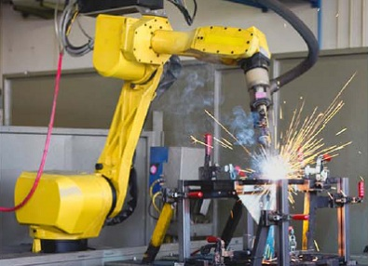
Why need time-aware software?
Programs thus far
file input/output (I/O)
user I/O
I/O specifications
Time-aware software
program timing specifications
often for use with physical systems
input from system clock
"Move to Position A"
"Begin Weld"
"Move to Position B over the next 10 seconds"
"End Weld"
Notes:
Our programs thus far haven’t been aware of the current time, but so what? Why would we need a time-aware program?
PROGRAMS THUS FAR: The programs written thus far in ENGR 1281 have centered around input and output from files or the user. These programs have all be created based on the program specifications in your application assignments. These specifications have thus far been dominated by user and file I/O specifications. For instance, input a shape and dimensions, output the area to a file. These programs have never been required however to operated under specific time frames.
TIME-AWARE PROGRAMS:
Time-aware programs however, are often created to address timing specifications. These specifications are usually required for the program to interact with physical systems such as appliances, robots, or automobiles. For instance, consider an industrial arc-welding robot. As you saw last week in lab, the welding process is extremely time sensitive. The pseudocode for a welding robot would be as follows (read from slide). Luckily, most computer systems allows the programmer to get input from the a “system clock”. Just like you can get input from a file, programs can get input from the computer’s “clock” in order to know how long the program has been running, or what time of day it is.

Slide 6
Using the system “clock”
Include
#include <time.h>
Get time
time(NULL);
Returns integer seconds since 12:00 AM, UTC January 1, 1970
#include <time.h>
...
int time_start, time_now, delta_t;
char letter;
printf("Enter a letter: ");
time_start = time(NULL);
scanf("%c",&letter);
time_now = time(NULL);
delta_t = time_now – time_start;
printf("Seriously?! It took %d seconds to come up with %c?!\n",delta_t,letter);
...
Seriously? It took 3 seconds to come up with z?!
Notes:
C Programs in UNIX can read the system clock using the time() function that is described in <time.h>. This function returns the time in seconds since midnight UTC January 1st, 1970. For all intents and purposes, UTC is the same as Greenwich Mean Time (GMT). While this is a strange way to measure time, it is relatively straight forward to use this function to measure the time between two events. Consider for instance the program on the slide that measures the time it takes a user to enter a letter at the terminal.
<time.h> has other functions that for instance convert the time() function output into a local time (the localtime function), or another function that converts this number of seconds into a human readable time string like “10:15 AM, Oct. 5th 2012”. We will have no need for these functions in today’s activity, but its good to know that you can convert time()’s output into other useful quantities.
An interesting side point would be to note that the basic Unix operating system has its own special "Y2K" kind of problem when the 32 bit integer value which is counting the number of seconds since midnight, January 1, 1970, overflows (Sometime in the year 2036 or 2037 or thereabouts.)

Slide 7
Pausing program execution
Sleep for 5 seconds (polling)
Sleep – Option 1
Repeatedly check time
Not really sleeping
Sleep – Option 2
Set an alarm clock
(OS provides alarm)
Include
#include <unistd.h>
Go to sleep sleep(int)
...
int start;
start = time(NULL);
while((time(NULL)- start) < 5){};
...
Sleep for 5 seconds (interrupt)
#include <unistd.h>
...
sleep(5);
...
Notes:
A useful capability to have in a time-aware program is the ability to “take a nap” or “go to sleep”. This capability can be produced by a simple routine that keeps checking to see if the required amount of time has passed. Until the rquired time has passed, the process continues to spend its resources checking the time (aka its not really sleeping!). This method of continually checking is sometime referred to as “polling”. If your computer is trying to do multiple things at once, this method of sleeping is wasting resources that could be used elsewhere!
A smarter way of sleeping is to rely on an external source to wake you up (aka you set an alarm clock). For desktop computers, the operating system will act as an “alarm clock” and wake up your program after it’s sleep time is up. With this function, the processor is not constantly consumed with checking the time, which can allow other non-sleeping processes to execute. This smart sleep function is provided in <unistd.h> as the sleep() function. It takes a desired number of seconds to sleep.

Slide 8
More Details in Lab 12
Visual Studio specifics
How to use the digital inputs and outputs
How to use the Proteus libraries
Covered in write-up and pre-lab activity

Slide 9
Today’s Activity
Write a C program to simulate the operation of a traffic light
Use UNIX timing functions (time() and sleep())
Print stoplight state to terminal
Submit per DAL and save program for LAB-PRE12
In lab (next week)
Modify program to work with the Proteus (same logic, but different functions)
Control a physical stoplight

Slide 10
Example Output
Write light states to terminal
Use a short cycle time
Terminate program after 30 seconds
NS Light = GREEN, EW Light = RED
Waiting 4 seconds
NS Light = YELLOW, EW Light = RED
Waiting 2 seconds
...

Slide 11
Summary
Time-aware software
Pausing program execution
Assignments for this week and next week
Questions?

Slide 12
Supplemental Slides

Slide 13
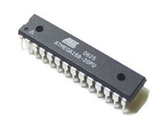
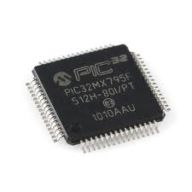
What is a microcontroller?
Small computer with on-chip:
Processor
Memory
Programmable input/output peripherals
Many form factors
Used everywhere (appliances, cars, etc.)
Affordable
More features (RAM, I/O, etc.), more expensive
Some available for under $1
Notes:
So we’ve been throwing out this term “microcontroller” a lot, but what is a microcontroller exactly?
It’s a small computer on a single chip that contains a CPU, memory, and programmable peripherals. Is your Intel core i5 a microcontroller? No. it’s a microprocessor, and requires memory and an I/O controller to make it useful. Microcontrollers contain nearly everything they need on one chip. They don’t require a breadboard, or a monitor to be useful, and can be used to read sensors and control actuators in an ever increasing range of applications. Microcontrollers are found inside of nearly every piece of electronics from cameras to printers to the highly coveted LOG-O-MATIC data logger.
In addition to being largely self-contained, microcontrollers are also very affordable. Obviously, the more features you want on a chip, the more it will cost, but these chips can start at under $1. For instance, you can get an 8MHz, 5 digital I/O, PIC microprocessor with 1.5KB of program space for $0.75

Slide 14
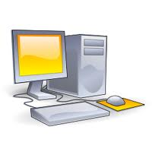

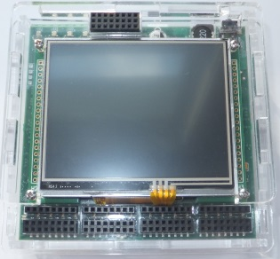
Proteus – FEH’s In-House Developed Microcontroller
Code written and compiled on a personal computer
Can be programmed in c/c++
Specialized versions of gcc/g++
Program downloaded via USB
Program run on device
Write & Compile
Download
Run
Notes:
The development process for microcontroller programs is different than for desktop programs.
Microcontroller programs can be written on a desktop machine and then downloaded to the microcontroller. These programs can be written in C, but require special versions of g++ to compile for the correct target processor. Once compiled correctly, programs for the microcontroller can be downloaded to the device (via USB in our case) and then run.

Slide 15
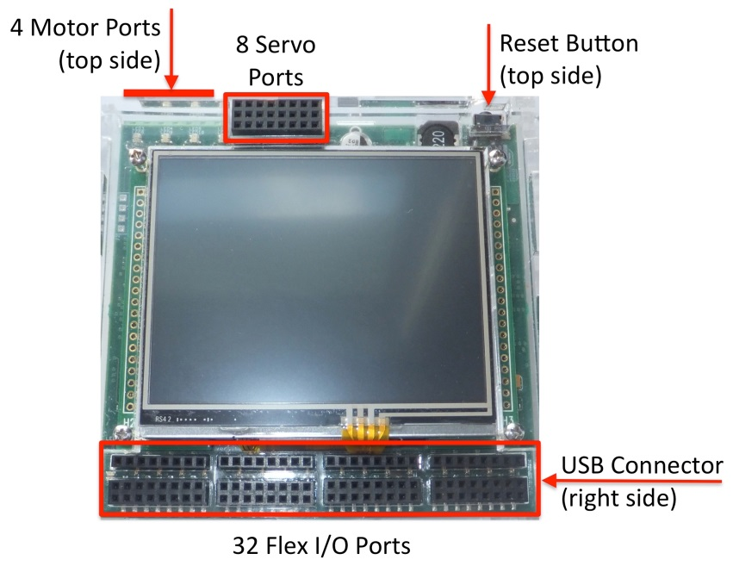
Proteus Specifications
Main CPU - ARM Cortex M4 32 Bit
96 MHz single core
128 kB RAM, 512kB Flash Storage
Many programmable inputs/outputs
32 Flex I/O Ports
digital input
digital output
analog input
8 Servo Ports
4 DC motor ports
320x240 Color LCD
Useful for debugging code and providing user feedback
Notes:
FEH Proteus Controller – developed in house.
The Proteus is based on a Freescale K60 microcontroller. Proteus operates at 100 MHz with a 32 bit CPU. Digital and Analog I/O, 512 KB of Flash Storage and 128 KB of RAM

Slide 16
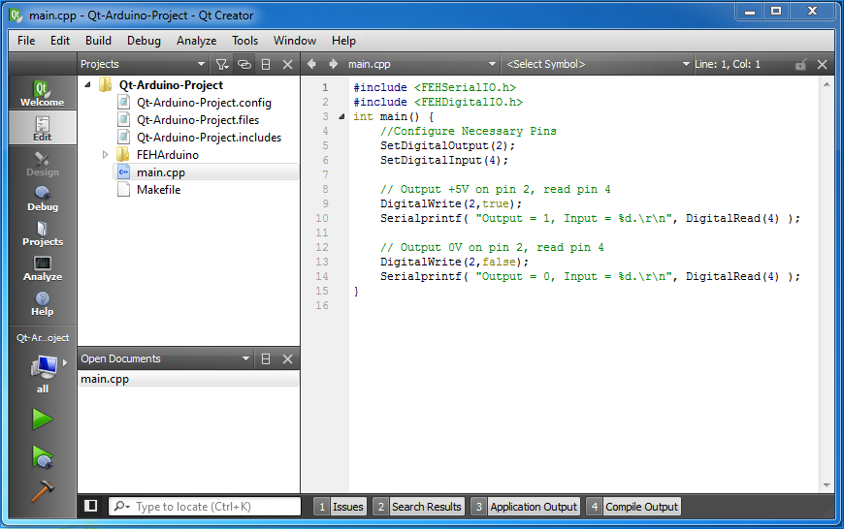
Proteus Programming – QtCreator
Configured to work with the Proteus
Integrated environment
Write code
Run program
See results
Notes:
FEH has configured the QtCreator development environment for use with the Arduino.
The QtCreator development environment is an integrated environment (like MATLAB) where you can develop, compile, and run your program from the same window. More details on the next slide.

Slide 17
Proteus Programming – QtCreator
Edit
Compile to micro SD card on computer
Remove micro SD from computer and insert in Proteus
Start Proteus to load software
Run software on Proteus
Notes:
FEH has configured the QtCreator development environment for use with the Arduino.
The QtCreator development environment is an integrated environment (like MATLAB) where you can develop, compile, and run your program from the same window. More details on the next slide.

