Slide 1
Variables!
Micro:Bit Lesson 1

Slide 2
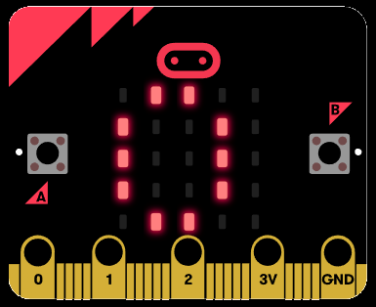
Variables in Micro:Bit
Use let to create variable foo then assign the value 5
Ex:
let foo = 5
basic.showNumber(foo)

Slide 3
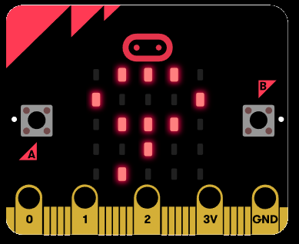
You can change your Variables!
To change a variable, simply reassign another number.
Assign the value 9 to foo
Ex:
let foo = 5
foo = 9
basic.showNumber(foo)

