Slide 1
Micro:Bit Pin Input
MicroPython
Notes:
Use this as the opening slide for your presentation. Include any additional info that you would like (instructor name, course name, course numbers, etc.).

Slide 2
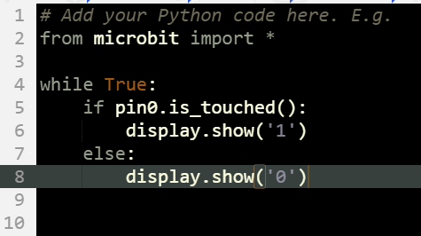


Micro:Bit Pin Input
Overview
Goal:
Final Code:
Check pin0 for input
Return a signal when input is detected
Objectives:
While Loops
Booleans
If statement
pin Object’s is_touched() function
display Object’s show function
Notes:
This is a slide for a two columns of content. Black headers are optional if you just want to include written text.
If you accidentally delete the custom bullets, just copy/paste a text box from another slide.
Remember to update the page numbers at the bottom (or delete if you choose not to use them).

Slide 3
Steps
Create
Infinite
Loop
Check
Pin0
For
Input
Change
Display
If
Input is
Detected
Notes:
Use this slide for introducing three quick concepts.

Slide 4
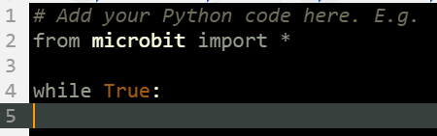
Create Infinite Loop
1 of 1
Add a while loop set to TRUE to your code
This will cause the Micro:Bit to loop forever
Notes:
If you have a cycle or sequence of concepts, use this slide

Slide 5
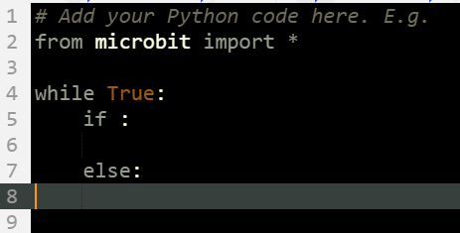
Check Pin0 For Input
1 of 2
Add a IF statement to your code
Notes:
If you have a cycle or sequence of concepts, use this slide

Slide 6
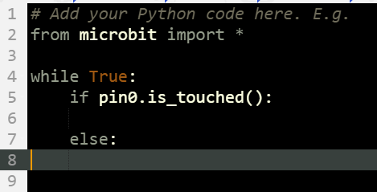
Check Pin0 For Input
2 of 2
Call the pin0 Object to see if the is_touched() function is triggered
Notes:
If you have a cycle or sequence of concepts, use this slide

Slide 7
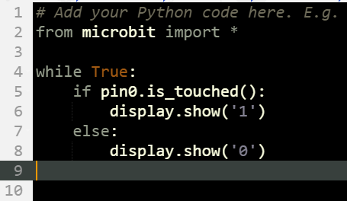
Change Display If Input is Detected
1 of 1
Call the display Object to call the show() function
Passing a “1” if true and “0” on false
Notes:
If you have a cycle or sequence of concepts, use this slide

Slide 8
Upload your Code
Notes:
Do you have a major concept or conclusion that is an integral part of your content? Drawing attention to a big idea with a bold slide is a very effective way to create a strong connection to the material. The student will be able to recall it by easily recalling the visual associated with the content. Use is suggested anywhere throughout the presentation and limited to no more than 4 per presentation.

Slide 9
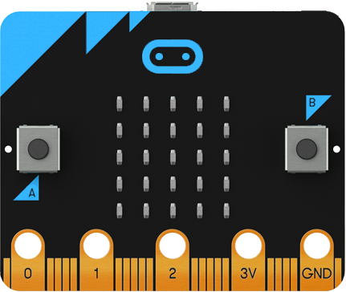
On your Micro:Bit
Touch finger to GND
AND
Touch Pin 0 to trigger it
Notes:
This is an image slide for two images. Images are placed in shapes here (for help, refer to our FAQ and Help section).

