Slide 1
Loops!
Micro:Bit Lesson 3

Slide 2
There are two types of loops

Slide 3
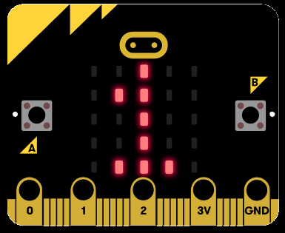
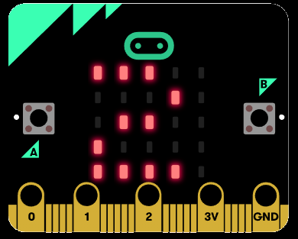
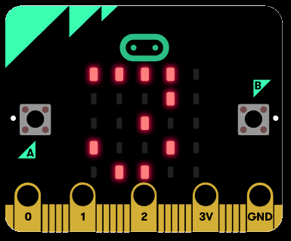
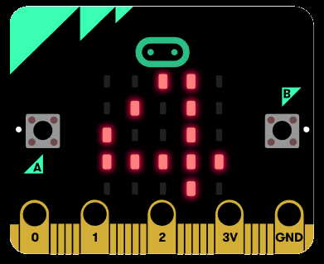
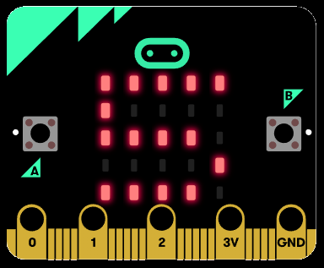
For Loops in Micro:Bit
A for loop will run until the condition in the middle is met (Note: will re-write this later)
Ex:
let i = 0
for (i = 0; i < 5; i++) {
basic.showNumber(i)
}

Slide 4
While Loops in Micro:Bit
A while loop will run until the condition is not true (Note: will re-write this later)
Ex:
let foo = 0
while (foo < 5) {
foo = foo + 1
basic.showNumber(foo)
}

