Slide 1
Powering A Mercury Bot

Slide 2
Batteries The Energy Source of Champions!
Fact: every Mercury bot has been powered by batteries
Battery selection is of primary importance
Strongly influences (-ed by) motor selection in single battery bots
Battery Selection Can Effect
Computing platform
Motor and servo performance
Sensor performance

Slide 3
A Few Things to Consider
Cost
Voltage
Required run time
Charging complexity
Capacity
Weight
The efficiency of electronics attached to the battery
The worst case!

Slide 4
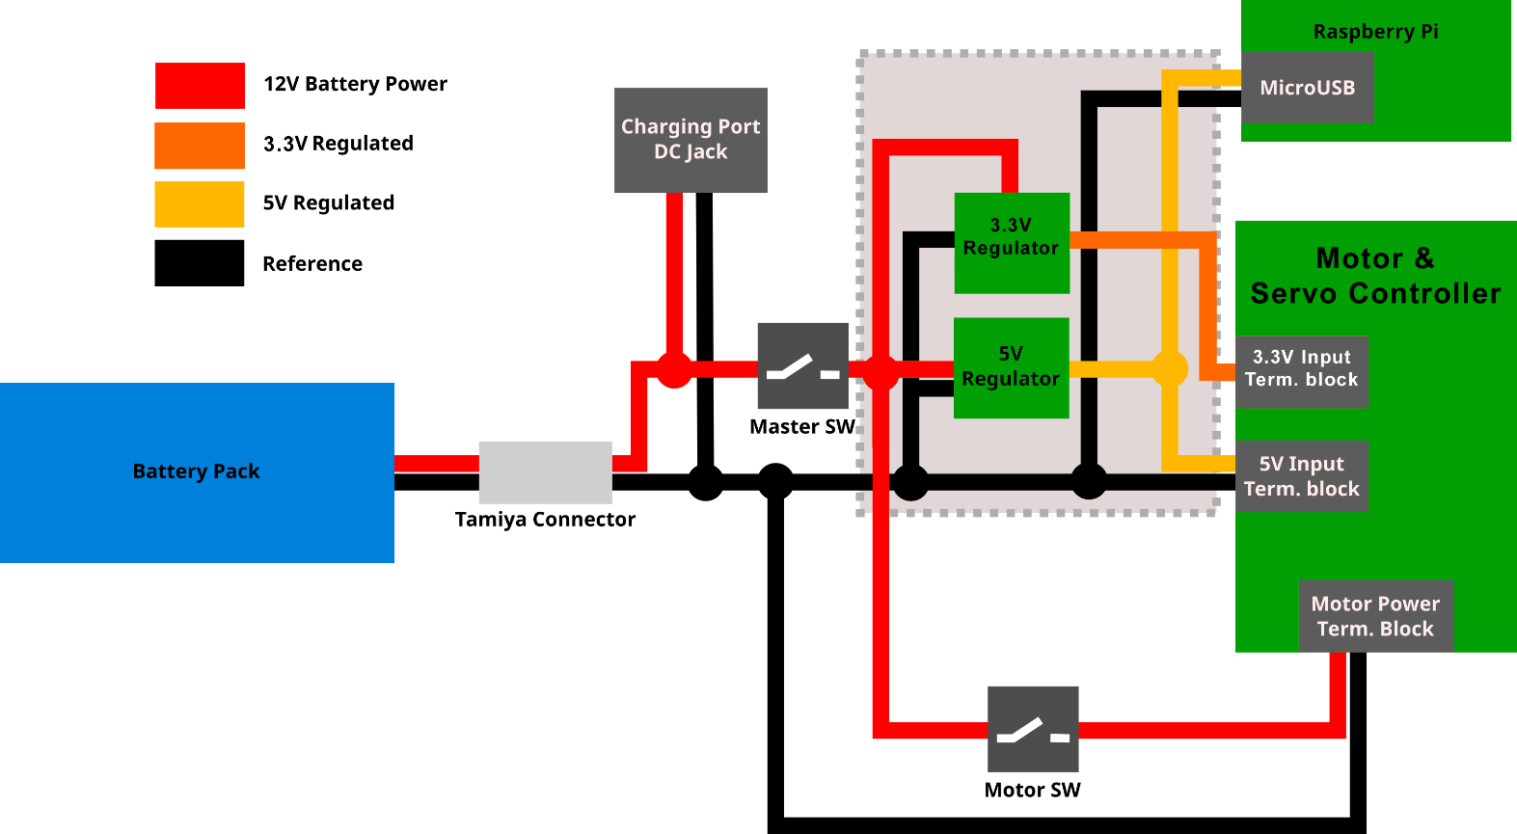
Power System Diagram

Slide 5
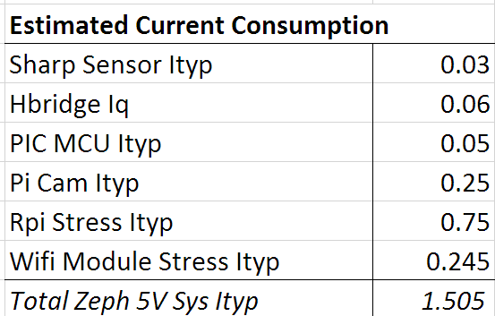
Current Consumption: Electronics

Slide 6
Current Consumption: Servos
Not generally specified
Analog servos usually require less current than digital when in motion
Correspondingly lower performance
Rule of thumb: standard servo stall current ~1A
More likely to stall than motors during testing
2 servos = 2A

Slide 7
Current Consumption: Motors
A Typical Mercury Bot
Weighs 15 lbs
Expected to climb a 30° incline @ 1m/s²
Has four 2.78” dia. wheels
Moves at 1m/s
Operates around 30 min between charging
BoE* per Motor Torque, Current @ 65% eff.
80 oz-in, where stall torque 320 – 400 oz-in
1.3 A

Slide 8
Some Good Motors

Slide 9

Total Current Consumption
$$I_{total}=I_{electronics}+I_{servos}{+I}_{motors}$$
$$I_{total}=1.5+2+4(1.3)$$
$I_{total}=8.7$A

Slide 10
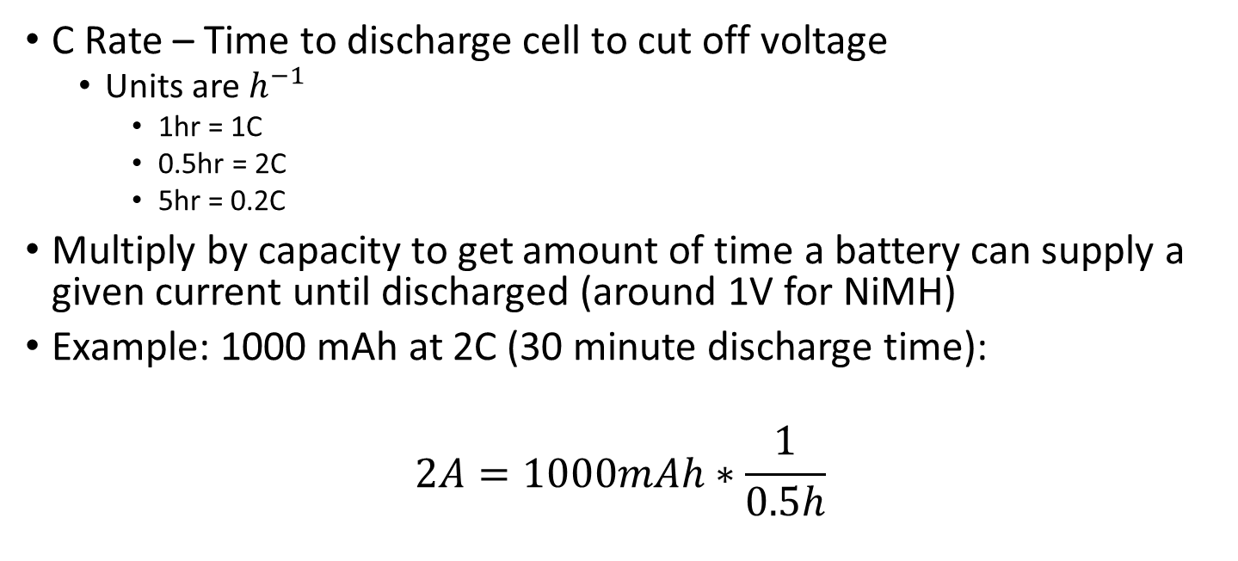
Battery Capacity
C Rate – Time to discharge cell to cut off voltage
Units are $h^{−1}$
1hr = 1C
0.5hr = 2C
5hr = 0.2C
Multiply by capacity to get amount of time a battery can supply a given current until discharged (around 1V for NiMH)
Example: 1000 mAh at 2C (30 minute discharge time):
$$2A=1000mAh∗\frac{1}{0.5h}$$

Slide 11
Battery Selection

Slide 12
Battery Selection

Slide 13
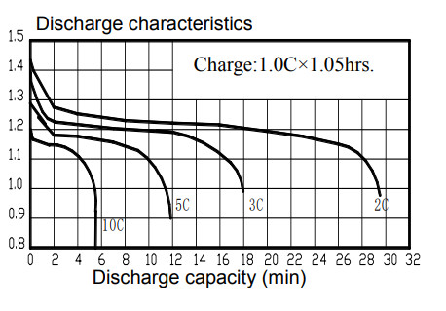
Battery Capacity
2C for 4600 mAh battery
9.2A > 8.7A
It’s good!

Slide 14
References
All About Batteries
https://learn.adafruit.com/all-about-batteries/
What is C-Rate
https://batteryuniversity.com/learn/article/what_is_the_c_rate
How to Calculate Battery Run-time
https://batteryuniversity.com/index.php/learn/article/bu_503_how_to_calculate_battery_runtime
A Guide to Understanding Battery Specifications
http://web.mit.edu/evt/summary_battery_specifications.pdf
Drive Motor Sizing Tool
https://www.robotshop.com/community/blog/show/drive-motor-sizing-tool

