Slide 1

Information Session - August 28, 2019

Slide 2
Officer Intro
President: Collin Thornton
Vice President: Fernando Cavazos
Treasurer: Joel Quarnstrom
Mechanical Lead: Hunter Yell
Electrical Lead: Lauren Brown
CEAT StuCo Rep: Matthew Petty

Slide 3
Advisors
Faculty Advisor: Dr. Jeffrey Callicoat
Co-Advisor: Dr. He Bai

Slide 4
Fall 2019
Meetings on Wednesday evenings
Tutorials on systems critical to competition
Design Teams
Minimum of 4 participants per team
Team leader, robot handler, robot operator, technical assistant

Slide 5
Funding
Design presentations take place in the weeks before the semester ends
Teams must present a detailed project overview, inclusive of a project timeline, that fully justifies system cost
Parts lists will be submitted to the officer team
Funds will be disbursed at organization’s discretion
Keep in mind that a major part of engineering is reducing costs

Slide 6
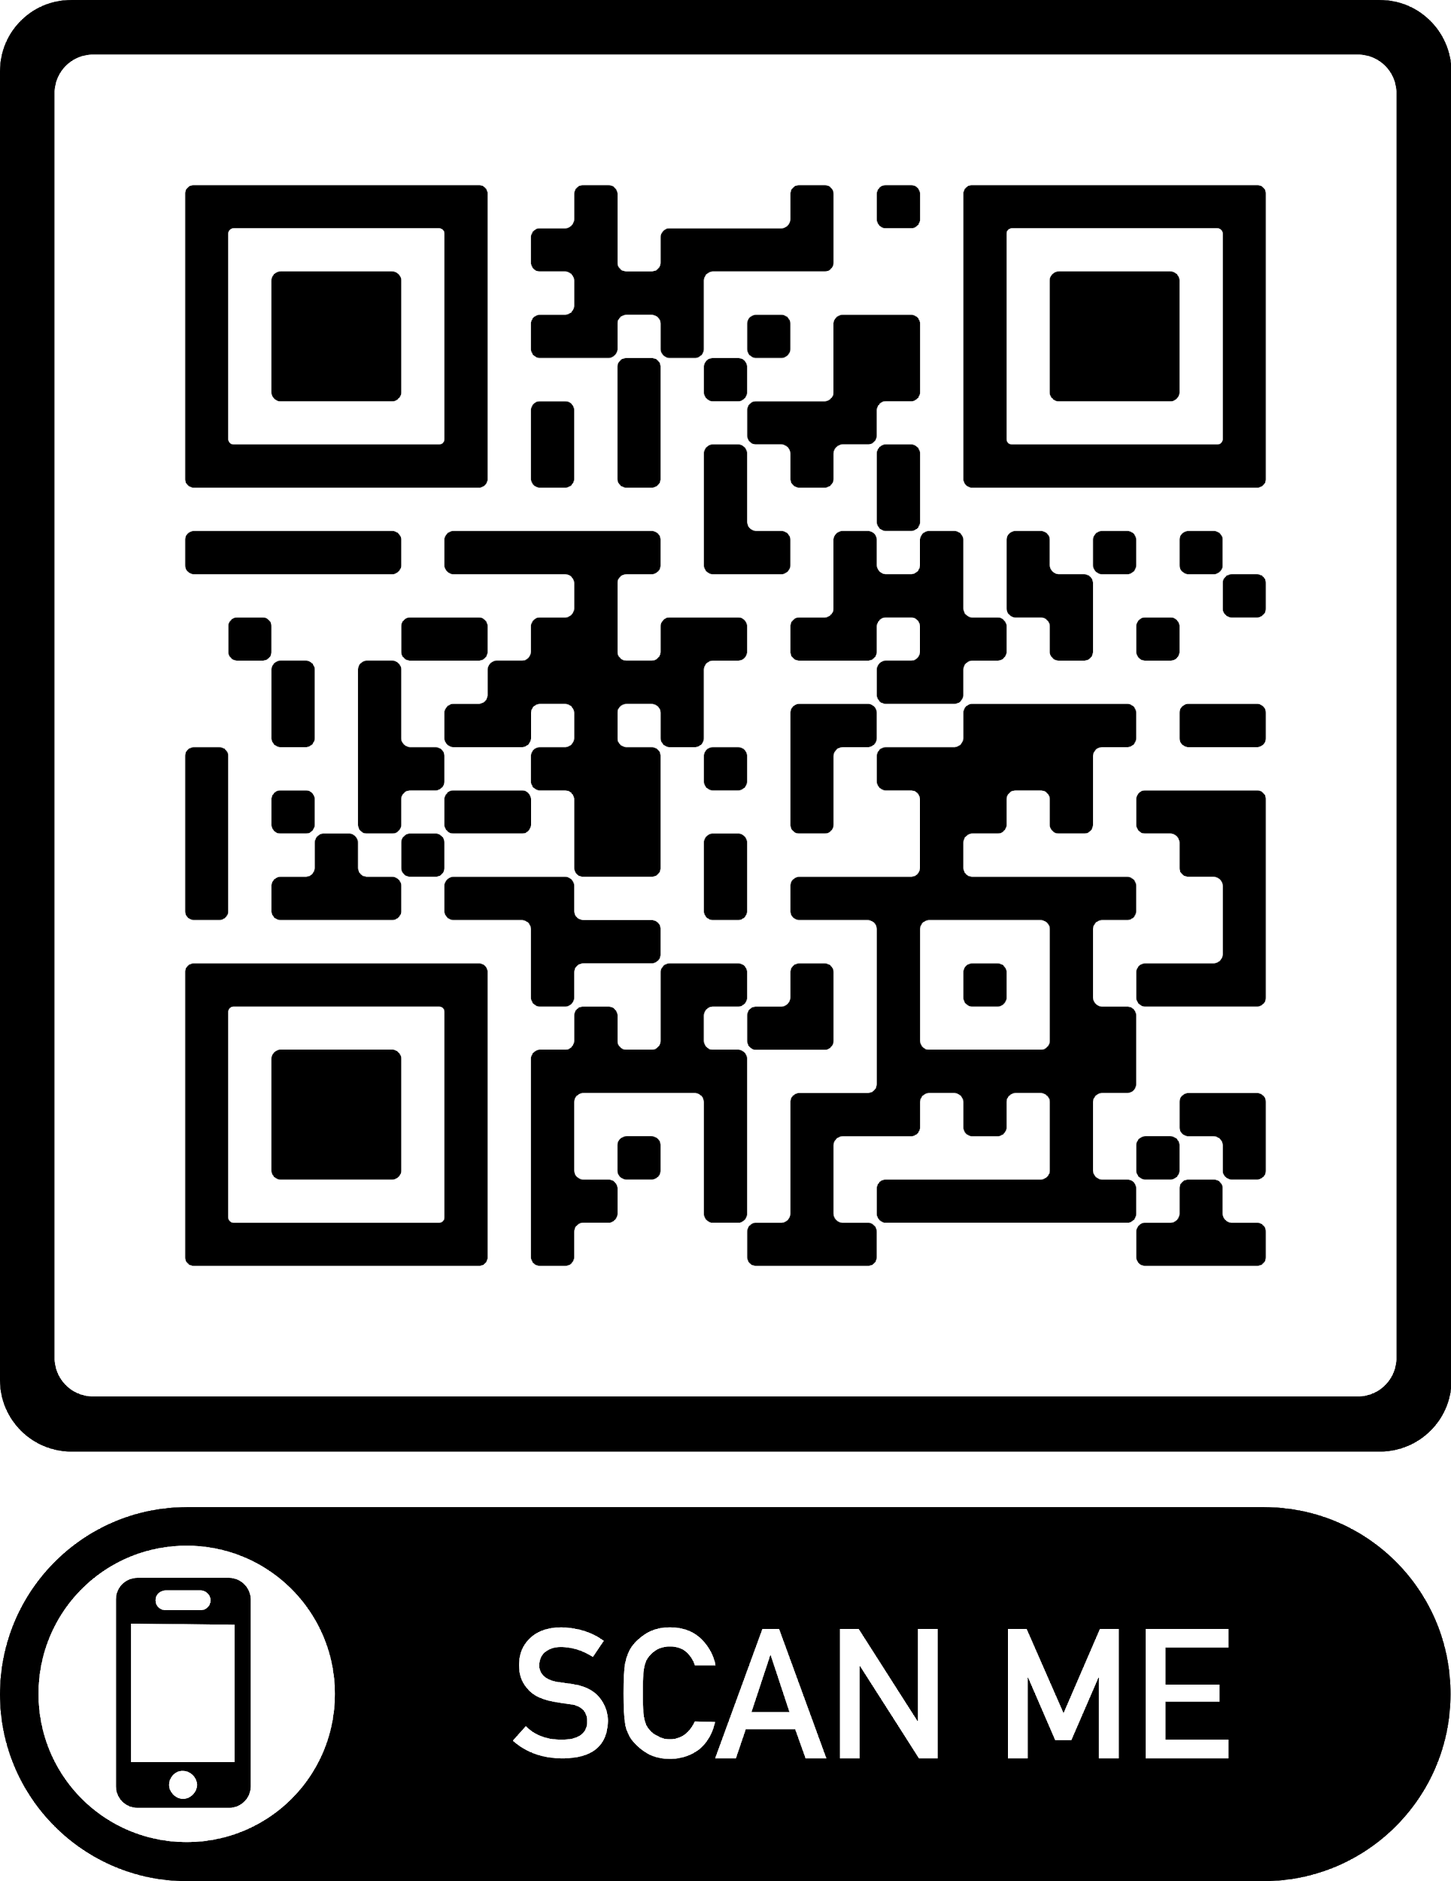
Competition
https://mercury.okstate.edu/content/mercury-challenge
A room will be provided on campus for the operators
Autonomous Section
Invites control theory centric problem solving
Relevant to real-world applications
Bypasses
Variable scoring in sections - related to difficulty

Slide 7
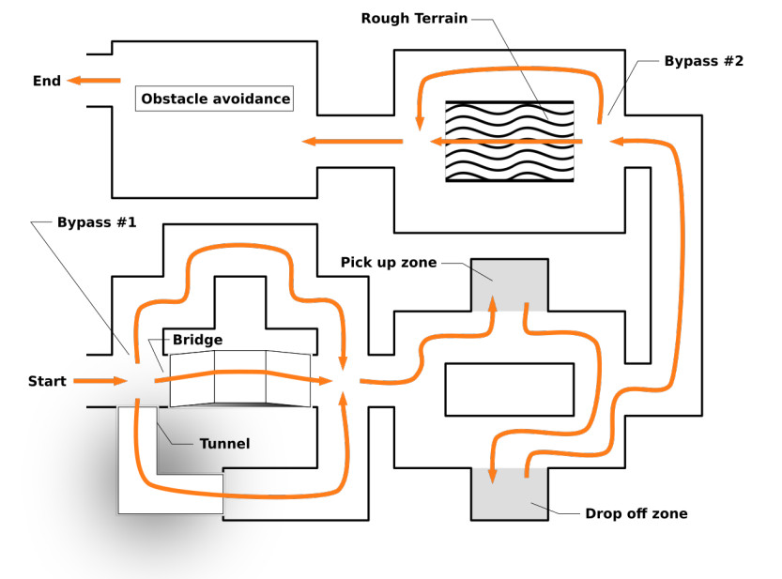
Competition Field Overview

Slide 8
Tutorial Sessions
Sep 4: Dr. Callicoat – Overview of engineering design
Sep 11: Fernando – Powering Mercury Robots
Sep 16: ABB – Industry Info Session
Sep 18: TBD – Networking w/ ESP8266
More to follow

Slide 9
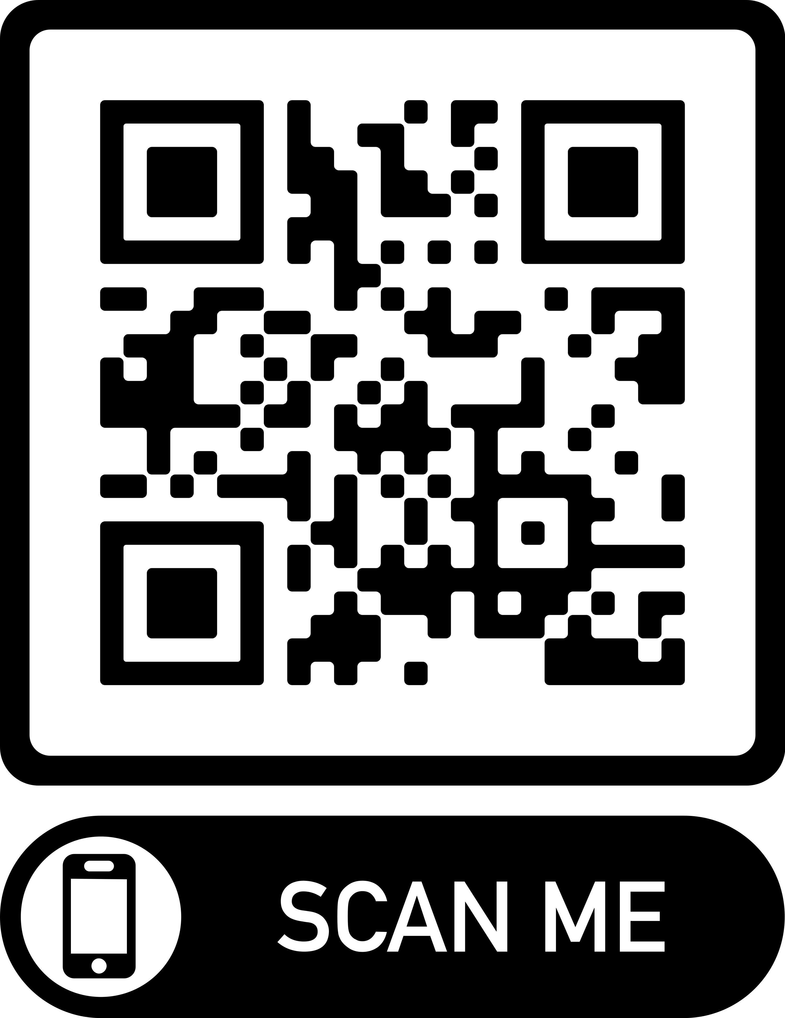
Team Formation
https://mercury.okstate.edu/content/osu-team-signups

