Slide 1

Effective Software

Slide 2
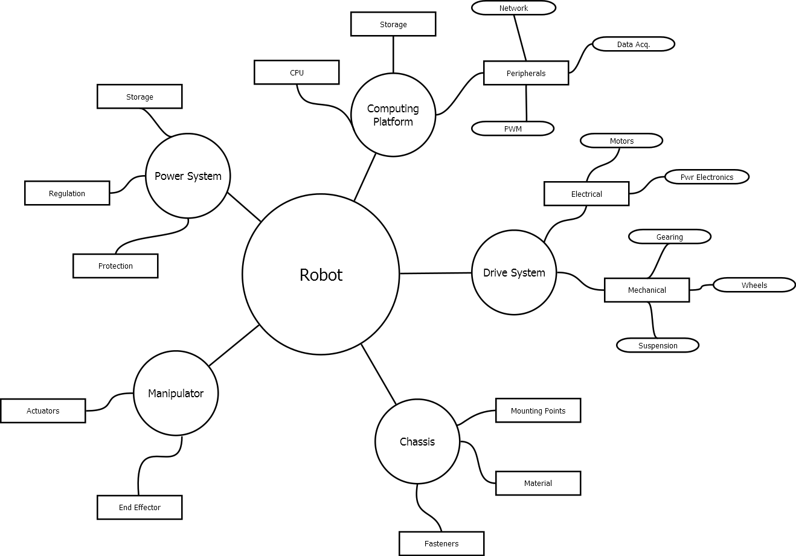
Formulating the Problem
Modularity - Categorize by subsystem
Each module represents a subproblem

Slide 3
Formulating the Problem
Modularity - Categorize by subsystem
Each module represents a subproblem
Most must be addressed
Either software or hardware

Slide 4
Formulating the Problem
Modularity - Categorize by subsystem
Each module represents a subproblem
Most must be addressed
Either software or hardware
Every graph will look different

Slide 5
Formulating the Problem
Focus on peripherals and control
Determined by complexity of robot
Network
Storage
Peripherals
Data Acq.
Computing Platform
CPU
PWM
Localization
Control
Manual
Planning
Obstacle Detection

Slide 6
Formulating the Problem
Focus on peripherals and control
Determined by complexity of robot
Most peripheral code is highly isolated
ie, a PWM class will be called by a motor driver class
Network
Storage
Peripherals
Data Acq.
Computing Platform
CPU
PWM
Localization
Control
Manual
Planning
Obstacle Detection

Slide 7
Formulating the Problem
Focus on peripherals and control
Determined by complexity of robot
Most peripheral code is highly isolated
ie, a PWM class will be called by a motor driver class
Control code is very integrated
Defined by obstacle avoidance section
Network
Storage
Peripherals
Data Acq.
Computing Platform
CPU
PWM
Localization
Control
Manual
Planning
Obstacle Detection

Slide 8
Addressing the Problem
Now’s the time to think about developing code
Localization
Control
Manual
Planning
Obstacle Detection

Slide 9
Addressing the Problem
Now’s the time to think about developing code
Each node represents a group of objects
Localization
Control
Manual
Planning
Obstacle Detection

Slide 10
Addressing the Problem
Now’s the time to think about developing code
Each node represents a group of objects
Must answer questions:
What information is required?
What information is produced?
How can the complexity be minimized?
Localization
Control
Manual
Planning
Obstacle Detection

Slide 11
Addressing the Problem
Now’s the time to think about developing code
Each node represents a group of objects
Must answer questions:
What information is required?
What information is produced?
How can the complexity be minimized?
Most importantly:
How can the code be developed independent of hardware?
Localization
Control
Manual
Planning
Obstacle Detection

Slide 12
Object Oriented Code
A class is set of information defining a specific data type
Using instance variables
Car
Tire
Instance Variables
Size
Speed
Linear vel.
Color
Material
Pressure

Slide 13
Object Oriented Code
A class is set of information defining a specific data type
Using instance variables
Can modify its data
Using instance methods
Car
Tire
Instance Variables
Size
Speed
Linear vel.
Color
Material
Pressure
Instance Methods
returnSpd()
calcLinVel()
calcPress()

Slide 14
Object Oriented Code
Tire
A class is set of information defining a specific data type
Using instance variables
Can modify its data
Using instance methods
Can be duplicated many times
Tire
Car
Tire
Tire
Instance Variables
Size
Speed
Linear vel.
Color
Material
Pressure
Instance Methods
returnSpd()
calcLinVel()
calcPress()

Slide 15
Addressing the Problem
Manual control must know
Commanded velocities
Actual velocities
If obstacle is in path
If it can override the command
PID gain values
Manual
Instance Variables
cmd_vel[3]
act_vel[3]
error[3]
motorCommand[2]
obstDetected
allowOverride
kP[2]
kI[2]
kD[2]

Slide 16
Addressing the Problem
Manual control must know
Commanded velocities
Actual velocities
If obstacle is in path
If it can override the command
PID gain values
Must output
Motor speed and direction
Manual
Instance Variables
cmd_vel[3]
act_vel[3]
error[3]
motorCommand[2]
obstDetected
allowOverride
kP[2]
kI[2]
kD[2]
Instance Methods
findActVel()
computeCmd()
overrideLogic()

Slide 17
Python Class Implementation
#! /usr/bin/env python
from os import system
class Manual(object):
def __init__(self):
print("started")
# Initialize variables
self.cmd_vel = {0,0,0} # linearX, linearY, angularZ
self.act_vel = {0,0,0} # ''
self.error = {0,0,0} # ''
self.motorCommand = {0,0}
self.obstDetected = False
self.allowOverride = True
self.kP = {1,1}
self.kI = {0,0}
self.kD = {0,0}
Manual
Instance Variables
cmd_vel[3]
act_vel[3]
error[3]
motorCommand[2]
obstDetected
allowOverride
kP[2]
kI[2]
kD[2]
Instance Methods
findActVel()
computeCmd()
overrideLogic()

Slide 18
Python Class Implementation
def computeCmd(self):
for i in range(0,2):
self.error[i] = self.cmd_vel[i]-self.act_vel[i]
P = {0,0} # P[0] = linearError, P[1] = angularError
for i in range(0,2):
P[i] = self.error[i]
P[0] = min(P[0], 1)
P[0] = max(P[0], 0)
# Now bound P[1] and convert to motor commands
return output
if __name__ == "__main__":
node = Manual()
node.findActVel()
node.computeCmd()
print("finished")
Manual
Instance Variables
cmd_vel[3]
act_vel[3]
error[3]
motorCommand[2]
obstDetected
allowOverride
kP[2]
kI[2]
kD[2]
Instance Methods
findActVel()
computeCmd()
overrideLogic()

