Slide 1
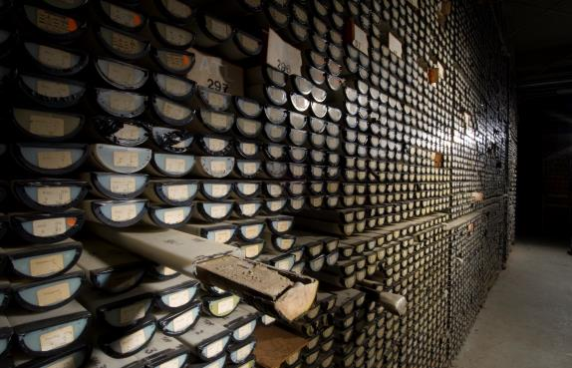
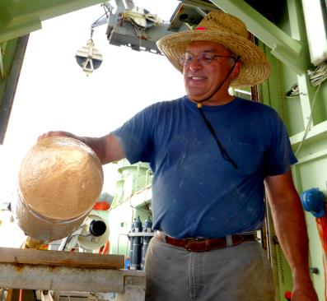
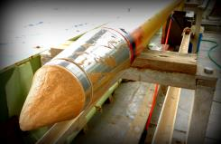


WHOI SEA FLOOR SAMPLES LABORATORY

Slide 2
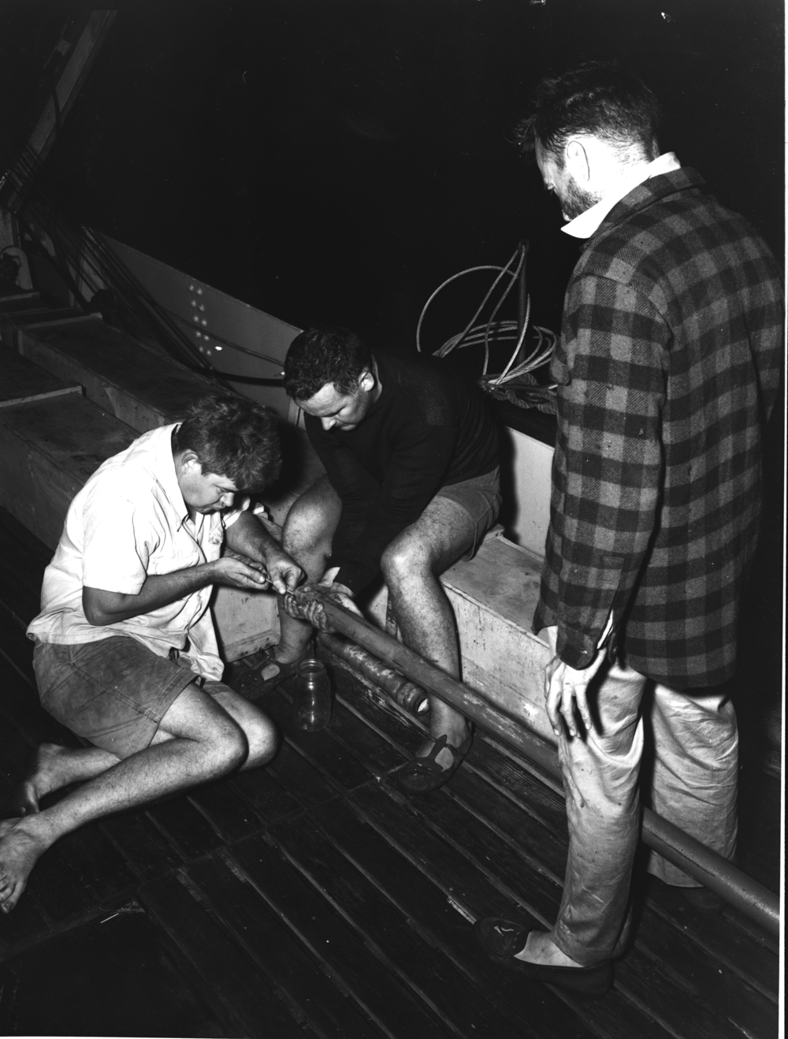
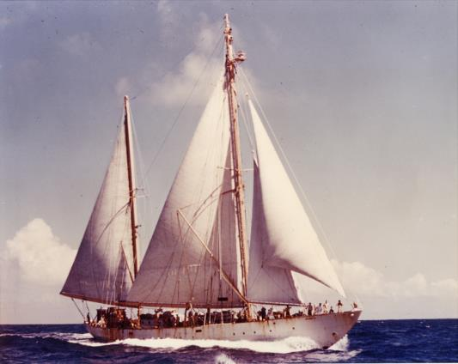
FIRST CORES AND DREDGES COLLECTED FROM
ATLANTIS 1947. EWING AND ERICSON.

Slide 3
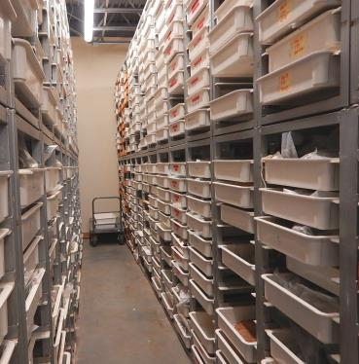
OLDEST CORES @ WHOI TAKEN FROM ATLANTIS IN 1956 .
‘DESC’ established 1968
COLLECTION TODAY = 21,400
10
17
42
29

Slide 4
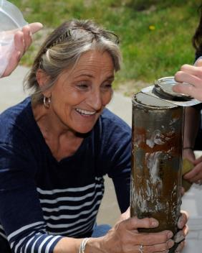
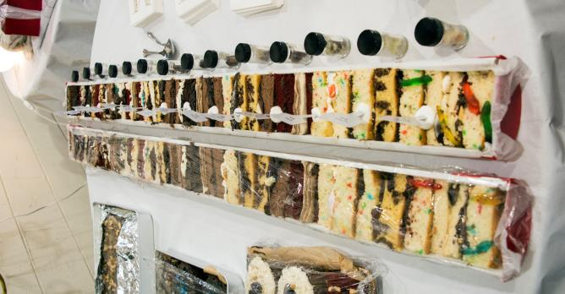
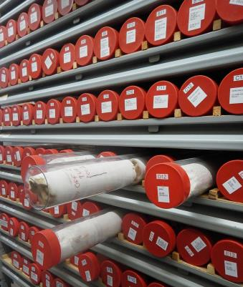
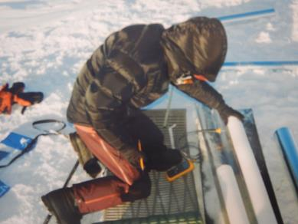

Slide 5
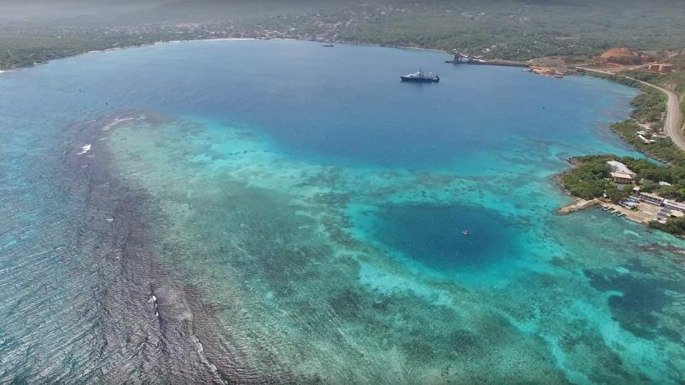
RECENT ADDITIONS
DISCOVERY BAY JAMAICA– VIBRA CORES JPC’S

Slide 6
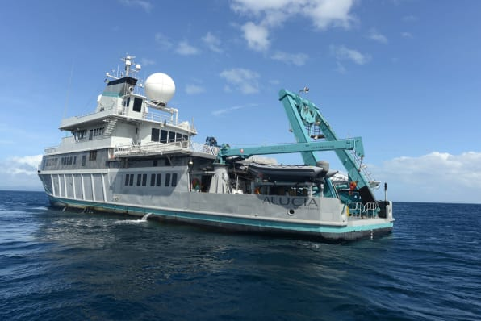
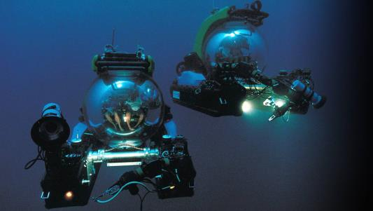
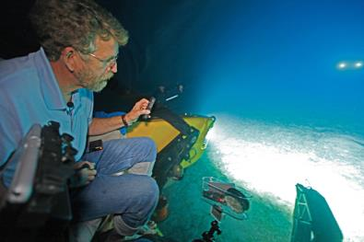
TRITON SUBS 1000 meter max.
RECENT ERUPTIONS GALAPAGOS

Slide 7
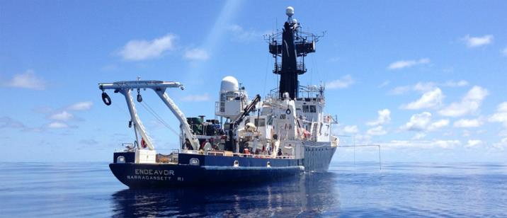
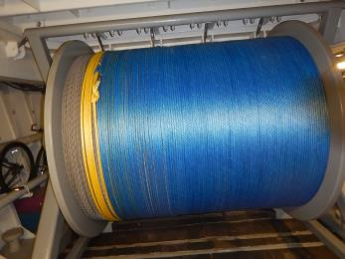
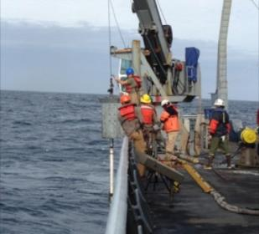
HI MODULUS ROPE TEST BIG BERTHA GRAVITY
CORES

Slide 8
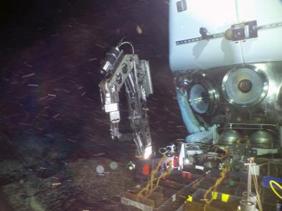
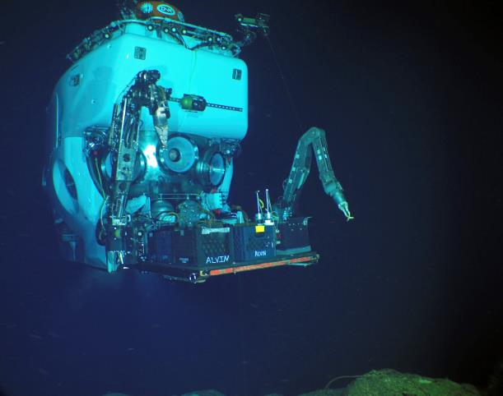
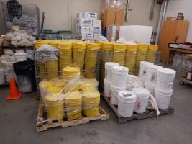
EPR SEAMOUNTS
4.6 TONS BASALT

Slide 9
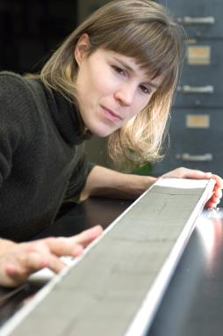
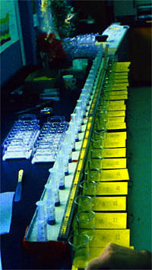
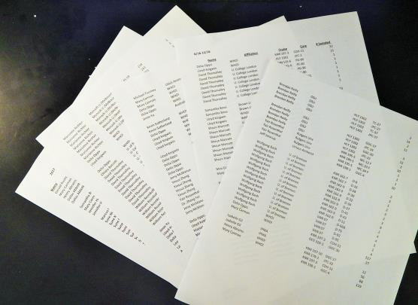
SAMPLE DISTRIBUTION
AVERAGE ANNUAL = 5,000 -6,000 DISCREET SAMPLES
‘16-’17 TO DATE = 3655…… 54 AFFILIATIONS
65% EXTERNAL ….. 78% SEDIMENT SUBS

Slide 10
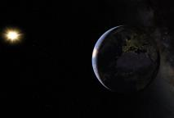
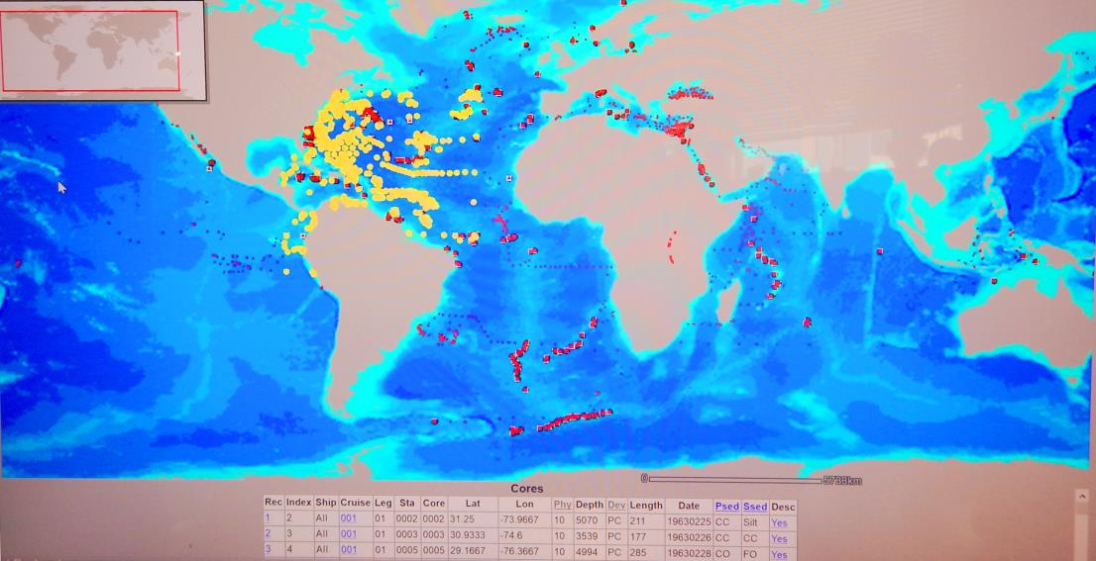
http://gis1server.whoi.edu/website/SC2k/viewer.htm
MUDDIE circa 1973
https://www.ngdc.noaa.gov/mgg/curator/

Slide 11
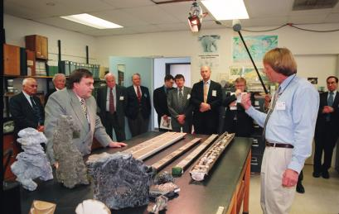
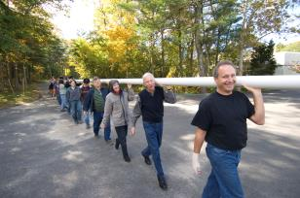
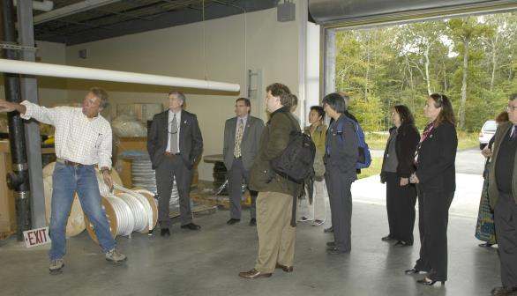
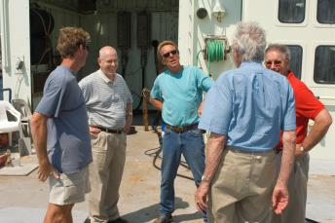
OUTREACH
2-3 ‘OFFICIAL’ TOURS PER MONTH
STUDENTS POST-DOCS TRUSTEES JOURNALISTS DONORS

Slide 12
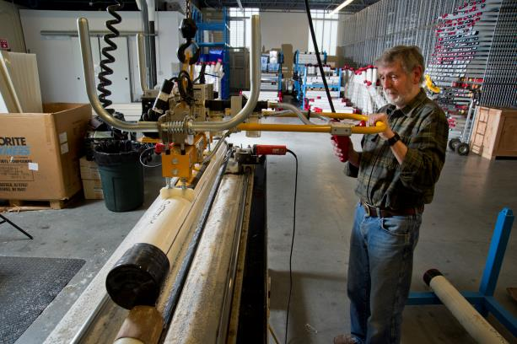
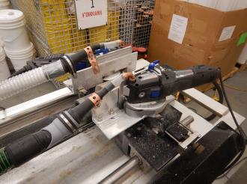
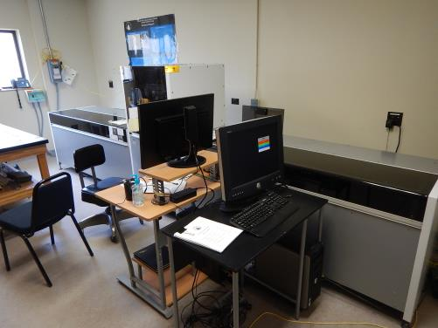
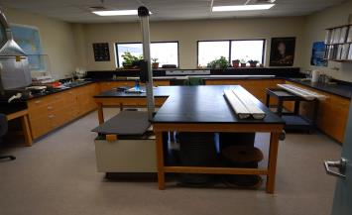
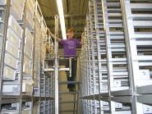
SPLITTER MODS
XRF SCANNER
VACU-LIFT
HI-DEF DIGITAL

Slide 13
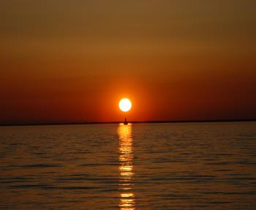
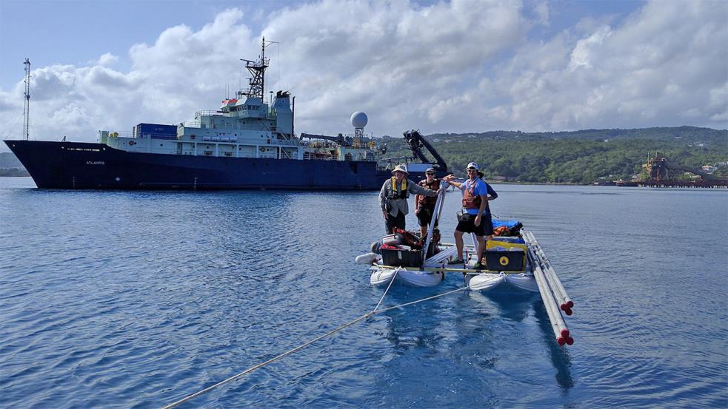
FUTURE >
CAT SCANNER
GEOTEK MSCL
IN – HOUSE $$$
NEW HAT

