Slide 1
Autonomous Aerial Vehicle
Oregon State
University Robotics Club

Slide 2
International Aerial Robotics Competition Mission 6
- Indoor Autonomous Aerial Vehicle
- Enter building through window
- Navigate using signs
- Avoid Various Obstacles
- Locate and Retrieve USB Flash Drive
- Exit Building

Slide 3
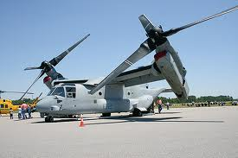
Flight Platform
Osprey Aircraft Design
Two primary motors mounted on two servos
Flight Controller Utilizing IMU
Simple Construction

Slide 4
Navigation
Localization and Mapping
  Infrared sensors mounted on servos
  Beacon Triangulation
Computer Vision
  Wireless Camera
  Identify Signs and Directions
  Locate Flash Drive

Slide 5
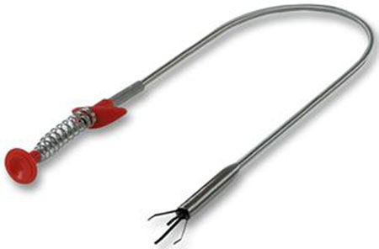
Flash Drive Pickup
Metal filaments in Tube
Sprung to spread out when exiting tube
Acts as claw to pickup flash drive
Electromagnet

Slide 6
Schedule
February 2011
  Stable Flight Platform
April 2011
  Mounted on Flight Platform
    Flash drive Pickup Mechanism
    SLAM implementation
    Computer Vision
July 2011
  Refined Competition Product

Slide 7
Team Members
Project Lead – Daniel Miller
Mechanical Lead – Kell Thomsen
Software Lead – Nick Kelly
Brad Nelson
Erik Lane
Jack Yslinger

Slide 8
Materials and Costs

Slide 9
Supporters
Boeing
Garmin
HP
Oregon State University College of Engineering (OSURC)
Sunstone Circuits
Atmel
Professor Kagan Tumer
Oregon Space Grant

Slide 10
Conclusion
Autonomous Aerial Vehicle team has a plan
Dedicated team members
Needs your help!
  -Parts
  -Design Review
  -Funding

