Slide 1

Capstone Spring 2018 Final Presentation
Scott Merrill, Andrew Ekstedt, and Scott Russell

Slide 2
The Secret Bunny Team:
Privacy Preserving Cloud & Email Encryption
Notes:
SR

Slide 3

Privacy Preserving Cloud & Email Encryption
The ”Privacy Preserving Cloud, Email and Password Manager” Capstone project is a research-oriented project that aims to implement the DSSE scheme proposed by David Cash.
CC0 Creative Commons
No attribution required

Slide 4
Project Summary / Expo pitch
Equifax breach -> what happens if someone breaches google drive
Solution: searchable encryption
Store encrypted data on a server and be able to efficiently search it without the server knowing about it
We are comparing how fast encryption algorithms can search through an encrypted database

Slide 5
What we accomplished
Researched searchable encryption
Implemented Cash-DSSE
Search, add, update, delete
Optimization variants of Cash-DSSE
Basic, packed, pointer
Benchmarks
Small and medium-size datasets
Compare against IM-DSSE
Created a demo app
Presented at Expo

Slide 6
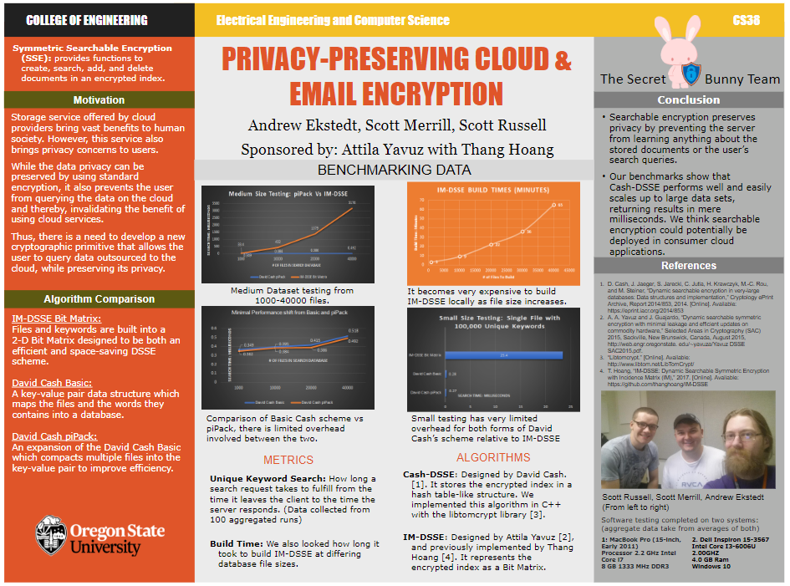

Slide 7
Requirements recap
Implement Cash-DSSE
Implement Client/Server
Implement Optimizations: packed, pointer, 2-level pointer
Benchmark against IM-DSSE

Slide 8
How it works

Slide 9
How it works
hello | 7
world | 7,11
goodbye | 11

Slide 10
How it works - Basic scheme
{1}hello | 7
{1}world | 7
{1}goodbye | 11
{2}world | 11

Slide 11
How it works - Basic scheme
1fa74619e | 5501749b
2750ecd1 | 90999a17
73918274 | 182aaab1
88bbe190 | b1004918

Slide 12
How it works - Packed scheme
{1}hello | 7
{1}world | 7,11
{1}goodbye | 11

Slide 13
How it works
1fa74619e | 5501749bc1746293
2750ecd1 | 90999a17008ab142
73918274 | 182aaab105a05abd

Slide 14
How it works - Pointer scheme
hello | 7
world | 7,11
goodbye | 11

Slide 15
How it works - Pointer scheme
hello | 2
world | 0
goodbye | 1
0 | 7
1 | 7,11
2 | 11

Slide 16
How it works - Pointer scheme
hello | 2,3,4
world | 0
goodbye | 1
0 | 7
1 | 7,11
2 | 11,1,18,19
3 | 21,34,54,6
4 | 30

Slide 17
How it works - Pointer scheme
1fa74619e | baababababab...
2750ecd1 | 0a1b2c3d4e5f...
73918274 | 8188aa9a9911...
0 | 5501749bc174...
1 | 90999a170089...
2 | 182aaab105a0...
3 | a21034b54c68...
4 | 773012381aab...

Slide 18
Demos

Slide 19
Code walkthrough / Demos
Core DSSE / Search Webpage Demo (AE)
Optimizations (SM)
Pack recap
Ptr - Code status and complications
Lvl2 - expected expansion
Benchmarks (SR)
Extras
Web app demo
UI optimizations

Slide 20
Benchmarking Hardware
Software testing completed on two systems:
MacBook Pro 2.2 GHz Intel Core i7 Ram: 8 GB OS X 10
Dell Inspiron 2.0 GHz Intel Core i5 Ram: 4 GB Windows 10
scott was here :)
Notes:
SR

Slide 21
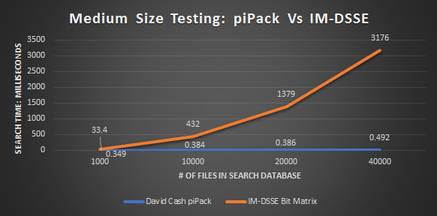
Benchmark Results
Notes:
SR

Slide 22
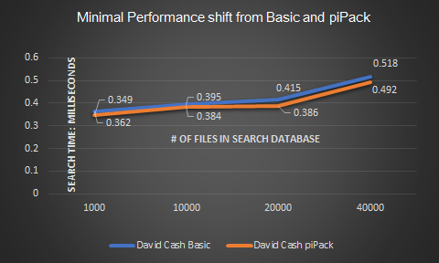
Benchmark Results: Continued
Notes:
SR

Slide 23
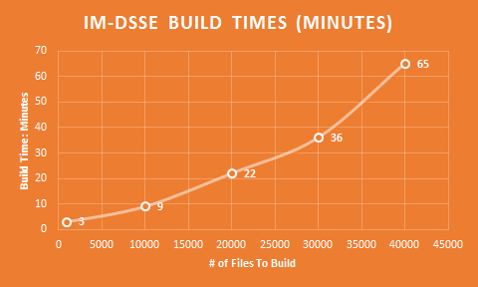
Benchmark Results: Continued
Notes:
SR

Slide 24
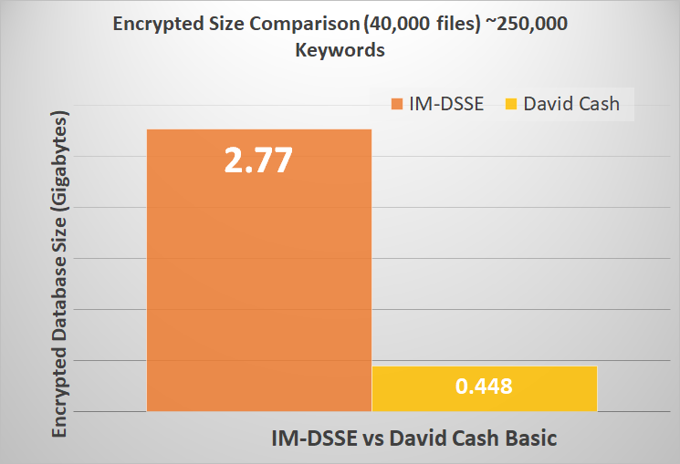
Benchmark Results: Continued
Notes:
SR

Slide 25
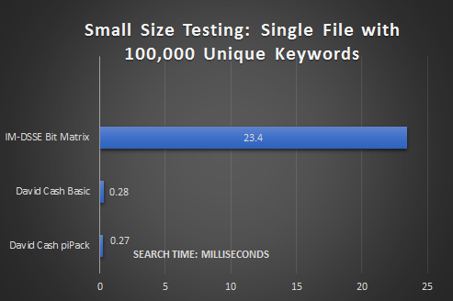
Benchmark Results: Continued
Notes:
SR

Slide 26
Requirements redux
Implement Cash-DSSE ✔
Implement Client/Server ✔
Implement Optimizations to Cash-DSSE:
packed ✔, pointer ✔, 2-level pointer ☹️
Benchmark against IM-DSSE ✔
Small Database ✔
Medium Database ✔
Encrypted File Size Comparison ✔

Slide 27


The Future!
Pointer Benchmarking
Level 2 pointer Optimization
Large Dataset Comparison (Wikipedia Plain Text dataset)

Slide 28
fin

