Slide 1
Capstone Progress Report
Winter 2017 Midterm
Andrew Ekstedt
Scott Merrill
Scott Russell

Slide 2

The Secret Bunny Team:
Privacy Preserving Cloud & Email Encryption
Notes:
SR

Slide 3
Project overview

Slide 4

Privacy Preserving Cloud & Email Encryption
The ”Privacy Preserving Cloud, Email and Password Manager” Capstone project is a research-oriented project that aims to find a way to implement the DSSE scheme proposed by David Cash.
CC0 Creative Commons
No attribution required

Slide 5
Last term (recap)

Slide 6
Current Progress

Slide 7

What we’re working on currently
DSSE Algorithm
POP3 Email Integration
Tokenization
Update/Delete

Slide 8
Future plans

Slide 9
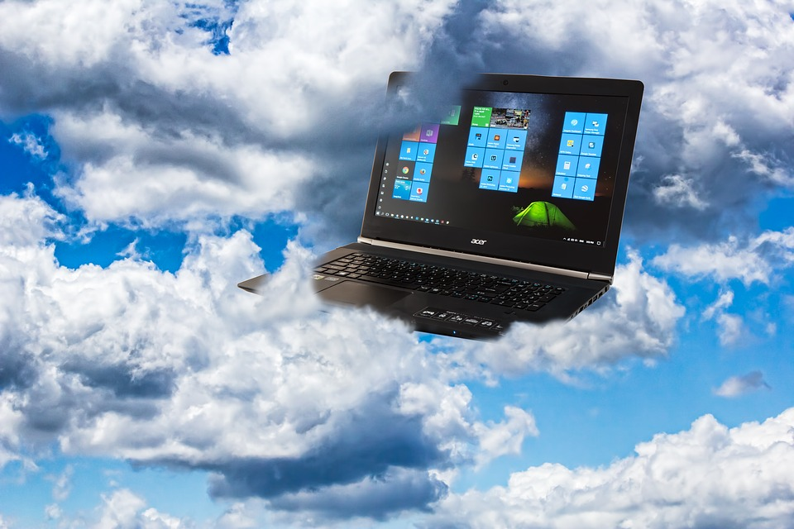
Future Project Implementations
Cloud Integration
Benchmarking
Parallelization/Optimization

Slide 10

Retrospective

Slide 11
Problems
mysterious linker errors with mailio and boost
getting gmail to send repeated emails for testing
meeting problems
TA MIA
Attila sick week 3
Team communication/meetings

Slide 12
What went well?
Our code compiles :)
Successful implementation of Libraries
Discussion Progress with Client/TA

Slide 13
Plans for 2nd half of Term
Our client has sent us in a small change of focus
Our main focus is getting the three levels of the core DSSE implemented.
The idea behind this, is the core DSSE is the more challenging part and the most important for research purposes.
Optimization and Implementation of Cloud/Server will come after, as they are not the main reason for this project.

Slide 14
Live Demos

Slide 15
POP3 Email Demo
Mailio Library
Email Setup
Script Examples for pulling emails.

Slide 16
Client/Server demo
Live demo of client/server interaction
Code walk-through

Slide 17
Planning for Engineering Expo

Slide 18

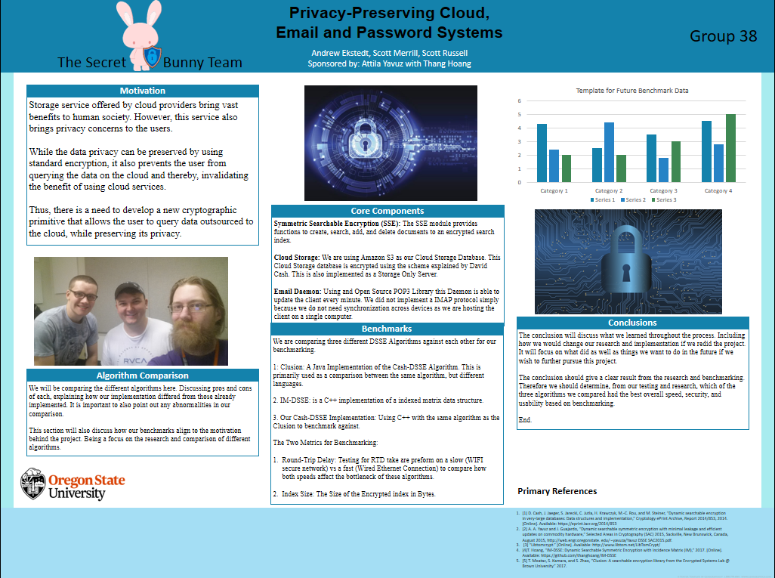
What we plan to do to display our code at expo
Things we may need
Anything we still need to work out:
Example: Is there going to be a live display?

Slide 19
Conclusion

Slide 20
Image Sources
https://pixabay.com/en/analytics-information-innovation-3088958/
https://pixabay.com/en/keyboard-key-success-online-621830/
https://pixabay.com/en/cloud-computing-computers-2116773/
https://pixabay.com/en/rabbit-characters-pink-cute-animal-2403904/
https://pixabay.com/en/whiteboard-white-board-blank-303145/
All images are licensed under Creative Commons CC0
Notes:
AE

