Slide 1
COMPASS
Cardinal Orientation Manipulation and Pattern-Aware Spatial Search
ACM SIGSPATIAL GEOSEARCH WORKSHOP
Kent O’Sullivan | Nicole Schneider | Hanan Samet
13 Nov 2023

Slide 2
Presentation Scope
Overview.
Background and current limitations.
Location-centric spatial pattern matching.
Object-centric spatial pattern matching.
Demo of COMPASS algorithms and data structures.
Conclusion and future directions.

Slide 3
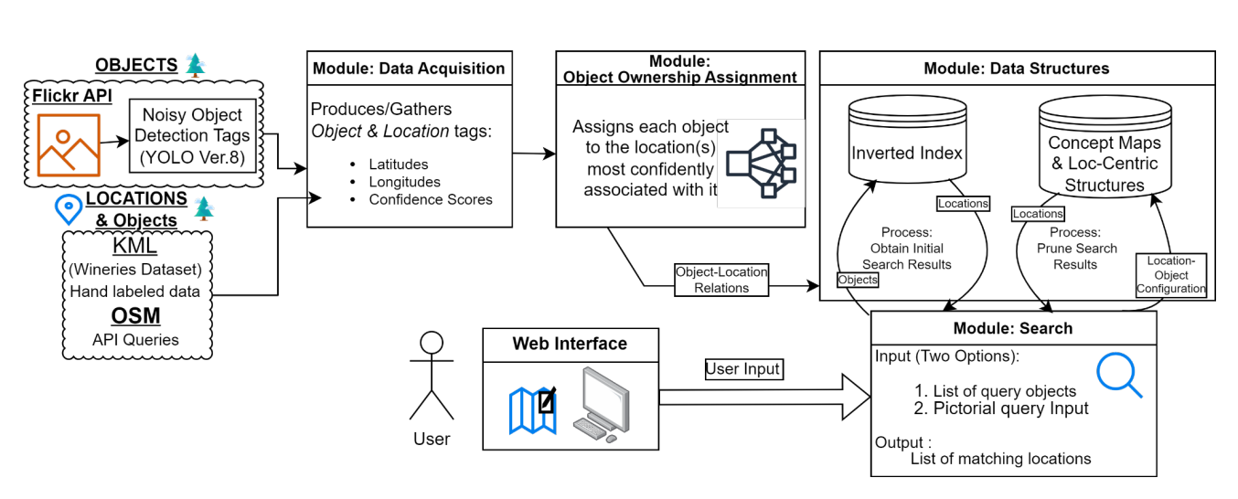
GESTALT Architecture
Data Structures & Search

Slide 4
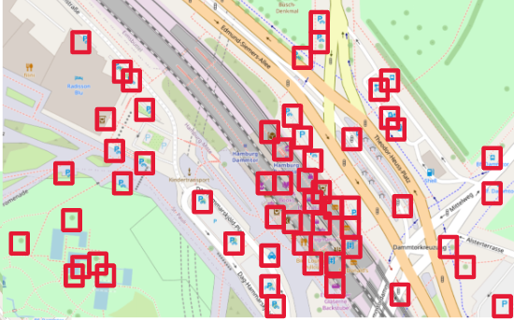
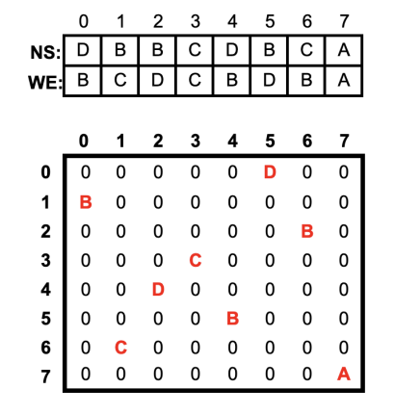
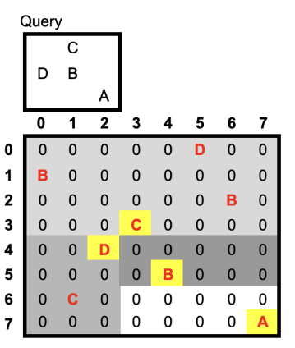
COMPASS provides scalable Spatial Pattern Matching (SPM)
Enables spatial search over objects and locations
Data structure: Matrix-based encoding of relative object positions
Search: Recursively prunes the matrix until a match is identified
←
←
Collect.
Encode.
Search.

Slide 5
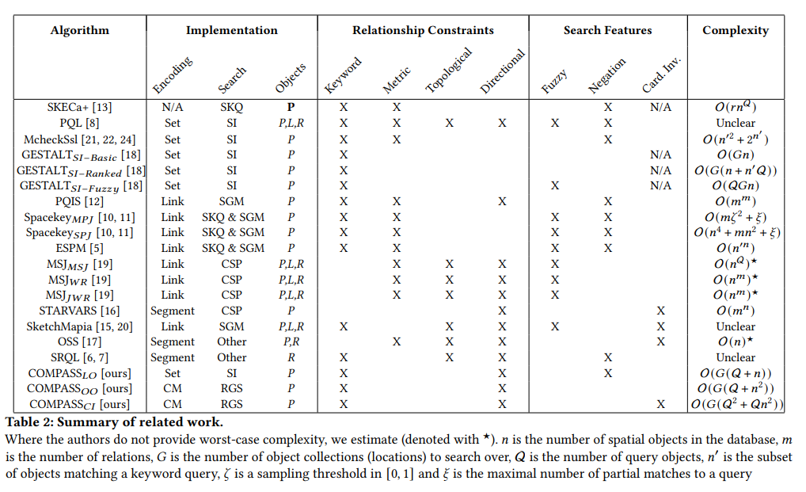
Most approaches to SPM are at least cubic in complexity
Keyword, metric, and topological constraints:
Ignore critical spatial information
Directional constraints:
Encode spatial patterns as pairwise constraints

Slide 6
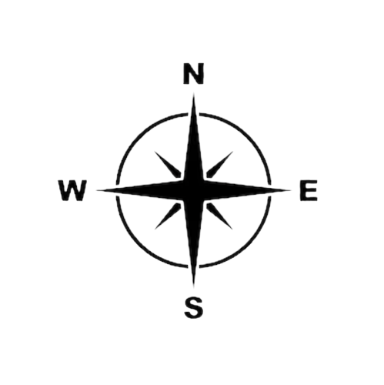
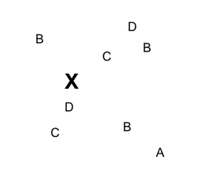
Location-Centric Spatial Pattern Matching
Given a known set of objects and how they each relate to a central location…

Slide 7
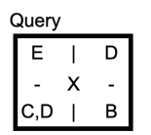
Location-Centric Spatial Pattern Matching
Given a known set of objects and how they each relate to a central location…
… and a sketch map or pictorial query…

Slide 8
Location-Centric Spatial Pattern Matching
Given a known set of objects and how they each relate to a central location…
… and a sketch map or pictorial query…
… determine which known locations are a match for the query.

Slide 9

COMPASS: Cardinal Orientation Manipulation and Pattern-Aware Spatial Search
Searching for objects by their directional relations to their associated location

Slide 10
Object-Centric Spatial Pattern Matching
Given a known set of objects arranged in a spatial pattern…

Slide 11

Object-Centric Spatial Pattern Matching
Given a known set of objects arranged in a spatial pattern…
… and a sketch map or pictorial query…

Slide 12
Object-Centric Spatial Pattern Matching
Given a known set of objects arranged in a spatial pattern…
… and a sketch map or pictorial query…
… determine if the query matches at least one set of known objects.

Slide 13
COMPASS: Cardinal Orientation Manipulation and Pattern-Aware Spatial Search
Searching for objects recursively by their directional relations to other objects

Slide 14
Cardinality-Invariant Object-Centric Spatial Pattern Matching
Given a known set of objects arranged in a spatial pattern…
✖
… and a sketch map or pictorial query…
↺
… determine if any orientation of the query matches at least one set of known objects.

Slide 15
COMPASS: Cardinal Orientation Manipulation and Pattern-Aware Spatial Search
Searching for objects by their directional relations to other objects, regardless of cardinal orientation of the query

Slide 16
Future directions
Extend COMPASS to find all instead of any match to the query pattern.
Extend our theoretical analysis of COMPASS with an empirical comparison against related works.
Investigate if the COMPASS matrix-based embedding can be extended to support line and region data.

Slide 17
Questions
Kent O’Sullivan | osullik@umd.edu
Nicole R Schneider | nsch@umd.edu
Hanan Samet | hjs@cs.umd.edu

