Slide 1
A Framework For Benchmarking Graph Based Artificial Intelligence
Thesis Defence
Kent O’Sullivan
Advisor: Prof Bill Regli
17 Apr 24

Slide 2
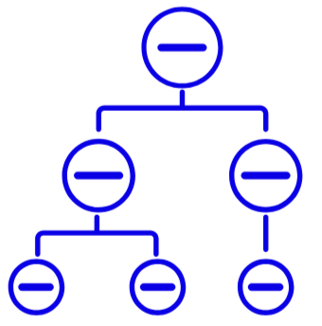



A Framework for GraphAI Benchmarking
The core contributions of this research are:
GraphAI
Taxonomy
Benchmark
Methodology
Population Segmentation
Benchmark
Effectiveness/Efficiency Analysis
Notes:
Abstract slide → Give viewers the ‘mad minute’ summary of what the thesis was about.

Slide 3
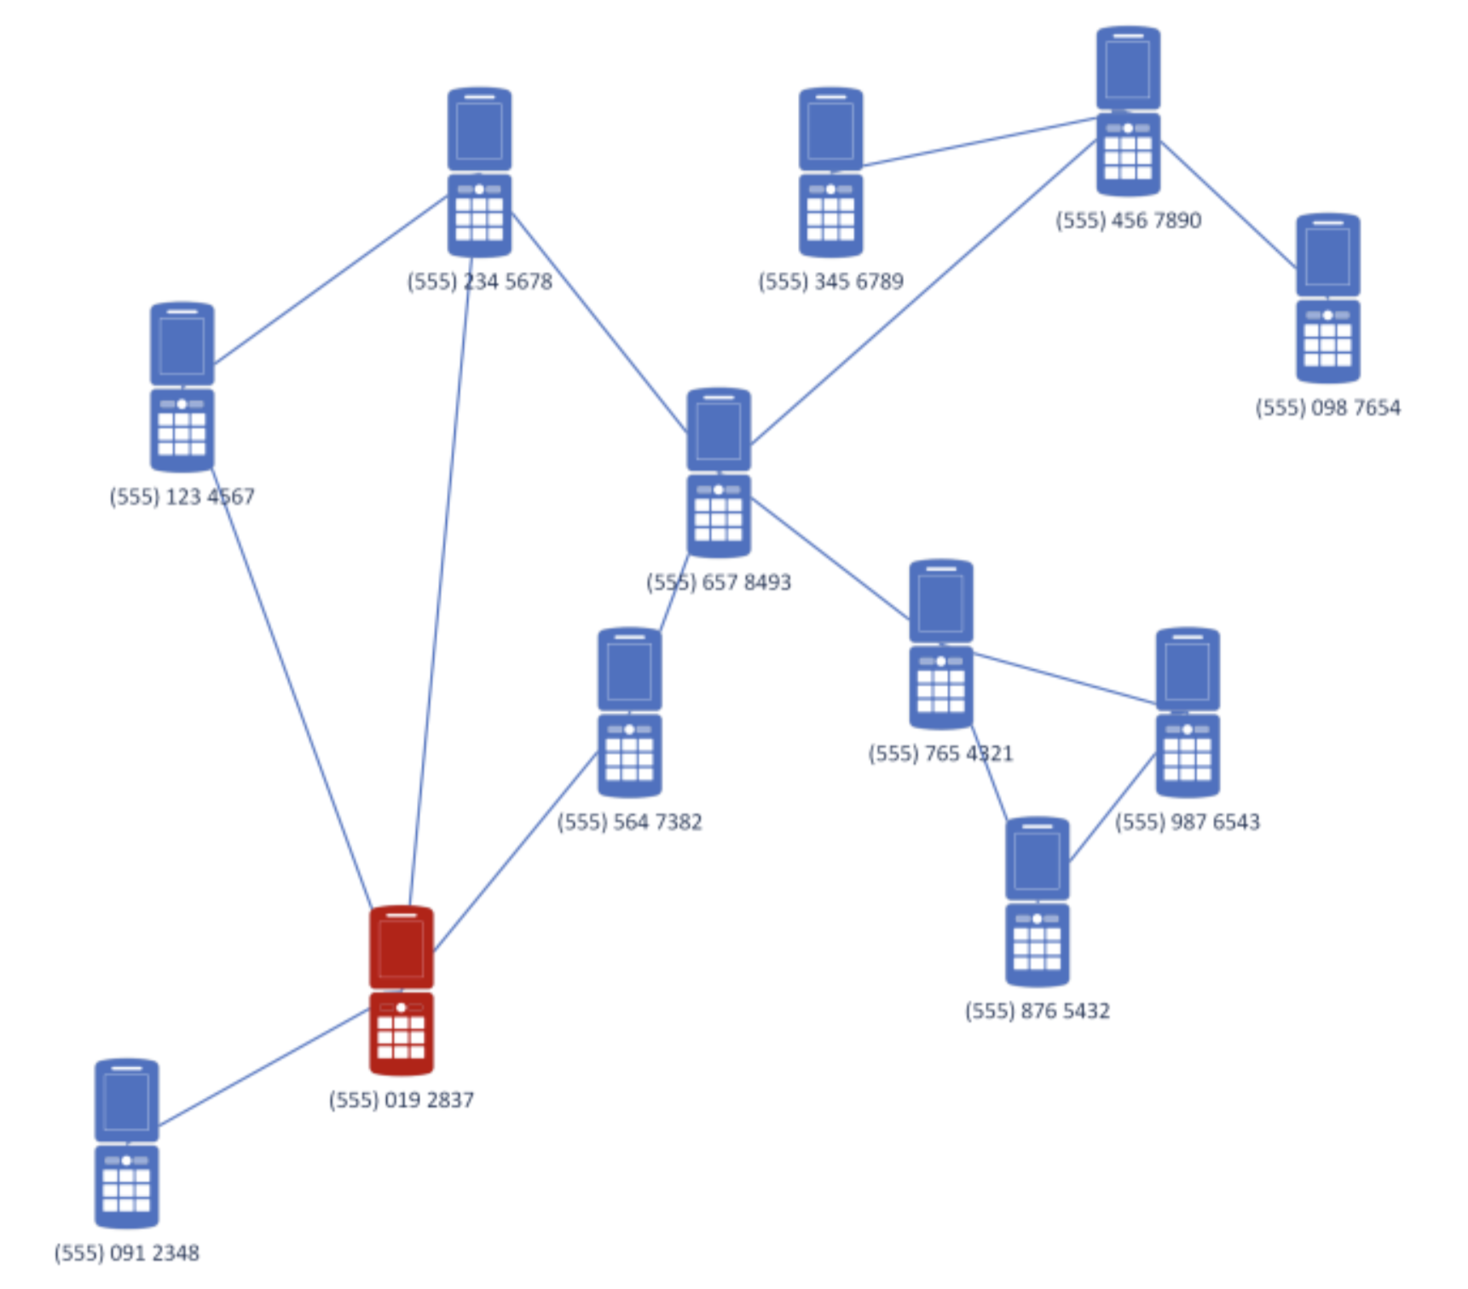
This is a graph
Phones are vertices and calls edges
Graphs (& GraphAI) solve many problems
Image Sources
https://www.researchgate.net/figure/Communication-network-diagram-between-construction-units-concerned_fig2_261094786
https://journalofbigdata.springeropen.com/articles/10.1186/s40537-019-0264-6

Slide 4
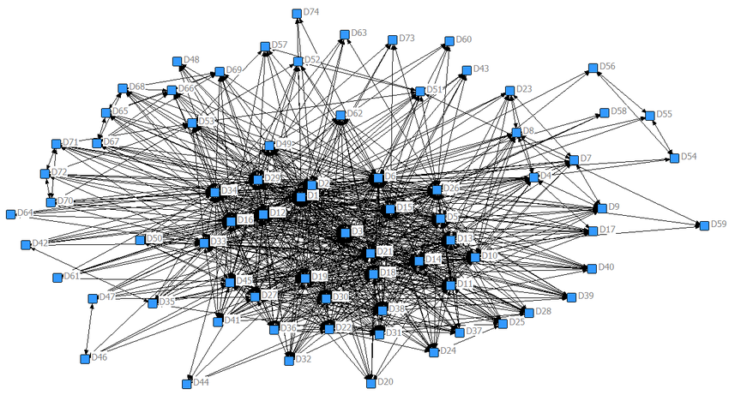
This is a graph
Phones are vertices and calls edges
Graphs (& GraphAI) solve many problems
But. Graphs get big and complex
Image Sources
https://www.researchgate.net/figure/Communication-network-diagram-between-construction-units-concerned_fig2_261094786
https://journalofbigdata.springeropen.com/articles/10.1186/s40537-019-0264-6

Slide 5
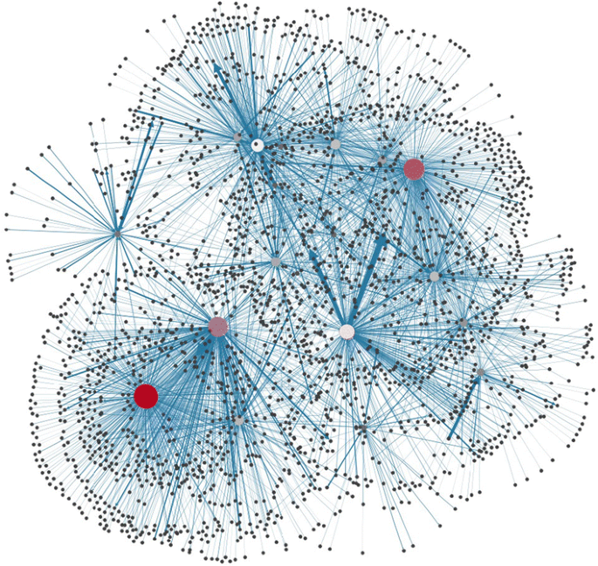
This is a graph
Phones are vertices and calls edges
Graphs (& GraphAI) solve many problems
But. Graphs get big and complex
… really big
Solving problems gets slow on big graphs
We can speed up problem solving by:
Distributing
Parallelizing
Compressing
Upgrading hardware
Adding accelerators
Approximating
Image Sources
https://www.researchgate.net/figure/Communication-network-diagram-between-construction-units-concerned_fig2_261094786
https://journalofbigdata.springeropen.com/articles/10.1186/s40537-019-0264-6

Slide 6
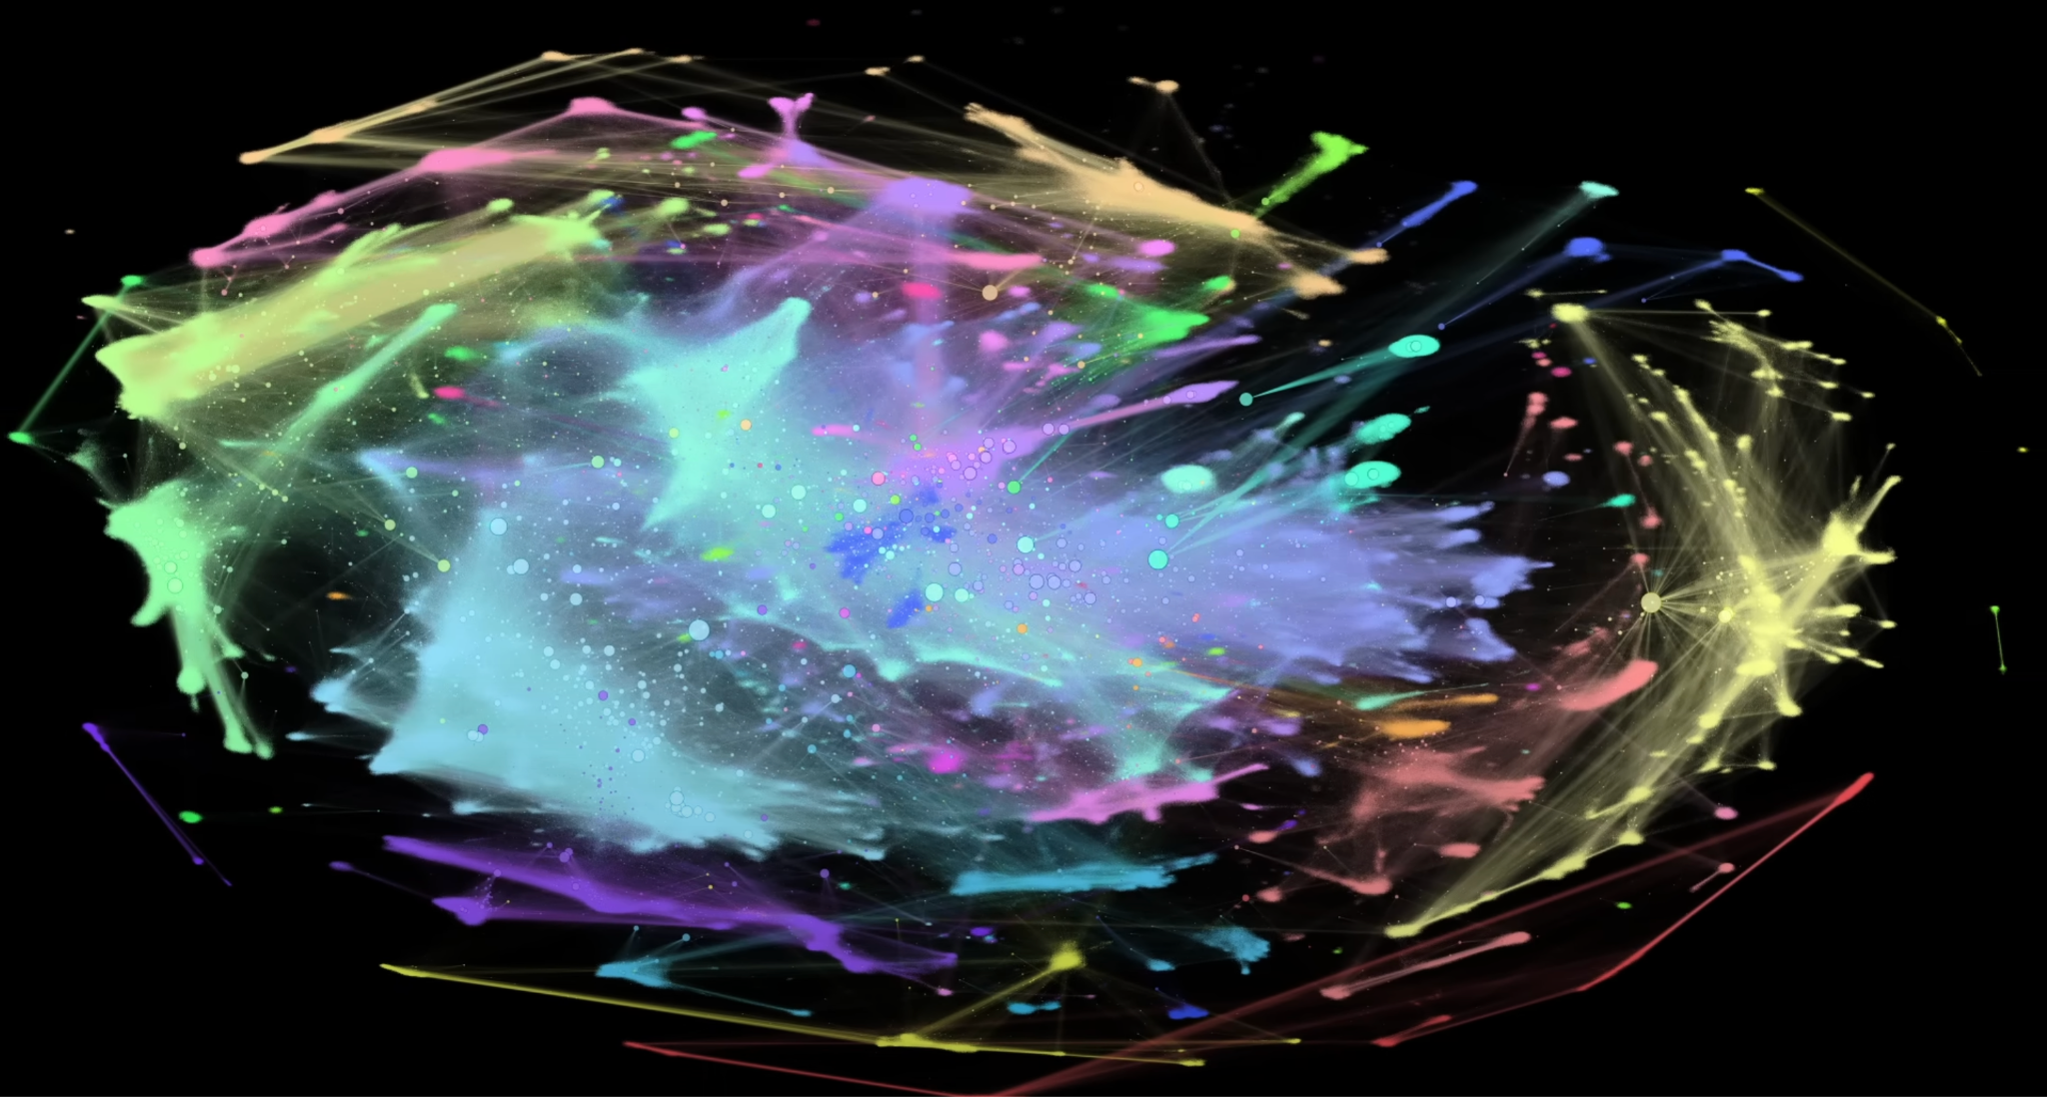
What if there was a way to compare the impact each improvement has on a system that solves problems with GraphAI?
So that we can consistently improve GraphAI performance while justifying our investments empirically.
For example, determining the cost effectiveness of adding hardware accelerators versus distributing the work to reduce processing time.
Further, a repeatable process can be easily extended to all problems in the GraphAI taxonomy.
Image Source: https://www.youtube.com/watch?v=JheGL6uSF-4

Slide 7
Agenda
Introduction
  Problem Definition
  Prior Work
  Novelty
  Impact
GraphAI Benchmarking
  GraphAI Taxonomy
  GraphAI Challenges
  The GraphAI Benchmarking Framework
  The GraphAI Benchmark Problem Development Methodology
Case Study
  Developing a Population Segmentation Problem Benchmark
  Findings
Future Work

Slide 8
INTRODUCTION

Slide 9
Introduction: Problem Definition
This thesis aims to determine if, how and when to speed up problem solving on linked data given a set of operating constraints.
How: to effectively combine the representations, hardware accelerators and algorithms.
If & When: it is appropriate to exploit acceleration to speed up the time to solution.
Constraints: on the efficiency, effectiveness and/or cost of a solution.
Notes:
Heilmeier Number 1:
What are you trying to do? Articulate your objectives using absolutely no jargon.

Slide 10
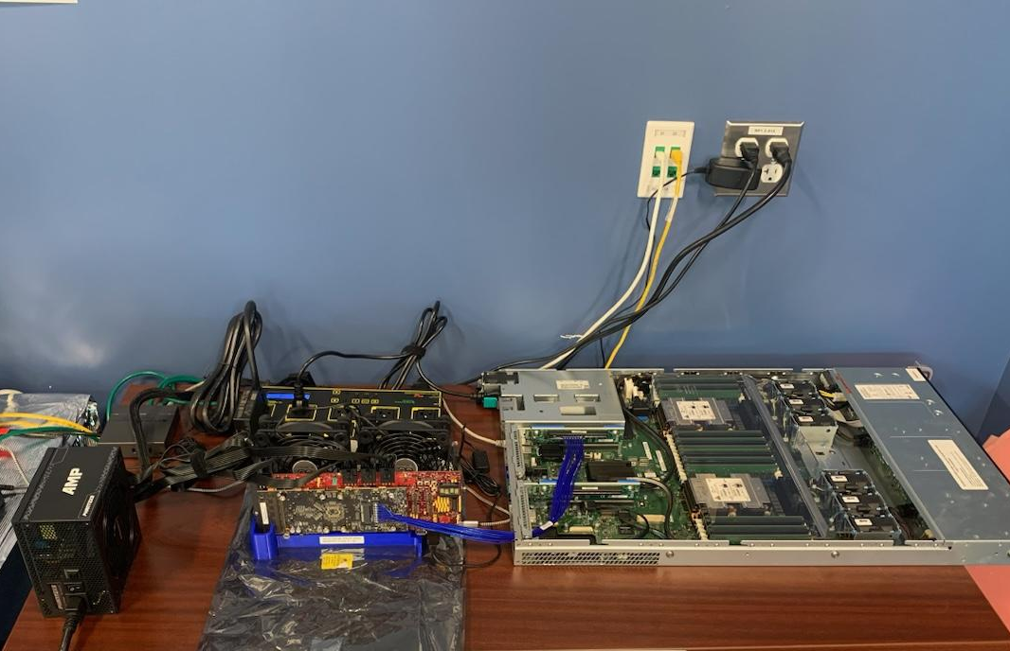
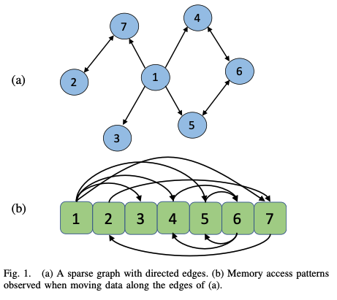
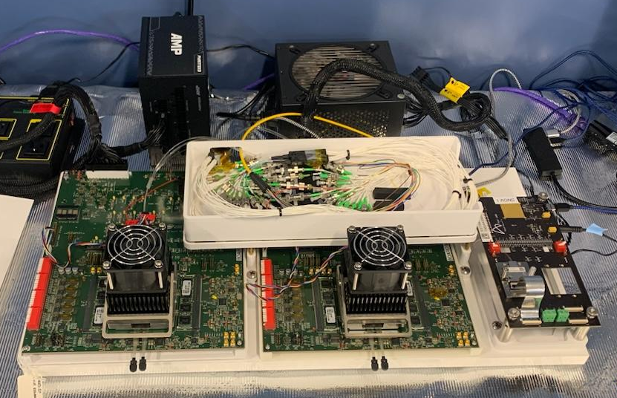
Introduction: Example Acceleration
The Intel PiUMA Software Development Vehicle
Prototype Graph Hardware Accelerators (right) aim to address
some of the causes of slowdown – but how well?
The Intel PiUMA Optical Interconnect System
Notes:
How did we get here?
This thesis research began with the aim to evaluate the performance of the Intel PiUMA hardware under the DARPA HIVE program.
Unfortunately, manufacturing faults in the Optical Interconnect led to an inability to test the Distributed Configuration on realistic workloads.
Further, the SDV had manufacturing faults that prevented it being used for testing.

Slide 11


Introduction: Prior Work
Race to maximize effectiveness or efficiency.
Focus on the kernels, and datasets rather than problems.
Lack variety of shapes & support for dynamic graphs
`Black-Box’
Benchmarks
Monitor internal system state to find bottlenecks
Require invasive system profiling & code instrumentation
Lack scalability
`White-Box’
Workload
Analyses
Notes:
Heilmeier Number 2:
How is it done today, and what are the limits of current practice?
\

Slide 12


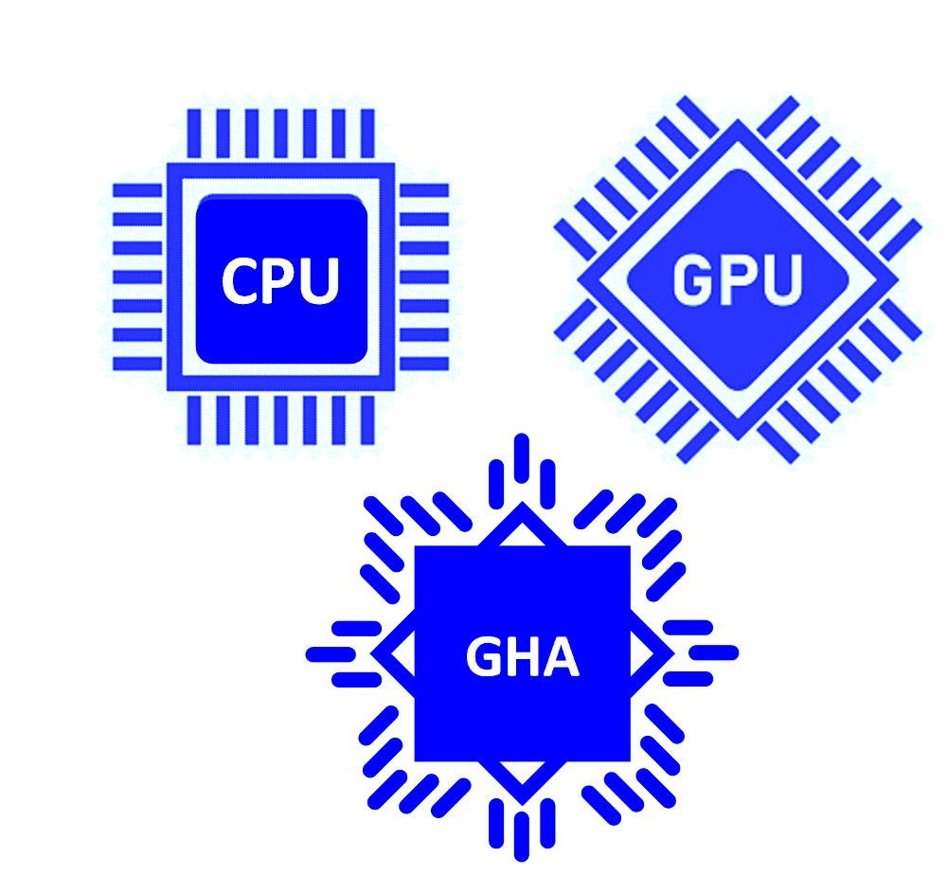

Introduction: Novelty
Our GraphAI benchmark framework builds on prior work by offering:
Balanced Benchmark
Problem Centric
Accelerator Agnostic
Efficiency vs Effectiveness
Notes:
Heilmeier Number 3:
What is new in your approach and why do you think it will be successful?
Balanced: General Utility of competitive benchmarks against the Detail of workload analysis without the invasive instrumentation.
Problem Centric: Focus on real world tasks, not kernel problems. E.g. “Find Mr Black’s 10 closest friends” vs “do BFS from node 123564 until frontier >- 10”
Accelerator Agnostic: Let someone bring any system they want, with any implementation they choose
Efficiency vs Effectiveness: Experimentally trade off efficiency of one approach with effectiveness of another

Slide 13



Introduction: Impact
The GraphAI Benchmark has broad utility to three key groups:
Analysts
Engineers
Researchers
Notes:
Heilmeier Number 3:
Who cares? If you are successful, what difference will it make?
Analysts: Understand how the GraphAI they employ performs in different circumstances
Engineers: Learn how many GraphAI behave on one system to make architectural choices.
Researchers: Study GraphAI performance to improve algos, representations and accelerators into the future.

Slide 14
The GraphAI Benchmark Framework

Slide 15







Our GraphAI Taxonomy
GraphAI
Graph Problem Solving
Graph Mining
Graph Reasoning
Graph Abstraction
Graph Prediction
Graph Transparency
Graph Search
Graph Matching
Common-Sense
Graph Embedding
Graph Neural Networks
Neuro-Symbolic AI
AI Planning
Community Detection
Ontological Inference
Representation Learning
KG Completion
RAG
Critical Path
Influence Mapping
KG Inference
Graph Generation
Graph Prediction
Post-Hoc Explanation
Related Work: https://chenxuhao.github.io/graphAI.html
Notes:
Explain The Taxonomy.
GPS: Classic AI tasks that formulate the world as a graph, for
example planning navigation routes and identifying the critical path through a project.
GM: AI tasks on graphs; graph mining. Analyze the structural characteristics of a graph.
Example: Spatial pattern matching or community detection.
GR: AI tasks that use graphs for inference:
Common sense reasoning, knowledge-graph question answering.
GA: Transforming graphs into other structures for downstream tasks
Embedding with Node2Vec or DeepWalk
GP: Learning directly on graphs, anything in the GNN family
E.g. Knowledge Graph completion, anomaly detection.
GT: Using graphs to make generative AI better
E.g. Grounding Generation in knowledge, capturing generation chains as graphs.
Key Takeaway: There are many tasks with many different needs; How do you balance the need to service many of them with constrained resources?
-> You need to optimize for the balance of efficiency and effectiveness.

Slide 16
GraphAI Benchmarking Challenges
nsch: “How, When, Constraints?” → “Trade-offs under constraints”?
If, How, When & Constraints?
Evaluation:
Effectiveness or Efficiency?
‘Racing’ systems or invasive analysis?
User:
Imposes Constraints
Accelerators are specialized
System:Problem ratio
Real World:
GraphAI problems behave differently
Acceleration is dependent on graph processing
GraphAI:
Graph Processing is Data Dependent
Lack of Spatial and Temporal Locality
No standard abstraction, representation or primitives
Graph:
Notes:
Graphs: The foundation of our challenges.
Processing is data dependent so it is challenging to predict how a GraphAI approach will behave without knowing the exact input.
As graphs get big we lose the ability to exploit caching and spend a lot of time waiting to retrieve neighboring parts of the graph from memory; the key bottleneck.
The lack of a standard approach to problems means there has been no standard approach to accelerating, and so comparing approaches becomes difficult.
GraphAI: Builds on Graphs
There are many problems in the taxonomy and each have their own computational challenges and limitations.
Accelerating GraphAI is typically bottlenecked by the amount we can accelerate graph processing components.
Real-World: The systems don’t exit in a Vacuum
The real world imposes efficiency, effectiveness and cost constraints e.g. a task needs to happen every hour but it takes an hour and ten minutes to complete needs to be sped up.
Accelerators are closely tied to the GraphAI task, abstraction, representation and primitives - Lack of standardization means that acceleration doesn’t improve GraphAI equally
One system must support many GraphAI tasks, meaning tradeoffs must be made.
User: Needs to make decisions:
Do they care about how fast or solution is created or how accurate it is.
Do we make those decision by racing systems in competitive benchmarks or by conducting invasive workload analysis.
Top of the pyramid calls back to the research question:
This thesis aims to determine if, how and when to speed up problem solving on linked data given a set of operating constraints.

Slide 17
A `Grey-Box’ approach to GraphAI Benchmarking
BLACK BOX
- Inputs known.
- System details unknown.
- Implementation unknown.
- Outputs evaluated.
GREY BOX
- Inputs known & designed to stimulate bottlenecks.
- System detail unknown.
- Implementation unknown.
- Outputs evaluated and analyzed to infer system and implementation detail.
WHITE BOX
- Inputs known.
- System detail known and instrumented.
- Implementation known and instrumented.
- Outputs rarely evaluated.
Notes:
Traditional Graph and AI benchmarks are `black box’ approaches that only controls the inputs and outputs of a system, which gives us a results but no understanding of How or Why that result occurred.
The Workload Analysis approach assumes total access to the system, generally requiring the use of profiling tools on the System Under Test and instrumentation of the implementation.
Our approach focuses on developing a `grey box’ approach, where we place no limitations on the system under test, but rather focus on the design of datasets and tasks that will stimulate bottleneck behaviours. Based on the observed input, output pairings, we can make inferences about the presence or absence of bottlenecks. In part this is based on the realization that the `data dependence’ of graph processing can actually be exploited for our benefit, rather than being a confounding variable in our analysis.
The grey box approach offers us a mechanism to understand the how and why of observed performance without needing invasive system access, freeing up system designers to use bespoke architectures, hardware and operating systems that may not otherwise be compatible with any instrumentation package.

Slide 18
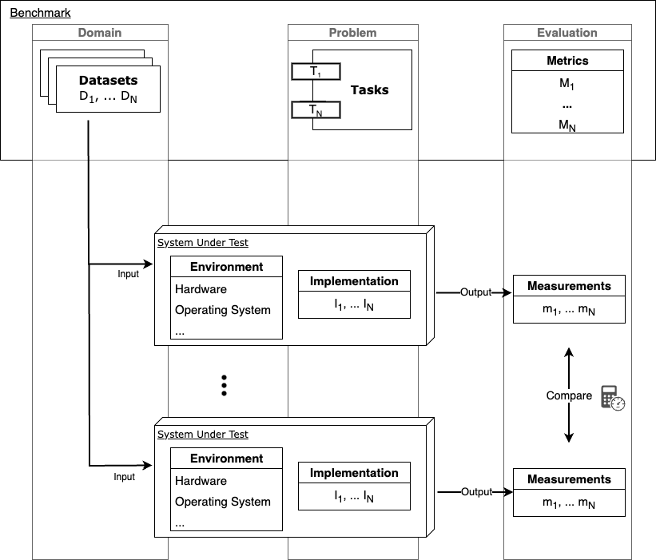
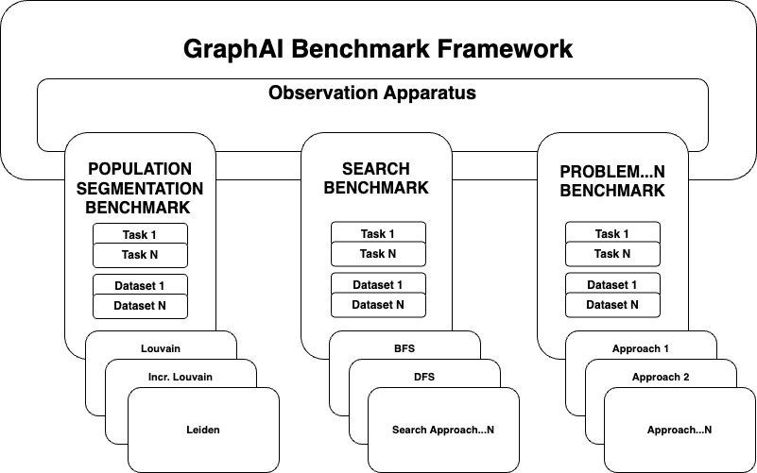
The GraphAI Benchmark Framework
A typical benchmark framework (left) underpins our GraphAI Framework (right)
Notes:
Define a benchmark.
Explain typical benchmark components [Abstract = Datasets, Tasks and Metrics] [Concrete = hardware, OS and Implementation]
Explain we want to be able to fix some components and vary the others to experiment with which combination gives us the best performance.
That’s what gives us the need for the GraphAI Benchmark Frameworks.
A framework for All GraphAI problems.
The framework consists of many independent benchmark problems. Each problem has a collection of tasks and datasets.
For each problem, many approaches can be tried; one of those approaches is the combination of a System and Implementation; where the system might be accelerated and the implementation can be any abstraction, representation and any combination of systems and implementations can exist.
A single observation apparatus stimulates the systems under test and collects the metrics.
The benchmark can evaluate the relative performance of systems, by applying multiple systems to the same problem (or problems).
It also allows for the strengths and weaknesses of a system to be explored, by running a single system against all problems.
Most importantly, the design of the benchmark allows us to experimentally vary components and trade-off between the efficiency and effectiveness to find the optimal system to meet all of our use cases.

Slide 19
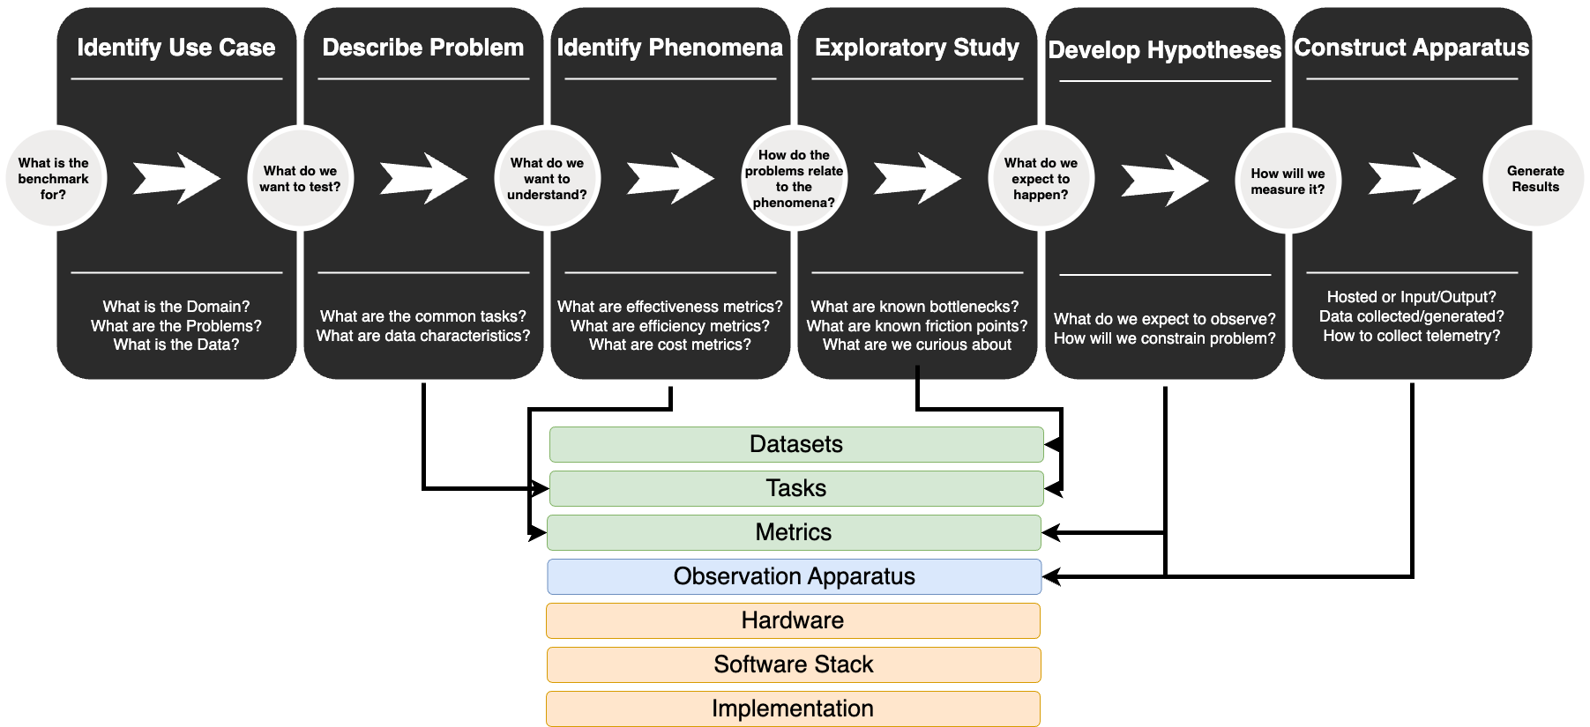
Graph AI Problem Development Methodology
We develop a formal empirical method to develop GraphAI benchmark problems:
Notes:
Goal: We want to balance the utility of general-purpose benchmarks with the expressiveness of workload analysis without incurring the invasive overheads.
Approach: We use an empirical approach and aim to design a constraint-based benchmark.
Explain The diagram:
Black is each step.
Circles are questions to focus work
Below the line are questions to focus output
Coloured components are the components of a benchmark that get built.
NOTE1. The arrows show how each step contributes.
NOTE2. We define the abstract components, not the concrete.

Slide 20
CASE STUDY
Applying the GraphAI Benchmark to Population Segmentation

Slide 21


Use Case
GraphAI
Searching, Planning and Scheduling
Structural Analysis
Graph Search
Graph Matching
AI Planning
Community Detection
Critical Path
Influence Mapping
An engineer architecting a new system needs to identify whether GPUs or specialized GHAs are a worthwhile investment for their GraphAI workloads given time and cost constraints.

Slide 22
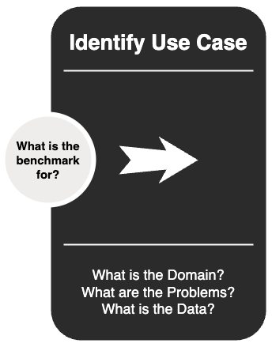
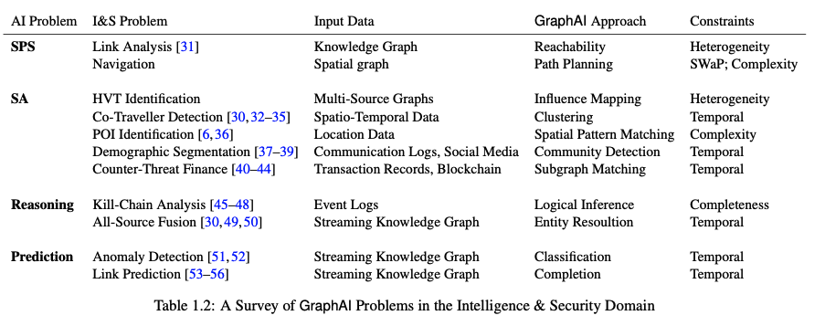
Step 1: Identify the Use Case
GPS
GM
GR
GP
A survey of Intelligence and Security use cases leads us to select Population Segmentation
Notes:
We surveyed existing work in GraphAI in the intelligence and Security domain and select Demographic (population) segmentation as a suitable GraphAI Problem.

Slide 23
Step 1: Identify the Use Case
Population Segmentation: Given a population, how can we divide it so that the most ‘like’ members are together?
Notes:
Population segmentation requires an organization to partition a given population into segments based on some criteria like political alignment, age, wealth etc.
It is used heavily in civil-military cooperation tasks, information operations and in the civilian context, marketing.

Slide 24
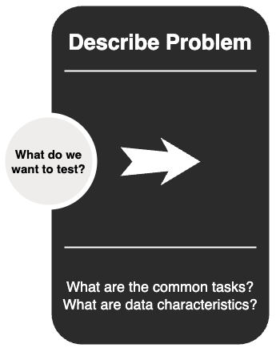
Step 2: Describe the Problem
Tasks:
Graph Partitioning
Graph Clustering
Community Detection
Dynamic Detection
Dataset Characteristics:
Scale-Free
‘Clique-y’ vs ‘Fuzzy’
Scale quadratic in Vertex Count
Attributed and Weighted
Notes:
Existing benchmarks can show how different partitioning approaches or different clustering approaches work; but they lack the general ‘problem’ focus we offer here. We can compare all these different ways of approaching the problem against each other

Slide 25
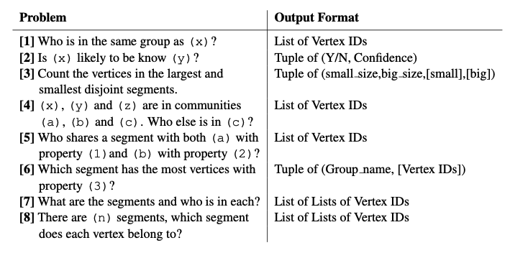
Step 2: Describe the Problem
Select problem-centric tasks and expected outputs for population segmentation.
Notes:
We create problems that are `general specifications’ rather than specific Kernels.
Each problem is framed as a natural language question, and specifies the return type.
The generality allows the SUT to use whatever method it likes to solve a problem.
For example, problem 7 could be solved with graph partitioning, graph clustering, label propagation or random guessing.
We only care about how quickly and how well the answer is provided.

Slide 26
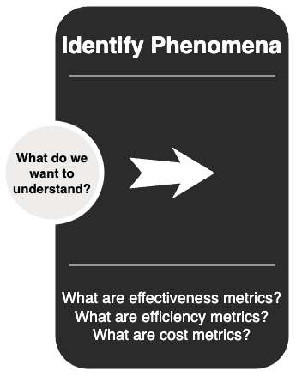
Step 3: Identify the Phenomena
Given the problem:
[7] What are the segments and who is in each?
We are interested in the phenomena:
What is the interaction between effectiveness and efficiency for population segmentation approaches?
Effectiveness Metric: Normalized Mutual Information of segments
Efficiency Metric: Batch Latency

Slide 27
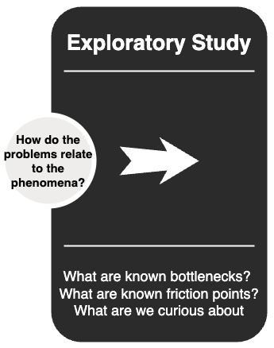
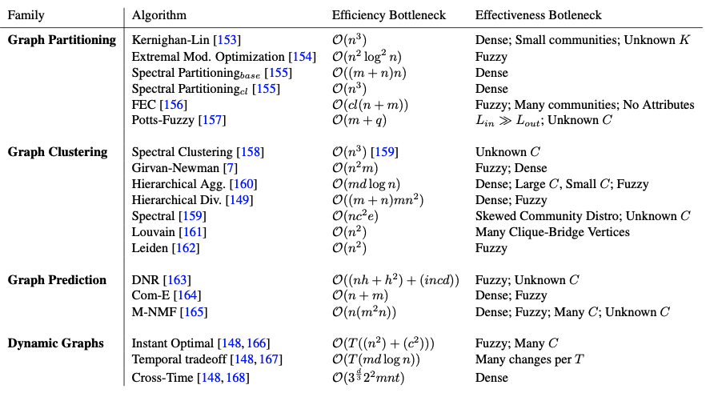
Step 4: Conduct Exploratory Study
n = number of vertices
m = number of edges
c = number of communities
i = number of iterations
t = number of timesteps
d = degeneracy of graph
A literature review of prior benchmarks, workload analyses & accelerator designs explores the problem
Notes:
We examine prior work in Community Detection (collection of work most closely related to population segmentation) and identify the efficiency and effectiveness bottlenecks that will inform our dataset design.

Slide 28
Step 4: Conduct Exploratory Study
Bottlenecks
Efficiency degrades most with size of graph
Effectiveness degrades most with fuzziness of communities
Friction Points
When the number of segments is not known
When a vertex can belong to many segments
When graphs are dynamic
Curiosities and Opportunities
Use of incremental and approximate approaches
Notes:
We find these features of datasets that will yield the most interesting datasets.

Slide 29
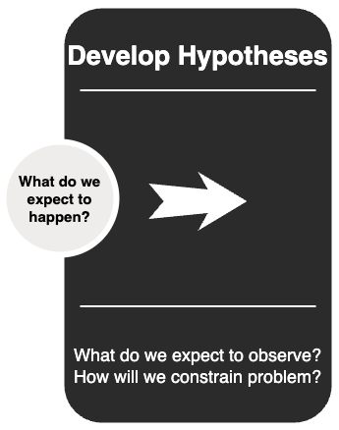
Step 5: Develop Hypotheses
GPU and other Graph Hardware Accelerator (GHA) hardware configurations will have a longer ETL time relative to the same input data and implementation on the baseline system.
GPU will have longer ETL time for scale-free input graphs than for mesh input graphs of the same size.
The effectiveness of each workload is independent of the hardware configuration used.
The BL of single-shot approaches will be equal to their ETL plus Ex Time for all inputs.
The effectiveness of an iterative or incremental implementation will improve monotonically over time as it converges to an optimal state.
Notes:
Hypotheses are
Hypotheses effectively formalize the mapping from input data to output characteristics and describe the nature of the bottleneck we expect to exist in a SUT if we observe a given input/output pair in the experimental results. For each hypothesis, we consider what system characteristic or bottleneck we want to stimulate and build a hypothesis about how to shape the input to trigger an observable change in the output compared to some baseline of performance.

Slide 30
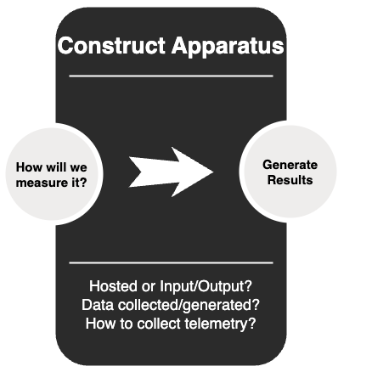
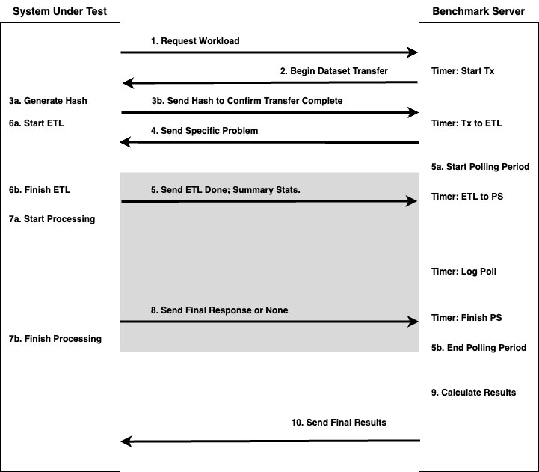
Step 6: Construct Apparatus
The apparatus is a system and approach-agnostic Input/Output model that measures effectiveness vs efficiency.
Notes:
The Observation Apparatus follows an Input-Output model to maximise the freedom of the SUT.
The grey box indicates the `Polling Period’. During this time the BS periodically asks the SUT for interim results. By collecting the interim results over time we can see which approaches can trade effectiveness for efficiency, and how the quality of results changes over time.

Slide 31
Collect Datasets
 | Mesh (Fuzzy) | 3 | 6 | 9 | 12 | 15
 | Random | 2 | 4 | 6 | 8 | 10
 | Scale- Free (Cliquey) | 1 | 2 | 3 | 4 | 5
 |  | Tiny (<60Mb) | Small (<16Gb) | Medium (<1Tb) | Large (<5Tb) | Huge (>5Tb)
 |  | >>> Efficiency Difficulty >>>
OSM-DE
OSM-RM
OSM-MD
OSM-WA
OSM-M
OSM-DC
>>> Effectiveness Difficulty >>>
Karate-Club
Cisco-Networks
Email-EU-Core
Wiki-Topcats
Orkut
Friendster
Notes:
We collect datasets to stimulate the efficiency and effectiveness limits of SUTs.
The Karate, Cisco, Email, Wiki-Topcats, Orkut and Friendster are all scale-free networks Sourced from the Stanford Large Network Data Repository.
The OSM datasets were generated by us, to contribute real-world mesh datasets based on road maps with ground-truth multi-level community labels based on the city and country membership.
We select the size thresholds as follows:
Tiny: Can be held entirely in the Cache of a median commercial system.
Small: Can Be held in the memory of a median personal computer.
Medium: Can be held in the memory of a median commercial system
Large: Can be held in the memory of a high-end commercial system
Huge: Larger than what can be held in the memory of most high-end commercial systems; should require distributed computing.

Slide 32
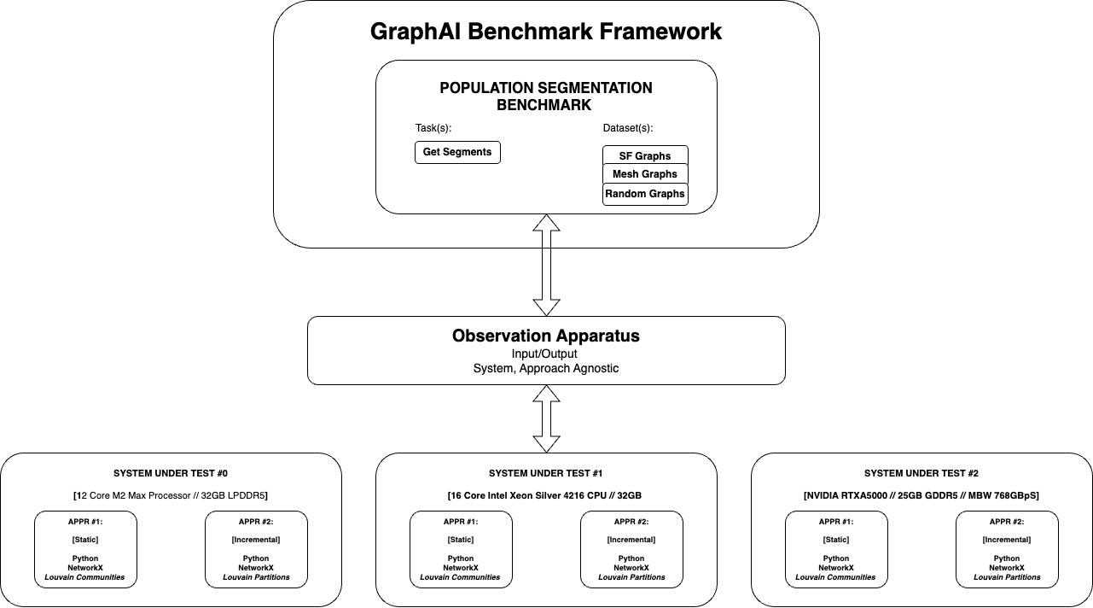
Experiment Setup
Run Experiment on cluster
Update results
Setup for demonstration of the Population Segmentation benchmark.
Notes:
Our experiments are configures as follows.
We have three systems under tests.
SUT1. The `Baseline’ is a `personal computer’ used to represent the current prototype capability that the team in the case study is trying to evolve from.
SUT2. A HPC Cluster running a single socket CPU.
SUT3. A HPC Cluster with an NVIDIA RTXA5000 GPU.
Two implementations are tested on each - A `one shot’ community detection approach and a `iterative’ community detection approach. Both are implemented in the NetworkX library.

Slide 33
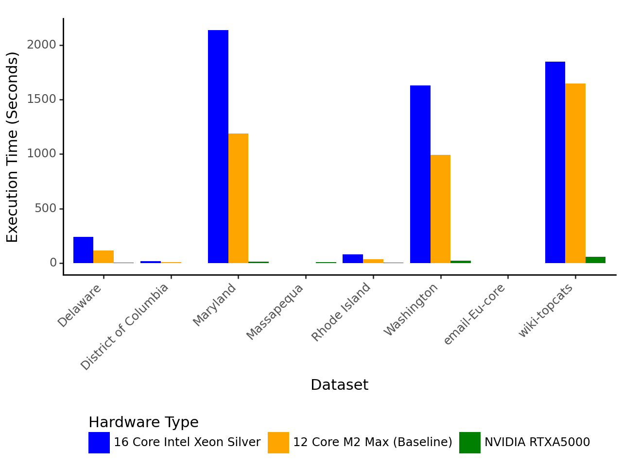
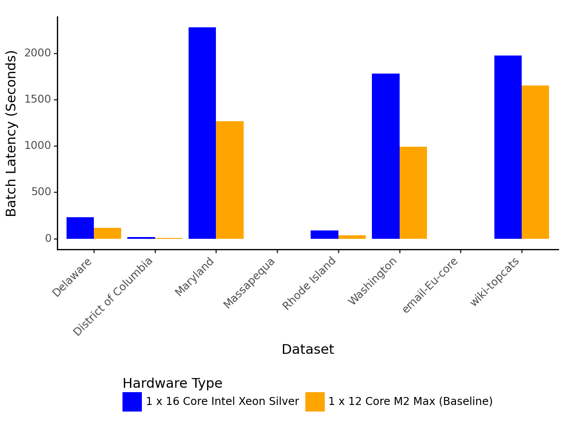
Results - Execution Time
Using a GPU yields a up to a 172x speed-up in execution time on MD Roads dataset; but does not support the incremental approach.
Batch Latency @1 roughly equals execution time – the ‘incremental’ approach is not incremental in time.

Slide 34
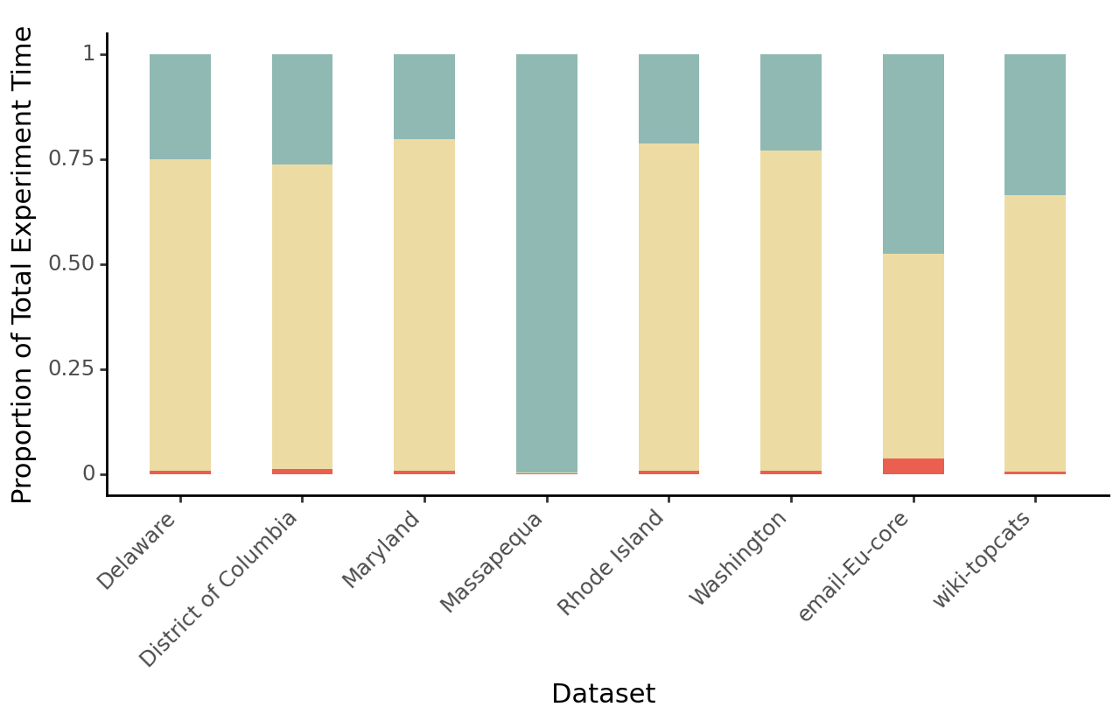
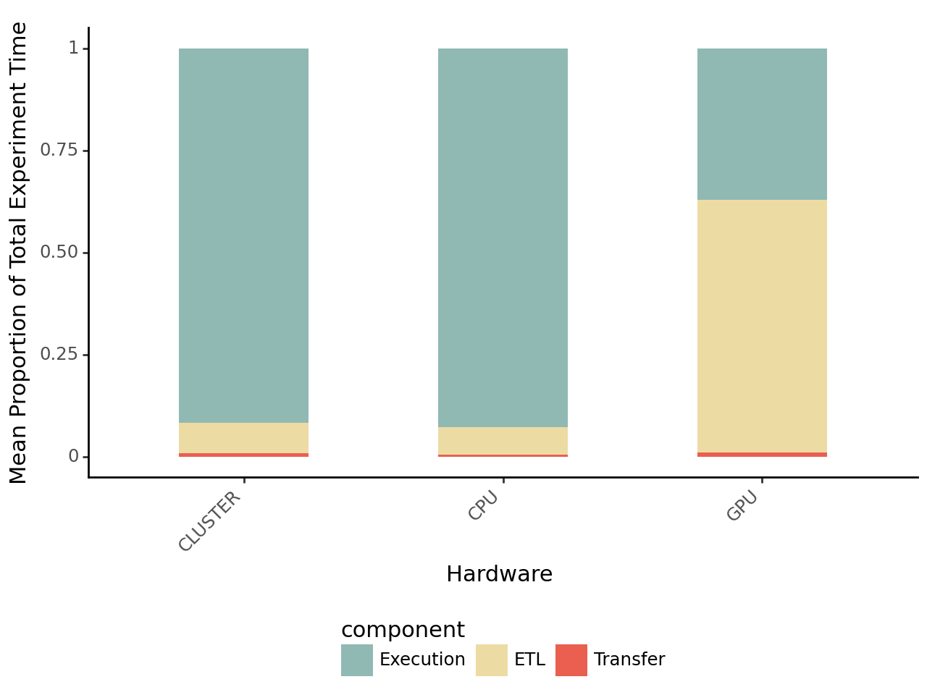
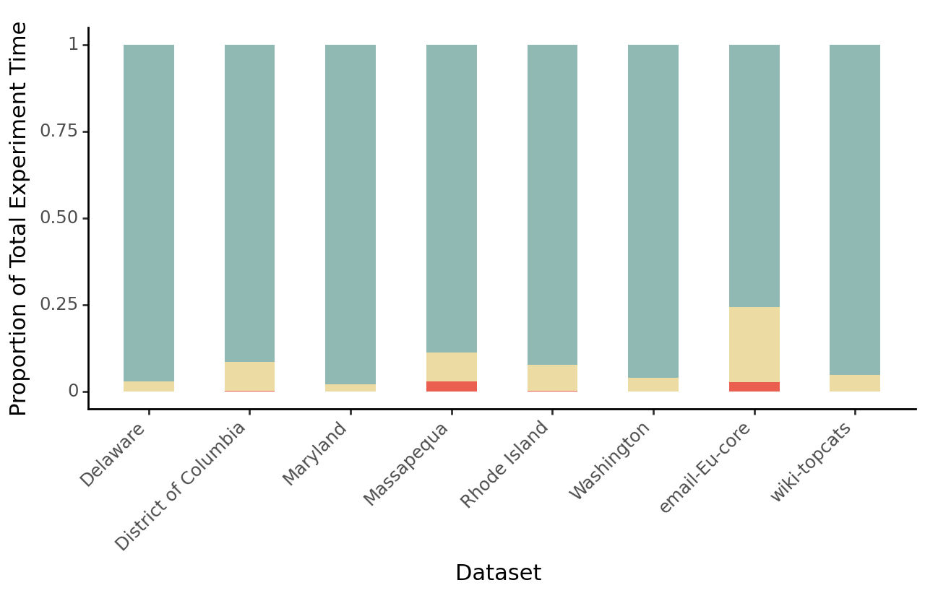
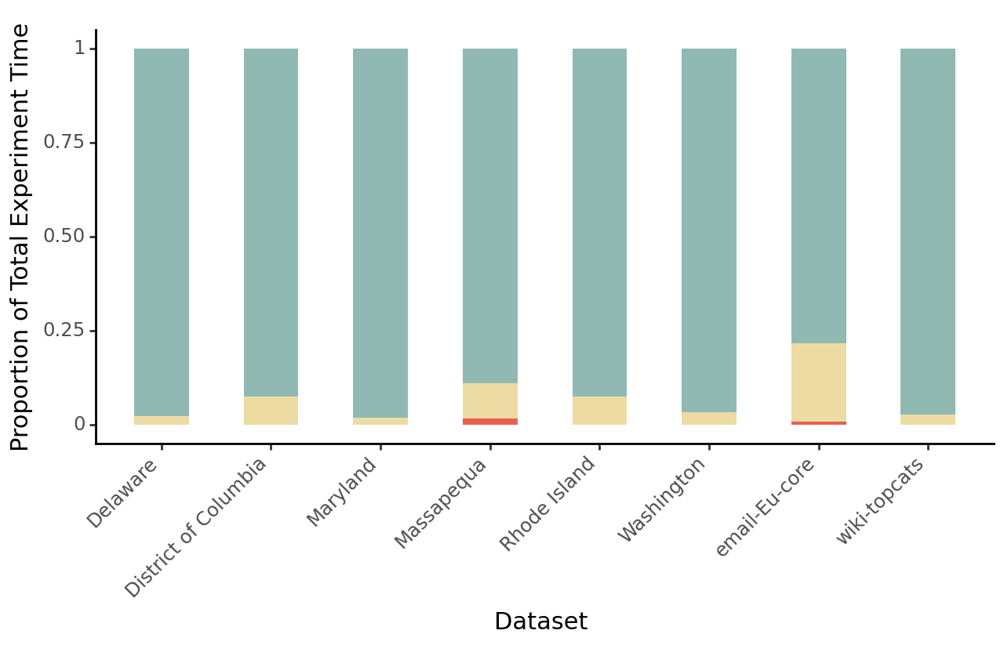
Results - Time Usage
GPU
Xeon
M2 Max
ETL is a much greater proportion of Processing time for GPU-based approaches than for CPU-based approaches.
Massapequa may be below partition threshold.

Slide 35
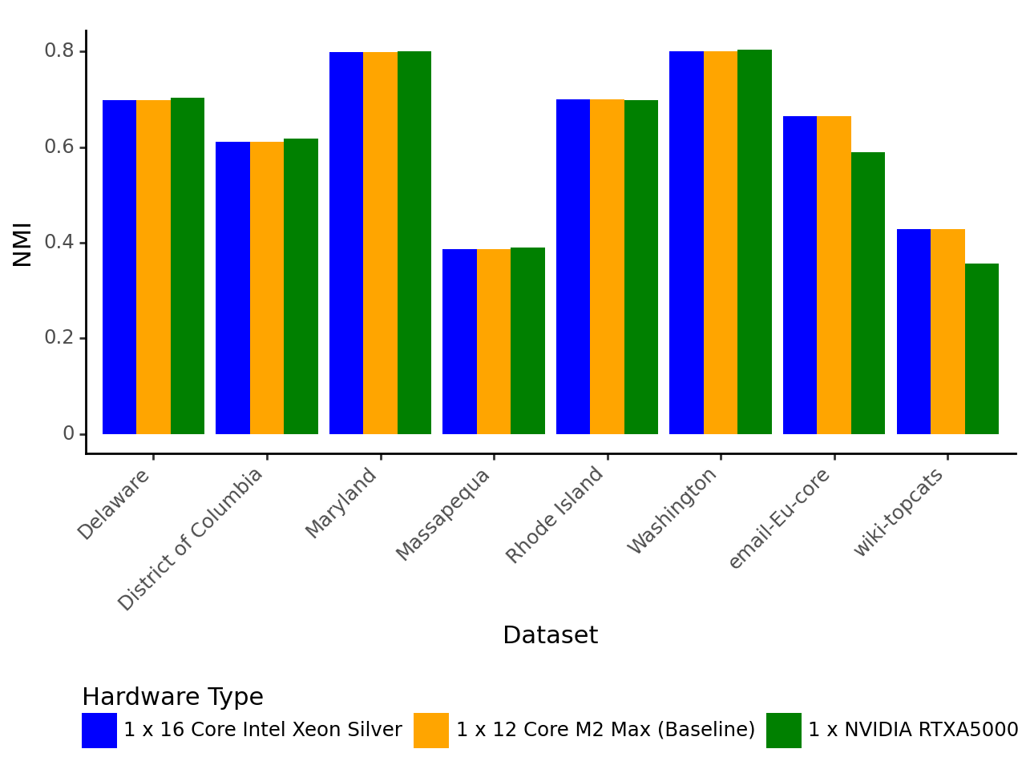
Results - Effectiveness of Static Approaches
Effectiveness degrades for GPU on scale-free datasets using the ‘static’ algorithm.
Likely due to initial partitioning scheme used by GPU.

Slide 36
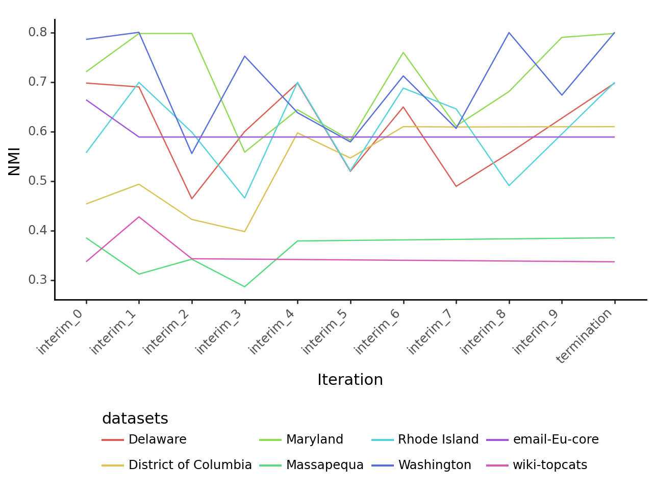
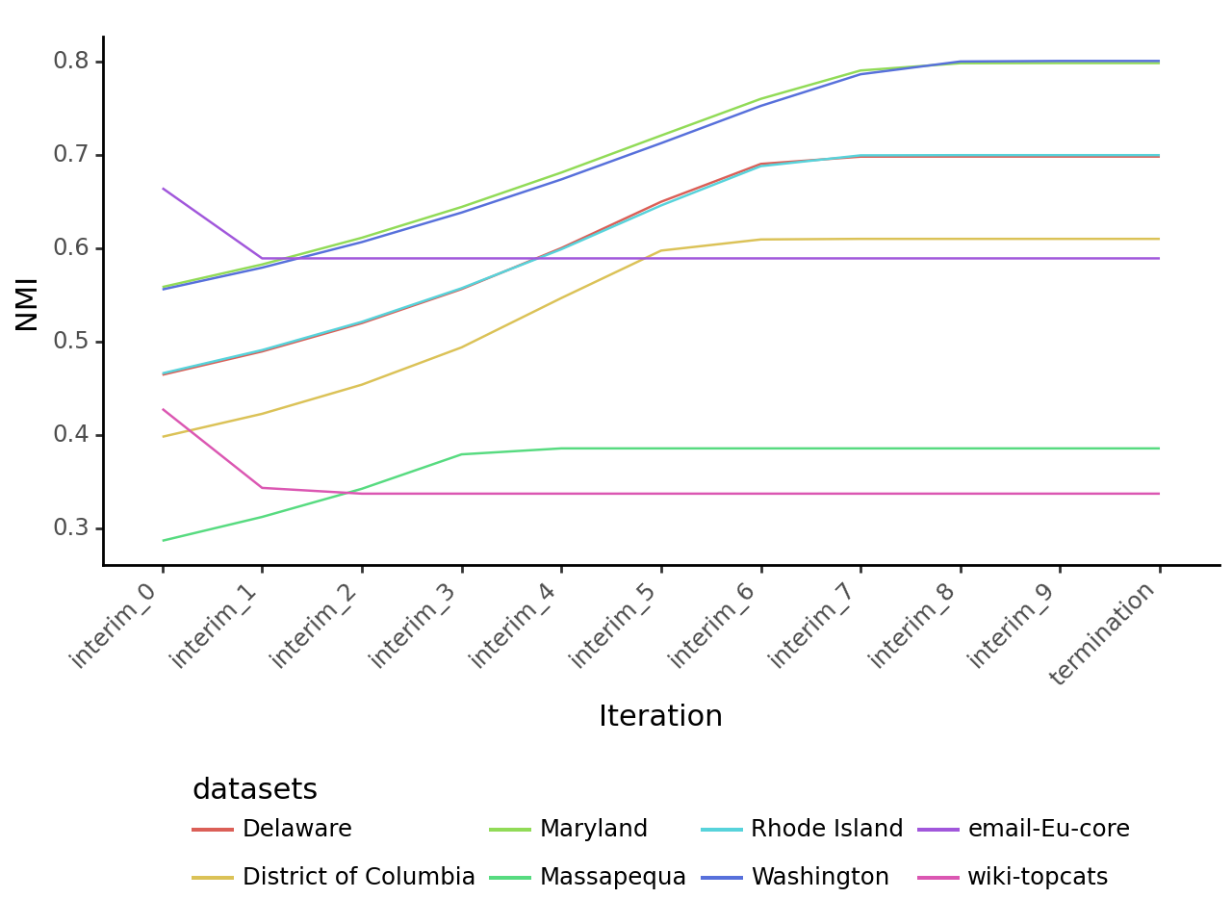
Results - Effectiveness of Incremental Approaches (NMI)
No Incremental Implementation for GPU
M2 Max
Xeon Silver
RTXA5000
The M2 Max implementation exhibits non-monotonic behavior in NMI improvement.
One could trade effectiveness for efficiency on the Xeon Silver.

Slide 37
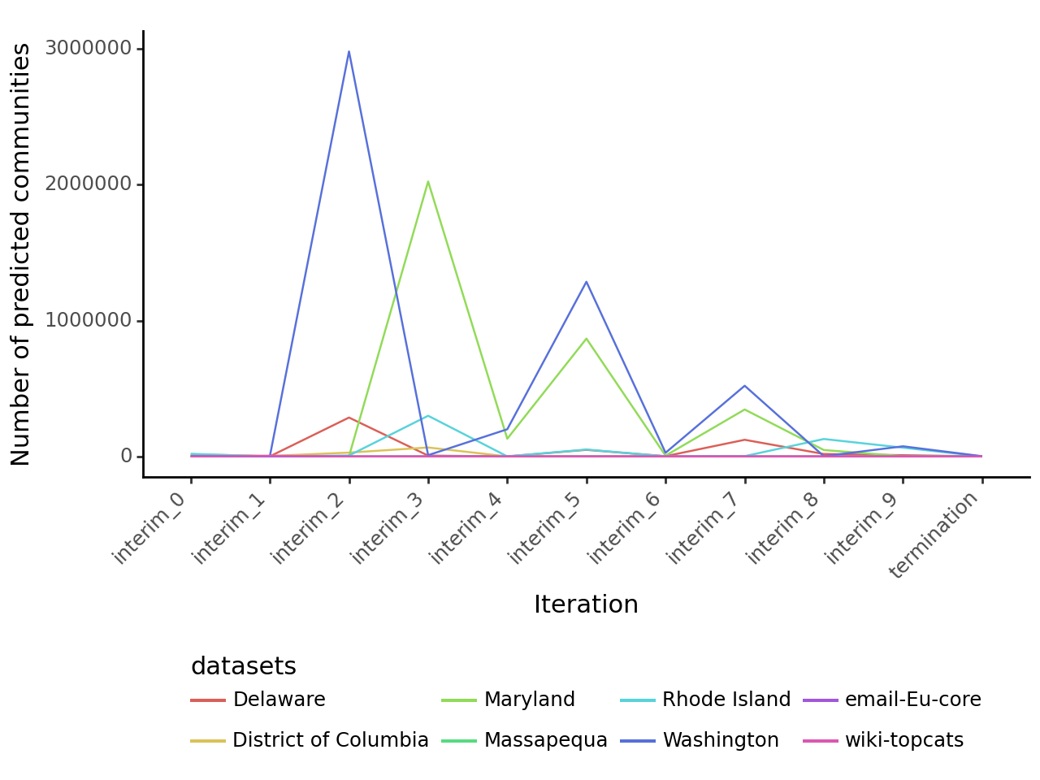
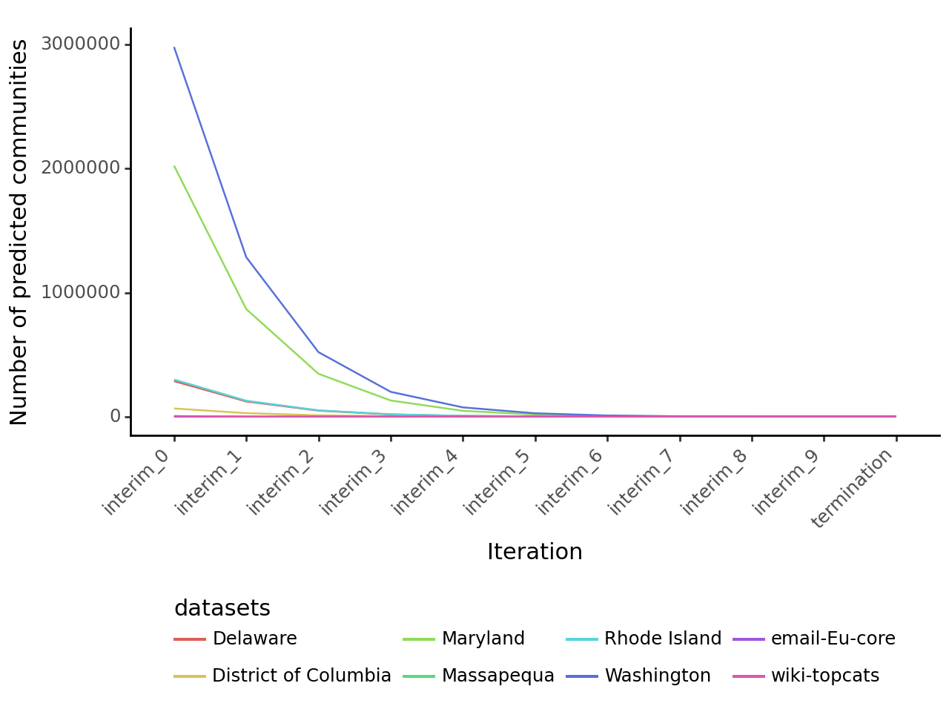
Results - Effectiveness of Incremental Approaches (#Seg)
No Incremental Implementation for GPU
M2 Max
Xeon Silver
RTXA5000
The M2 Max implementation exhibits non-monotonic behaviour in Segment size.
The ‘granularity’ of communities gets coarser over time on the Xeon Silver.

Slide 38
Decision:
GraphAI
Searching, Planning and Scheduling
Structural Analysis
Graph Search
Graph Matching
AI Planning
Community Detection
Critical Path
Influence Mapping
Based on Population Segmentation alone, recommend spending ~$2500 on RTX A5000.
We could trade effectiveness for efficiency, but GPU will perform better these small datasets.
Full assessment requires repeating the process for each GraphAI Problem.

Slide 39
Future Work
Measuring Cost
Currently measure Effectiveness and Efficiency
Power is a good proxy for cost; but requires a hosted solution
Expanding Coverage to other GraphAI Problems
Next: Isomorphic Subgraph Matching for Spatial Pattern Matching
Engineering
API-Based model; hosted leaderboard; dynamic inputs
Maturity Model
Focus appears to gradually shift from effectiveness to efficiency as fields develop

Slide 40
Summary
Problem:
To determine how and when to speed up problem solving on linked data given a set of operating constraints.
Contributions:
GraphAI
Taxonomy
Benchmark
Methodology
Population Segmentation
Benchmark
Effectiveness/Efficiency Analysis
Notes:
Surveys of GraphAI; I&S Problems in GraphAI,; GraphAI Benchmarking Approaches; GraphAI Bottlenecks and Acceleration Techniques & Community Detection Benchmarks
A Methodology For empirically developing GraphAI problems for the benchmark Framework.
Datasets and a tool for creating real-world attributed, weighted directed graphs with ground truth communities from OpenStreetMap data.
A Benchmark Problem and implementation for Population Segmentation.
A brief Evaluation of the Efficiency/Effectiveness tradeoffs between two NetworkX community detection implementations.

Slide 41
Questions
If you have any questions, please reach out on:
osullik@umd.edu
+1 (202) 257 5565 [US Cell]
+61 (0) 431 133 963 [Aus Cell for Signal, Whatsapp etc]

