Slide 1
WORKING LOCAL PROTOTYPE
Lens
Company intelligence for AIVC
Company briefs from fictional evidence in 30 seconds or less
Technical challenge · Product, architecture, and pilot plan
31 AUG 2026
Lens
Notes:
Open with the answer: Lens is a working local prototype that builds a company brief from imported evidence. Production freshness and access control are not part of this build.
[Sources]
- /Users/alexthorpe/Documents/GitHub/AVIC/docs/AIVC_Technical_Challenge_Task_4.2.pdf
- /Users/alexthorpe/Documents/GitHub/AVIC/docs/prd-v1.md
- /Users/alexthorpe/Documents/GitHub/AVIC/README.md
[/Sources]

Slide 2
What job does Lens replace?
An AIVC principal prepares for discussions across about 50 portfolio companies and 200 pipeline companies.
The facts are spread across CRM records, meeting notes, Slack, filings, and news. The AIVC principal must find the latest value, check the source, and see what is missing.
≈250
90 min
≤30 sec
companies in scope
manual preparation
brief target
About 50 portfolio + 200 pipeline
Scenario estimate; not a measured baseline
Lens organizes evidence. The AIVC principal keeps the investment judgment.
02
Notes:
The brief defines the intended user and company universe. The 90-minute value is a scenario estimate. The 30-second value is the product target.
[Sources]
- /Users/alexthorpe/Documents/GitHub/AVIC/docs/AIVC_Technical_Challenge_Task_4.2.pdf
- /Users/alexthorpe/Documents/GitHub/AVIC/docs/prd-v1.md
[/Sources]

Slide 3
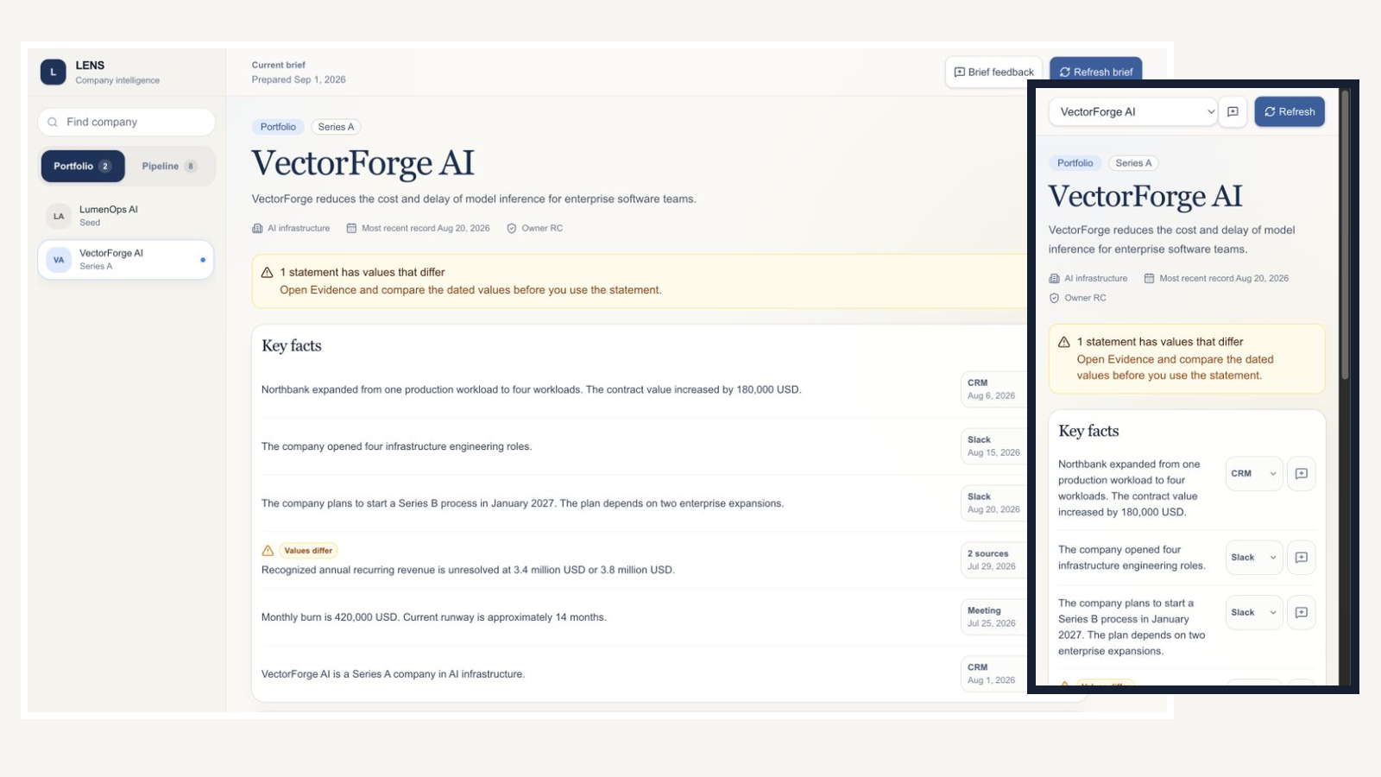
What does Lens let an AIVC principal do?
The same brief and evidence flow works on desktop and mobile.
1
Select company
Choose a portfolio or pipeline company.
2
Scan the brief
Read Key facts, Risks, and Questions.
3
Open the source
See values, dates, evidence, and the original record.
4
Send feedback
Mark content Good, Bad, or Wrong.
03
Notes:
Show the current desktop and mobile interface. The AIVC principal can select a company, scan the brief, open evidence, inspect the original source, refresh the brief, and send feedback on either screen size. The screenshots are current captures from the running Lens application.
[Sources]
- /Users/alexthorpe/Documents/GitHub/AVIC/docs/AIVC_Technical_Challenge_Task_4.2.pdf
- /Users/alexthorpe/Documents/GitHub/AVIC/app/page.tsx
- /Users/alexthorpe/Documents/ChatGPT/AIVC/_deck_responsive_screenshot.GnRh2f/lens-desktop.png
- /Users/alexthorpe/Documents/ChatGPT/AIVC/_deck_responsive_screenshot.GnRh2f/lens-mobile.png
[/Sources]

Slide 4
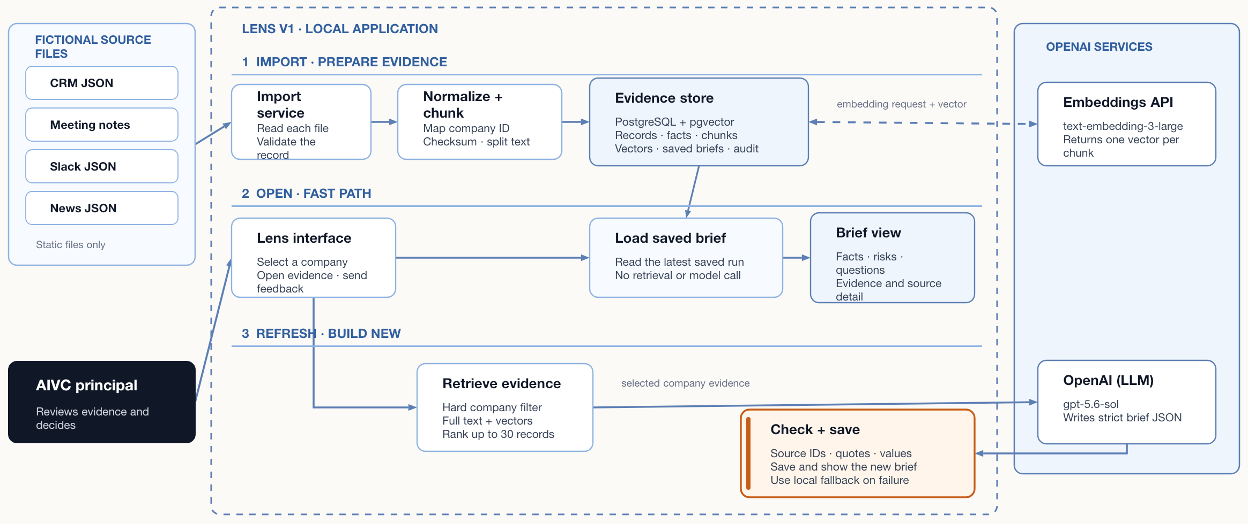
How does Lens work end to end?
Import prepares evidence. Open loads the saved brief. Refresh retrieves evidence and builds a new brief.
1 CURRENT IMPORT · BEFORE REQUEST
2 CURRENT BRIEF · ON REQUEST
Sources
Import
Evidence store
Retrieve
Build brief
Investor UI
Static CRM
Meeting notes
Slack
News records
No filings adapter
Read each file
Validate record
Check company ID
Keep source record
Checksum and chunk
Request embeddings
PostgreSQL and pgvector
Companies and source records
Facts and dates
Chunks and embeddings
Brief runs and evidence
Create query embedding
Company ID filter in SQL
Full-text and embedding search
Rank up to 30 records
Use quality and recency
gpt-5.6-sol
Responses API
Selected sources
Strict checks
Save or fallback
Portfolio or pipeline
Brief in 30 seconds or less
Open evidence and full source
Send feedback
CONTROLS THAT STAY
Checksums · company filter · selected source IDs · value support · source-status guard · timeout · fallback · feedback
PRODUCTION HARDENING Managed connectors · access rules · reviewed prompts · model policy · monitoring
04
Notes:
Lens has three paths. First, import prepares evidence before use. It reads the fictional CRM, meeting, Slack, and news files. It validates each record, maps the company ID, creates chunks, requests embeddings, and stores the records and vectors in PostgreSQL with pgvector. Second, the open path is fast. When the principal opens Lens or selects a company, the app loads the latest saved brief. This path does not run retrieval or call a model. If the company has no saved brief, the app prepares the first one. Third, Refresh brief builds a new brief. Retrieval applies a hard company filter and ranks up to 30 records by full-text match, vector similarity, source quality, and date. The app sends only the selected evidence to gpt-5.6-sol through the OpenAI Responses API. The server checks source IDs, company isolation, direct quotes, values, source status, and investment safety. It saves the new brief and audit data. If generation fails a check or exceeds the time budget, local rules create a source-supported fallback. Import is separate from brief use. Lens does not watch a folder or Slack. To add a demo record, add it in a supported format, run import, and then select Refresh brief.
[Sources]
- /Users/alexthorpe/Documents/GitHub/AVIC/README.md
- /Users/alexthorpe/Documents/GitHub/AVIC/docs/architecture.md
- /Users/alexthorpe/Documents/GitHub/AVIC/app/page.tsx
- /Users/alexthorpe/Documents/GitHub/AVIC/app/api/briefs/route.ts
- /Users/alexthorpe/Documents/GitHub/AVIC/lib/embeddings.ts
- /Users/alexthorpe/Documents/GitHub/AVIC/lib/ingestion.ts
- /Users/alexthorpe/Documents/GitHub/AVIC/lib/retrieval.ts
- /Users/alexthorpe/Documents/GitHub/AVIC/lib/brief-generation.ts
- /Users/alexthorpe/Documents/GitHub/AVIC/db/schema.sql
[/Sources]

Slide 5
Why does this stack fit V1?
TECHNOLOGY
WHY IT FITS V1 AND THE TRADE-OFF
Next.js, React, TypeScript, and Shadcn
One app serves the interface and API routes. Trade-off: the web and service layers do not scale separately.
PostgreSQL 17 and pgvector
One database stores facts, source text, and embeddings. Trade-off: a larger system can need separate search and file storage.
File adapters and local Docker
Files make the demo repeatable without live access. Trade-off: new data needs a manual import.
OpenAI (LLM)
Embeddings find evidence. gpt-5.6-sol writes the brief. Trade-off: model cost and failure require checks and a local backup.
05
Notes:
The architecture uses one Next.js application for the interface and API routes. This choice keeps the V1 deployment small. Separate web and service deployments can become useful when traffic or ownership grows. PostgreSQL and pgvector store structured facts, source text, and embeddings in one database. This choice keeps transactions and company filters together. A larger system can move source files to object storage and move search to a separate service. File adapters make the demo repeatable without live access. Production needs approved read-only connectors and incremental imports. OpenAI provides embeddings and brief generation. The server uses strict checks, timeouts, a local backup, and saved audit data. These controls reduce model risk. The trade-off is model cost, response time, and provider dependence. The active embedding model is text-embedding-3-large. The active brief model is gpt-5.6-sol through the Responses API.
[Sources]
- /Users/alexthorpe/Documents/GitHub/AVIC/docs/AIVC_Technical_Challenge_Task_4.2.pdf
- /Users/alexthorpe/Documents/GitHub/AVIC/docs/architecture.md
- /Users/alexthorpe/Documents/GitHub/AVIC/docs/prd-v1.md
- /Users/alexthorpe/Documents/GitHub/AVIC/package.json
- /Users/alexthorpe/Documents/GitHub/AVIC/lib/embeddings.ts
- /Users/alexthorpe/Documents/GitHub/AVIC/lib/brief-generation.ts
- /Users/alexthorpe/Documents/GitHub/AVIC/lib/retrieval.ts
- /Users/alexthorpe/Documents/GitHub/AVIC/db/schema.sql
- https://developers.openai.com/api/docs/models/text-embedding-3-large
- https://developers.openai.com/api/docs/models/gpt-5.6-sol
[/Sources]

Slide 6
How would two people reach an internal pilot in eight weeks?
PROPOSED · WEEKS 1–2
WEEKS 3–4
WEEKS 5–6
WEEKS 7–8
Build one source-to-brief path
Connect one approved source
Test retrieval and access
Run the pilot and scale test
Reference answers
Source contract
One-company slice
Read-only connector
Incremental import
Company mapping check
Access checks
Evaluated retrieval
Generation and fallback evaluation
Reconciliation
Monitoring
250-company test and principal pilot
PERSON 1 · Product and application
PERSON 2 · Data and platform
SHARED · Source contract and evaluation set
06
Notes:
This is a proposed plan for two people. The 250-company test appears in weeks 7 and 8 because it has not been run. Weeks 5 and 6 include retrieval evaluation and generation-and-fallback evaluation. The plan depends on source access, company IDs, access rules, and review time from the AIVC principal.
[Sources]
- /Users/alexthorpe/Documents/GitHub/AVIC/docs/AIVC_Technical_Challenge_Task_4.2.pdf
- /Users/alexthorpe/Documents/GitHub/AVIC/docs/prd-v1.md
- /Users/alexthorpe/Documents/GitHub/AVIC/docs/architecture.md
- /Users/alexthorpe/Documents/GitHub/AVIC/scripts/verify-generation.ts
[/Sources]

Slide 7
What do I de-risk first, and what changes with more time?
First risk: retrieve the right evidence and show when the answer is uncertain.
FIRST PROTOTYPE
CRITICAL DEPENDENCIES
WITH MORE TIME
One company and one real source
Access and ownership
Generalize and operate
One current fact
One true conflict
One missing fact
One changed source record
Reference answers
Source owners
API access
Canonical company IDs
Access and retention rules
Model policy
Principal review
Connectors and reconciliation
Access-aware retrieval
Retrieval and generation evaluation
Reviewer workflow and monitoring
NEXT DECISION
Approve one source-to-brief pilot after source owners, access owners, and the AIVC principal confirm the test set.
07
Notes:
The first risk is evidence retrieval, not model choice. The next slice should use one approved source and a small reference answer set. With more time, evaluate both retrieval and source-supported generation, then add the reviewer workflow and monitoring. The decision is whether to approve that source-to-brief pilot after the named owners confirm access and evaluation conditions.
[Sources]
- /Users/alexthorpe/Documents/GitHub/AVIC/docs/AIVC_Technical_Challenge_Task_4.2.pdf
- /Users/alexthorpe/Documents/GitHub/AVIC/docs/prd-v1.md
- /Users/alexthorpe/Documents/GitHub/AVIC/docs/architecture.md
- /Users/alexthorpe/Documents/GitHub/AVIC/lib/retrieval.ts
- /Users/alexthorpe/Documents/GitHub/AVIC/lib/brief-generation.ts
- /Users/alexthorpe/Documents/GitHub/AVIC/scripts/verify-v1.ts
- /Users/alexthorpe/Documents/GitHub/AVIC/scripts/verify-generation.ts
[/Sources]

