Slide 1
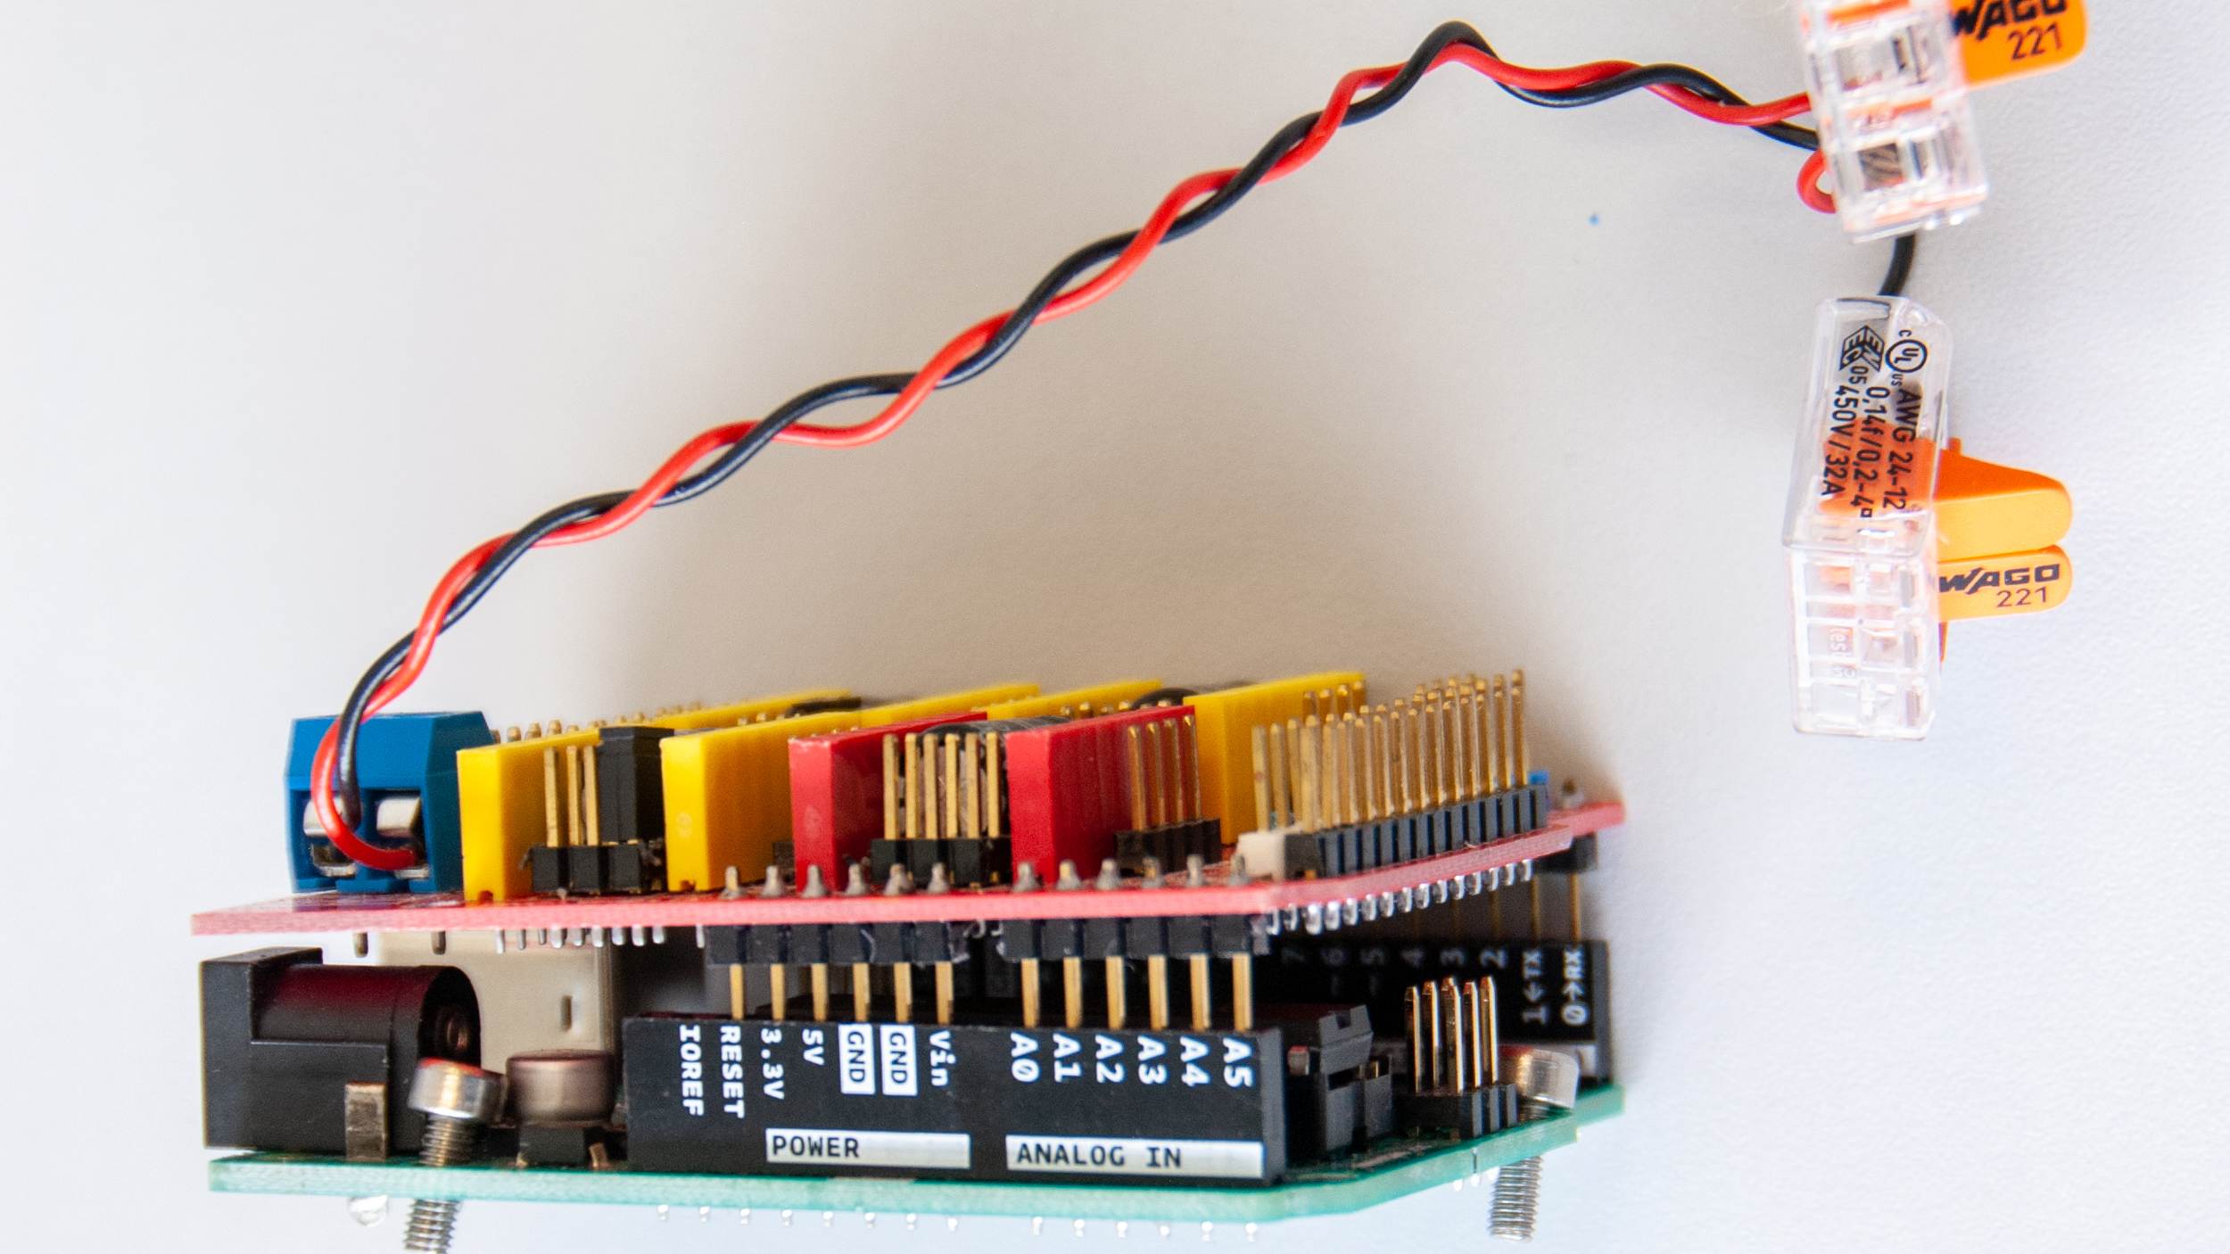
Black jumper caps
M0
M2
M1

Slide 2
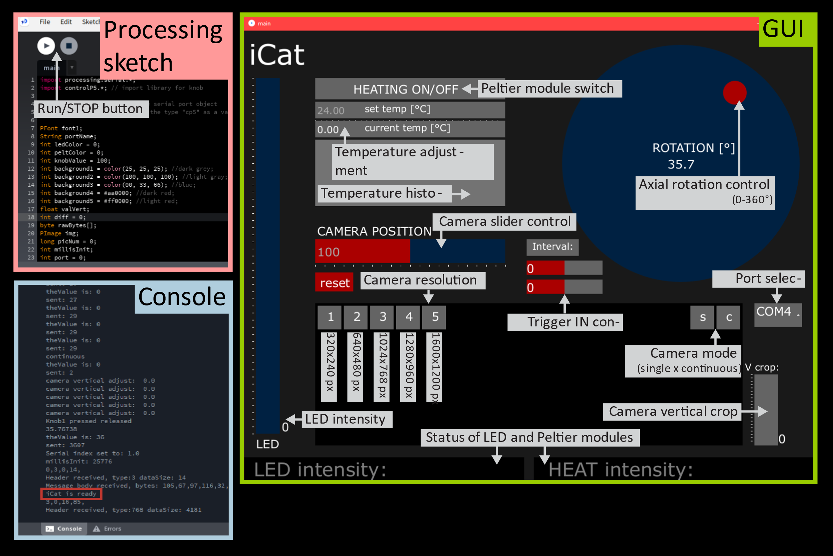
New version, see illustrator

Slide 3
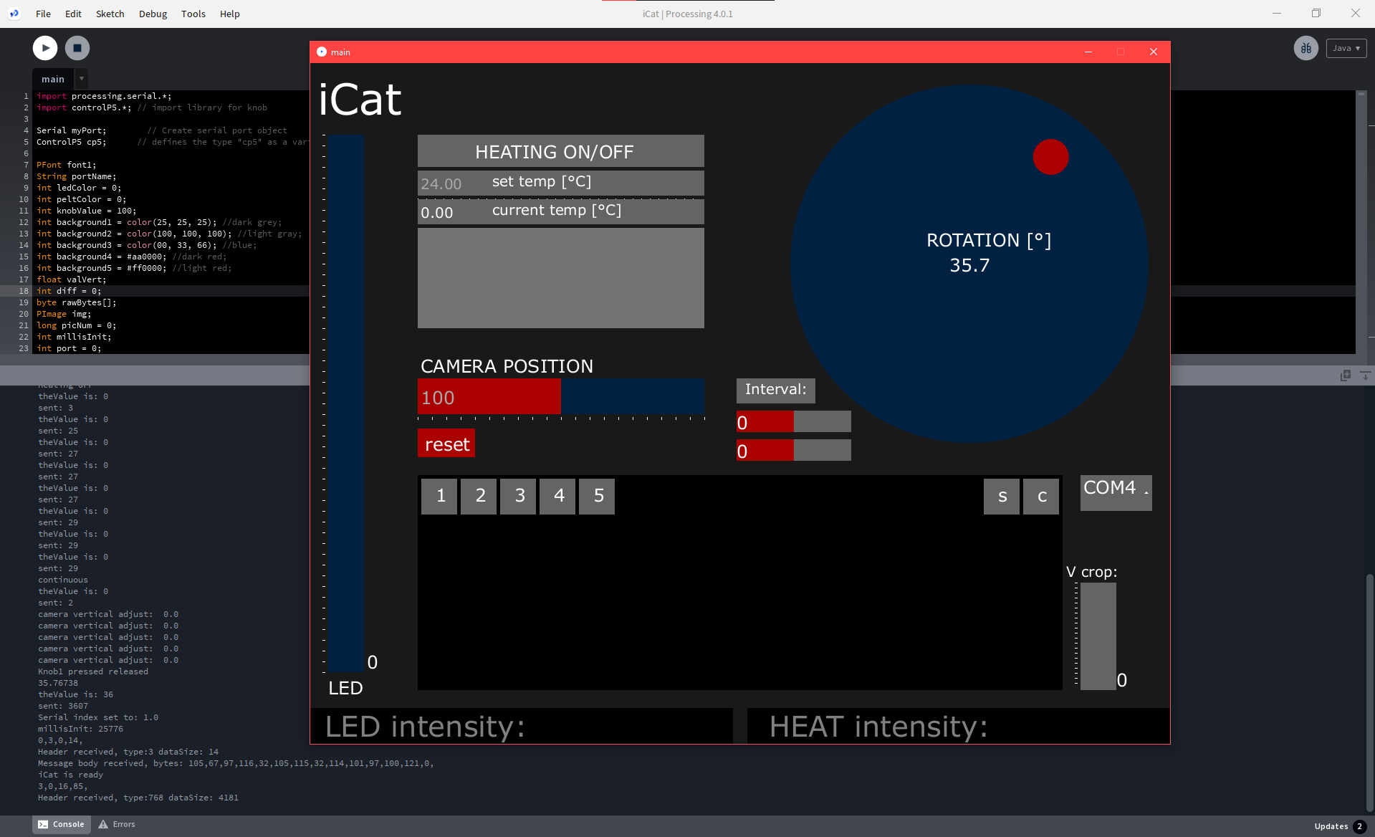
Run iCat
GUI
Peltier switch
axial control
temperature setting and graph
Processing sketch
camera position control
console
port selection
trigger IN control
camera resolution
single/continuous mode
LED intensity
camera vertical cropping
Old version, for a new one see illustrator

