Slide 1
How environmental, socio-demographic, and health indicators influence malaria prevalence?
Oswaldo C. Villena, Catherine Lippi, Sadie J. Ryan, Leah R. Johnson

Slide 2
Introduction
Malaria transmission dynamics are influenced by an array of environmental, socio-demographic, and health indicators which determine the abundance and distribution of malaria vectors and the parasites they transmit.
The most well study indicators that influence malaria dynamics are temperature and precipitation.
In this study, we analyzed how malaria prevalence is influenced by a set of environmental, socio-demographic, and health indicators

Slide 3
Introduction
Environmental indicators: temperature (mean, maximum of warmest month, minimum of coldest month, and isothermality); precipitation (mean, driest quarter, and warmest quarter); elevation; and vegetation cover as NDVI.
Socio-demographic Indicators: population density (km2), adjusted gross domestic product, and the year the malaria prevalence study took place.
Health indicator: basic reproductivenumber (R0).
To analyze how all this indicators influenced malaria prevalence, we are using generalized linear models (glm) and classification and regression tree models (CART)

Slide 4
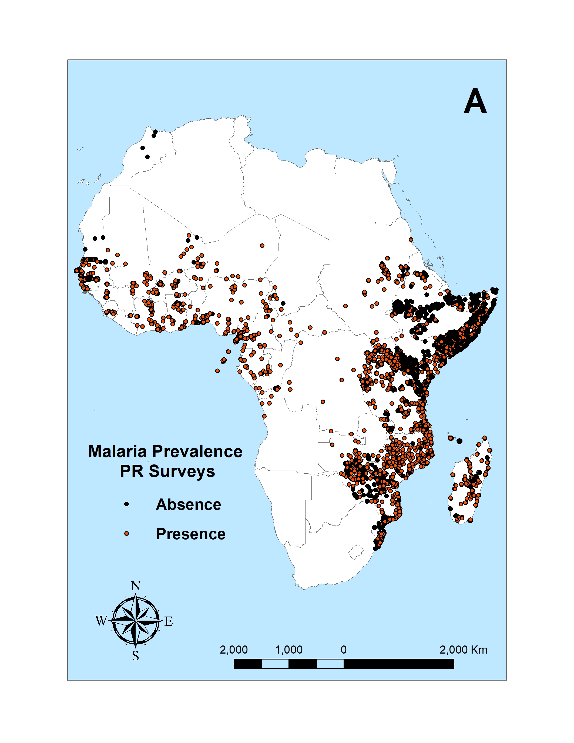
Malaria prevalence data
We obtained data on P. Falciparum and P. vivax prevalence data collected at the village level in 46 countries in Africa and 21 countries in Asia from 1990 to 2017 from the Malaria Atlas Project – MAP.
P. Falciparum malaria prevalence in Africa

Slide 5
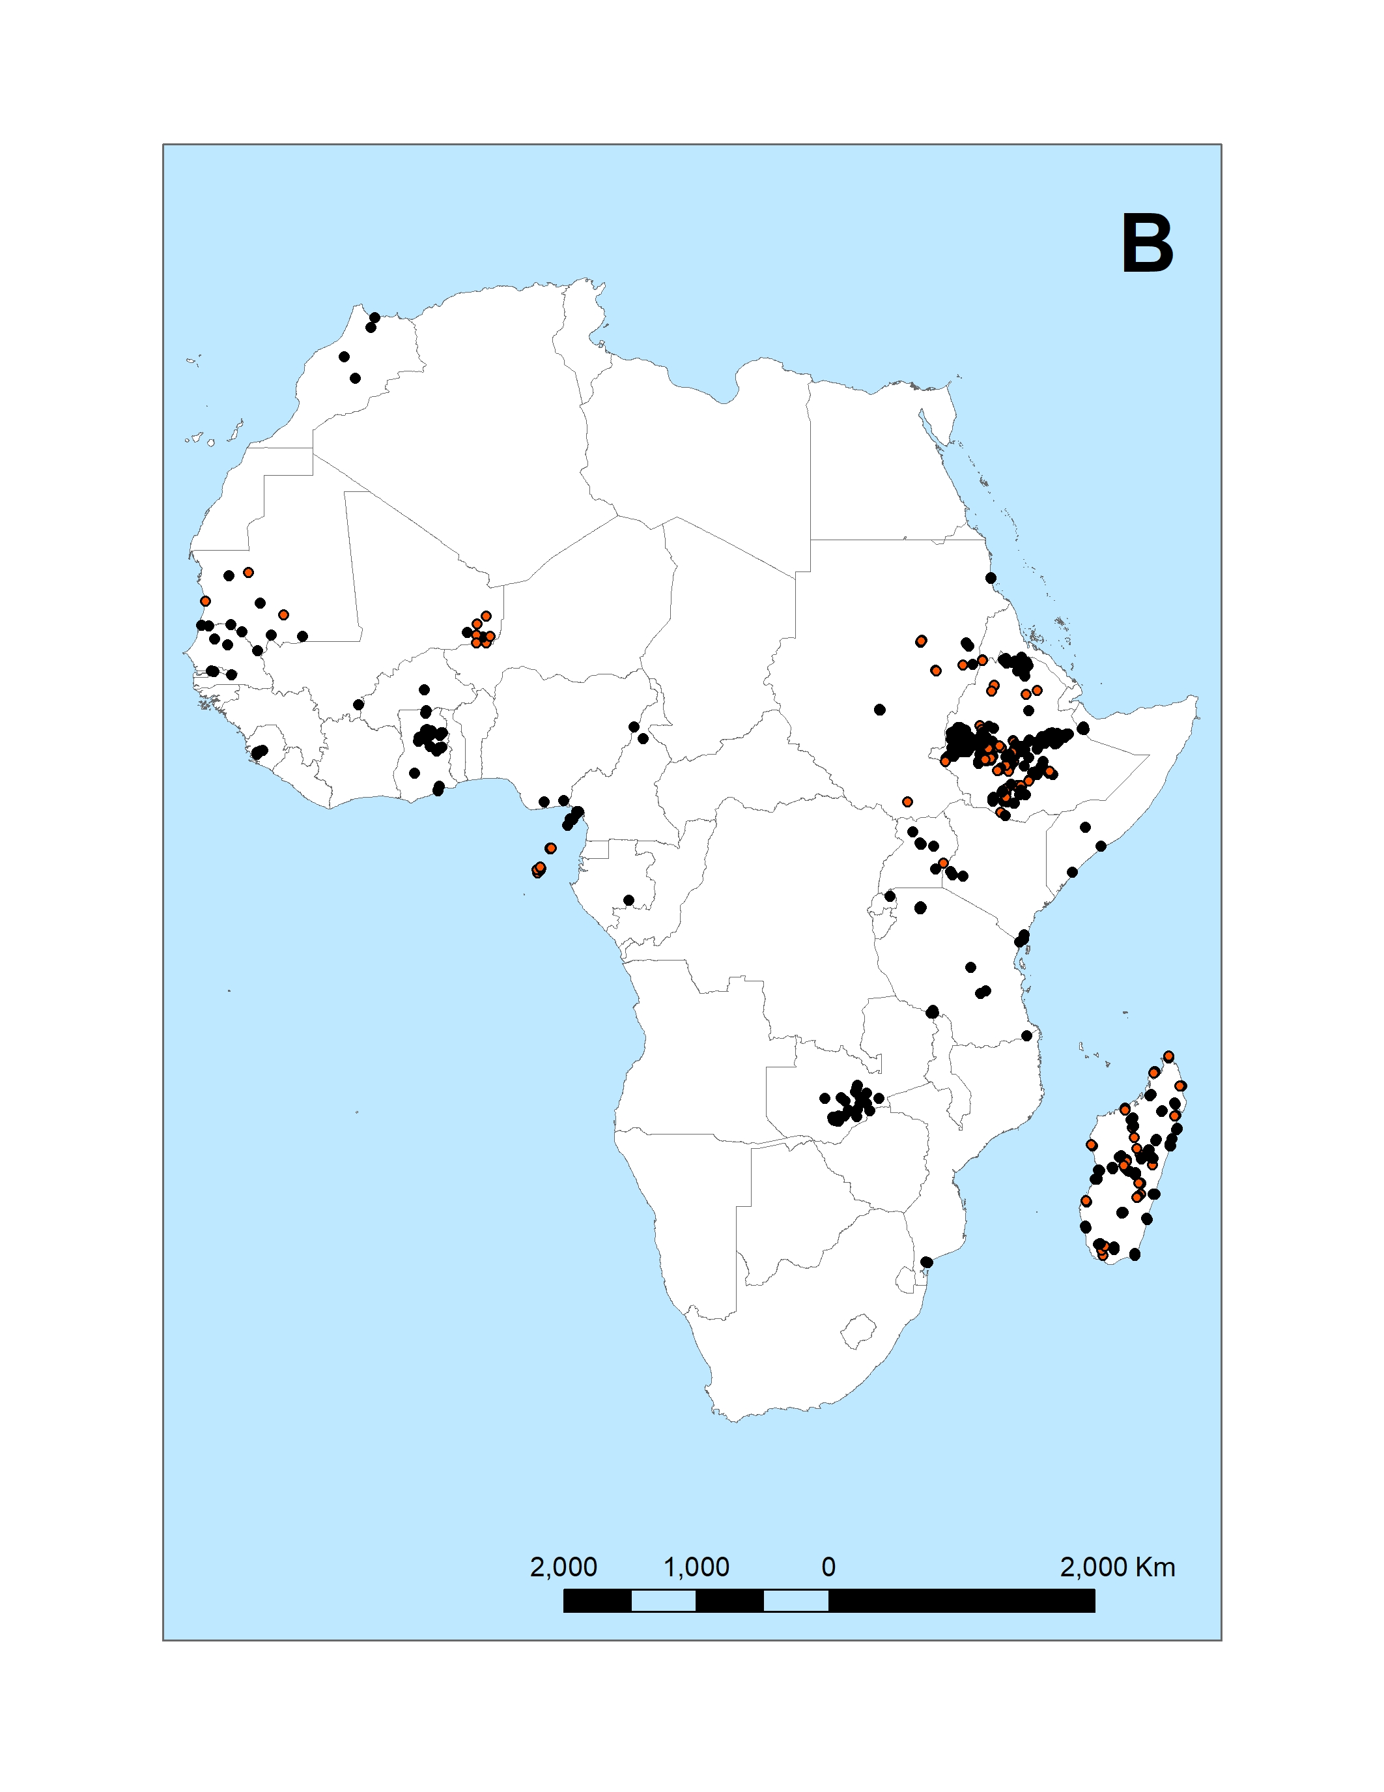
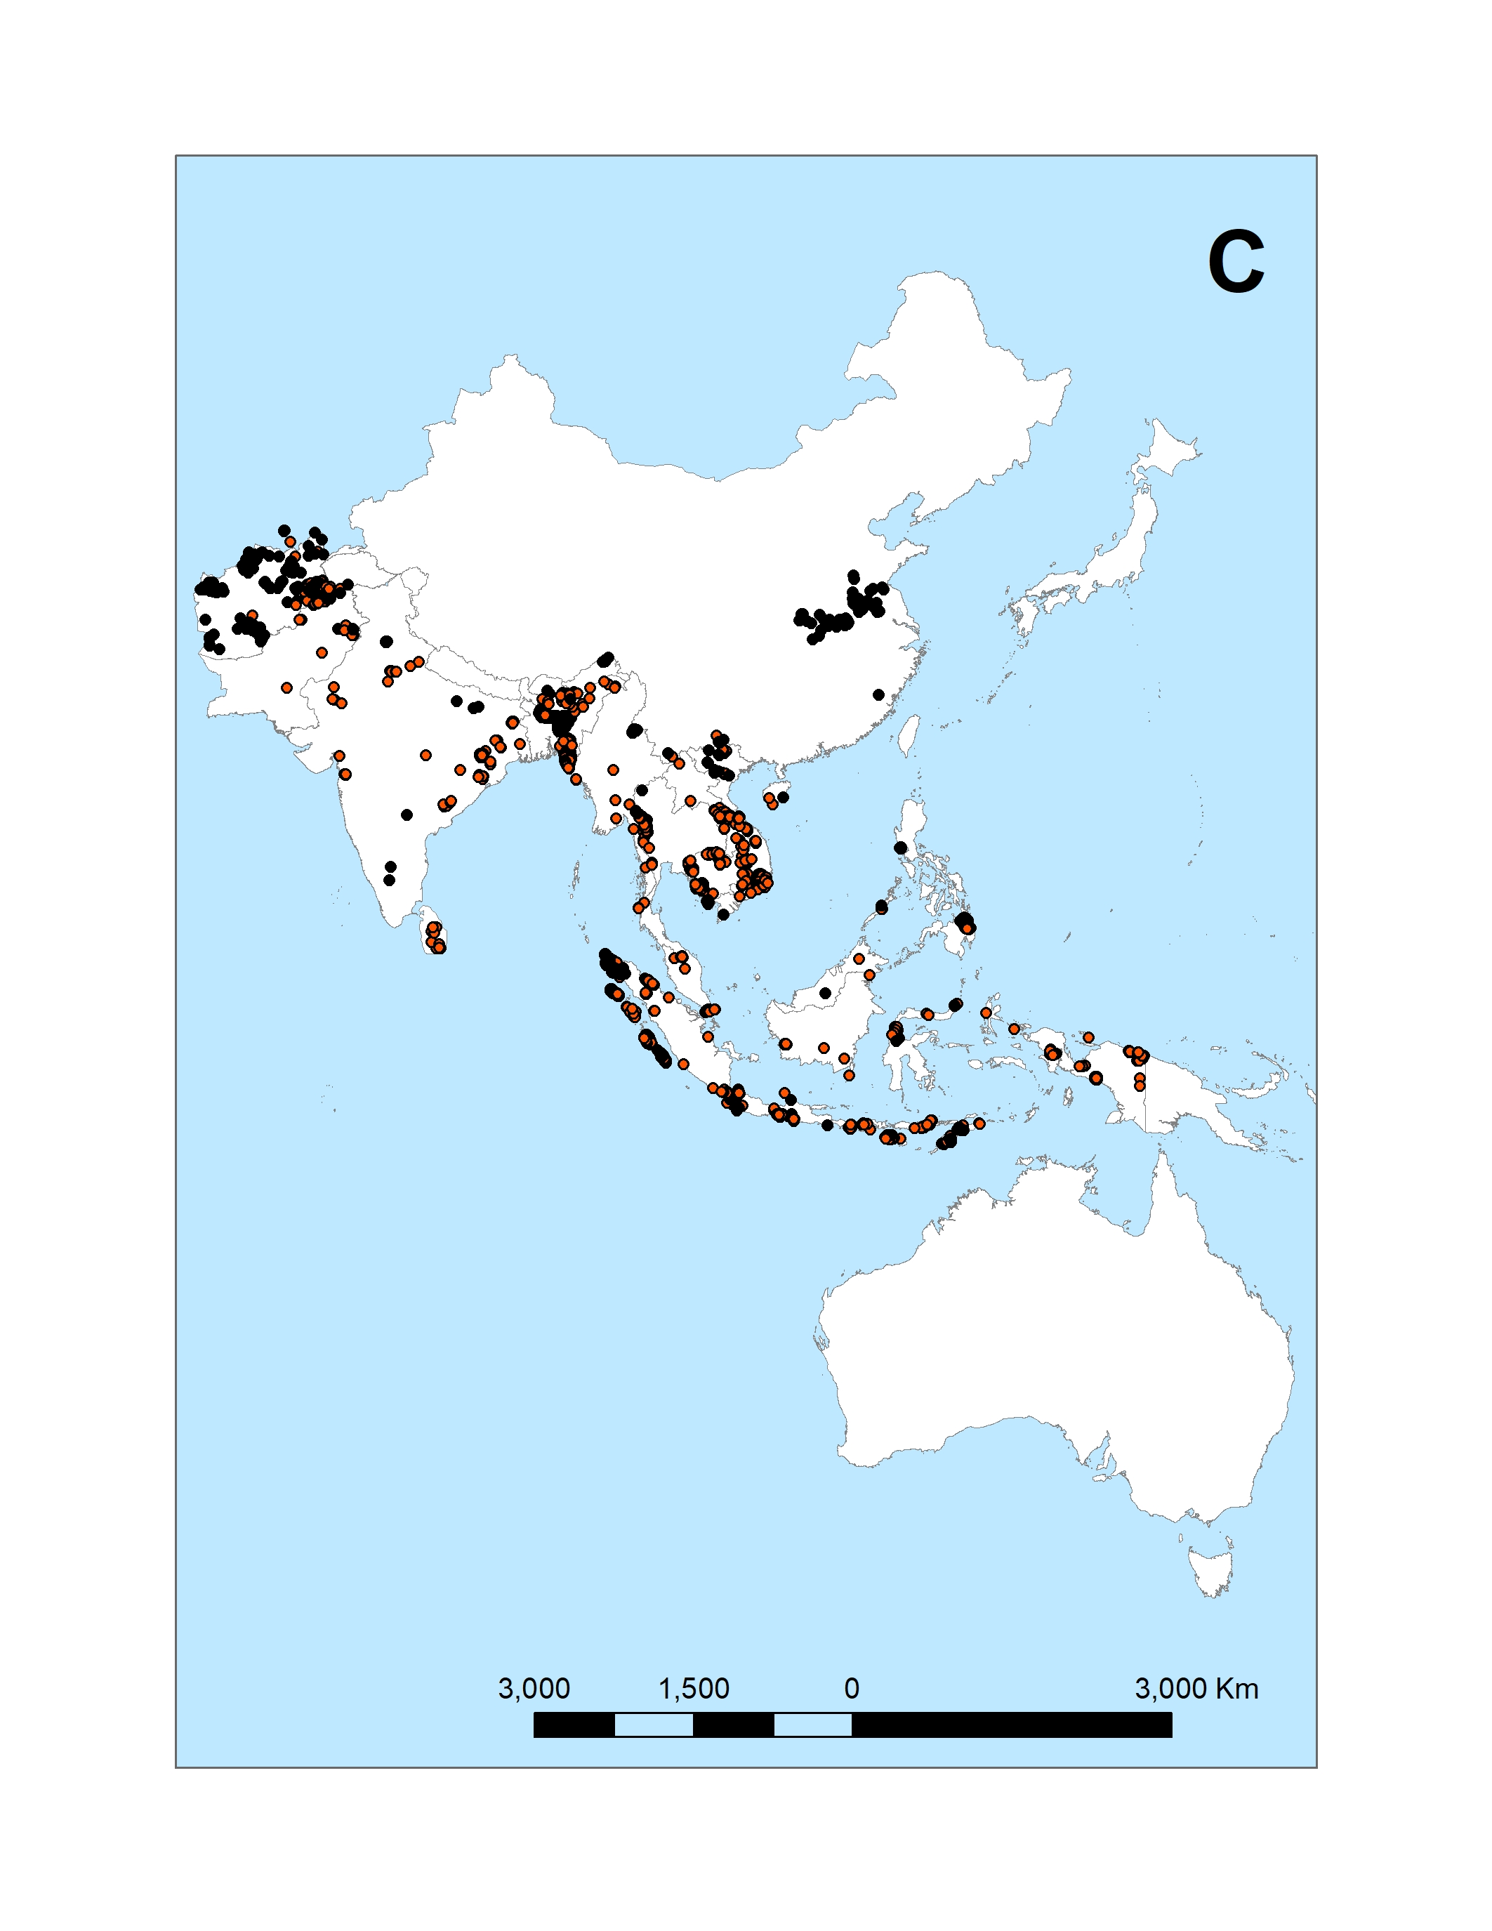
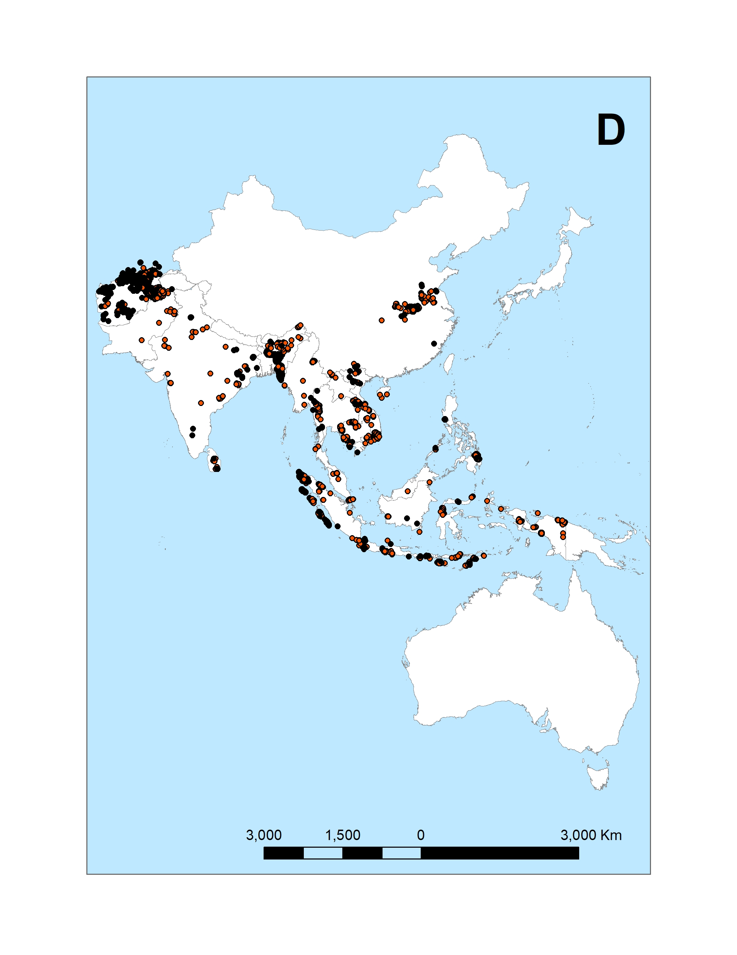
Malaria prevalence data
P. Vivax malaria prevalence - Africa
P. falciparum malaria prevalence - Asia
P. vivax malaria prevalence - Asia

Slide 6
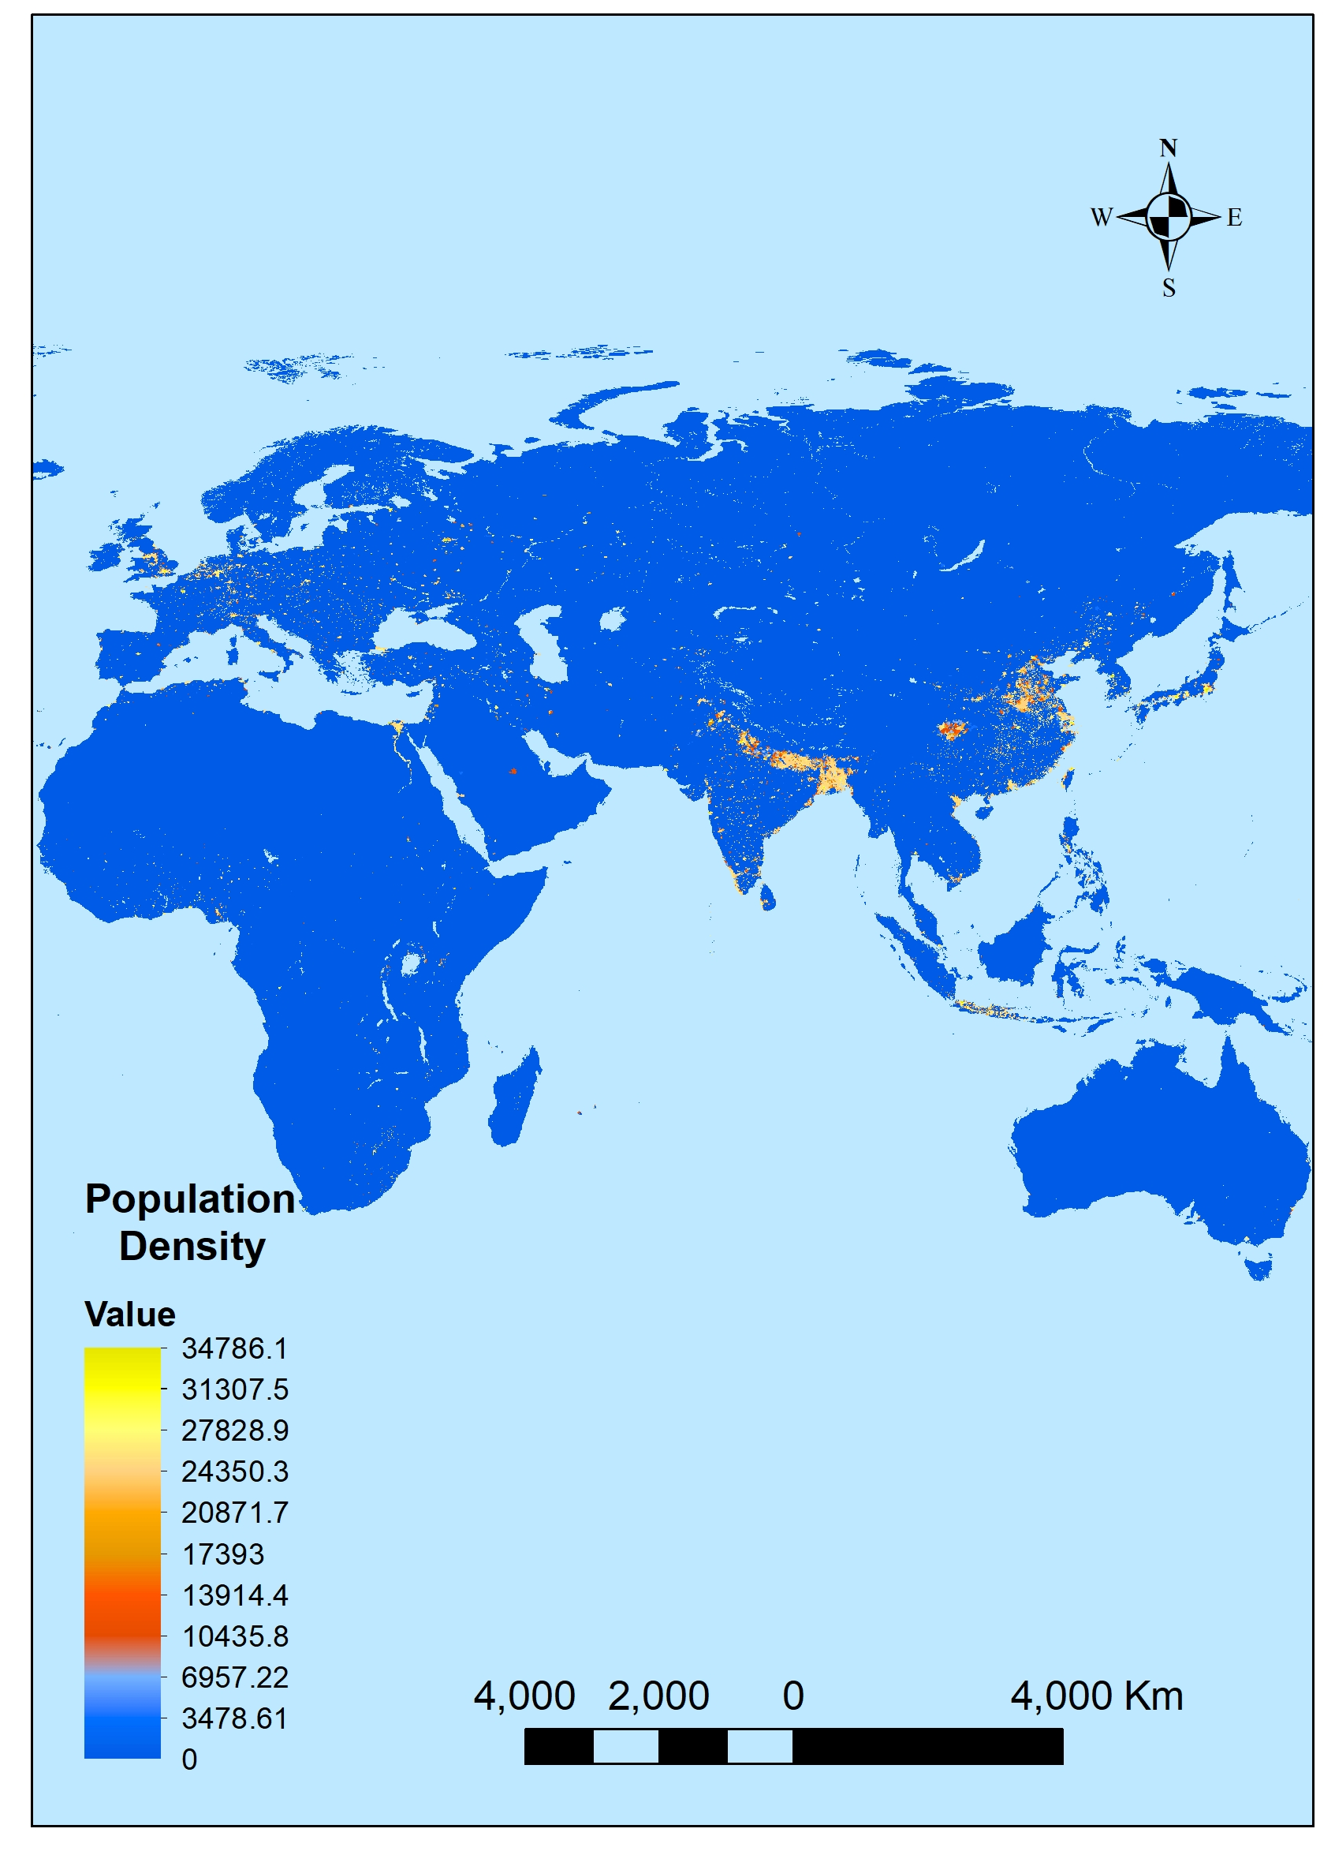
Population density
Approximate population density at the village level where the prevalence studies took place were obtained from the Global Rural-Urban Mapping Project - GRUMP project (Balk et al. 2006).
GRUMP raster data used to extract population density were from:
1990 (extracted population data from 1990-1994)
1995 (extracted population data from 1995 – 1999)
2000 (extracted population data from 2000 – 2004)
2005 (extracted population data from 2005 -2009)
2010 (extracted population data from 2010 – 2014)
2015 (extracted population data from 2015 -2017)
Data were imported into ArcGIS software version10.8 and population density data at each location in our prevalence dataset was extracted using the “extract values to points” tool from the spatial analysis toolset.
GRUMP v1: Population density 1990

Slide 7
Adjusted gross domestic producto per capita
GDP per capita adjusted for price changes over time (inflation) from 1970 to 2017 were obtained from the Economic Growth project (Roser, 2013). Adjusted GDP per capita data was obtained by country and by year for each of the countries were the malaria prevalence studies took place.

Slide 8
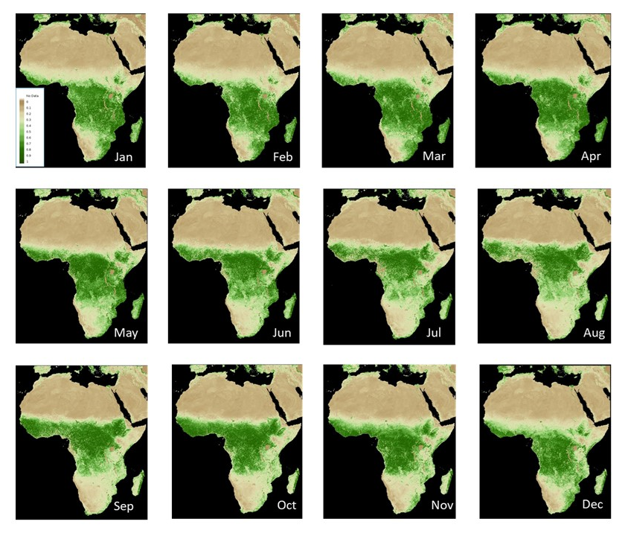
Normalize difference vegetation index
Monthly NDVI data at the village level were extracted from NDVI raster data from FEWS-NET from July 2002 to 2017.
To get data from years previous to July 2002, raster data sets from 2003 to 2007 by month were combined and the mean calculated using the “Cell Statistics” mean function from ArcMap 10.8.1.
For Asia, FEWS-NET NDVI data were not available for Indonesia and Papua New Guinea. We used the NDVI data from the Borneo deforestation 2000-2012 project.
FEWS-NET: NDVI data by month from 2005 - Africa

Slide 9
Temperature data
Monthly minimum, maximum and average temperature in Celsius degree from 1970 to 2017 was obtained from the WorldClim Global Climate Data Project – WorldClim
The temperature data has a 5 minutes resolution (17.3 km2)
From the WorldClim monthly temperature data we calculated an aggregated mean temperature for the minimum, maximum, and average temperature for four quarters prior to the start month of each malaria prevalence study (e.g., qtmin1, qtmean1, qtmx1 in data-set).

Slide 10
Precipitation
Monthly average precipitation in mm from 1970 to 2017 was obtained from the WorldClim GlobalClimate Data Project – WorldClim
The precipitation data obtained from WorldClim has a 5 minutes resolution (17.3 km2).
From the WorldClim montly precipitation data we calculated an aggregated mean precipitation for four quarters prior to the start month of each malaria prevalence study (e.g., qprecp1, qprecp2 in data-set)

Slide 11
Bioclimatic variables
Monthly data from 19 bioclimatic variables (e.g., Mean annual temperature, mean annual precipitation) was obtained from the WorldClim Global DataProject - WorldClim
Bioclimatic variables are derived from the monthly temperature and precipitation values.
For our final models we used Isothermality (bio3), Maximum temperature of warmest month (bio5), Minimum temperature of coldest month (bio6), Precipitation of driest quarter (bio17), and precipitation of warmest quarter (bio18). Other bioclimatic variables are highly correlated with temperature (qtmean) and precipitation (qprecp) variables.

Slide 12
Basic reproductive number – R0
The Basic Reproductive Number-R0 data was extracted from (Villena et al., 2020). R0 data included R0 posterior samples and temperature data from 5◦C to 45◦C with data points at intervals of 0.1◦C.
R0data points were matched with aggregated mean temperature for each of the four quarters (qtmean1 – qtmean4) prior to the start month of each malaria prevalence study using temperature as a merging variable.

Slide 13
Manuscript: Data analysis using GLM and CART models
Presence/absence of malaria prevalence is our predicted variable, and it is treated as binary data,
We will analyze the data using two different approaches: a generalized linear model (GLM) and a classification and regression tree (CART).
We categorized each location in our dataset with a binary response variable to indicate whether or not malaria had been observed at that location in our prevalence dataset, that is we defined the response yi for the ith location as yi=1 if malaria prevalence > 0 and yi=0 if malaria prevalence = 0.
In the GLM analysis, we used the following predictors: mean temperature for the two previous quarters to the start of the study, mean precipitation for the two previous quarters to the start of the study, isothermality (bio3), maximum temperature of warmest month (bio5), min temperature of coldest month (bio6), precipitation of warmest quarter (bio17), precipitation of coldest quarter (bio18), gross domestic product, population density, reproductive number (Ro) for the two previous quarters of the start of the study, year in which the study start, elevation, and NDVI index.
We implemented the GLMs using the function glm from the stats package in R (Team et al., 2013)

Slide 14
Manuscript: Data analysis using GLM and CART models
Next, we analyzed our data using a classification and regression tree (CART) approach.
For the CART approach we used the rpart function from the rpart (Recursive partioning and regression trees) package in R (Team et al., 2013).
The rpart function works by splitting the dataset recursively, which means that the subsets that result from a split are further split until a predetermined termination criterion is reached.
Estimated time for 1st manuscript draft: November 30th, 2020.

Slide 15
Possible manuscript 2: Data analysis by country (only for countries rich on data)
We Will focus the data analysis on rich data countries
Plasmodium falciparum:
Africa: Kenya, Somalia, Tanzania, Mozambique, Burundi, Ethiopia
Asia: Indonesia, Afghanistan, Philippines
Plasmodium vivax
1. Africa: Ethiopia, Madagascar
2. Asia: Indonesia, Philippines, Afghanistan, Bangladesh, Solomon Islands, Vanuatu

Slide 16
References
Balk, D. L., Deichmann, U., Yetman, G., Pozzi, F., Hay, S. I., and Nelson, A. (2006). Determiningglobal population distribution: methods, applications and data.Advances in parasitology, 62:119–156.
Lippi, C., Gaff, H., White, A., St. John, H., Richards, A., and Ryan, S. 2020. Exploring the niche of Ritkettsia montanensis (Ritkettsiales:Rickettsiaceae) infection of the American dog tick (Acari:Ixodidae), using multiple species distribution model approaches. MedRxiv, doi: https://doi.org/10.1101/2020.09.29.20204149
Roser, M. (2013). Economic growth.Our World in Data. https://ourworldindata.org/economic-growth.
Villena, O.C., Ryan, S.J., Murdock, C.C., Johnson, L.R. 2020. Temperature impacts the transmission of malaria parasites by Anopheles gambiae and Anopheles stephensi mosquitoes. bioRxiv, https://doi.org/10.1101/2020.07.08.194472

