Slide 1
Schrodinger’s Equation
Dylan McIntyre and Nicholas Jira

Slide 2
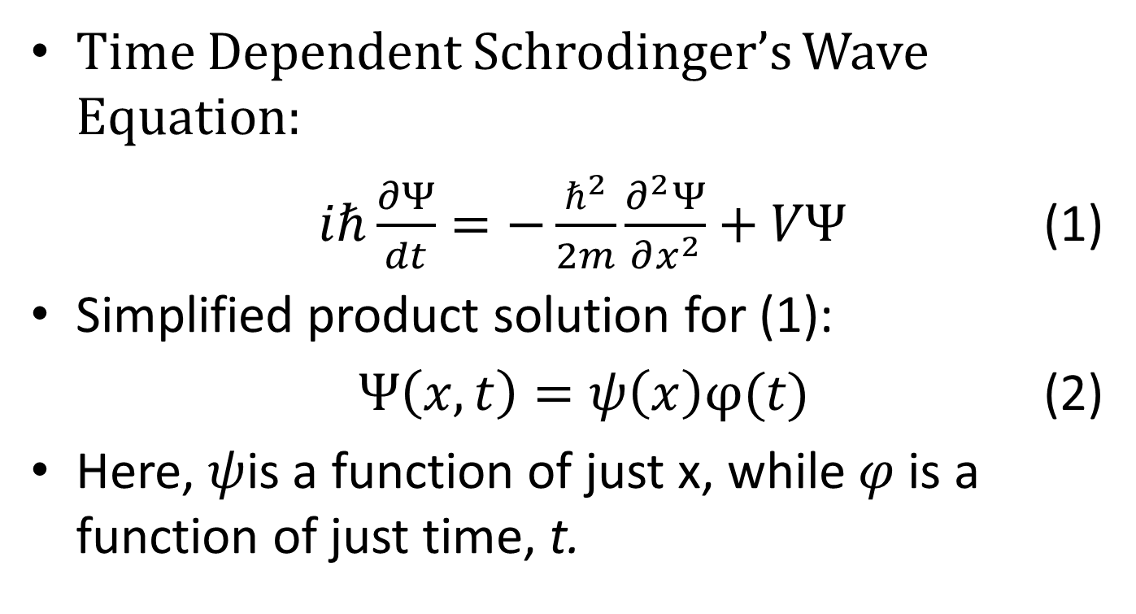
Time Dependent
Time Dependent Schrodinger’s Wave Equation:
$iℏ\frac{∂Ψ}{dt}=−\frac{ℏ^{2}}{2m}\frac{∂^{2}Ψ}{∂x^{2}}+VΨ$ (1)
Simplified product solution for (1):
$Ψ\left(x,t\right)=ψ\left(x\right)φ(t)$ (2)
Here, $ψ$is a function of just x, while $φ$ is a function of just time, t.

Slide 3
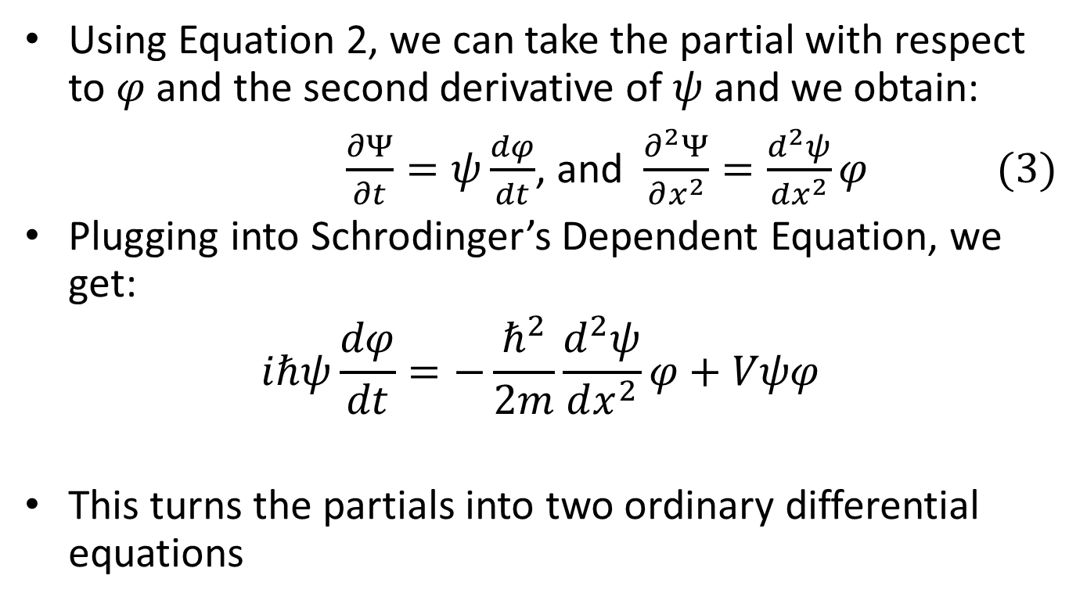
Using Equation 2, we can take the partial with respect to $φ$ and the second derivative of $ψ$ and we obtain:
$\frac{∂Ψ}{∂t}=ψ\frac{dφ}{dt}$, and $\frac{∂^{2}Ψ}{∂x^{2}}=\frac{d^{2}ψ}{dx^{2}}φ (3)$
Plugging into Schrodinger’s Dependent Equation, we get:
$$iℏψ\frac{dφ}{dt}=−\frac{ℏ^{2}}{2m}\frac{d^{2}ψ}{dx^{2}}φ+Vψφ$$
This turns the partials into two ordinary differential equations

Slide 4
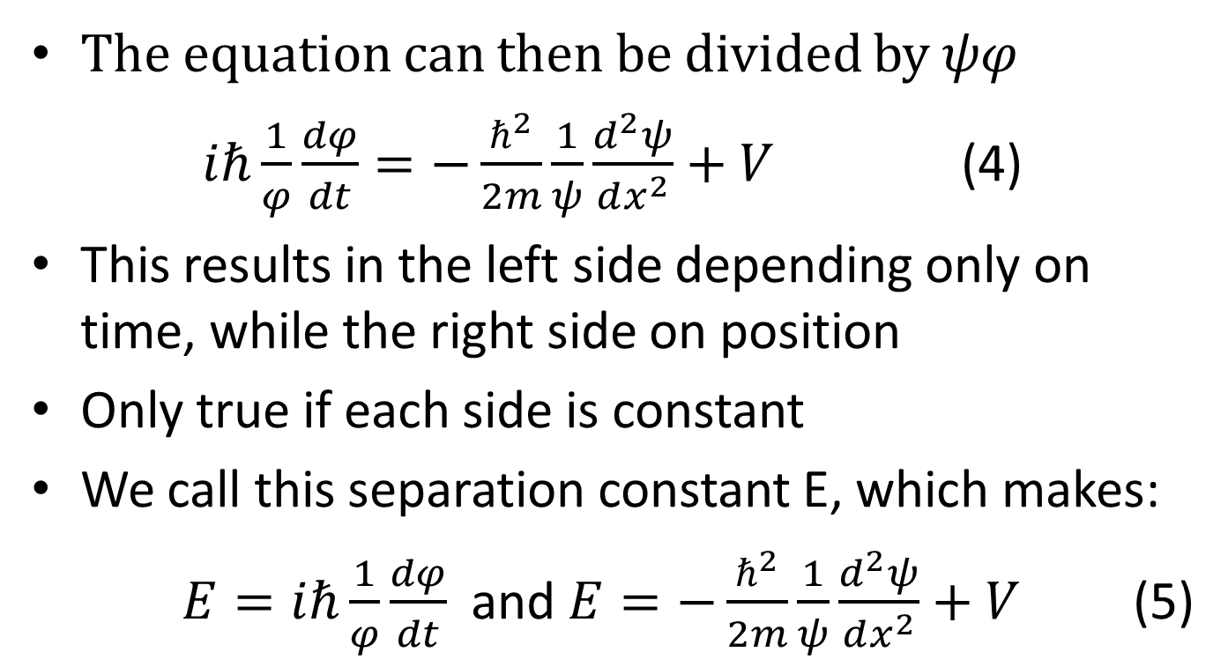
The equation can then be divided by $ψφ$
$iℏ\frac{1}{φ}\frac{dφ}{dt}=−\frac{ℏ^{2}}{2m}\frac{1}{ψ}\frac{d^{2}ψ}{dx^{2}}+V$ (4)
This results in the left side depending only on time, while the right side on position
Only true if each side is constant
We call this separation constant E, which makes:
$E=iℏ\frac{1}{φ}\frac{dφ}{dt}$ and $E=−\frac{ℏ^{2}}{2m}\frac{1}{ψ}\frac{d^{2}ψ}{dx^{2}}+V$ (5)

Slide 5
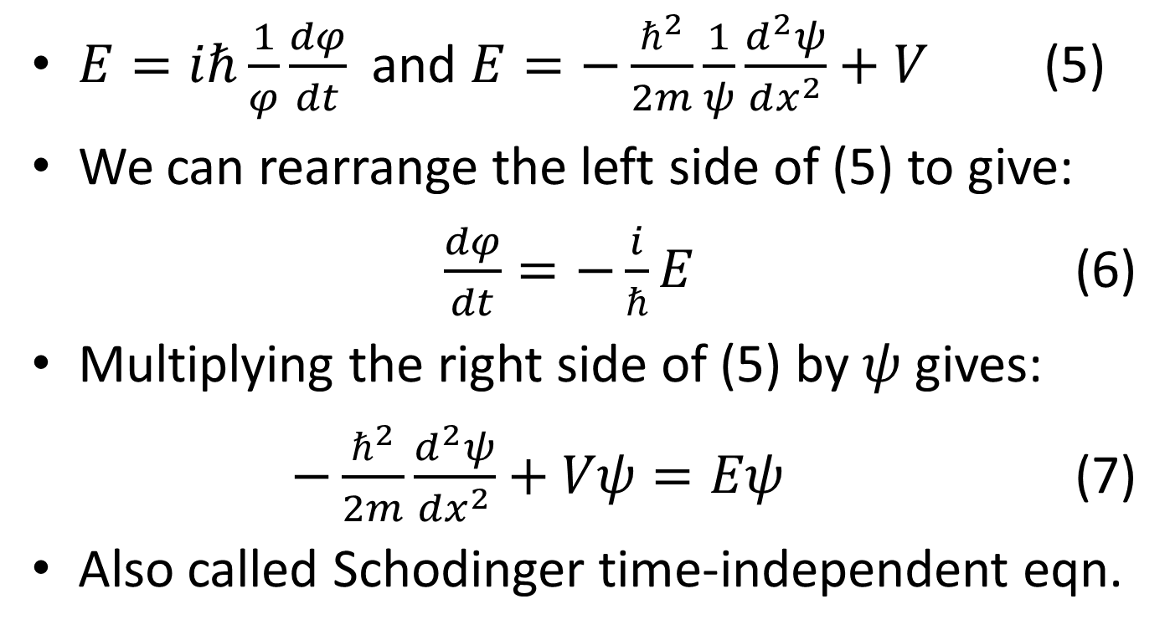
$E=iℏ\frac{1}{φ}\frac{dφ}{dt}$ and $E=−\frac{ℏ^{2}}{2m}\frac{1}{ψ}\frac{d^{2}ψ}{dx^{2}}+V$ (5)
We can rearrange the left side of (5) to give:
$\frac{dφ}{dt}=−\frac{i}{ℏ}E$ (6)
Multiplying the right side of (5) by $ψ$ gives:
$−\frac{ℏ^{2}}{2m}\frac{d^{2}ψ}{dx^{2}}+Vψ=Eψ$ (7)
Also called Schodinger time-independent eqn.

Slide 6
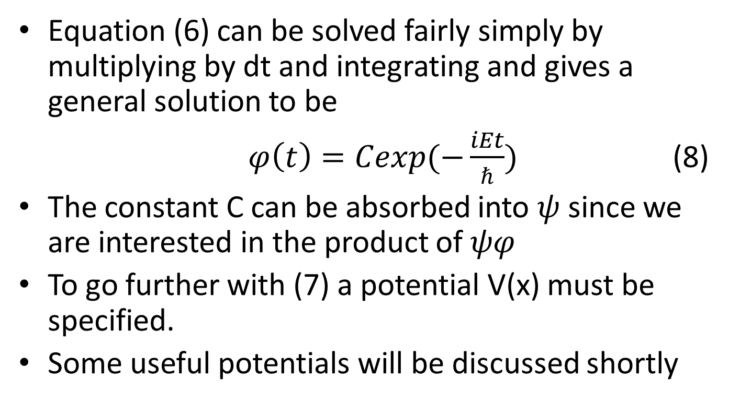
Equation (6) can be solved fairly simply by multiplying by dt and integrating and gives a general solution to be
$φ\left(t\right)=Cexp(−\frac{iEt}{ℏ})$ (8)
The constant C can be absorbed into $ψ$ since we are interested in the product of $ψφ$
To go further with (7) a potential V(x) must be specified.
Some useful potentials will be discussed shortly

Slide 7
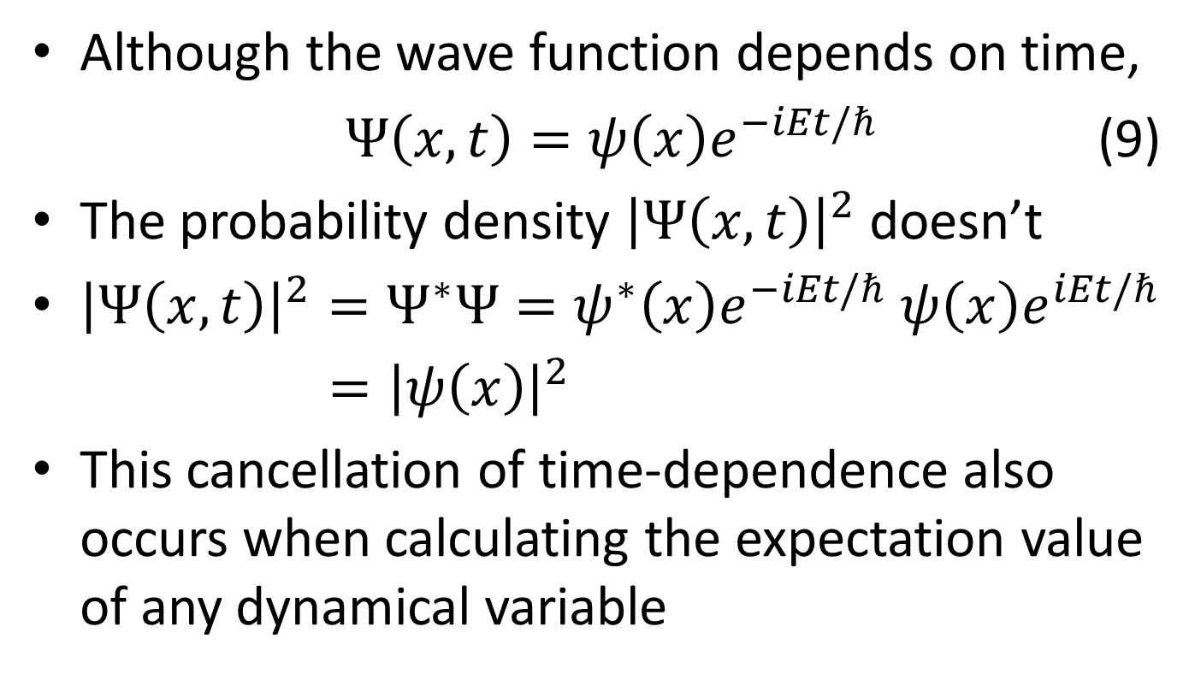
Usefulness of Separable Solutions
Although the wave function depends on time,
$Ψ\left(x,t\right)=ψ\left(x\right)e^{−iEt/ℏ}$ (9)
The probability density ${\left|Ψ\left(x,t\right)\right|}^{2}$ doesn’t
${\left|Ψ\left(x,t\right)\right|}^{2}=Ψ^{∗}Ψ=ψ^{∗}\left(x\right)e^{−iEt/ℏ}$ $ψ\left(x\right)e^{iEt/ℏ}$
$={\left|ψ\left(x\right)\right|}^{2}$
This cancellation of time-dependence also occurs when calculating the expectation value of any dynamical variable

Slide 8
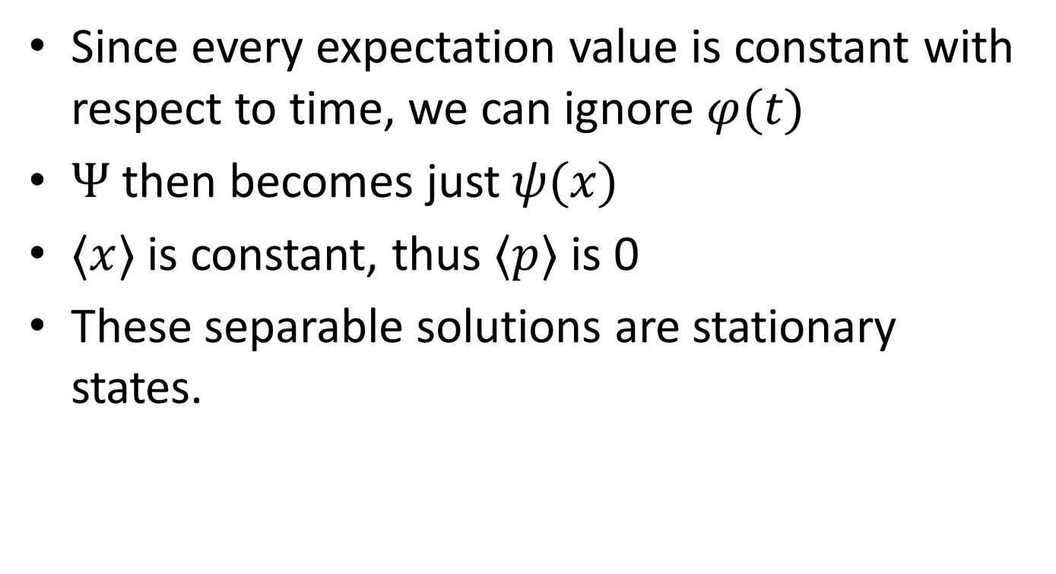
Stationary States
Since every expectation value is constant with respect to time, we can ignore $φ(t)$
$Ψ$ then becomes just $ψ(x)$
$〈x〉$ is constant, thus $〈p〉$ is 0
These separable solutions are stationary states.

Slide 9
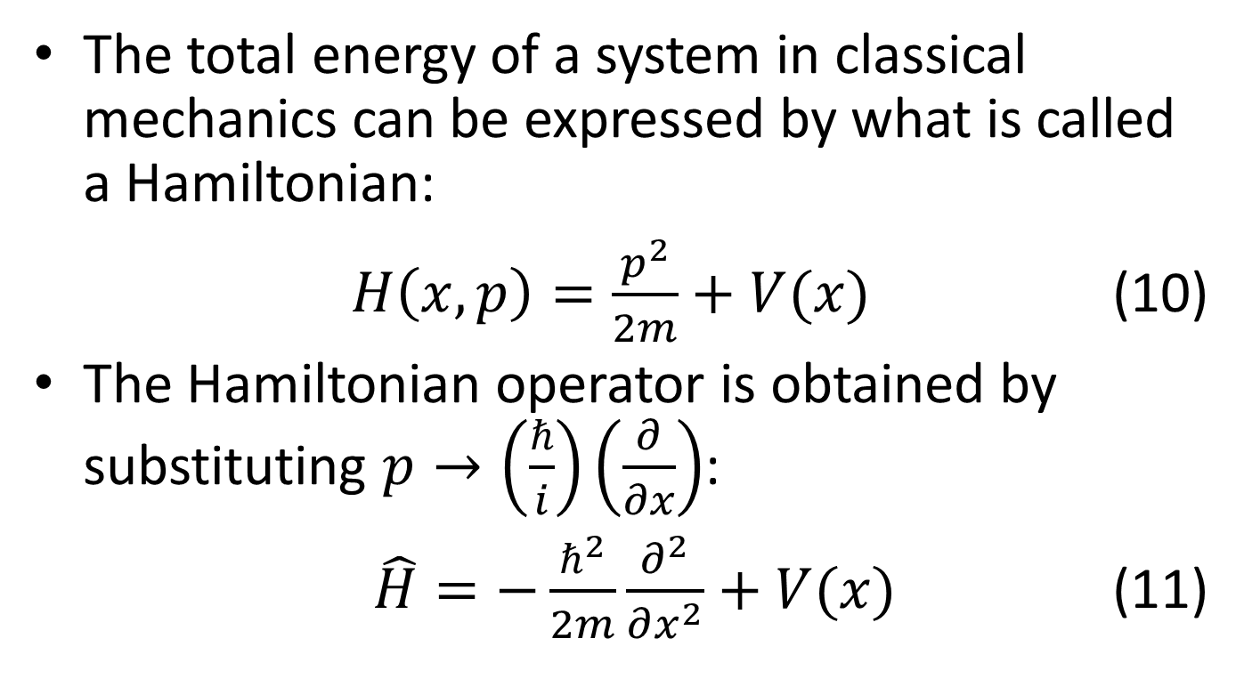
Definite Total Energy
The total energy of a system in classical mechanics can be expressed by what is called a Hamiltonian:
$H\left(x,p\right)=\frac{p^{2}}{2m}+V(x)$ (10)
The Hamiltonian operator is obtained by substituting $p→\left(\frac{ℏ}{i}\right)\left(\frac{∂}{∂x}\right)$:
$\hat{H}=−\frac{ℏ^{2}}{2m}\frac{∂^{2}}{∂x^{2}}+V(x)$ (11)

Slide 10
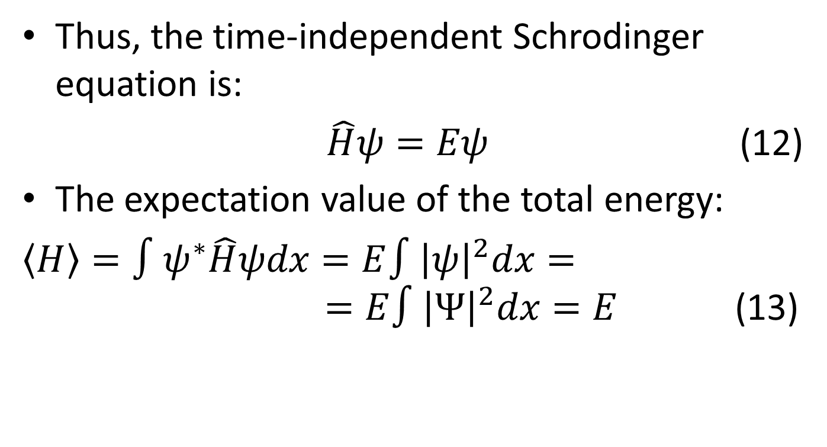
Thus, the time-independent Schrodinger equation is:
$\hat{H}ψ=Eψ$ (12)
The expectation value of the total energy:
$〈H〉=∫ψ^{∗}\hat{H}ψdx=E∫{\left|ψ\right|}^{2}dx= =E∫{\left|Ψ\right|}^{2}dx=E$ (13)

Slide 11
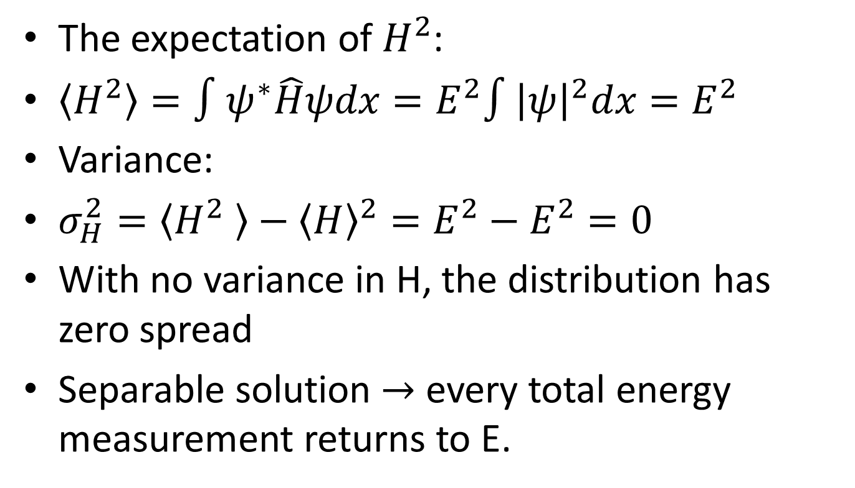
The expectation of $H^{2}$:
$〈H^{2}〉=∫ψ^{∗}\hat{H}ψdx=E^{2}∫{\left|ψ\right|}^{2}dx=E^{2}$
Variance:
$σ_{H}^{2}=〈H^{2} 〉−{〈H〉}^{2}=E^{2}−E^{2}=0$
With no variance in H, the distribution has zero spread
Separable solution $→$ every total energy measurement returns to E.

Slide 12
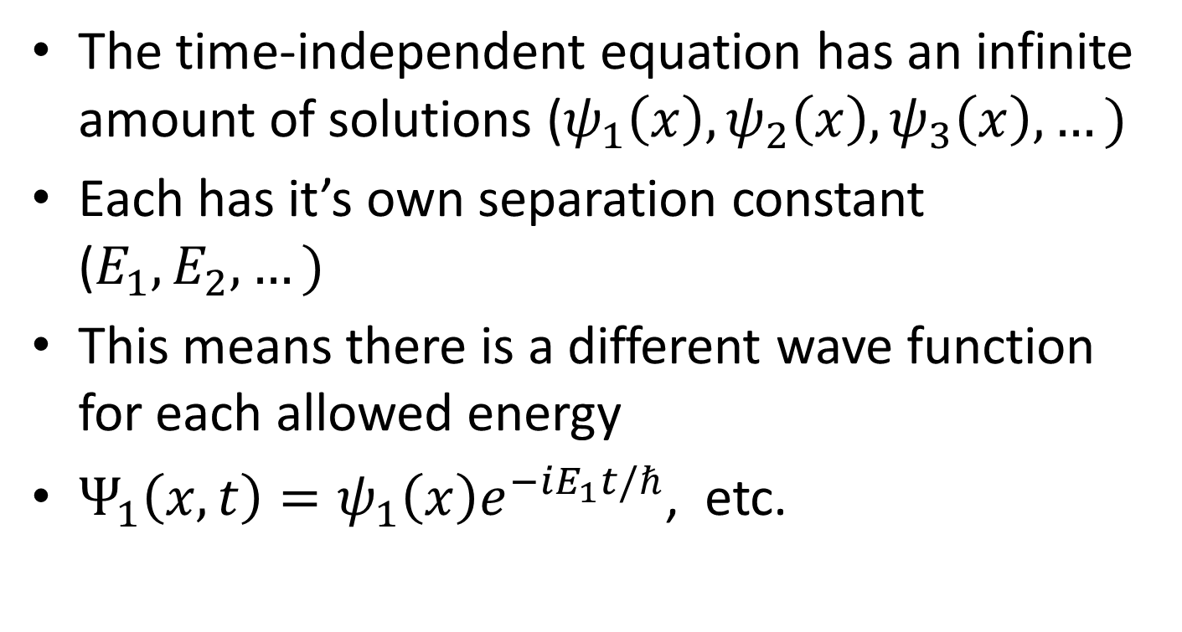
Linear Combinations
The time-independent equation has an infinite amount of solutions ($ψ_{1}\left(x\right), ψ_{2}\left(x\right),ψ_{3}\left(x\right),…)$
Each has it’s own separation constant ($E_{1}, E_{2},…)$
This means there is a different wave function for each allowed energy
$Ψ_{1}\left(x,t\right)=ψ_{1}\left(x\right)e^{−iE_{1}t/ℏ}$, etc.

Slide 13
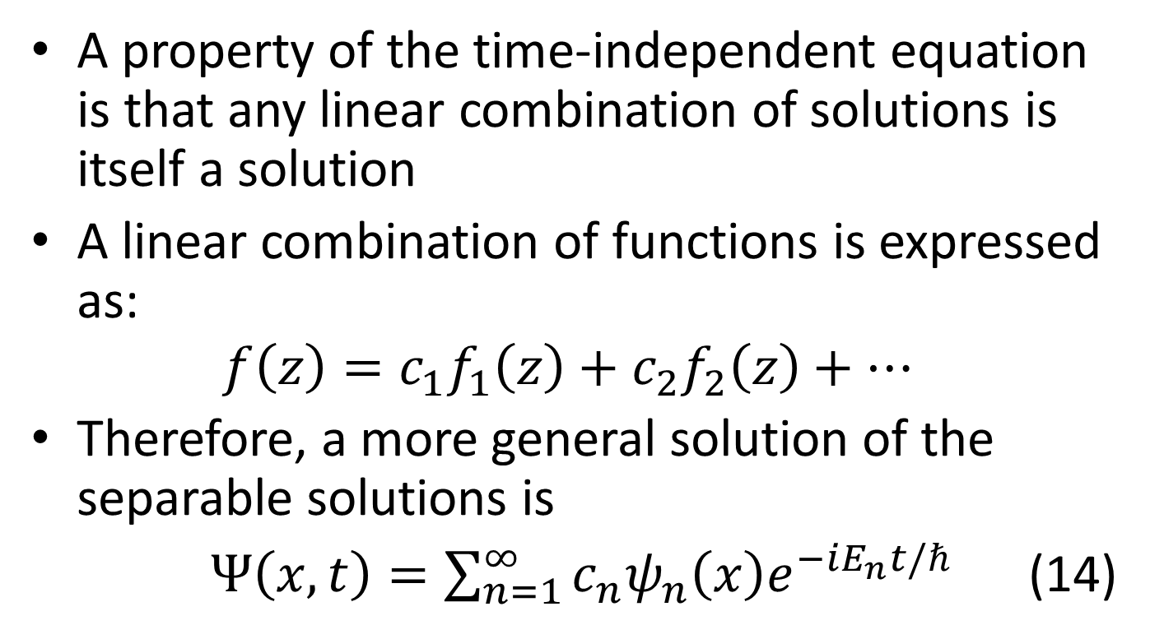
Linear Combinations
A property of the time-independent equation is that any linear combination of solutions is itself a solution
A linear combination of functions is expressed as:
$$f\left(z\right)=c_{1}f_{1}\left(z\right)+c_{2}f_{2}\left(z\right)+…$$
Therefore, a more general solution of the separable solutions is
$Ψ\left(x,t\right)=\sum_{n=1}^{∞}{c_{n}ψ_{n}\left(x\right)e^{−iE_{n}t/ℏ}}$ (14)

Slide 14
Linear Combinations
Every solution to the time-dependent equation can be written in the form of (14)
After solving the time-independent equation, it is relatively straightforward in principle to obtain the general solution to the time-dependent equation

Slide 15
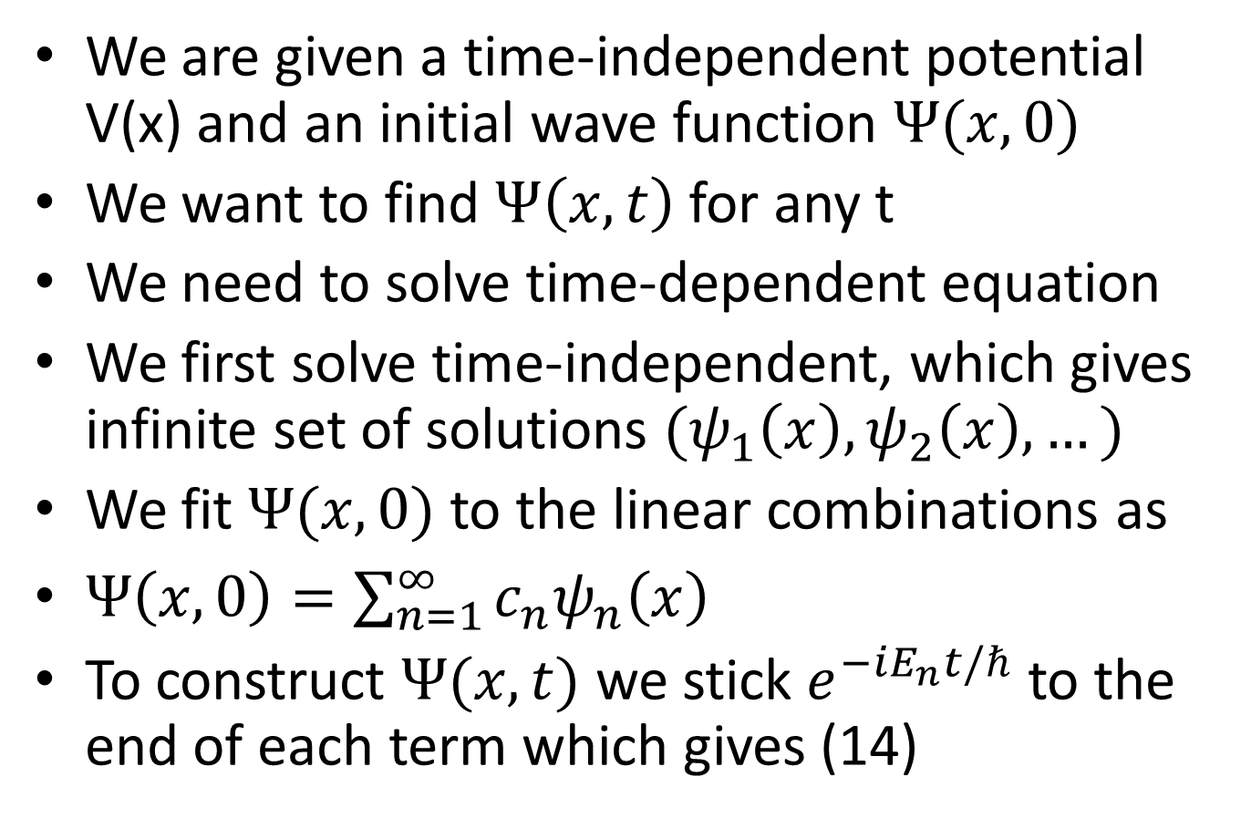
To Summarize..
We are given a time-independent potential V(x) and an initial wave function $Ψ(x,0)$
We want to find $Ψ\left(x,t\right)$ for any t
We need to solve time-dependent equation
We first solve time-independent, which gives infinite set of solutions $(ψ_{1}\left(x\right), ψ_{2}\left(x\right), …)$
We fit $Ψ(x,0)$ to the linear combinations as
$Ψ\left(x,0\right)=\sum_{n=1}^{∞}{c_{n}ψ_{n}\left(x\right)}$
To construct $Ψ(x,t)$ we stick $e^{−iE_{n}t/ℏ}$ to the end of each term which gives (14)

Slide 16
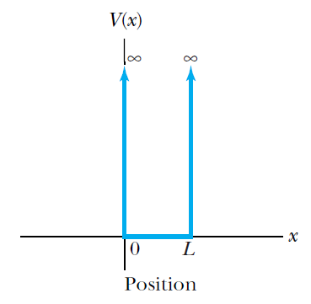
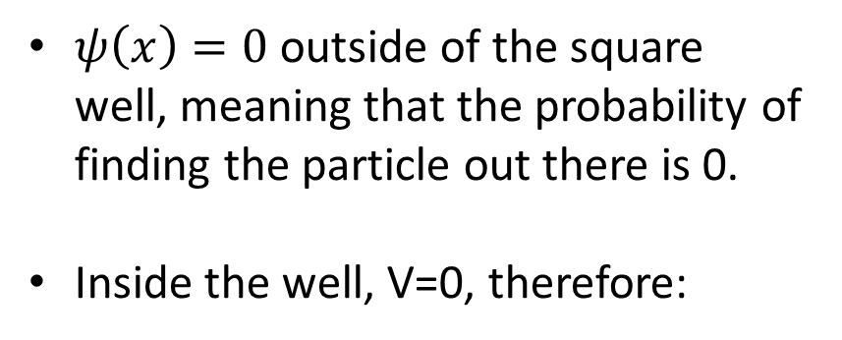
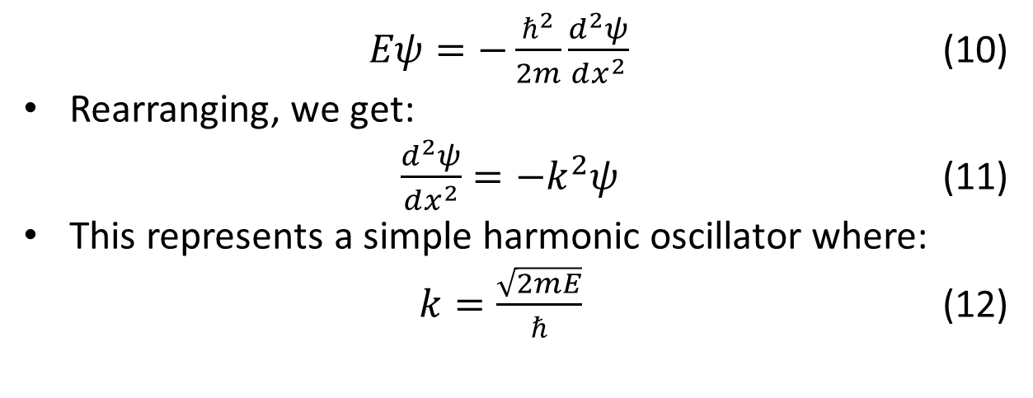
The Infinite Square Well
$ψ\left(x\right)=0$ outside of the square well, meaning that the probability of finding the particle out there is 0.
Inside the well, V=0, therefore:
$Eψ=−\frac{ℏ^{2}}{2m}\frac{d^{2}ψ}{dx^{2}}$ (10)
Rearranging, we get:
$\frac{d^{2}ψ}{dx^{2}}=−k^{2}ψ$ (11)
This represents a simple harmonic oscillator where:
$k=\frac{\sqrt{2mE}}{ℏ}$ (12)

Slide 17
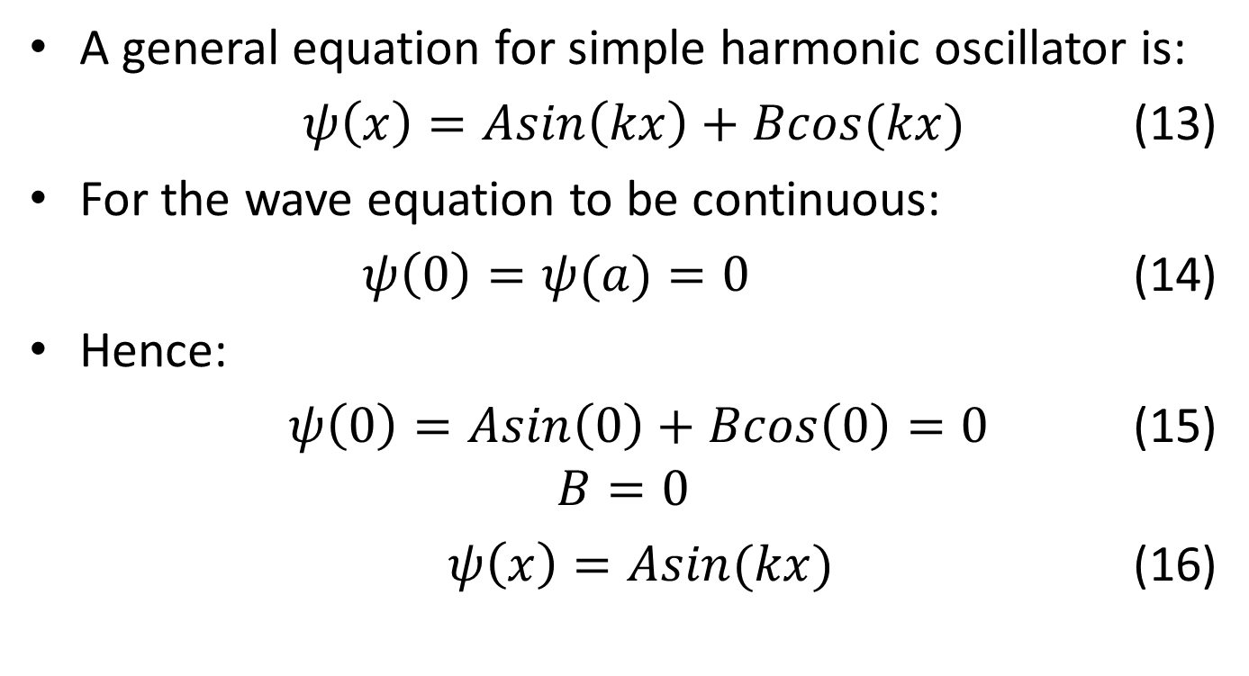
The Infinite Square Well
A general equation for simple harmonic oscillator is:
$ψ\left(x\right)=Asin\left(kx\right)+Bcos(kx)$ (13)
For the wave equation to be continuous:
$ψ\left(0\right)=ψ(a)=0$ (14)
Hence:
$ψ\left(0\right)=Asin\left(0\right)+Bcos\left(0\right)=0$ (15)
$$B=0$$
$ψ\left(x\right)=Asin(kx)$ (16)

Slide 18
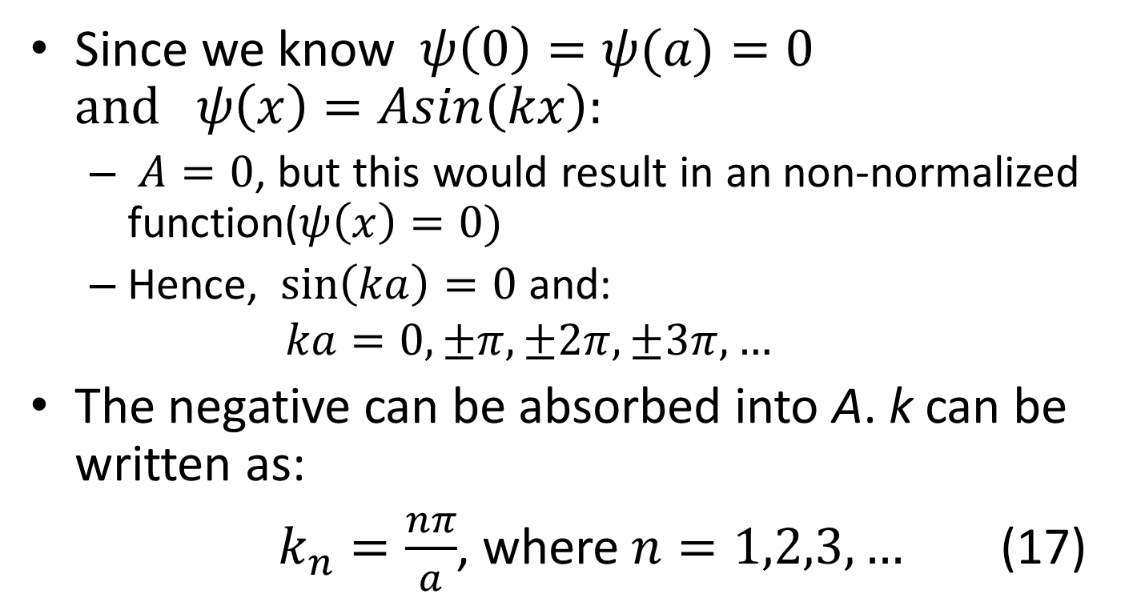
Infinite Square Well
Since we know $ψ\left(0\right)=ψ(a)=0$ $and ψ\left(x\right)=Asin\left(kx\right):$
$A=0$, but this would result in an non-normalized function($ψ\left(x\right)=0)$
Hence, $\sin\left(ka\right)=0$ and:
$$ka=0,±π,±2π,±3π,…$$
The negative can be absorbed into A. k can be written as:
$k_{n}=\frac{nπ}{a}$, where $n=1,2,3,…$ (17)

Slide 19
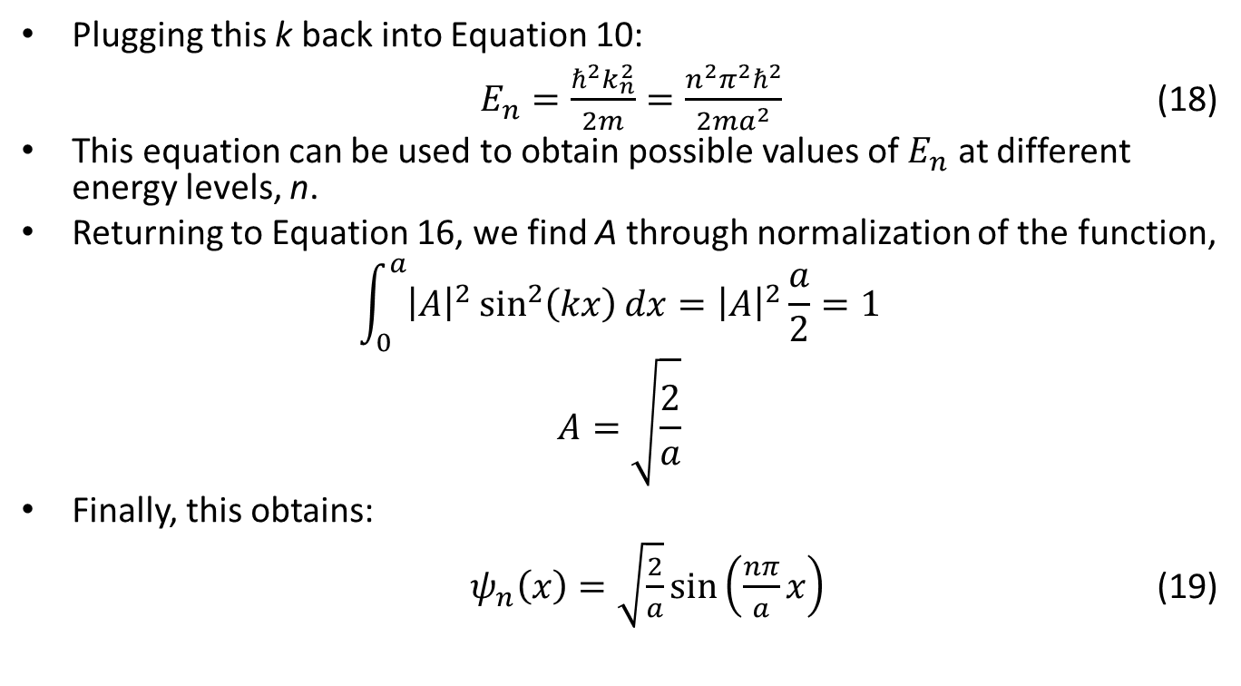
Infinite Square Well
Plugging this k back into Equation 10:
$E_{n}=\frac{ℏ^{2}k_{n}^{2}}{2m}=\frac{n^{2}π^{2}ℏ^{2}}{2ma^{2}}$ (18)
This equation can be used to obtain possible values of $E_{n}$ at different energy levels, n.
Returning to Equation 16, we find A through normalization of the function,
$$\int_{0}^{a}{{\left|A\right|}^{2}\sin^{2}\left(kx\right)dx}={\left|A\right|}^{2}\frac{a}{2}=1$$
$$A=\sqrt{\frac{2}{a}}$$
Finally, this obtains:
$ψ_{n}\left(x\right)=\sqrt{\frac{2}{a}}\sin\left(\frac{nπ}{a}x\right)$ (19)

Slide 20
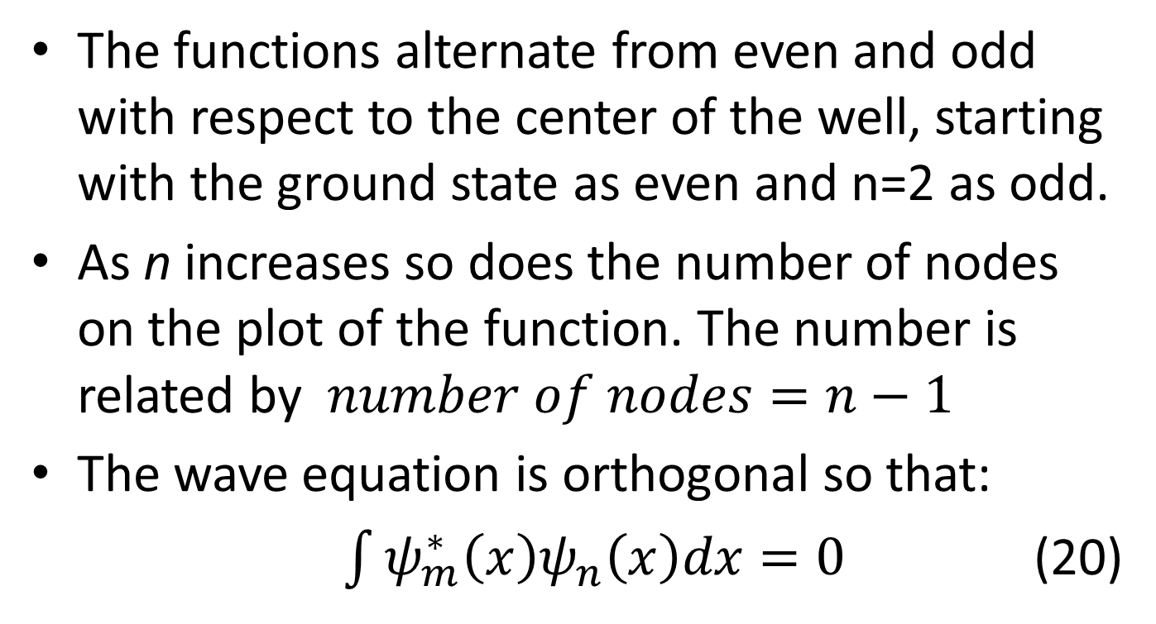
Properties of the Wave Equation
The functions alternate from even and odd with respect to the center of the well, starting with the ground state as even and n=2 as odd.
As n increases so does the number of nodes on the plot of the function. The number is related by $number of nodes=n−1$
The wave equation is orthogonal so that:
$\int{ψ_{m}^{∗}\left(x\right)ψ_{n}\left(x\right)dx=0}$ (20)

Slide 21
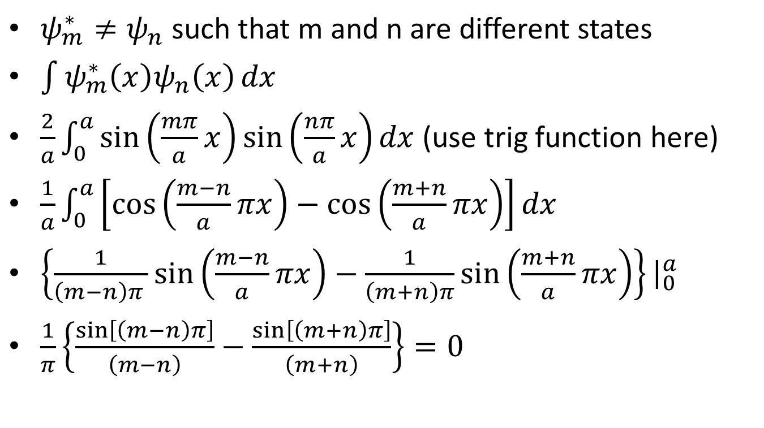
Mutually Orthogonal Proof
$ψ_{m}^{∗}≠ψ_{n}$ such that m and n are different states
$\int{ψ_{m}^{∗}\left(x\right)ψ_{n}\left(x\right)}dx$
$\frac{2}{a}\int_{0}^{a}{\sin\left(\frac{mπ}{a}x\right)\sin\left(\frac{nπ}{a}x\right)dx }$(use trig function here)
$\frac{1}{a}\int_{0}^{a}{\left[\cos\left(\frac{m−n}{a}πx\right)−\cos\left(\frac{m+n}{a}πx\right)\right]dx }$
$\left\{\frac{1}{\left(m−n\right)π }\sin\left(\frac{m−n}{a}πx\right)−\frac{1}{\left(m+n\right)π}\sin\left(\frac{m+n}{a}πx\right)\right\}{\left.​\right|}_{0}^{a}$
$\frac{1}{π}\left\{\frac{\sin\left[\left(m−n\right)π\right]}{\left(m−n\right)}−\frac{\sin\left[\left(m+n\right)π\right]}{\left(m+n\right)}\right\}=0$

Slide 22
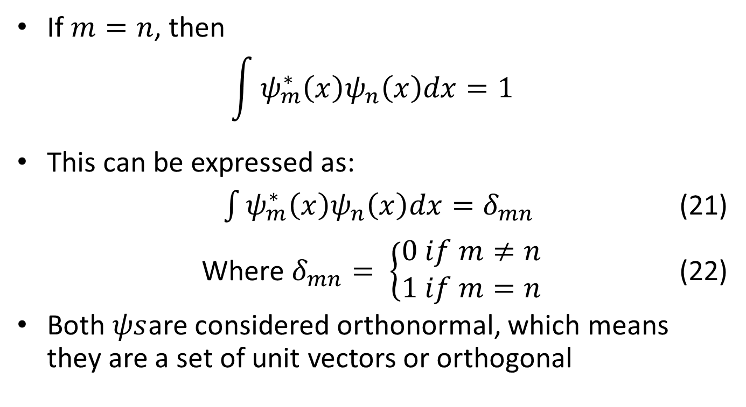
Mutually Orthogonal Proof
If $m=n$, then
$$\int{ψ_{m}^{∗}\left(x\right)ψ_{n}\left(x\right)dx=1}$$
This can be expressed as:
$\int{ψ_{m}^{∗}\left(x\right)ψ_{n}\left(x\right)dx=δ_{mn}}$ (21)
Where $δ_{mn}= \left\{\begin{aligned}0 if m≠n \\ 1 if m=n\end{aligned}\right.$ (22)
Both $ψs$are considered orthonormal, which means they are a set of unit vectors or orthogonal

Slide 23
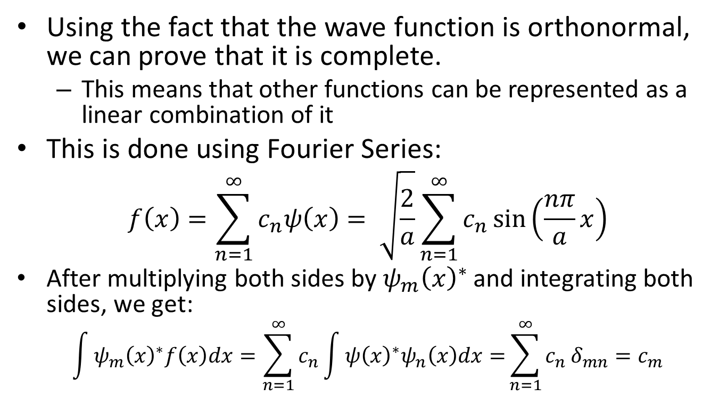
Completeness
Using the fact that the wave function is orthonormal, we can prove that it is complete.
This means that other functions can be represented as a linear combination of it
This is done using Fourier Series:
$$f\left(x\right)=\sum_{n=1}^{∞}{c_{n}ψ\left(x\right)}= \sqrt{\frac{2}{a}}\sum_{n=1}^{∞}{c_{n}\sin\left(\frac{nπ}{a}x\right)}$$
After multiplying both sides by$ψ_{m}{\left(x\right)}^{∗}$ and integrating both sides, we get:
$$\int{ψ_{m}{\left(x\right)}^{∗}f\left(x\right)dx}=\sum_{n=1}^{∞}{c_{n}}\int{ψ{\left(x\right)}^{∗}ψ_{n}\left(x\right)dx=}\sum_{n=1}^{∞}{c_{n}}δ_{mn}=c_{m}$$

Slide 24
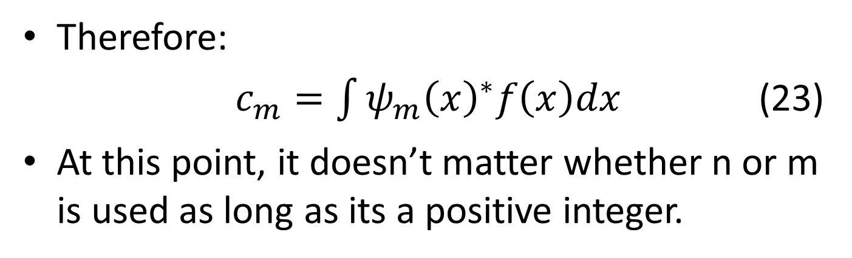
Completeness
Therefore:
$c_{m}=\int{ψ_{m}{\left(x\right)}^{∗}f\left(x\right)dx}$ (23)
At this point, it doesn’t matter whether n or m is used as long as its a positive integer.

Slide 25
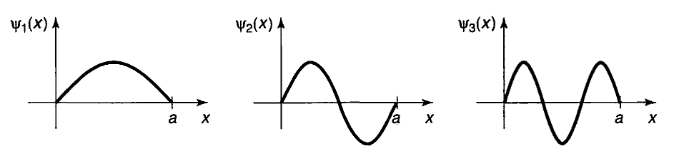

Slide 26
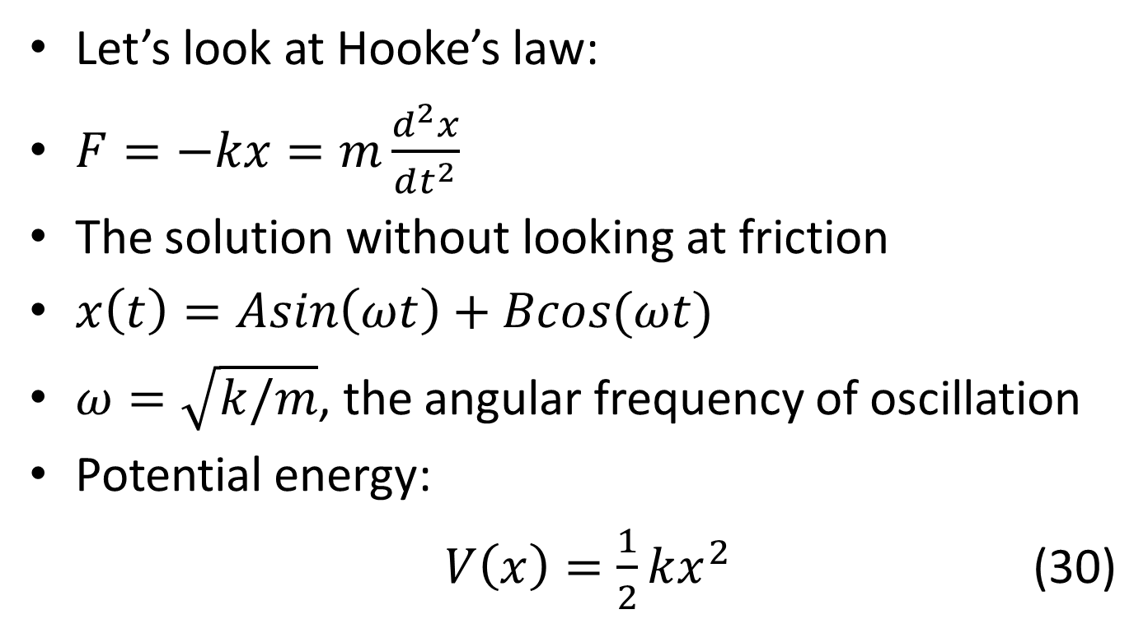
The Harmonic Oscillator
Let’s look at Hooke’s law:
$F=−kx=m\frac{d^{2}x}{dt^{2}}$
The solution without looking at friction
$x\left(t\right)=Asin\left(ωt\right)+Bcos(ωt)$
$ω=\sqrt{k/m}$, the angular frequency of oscillation
Potential energy:
$V\left(x\right)=\frac{1}{2}kx^{2}$ (30)

Slide 27
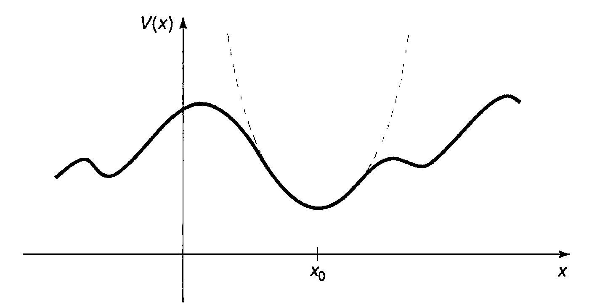
Parabolic Behavior
Graph taken from Griffiths
Nearly all potential approximately display parabolic behavior near the local minimum

Slide 28
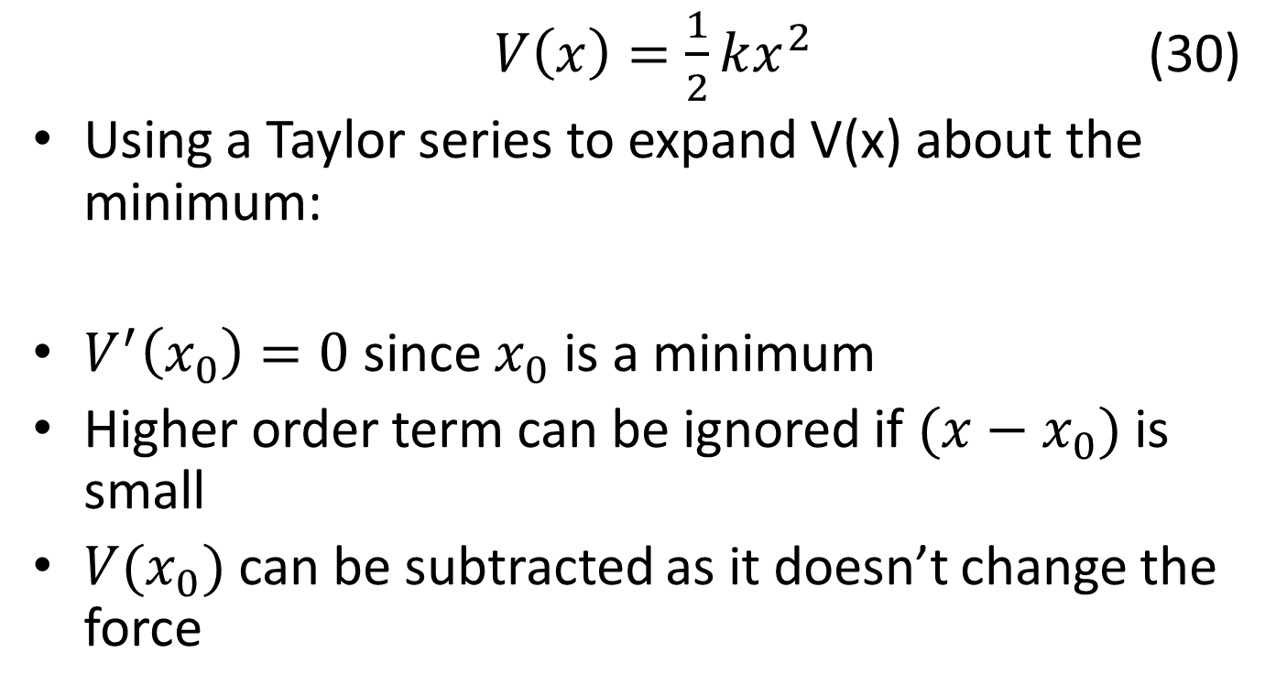
$V\left(x\right)=\frac{1}{2}kx^{2}$ (30)
Using a Taylor series to expand V(x) about the minimum:
$V^{′}\left(x_{0}\right)=0$ since $x_{0}$ is a minimum
Higher order term can be ignored if $(x−x_{0})$ is small
$V(x_{0})$ can be subtracted as it doesn’t change the force

Slide 29
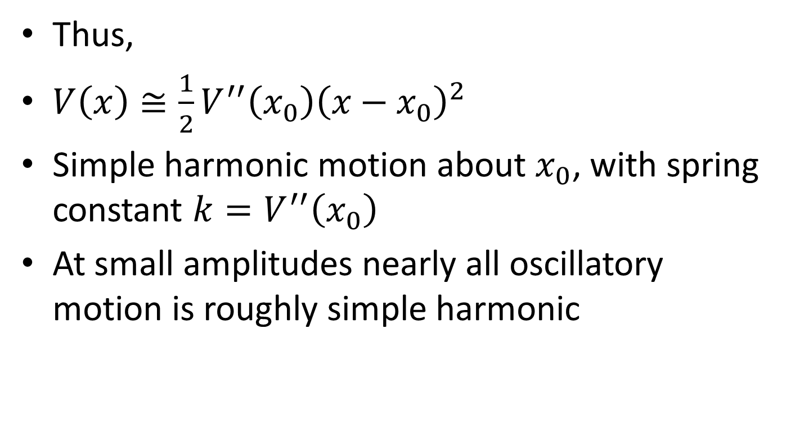
Thus,
$V\left(x\right)≅\frac{1}{2}V^{′′}\left(x_{0}\right){\left(x−x_{0}\right)}^{2}$
Simple harmonic motion about $x_{0}$, with spring constant $k=V^{′′}\left(x_{0}\right)$
At small amplitudes nearly all oscillatory motion is roughly simple harmonic

Slide 30
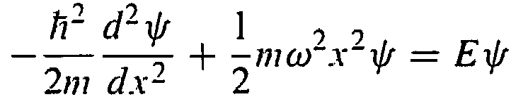
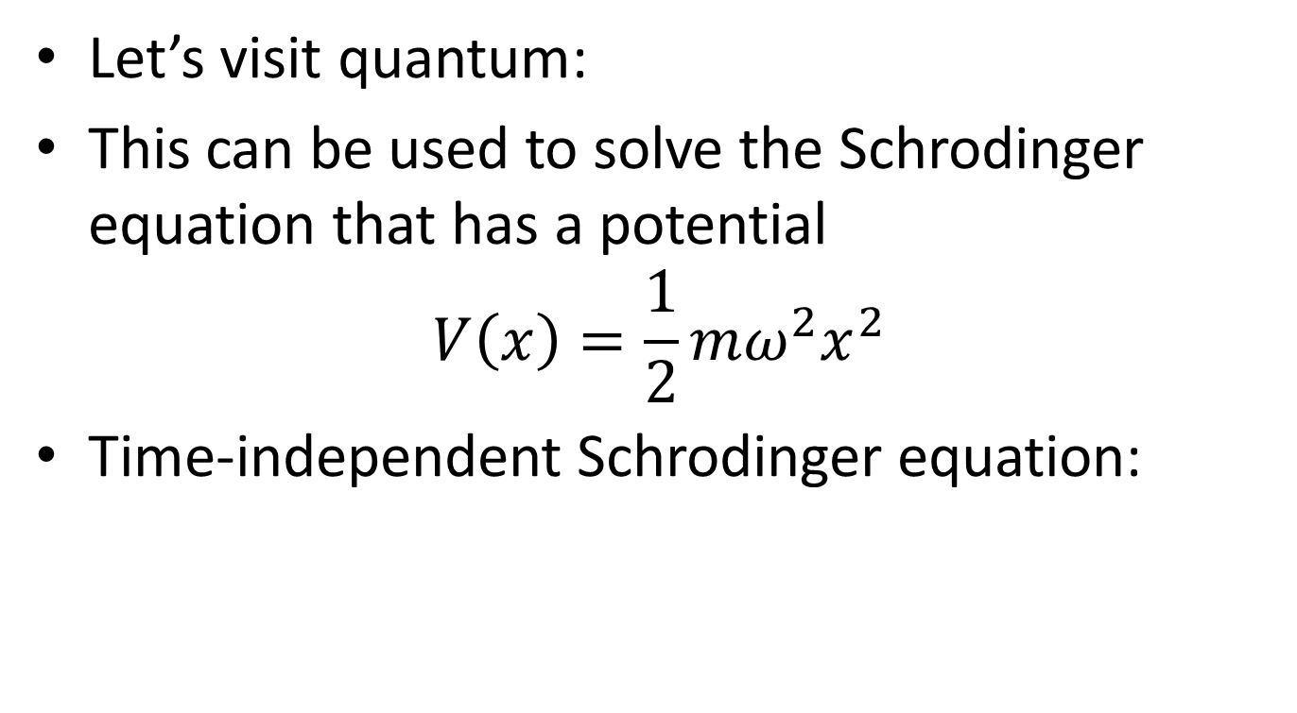
Let’s visit quantum:
This can be used to solve the Schrodinger equation that has a potential
$$V\left(x\right)=\frac{1}{2}mω^{2}x^{2}$$
Time-independent Schrodinger equation:

Slide 31
Two methods:
Power Series Method – “Brute force” method can be applied to many different potentials
Ladder Operators – “diabolically clever algebraic technique”

Slide 32
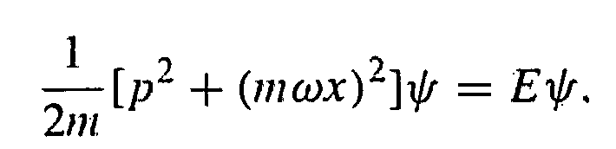
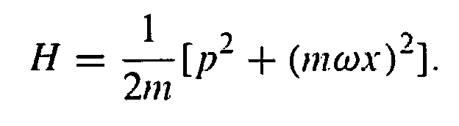
Algebraic Method
Rewrite Schrodinger’s Equation (with simple harmonic potential) using the momentum operator
This allows us to get the Hamiltonian

Slide 33

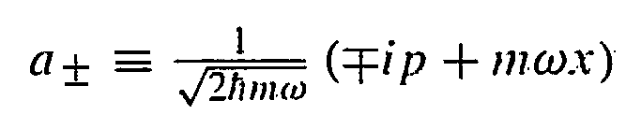
In the case of numbers we have a identity:
However, since p is an operator, it does not generally commute. But, let’s examine this anyways.

Slide 34
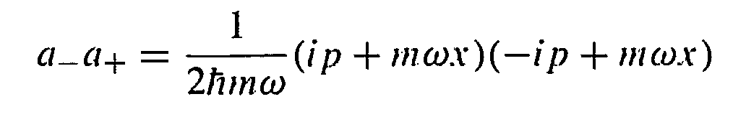
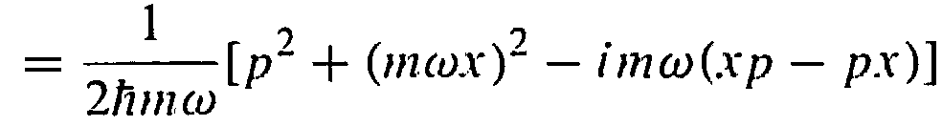
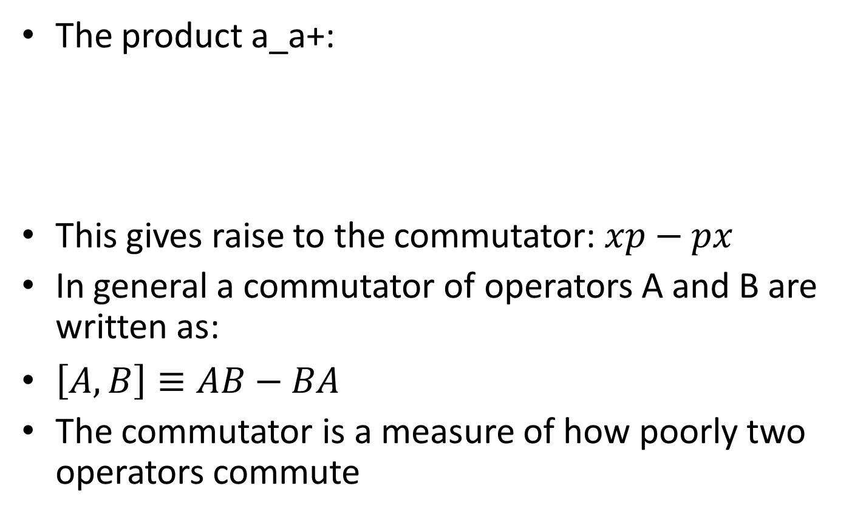
The product a_a+:
This gives raise to the commutator: $xp−px$
In general a commutator of operators A and B are written as:
$\left[A,B\right]≡AB−BA$
The commutator is a measure of how poorly two operators commute

Slide 35
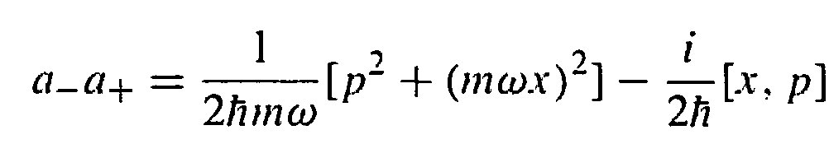

Using the new notation:
Operators are tricky and so we introduce a “test function” that they can act on
Now the function can be thrown away
This is called the canonical commutation relation

Slide 36
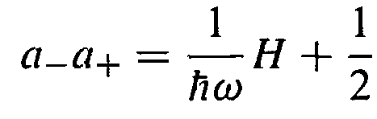
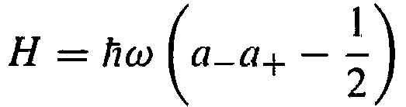
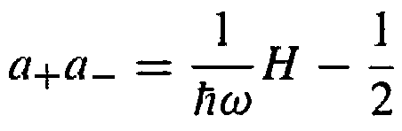
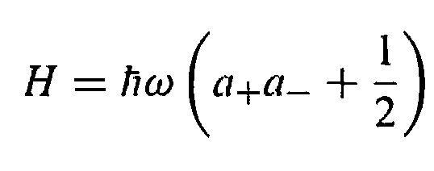

$a_{−}a_{+}$then becomes
The reversal of a’s would result in

Slide 37
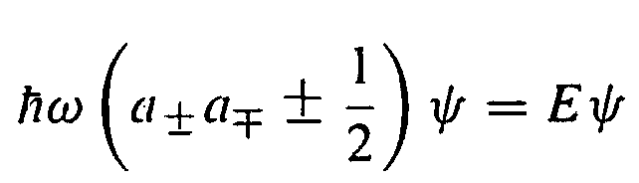
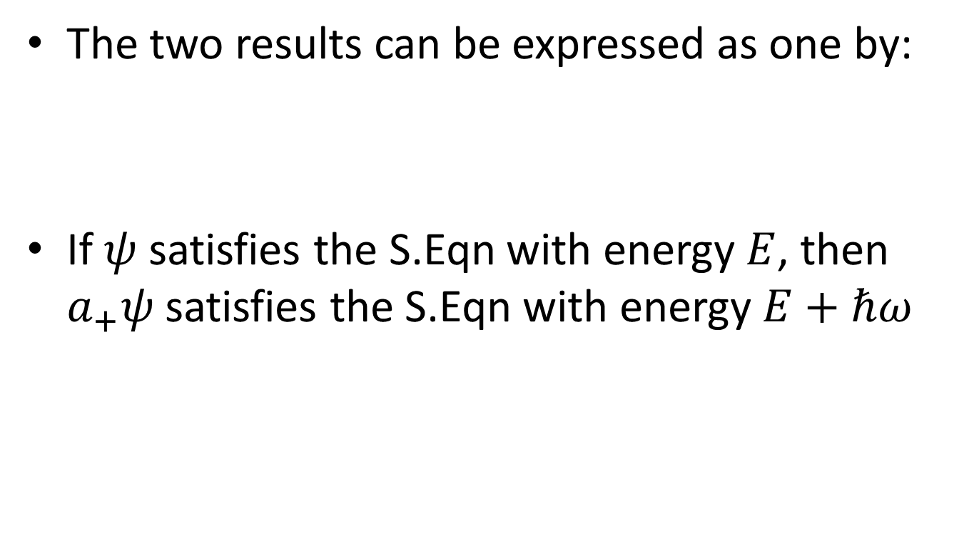
The two results can be expressed as one by:
If $ψ$ satisfies the S.Eqn with energy $E$, then $a_{+}ψ$ satisfies the S.Eqn with energy $E+ℏω$

Slide 38
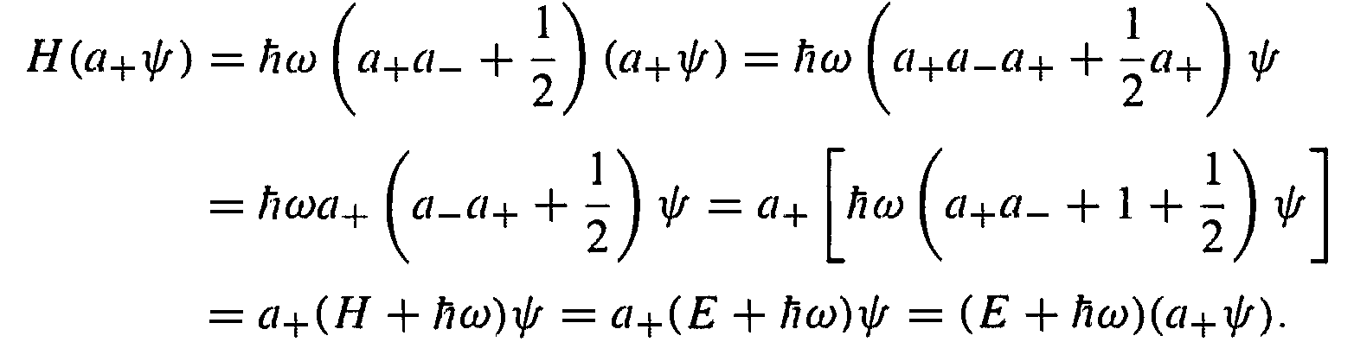
Proof (from Griffiths):

Slide 39
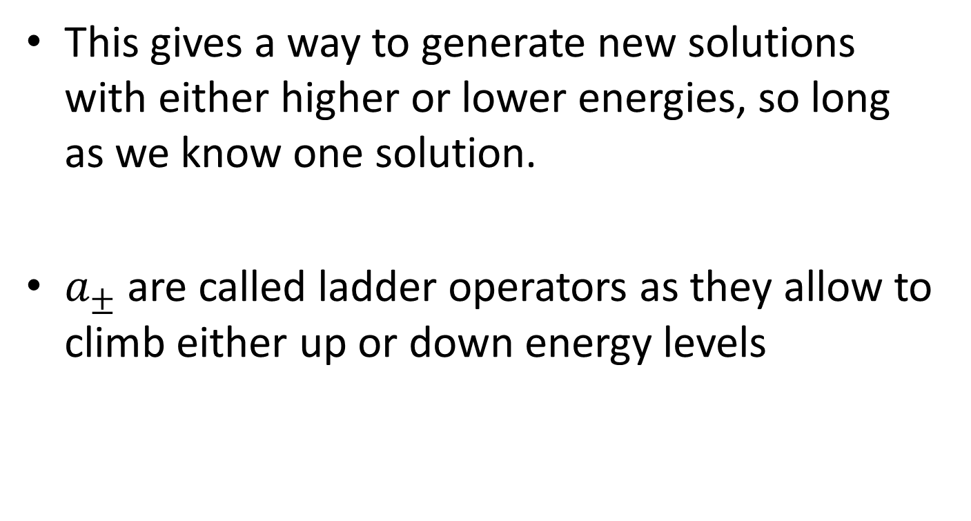
This gives a way to generate new solutions with either higher or lower energies, so long as we know one solution.
$a_{±}$ are called ladder operators as they allow to climb either up or down energy levels

Slide 40
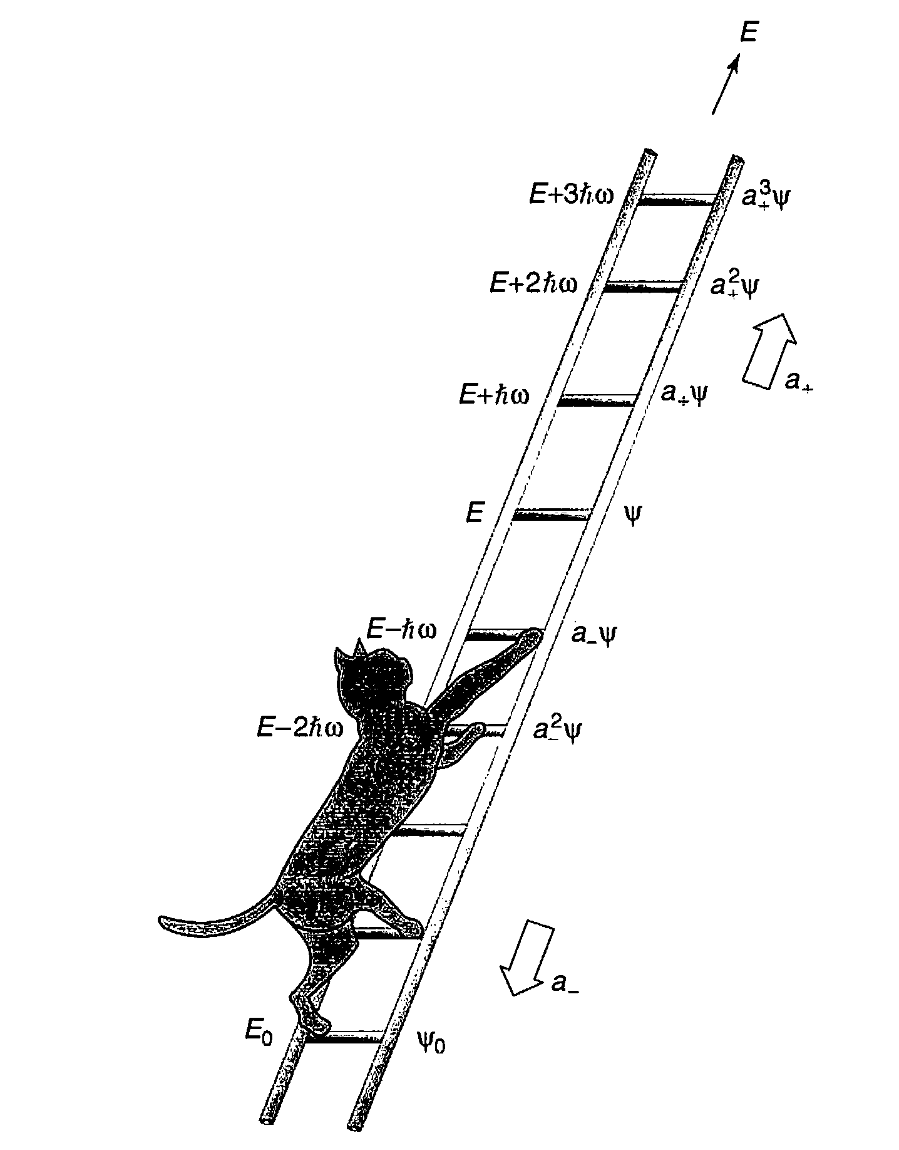
From Griffiths

Slide 42
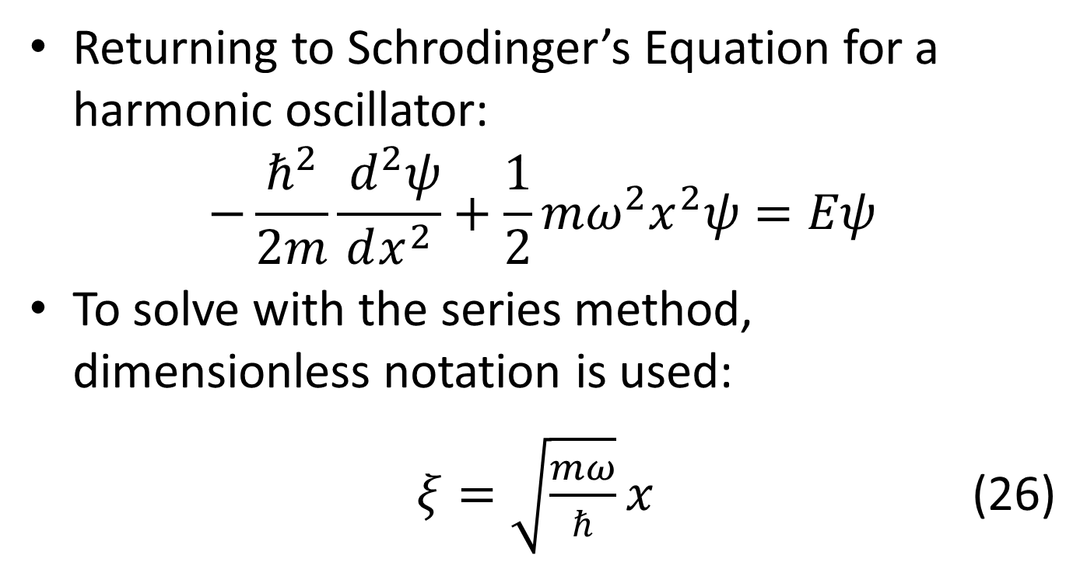
Analytical Method
Returning to Schrodinger’s Equation for a harmonic oscillator:
$$−\frac{ℏ^{2}}{2m}\frac{{ d}^{2}ψ}{dx^{2}}+\frac{1}{2}mω^{2}x^{2}ψ=Eψ$$
To solve with the series method, dimensionless notation is used:
$ξ=\sqrt{\frac{mω}{ℏ}}x$ (26)

Slide 43
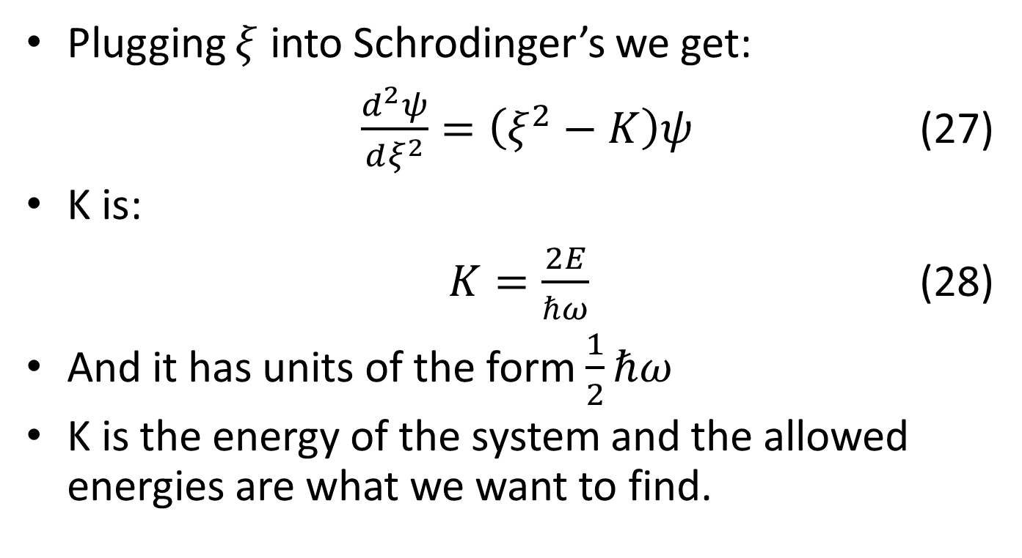
Analytical Method
Plugging $ξ$ into Schrodinger’s we get:
$\frac{d^{2}ψ}{dξ^{2}}=\left(ξ^{2}−K\right)ψ$ (27)
K is:
$K=\frac{2E}{ℏω}$ (28)
And it has units of the form $\frac{1}{2}ℏω$
K is the energy of the system and the allowed energies are what we want to find.

Slide 44

Analytical Method
If $ξ$ becomes much larger than K, then equation 27 becomes:
$\frac{d^{2}ψ}{dξ^{2}}≈ξ^{2}ψ$ (29)
The approximate solution is:
$ψ\left(ξ\right)≈Ae^{−\frac{ξ^{2}}{2}}+Be^{\frac{ξ^{2}}{2}}$ (30)
When trying to normalize B, x will approach infinity making it impossible to normalize
This gives the function a asymptotic form, meaning the solution will be close but not exact.

Slide 45

Power Series Method
So to get an exact function, we invoke the start of the power series to “strip off” the exponential.
This gives:
$ψ\left(ξ\right)=h\left(ξ\right)e^{−\frac{ξ^{2}}{2}}$ (31)
Now we derive (31):
$$\frac{dψ}{dξ}=\left(\frac{dh}{dξ}−ξh\right)e^{−\frac{ξ^{2}}{2}}$$
Taking the derivative again:
$\frac{d^{2}ψ}{dξ^{2}}=\left(\frac{d^{2}h}{dξ^{2}} −\frac{2ξdh}{dξ}+\left(ξ^{2}−1\right)h\right)e^{−\frac{ξ^{2}}{2}}$ (32)

Slide 46

Power Series Method
Plugging into Equation (27), the exponential cancels out leaving us with:
$\frac{d^{2}ψ}{dξ^{2}}−\frac{2ξdh}{dξ}+\left(K−1\right)h=0$ (33)
Now we can use the power series to find values for the energies.
$h\left(ξ\right)=a_{0}+a_{1}ξ+a_{2}ξ^{2}+⋯=\sum_{j=0}^{∞}{a_{j}ξ^{j}}$(34)

Slide 47

Power Series Method
Differentiating that twice, we obtain:
$$\frac{d^{2}h}{dξ^{2}}=2a^{2}+6a_{3}ξ+12a_{4}ξ^{2}+⋯=\sum_{j=0}^{∞}{\left(j+1\right)\left(j+2\right)a_{j+2}ξ^{2}}$$
We can plug the right side into Equation (33):
$$\sum_{j=0}^{∞}{\left[\left(j+1\right)\left(j+2\right)a_{j+2}−2ja_{j}+\left(K−1\right)a_{j}\right]ξ^{j }=0}$$
Then:
$\left(j+1\right)\left(j+2\right)a_{j+2}−2ja_{j}+\left(K−1\right)a_{j}=0$ (35)
Finally we get:
$a_{j+2}=\frac{2j+1−K}{(j+1)(j+2)}a_{j}$ (36)

Slide 48

Recursion Formula
The recursion formula calculates all the odd and even coefficients, a and is equivalent o Schrodinger equation.
For example, the even numbers:
$a_{2}=\frac{1−K}{2}a_{0}$ $a_{4}=\frac{5−k}{12}a_{2}$
And for odd:
$a_{3}=\frac{3−K}{6}a_{1}$ $a_{5}=\frac{7−k}{20}a_{3}$

Slide 49

Recursion Formula
The solution becomes another series:
$h\left(ξ\right)=h_{even}\left(ξ\right)+h_{odd}\left(ξ\right)$ (37)
$$h_{even}=a_{0}+a_{2}ξ^{2}+a_{4}ξ^{4}+⋯$$
$$h_{odd}=a_{1}ξ+a_{3}ξ^{3}+a_{5}ξ^{5}+⋯$$
The recursion formula can’t always obtain $h(ξ)$ because not all solutions are normalizable.
One example of this is for a very large j the recursion formula becomes:
$$a_{j+2}≈\frac{2}{j}a_{j}$$

Slide 50

Recursion Formula
The solution then becomes:
$a_{j}≈\frac{C}{\left(\frac{j}{2}\right)!}$ (38)
Where C is some constant.
When finding $h\left(ξ\right)$, this solution becomes:
$h\left(ξ\right)≈C\sum{\frac{1}{\frac{j}{2}}}ξ^{j}≈C\sum{\frac{1}{j!}ξ^{2j}}≈Ce^{ξ^{2}}$ (39)

Slide 51

Final Energy Equation
At this point, we need to end the power series otherwise the function will become asymptotic again when taking $e^{ξ^{2}}$.
We end it by setting a limit to j such that the limit, n, is:
$$a_{n+2}=0$$
From equation (36), this leads to:
$K=2n+1$ (40)
Lastly, going back to equation (28):
$E_{n}=\left(n+\frac{1}{2}\right)ℏω$ (41)

Slide 52
Questions?
Thanks for coming!
Special thanks to David J. Griffiths and his book Introduction to Quantum Mechanics

