Slide 1
Chapter 6 - Quantum Mechanics II
Dylan McIntyre and Nick Jira

Slide 2
Quantum Theory
Disagreement of quantum theory interpretation among different physicists
Two solutions proposed:
Werner Heisenberg: Matrix formulation of quantum mechanics
Erwin Schrodinger: Wave mechanics similar to mathematical of classical wave descriptions
Paul Dirac and Schrodinger later showed that the two proposed solutions are identical, just different in form

Slide 3


Schrodinger Wave Equation
A wave function was suggested to describe the motion of de Broglie’s wave theory for particles
Schrodinger Wave Equation (Time-Dependent, one dimension):
(1)
Schrodinger Wave Equation( Time- Independent):
(2)
Similar to Classical except it depends on first-order derivate of time
Position, energy and momentum can’t be know exactly or at the same time. The uncertainty principle needs to be considered as well as probability.

Slide 4
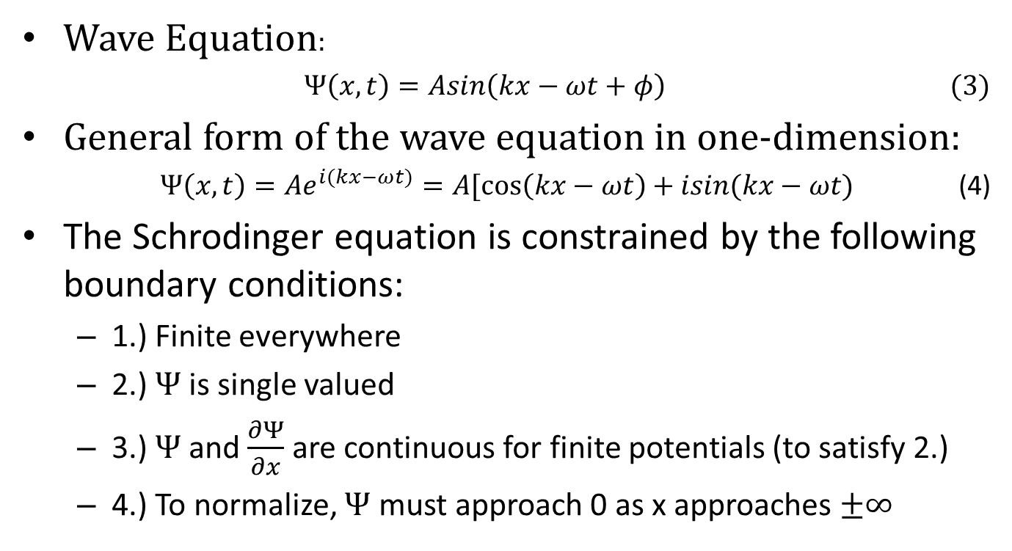
Schrodinger Wave Equation
Wave Equation:
$Ψ\left(x,t\right)=Asin\left(kx−ωt+φ\right)$ (3)
General form of the wave equation in one-dimension:
$Ψ\left(x,t\right)=Ae^{i(kx−ωt)}=A[\cos\left(kx−ωt\right)+isin(kx−ωt)$ (4)
The Schrodinger equation is constrained by the following boundary conditions:
1.) Finite everywhere
2.) $Ψ$ is single valued
3.) $Ψ$ and $\frac{∂Ψ}{∂x}$ are continuous for finite potentials (to satisfy 2.)
4.) To normalize, $Ψ$ must approach 0 as x approaches $±∞$

Slide 5
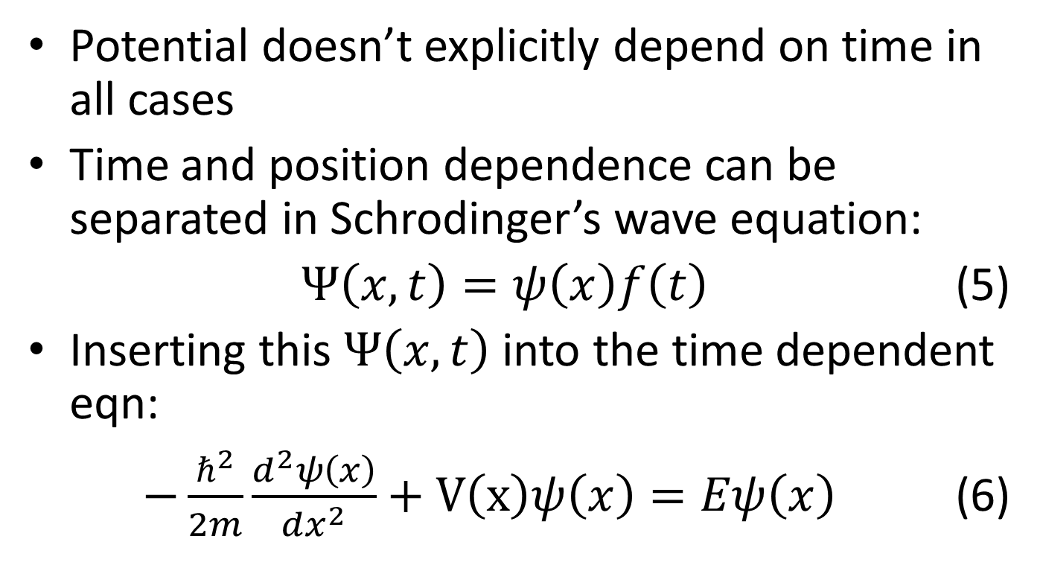
Schrodinger Wave Equation
Potential doesn’t explicitly depend on time in all cases
Time and position dependence can be separated in Schrodinger’s wave equation:
$Ψ\left(x,t\right)=ψ\left(x\right)f\left(t\right)$ (5)
Inserting this $Ψ\left(x,t\right)$ into the time dependent eqn:
$−\frac{ℏ^{2}}{2m}\frac{d^{2}ψ\left(x\right)}{dx^{2}}+V\left(x\right)ψ\left(x\right)=Eψ\left(x\right)$(6)

Slide 6


Normalization of Wave Function
Wave equations can be used to find the probable values of the particles position, energy, momentum, etc.
Before finding the probability, the wave function needs to be normalized
(7)
A normalized wave function can then be plugged in the following equation:
(8)

Slide 7
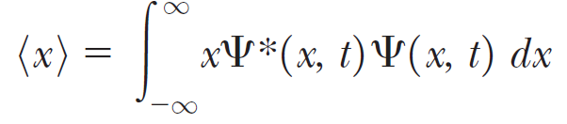
Expectation Value
Using wave functions, we can predict the average value of a given quantity of measurements. This is called the expectation value.
For a normalized wave function, the expected value for position is given by:
(9)

Slide 8


Expectation Value
The function for the expected value of momentum, <p>, is:
(10)
For energy <E>:
(11)

Slide 9
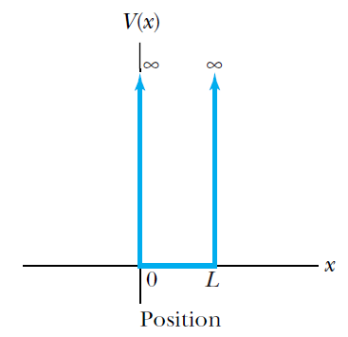
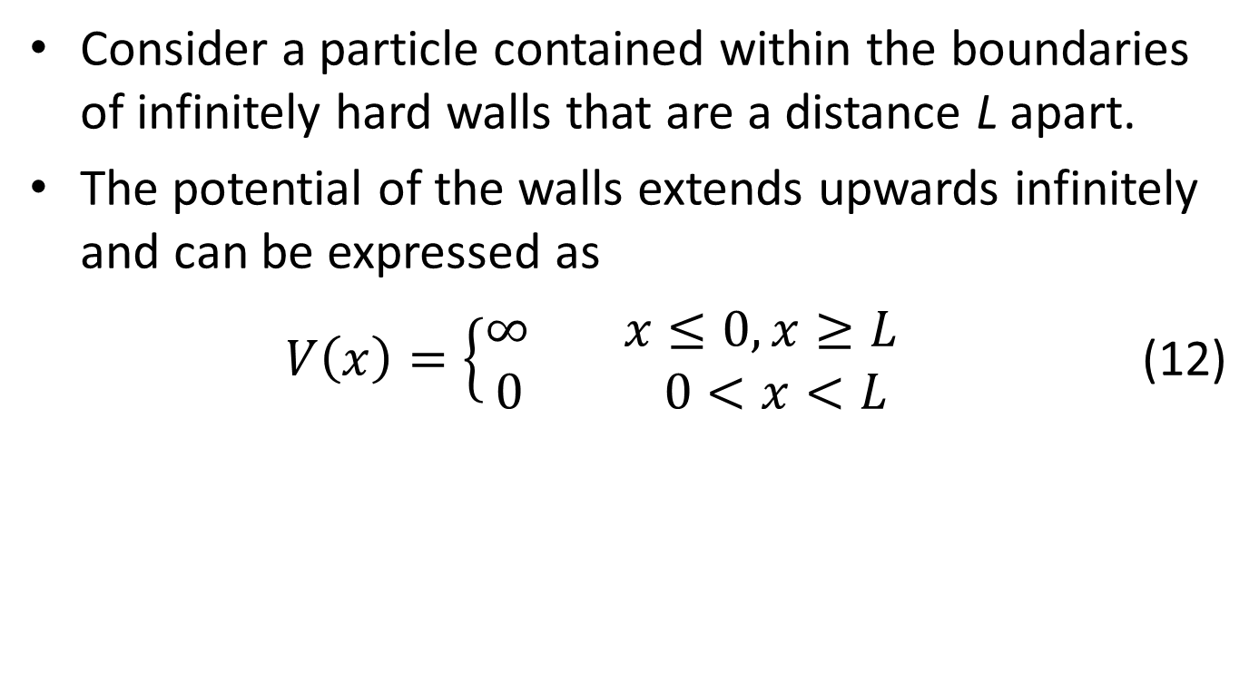
Infinite Square-Well Potential
Consider a particle contained within the boundaries of infinitely hard walls that are a distance L apart.
The potential of the walls extends upwards infinitely and can be expressed as
$V\left(x\right)=\left\{\begin{aligned}∞ x≤0, x≥L \\ 0 0<x<L\end{aligned}\right.$(12)

Slide 10
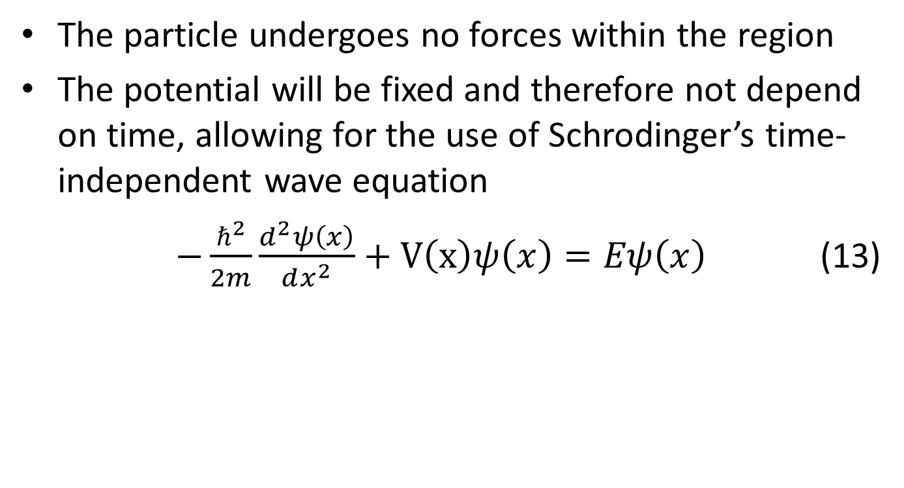
Infinite Square-Well Potential
The particle undergoes no forces within the region
The potential will be fixed and therefore not depend on time, allowing for the use of Schrodinger’s time-independent wave equation
$−\frac{ℏ^{2}}{2m}\frac{d^{2}ψ\left(x\right)}{dx^{2}}+V\left(x\right)ψ\left(x\right)=Eψ\left(x\right)$ (13)

Slide 11
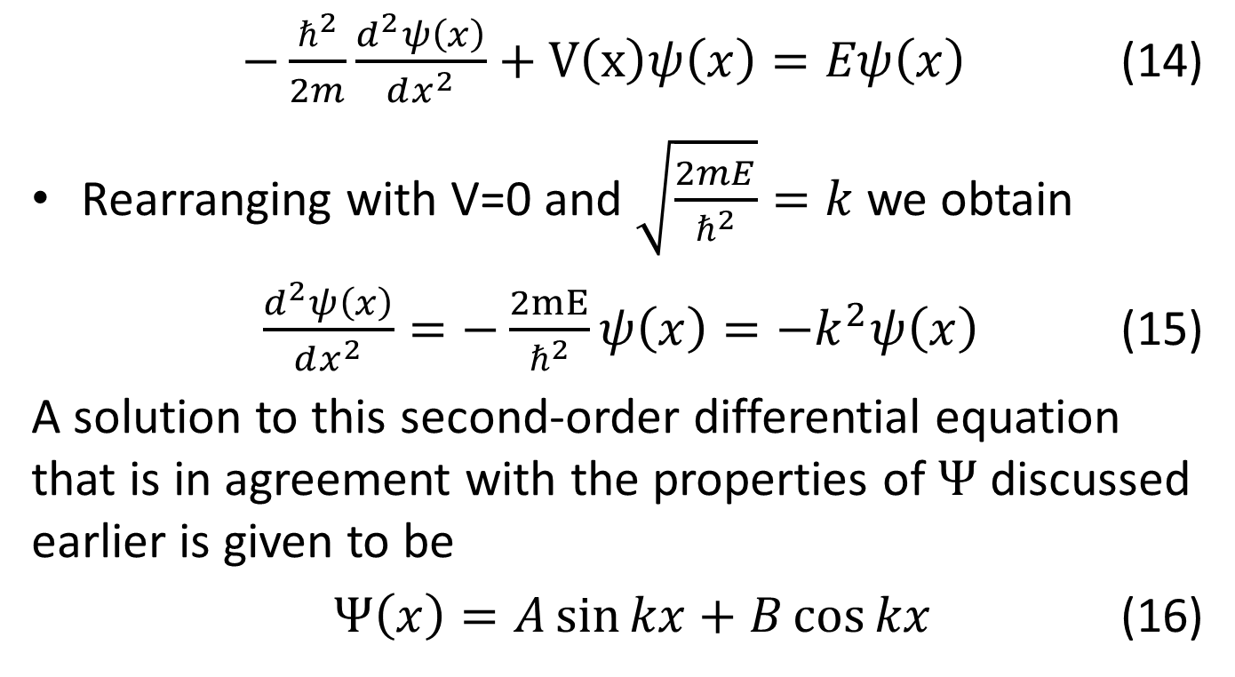
Infinite Square-Well Potential
$−\frac{ℏ^{2}}{2m}\frac{d^{2}ψ\left(x\right)}{dx^{2}}+V\left(x\right)ψ\left(x\right)=Eψ\left(x\right)$ (14)
Rearranging with V=0 and $\sqrt{\frac{2mE}{ℏ^{2}}}=k$ we obtain
$\frac{d^{2}ψ\left(x\right)}{dx^{2}}=−\frac{2mE}{ℏ^{2}}ψ\left(x\right)=−k^{2}ψ\left(x\right)$ (15)
A solution to this second-order differential equation that is in agreement with the properties of $Ψ$ discussed earlier is given to be
$Ψ\left(x\right)=A\sin{kx+B\cos{kx}}$ (16)

Slide 12
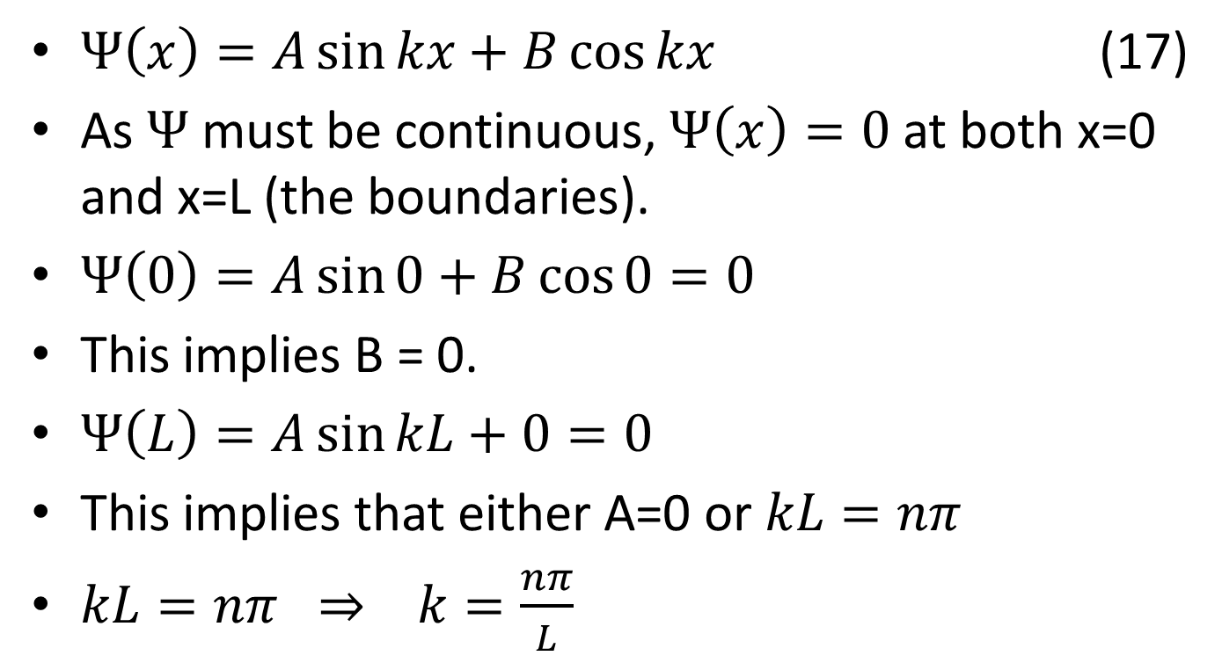
Infinite Square-Well Potential
$Ψ\left(x\right)=A\sin{kx+B\cos{kx}}$ (17)
As $Ψ$ must be continuous, $Ψ\left(x\right)=0$ at both x=0 and x=L (the boundaries).
$Ψ\left(0\right)=A\sin{0+B\cos{0}}=0$
This implies B = 0.
$Ψ\left(L\right)=A\sin{kL+0}=0$
This implies that either A=0 or $kL=nπ$
$kL=nπ ⇒ k=\frac{nπ}{L}$

Slide 13
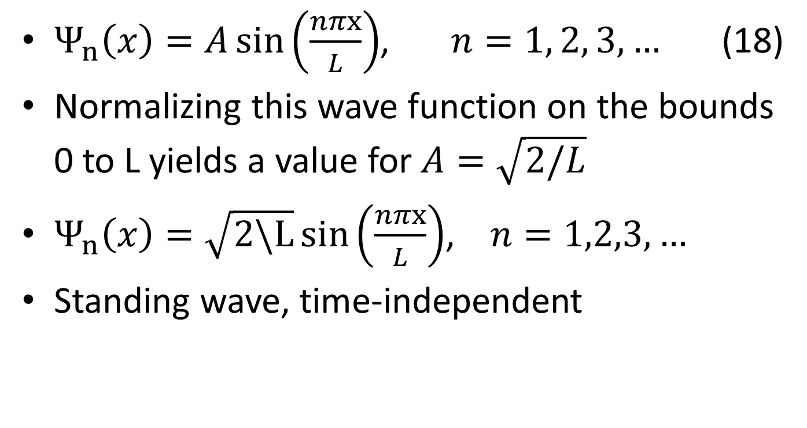
Infinite Square-Well Potential
$Ψ_{n}\left(x\right)=A\sin\left(\frac{nπx}{L}\right)$, $n=1, 2, 3,…$ (18)
Normalizing this wave function on the bounds 0 to L yields a value for $A=\sqrt{2/L}$
$Ψ_{n}\left(x\right)=\sqrt{2\backslash L}\sin\left(\frac{nπx}{L}\right)$, $n=1,2,3,…$
Standing wave, time-independent

Slide 14
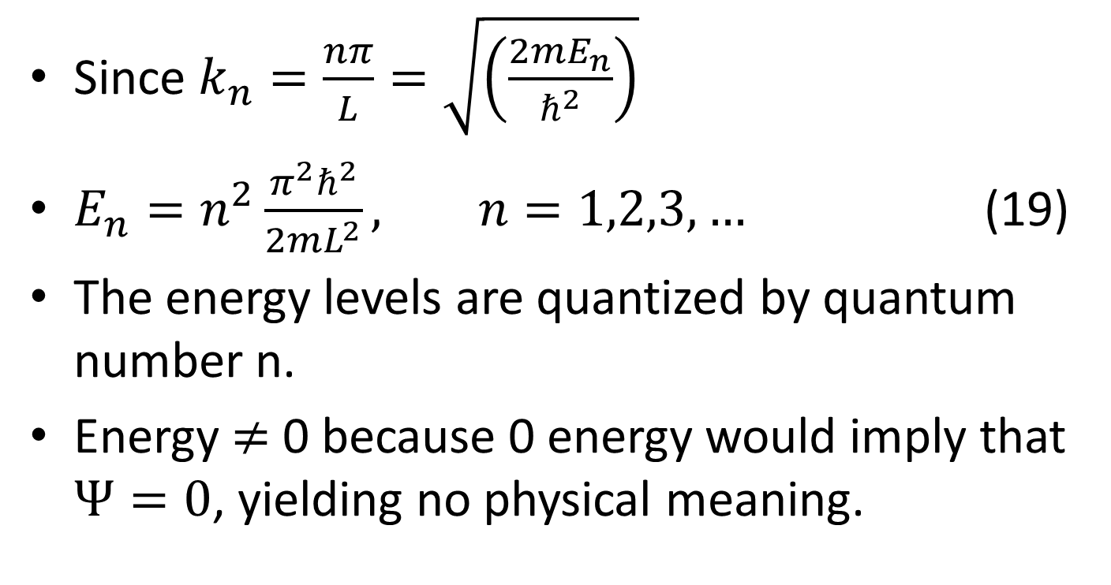
Infinite Square-Well Potential
Since $k_{n}=\frac{nπ}{L}=\sqrt{\left(\frac{2mE_{n}}{ℏ^{2}}\right)}$
$E_{n}=n^{2}\frac{π^{2}ℏ^{2}}{2mL^{2}}, n=1,2,3,…$ (19)
The energy levels are quantized by quantum number n.
Energy $≠$ 0 because 0 energy would imply that $Ψ=0$, yielding no physical meaning.

Slide 15
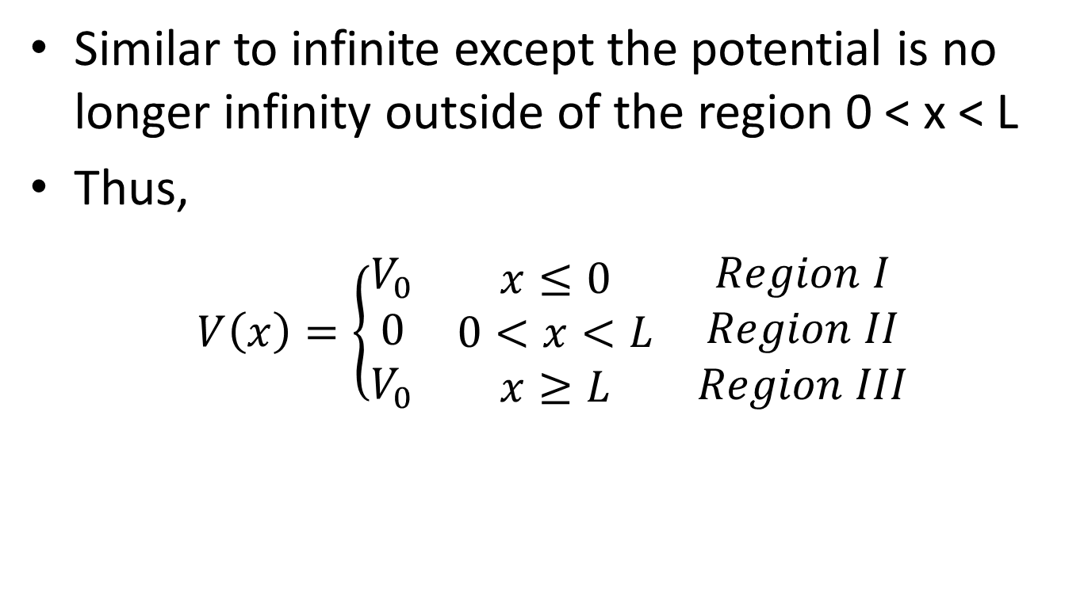
Finite Square-Well Potential
Similar to infinite except the potential is no longer infinity outside of the region 0 < x < L
Thus,
$V\left(x\right)=\left\{\begin{aligned}V_{0} \\ 0 \\ V_{0}\end{aligned}\right.$ $\begin{matrix}x≤0 \\ 0<x<L \\ x≥L\end{matrix}$ $\begin{matrix}Region I \\ Region II \\ Region III\end{matrix}$

Slide 16
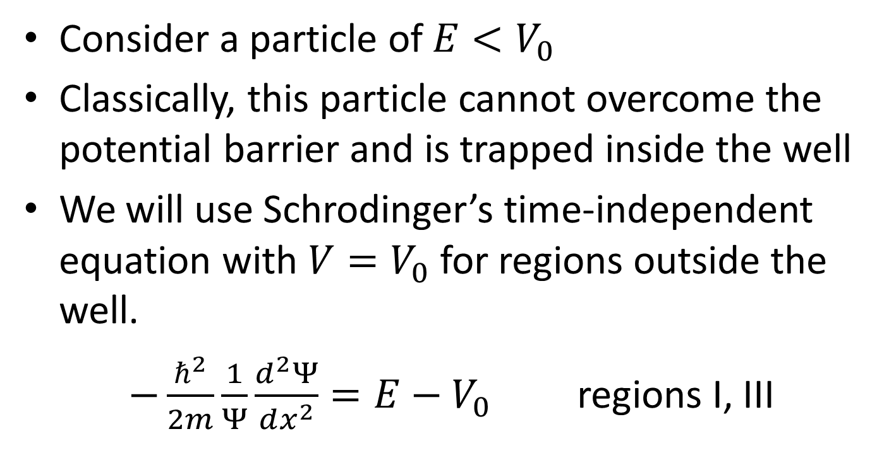
Finite Square-Well Potential
Consider a particle of $E<V_{0}$
Classically, this particle cannot overcome the potential barrier and is trapped inside the well
We will use Schrodinger’s time-independent equation with $V=V_{0}$ for regions outside the well.
$−\frac{ℏ^{2}}{2m}\frac{1}{Ψ}\frac{d^{2}Ψ}{dx^{2}}=E−V_{0}$ regions I, III

Slide 17
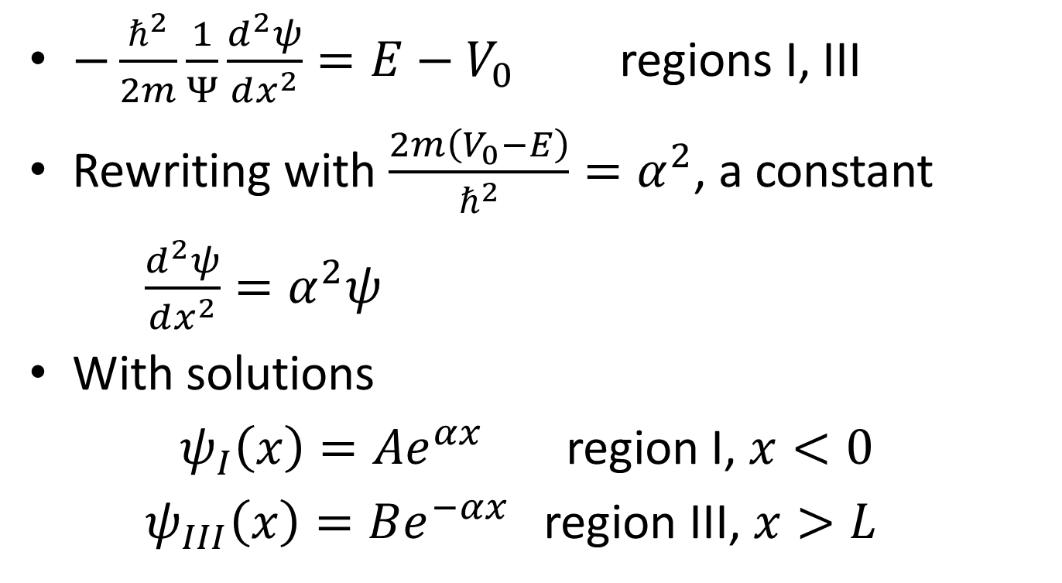
Finite Square-Well Potential
$−\frac{ℏ^{2}}{2m}\frac{1}{Ψ}\frac{d^{2}ψ}{dx^{2}}=E−V_{0}$ regions I, III
Rewriting with $\frac{2m\left(V_{0}−E\right)}{ℏ^{2}}=α^{2}$, a constant
$\frac{d^{2}ψ}{dx^{2}}=α^{2}ψ$
With solutions
${ ψ}_{I}\left(x\right)=Ae^{αx}$ region I, $x<0$
$ψ_{III}\left(x\right)=Be^{−αx}$ region III, $x>L$

Slide 18
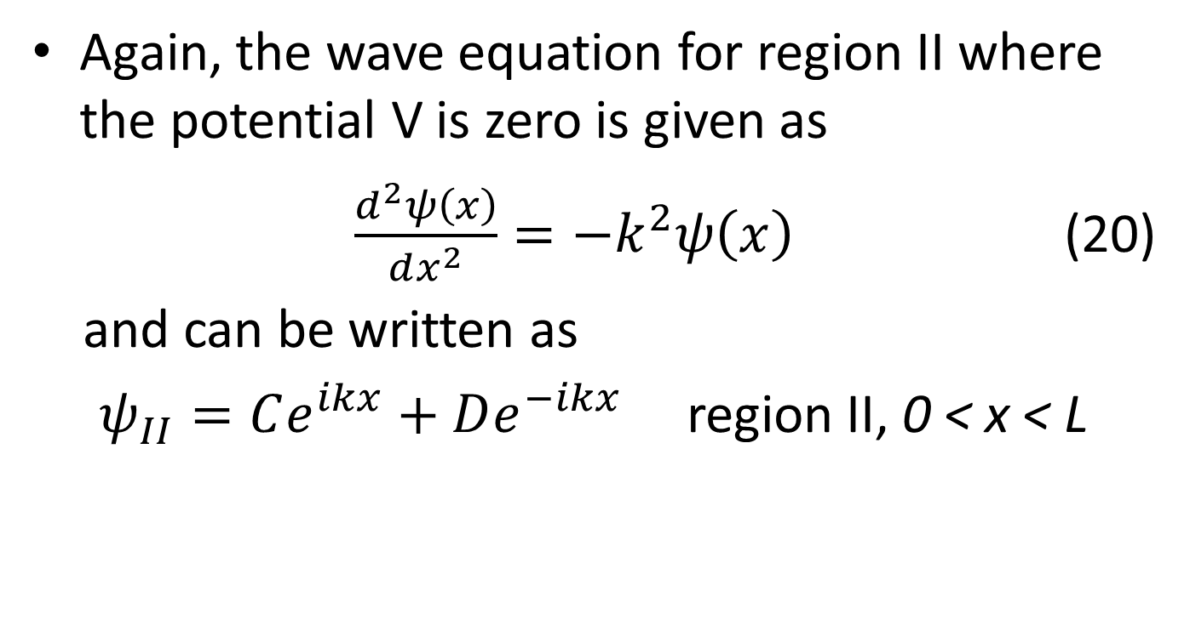
Finite Square-Well Potential
Again, the wave equation for region II where the potential V is zero is given as
$\frac{d^{2}ψ\left(x\right)}{dx^{2}}=−k^{2}ψ\left(x\right)$ (20)
and can be written as
$ψ_{II}=Ce^{ikx}+De^{−ikx}$ region II, 0 < x < L

Slide 19
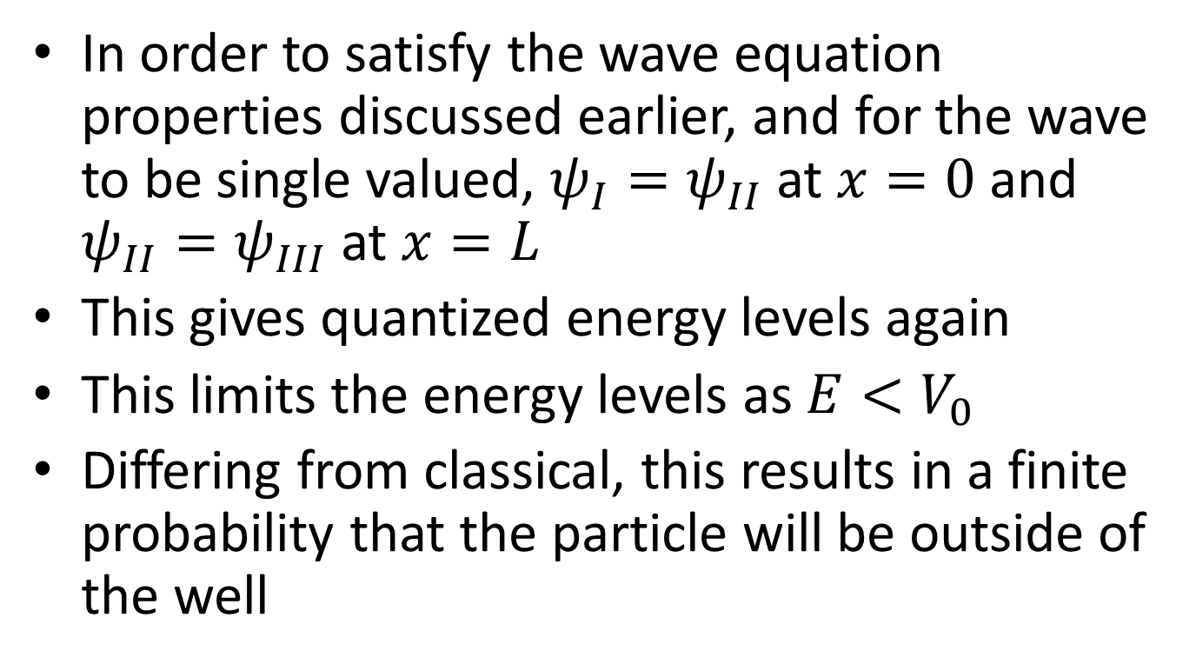
Finite Square-Well Potential
In order to satisfy the wave equation properties discussed earlier, and for the wave to be single valued, $ψ_{I}=ψ_{II}$ at $x=0$ and $ψ_{II}=ψ_{III}$ at $x=L$
This gives quantized energy levels again
This limits the energy levels as $E<V_{0}$
Differing from classical, this results in a finite probability that the particle will be outside of the well

Slide 20
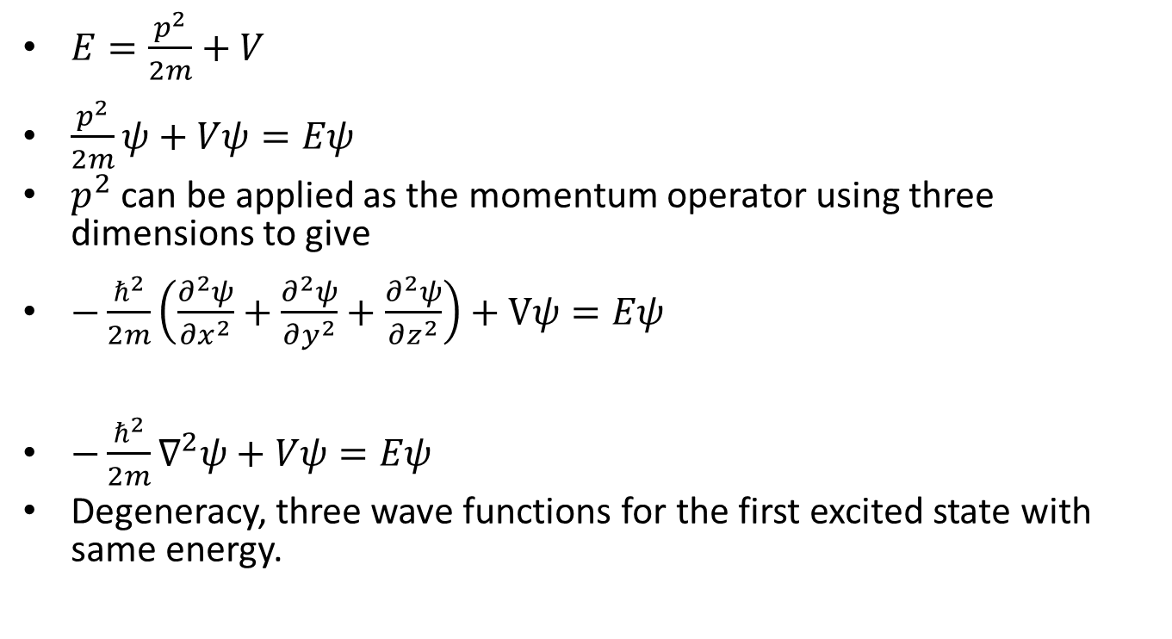
Three-Dimensional Infinite-Potential Well
$E=\frac{p^{2}}{2m}+V$
$\frac{p^{2}}{2m}ψ+Vψ=Eψ$
$p^{2}$ can be applied as the momentum operator using three dimensions to give
$−\frac{ℏ^{2}}{2m}\left(\frac{∂^{2}ψ}{∂x^{2}}+\frac{∂^{2}ψ}{∂y^{2}}+\frac{∂^{2}ψ}{∂z^{2}}\right)+Vψ=Eψ$
${−\frac{ℏ^{2}}{2m}∇}^{2}ψ+Vψ=Eψ$
Degeneracy, three wave functions for the first excited state with same energy.

Slide 21
Simple Harmonic Oscillators
Simple harmonic motion can be found and applied in quantum mechanics through observation of diatomic molecules and phonons in crystal lattices.
In a lattice, the force on each atom is dependent on their distance x and the equilibrium distance x0.
The lowest potential is then given by:
$V=\frac{kx^{2}}{2}$ (21)

Slide 22
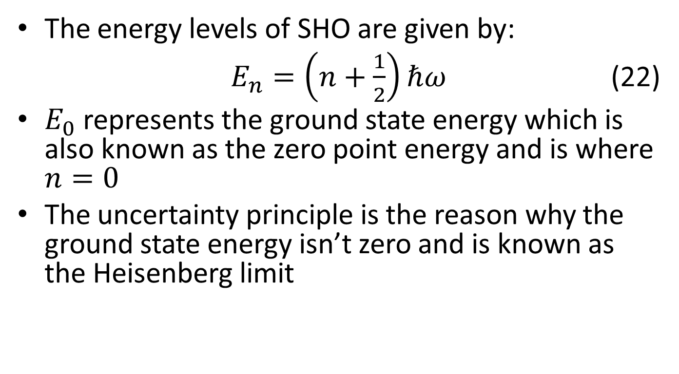
Simple Harmonic Motion
The energy levels of SHO are given by:
$E_{n}=\left(n+\frac{1}{2}\right)ℏω$ (22)
$E_{0}$ represents the ground state energy which is also known as the zero point energy and is where $n=0$
The uncertainty principle is the reason why the ground state energy isn’t zero and is known as the Heisenberg limit

Slide 23
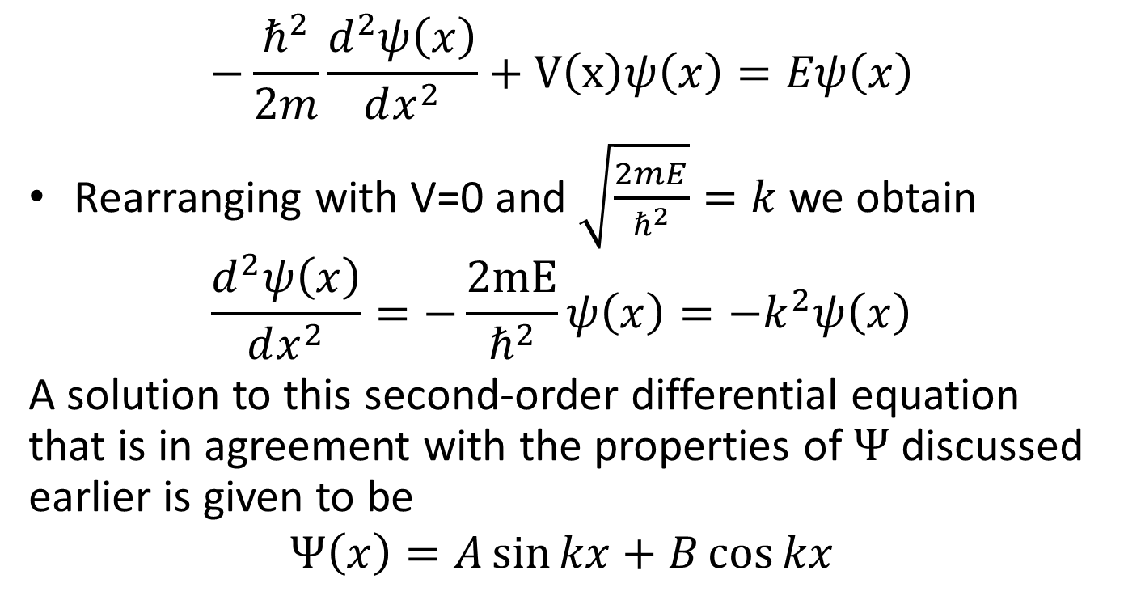
Barriers and Tunneling
A particle, with energy E ,traveling at a box with potential $V_{0}$, will interact by either reflecting off the box or transmitting through it.
In quantum mechanics, when E≫$V_{0}$, then almost total transmission occurs. When E≪$V_{0}$, almost total reflection will occur.
The probability of reflection occurring and transmission occurring needs to add up to 1. ($R+T=1)$

Slide 24
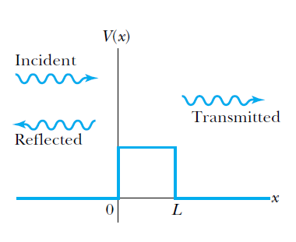
Barriers and Tunneling

Slide 25


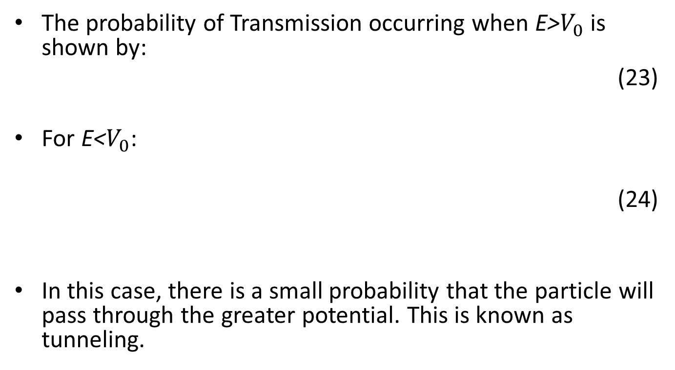
Barriers and Tunneling
The probability of Transmission occurring when E>$V_{0}$ is shown by:
(23)
For E<$V_{0}$:
(24)
In this case, there is a small probability that the particle will pass through the greater potential. This is known as tunneling.

Slide 26
Barriers and Tunneling
There are also cases in which the potential barrier can be negative.
In this case, transmission and reflection could both occur, but the wavelength within the barrier would decrease
At certain widths, the negative potential could cause the incident waves to move in or out of phase.
This can cause a more complete transmission or reflection
Out of phase waves could cause cancellation of the wave within the barrier

Slide 27
Alpha Particle Decay
Elements heavier than lead experience alpha particle decay
Alpha particles within the nucleus of these atoms experience “attractive nuclear force as well as the repulsive Coulomb force.”
This creates a situation similar to the square well potential and some alpha particles can escape the nucleus through tunneling
This explains the wide range of emissions of alpha particles

