Slide 1
The Dirac Delta-Function Potential
Dylan J. McIntyre and Nicholas C. Jira

Slide 2
Content
Brief overview of the relationship between step functions and the delta-function
Quickly talk about bound states
Show how the delta-function can be used to determine the discontinuity of the derivative of the bound states
Notes:
Intuition of delta-function
Bound states of position in an infinite potential well

Slide 3
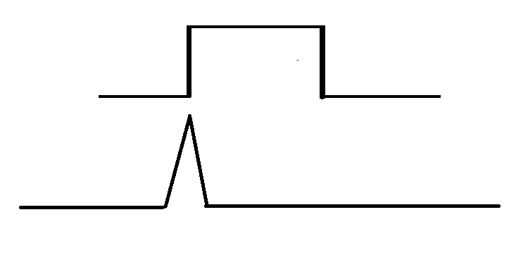
Step Functions
Example of some functions..

Slide 4
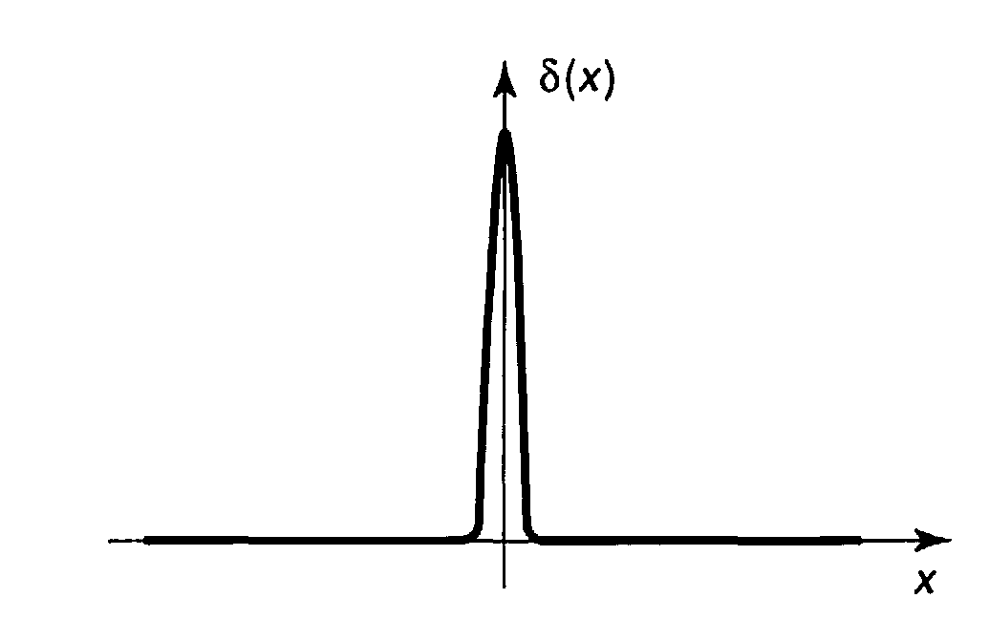
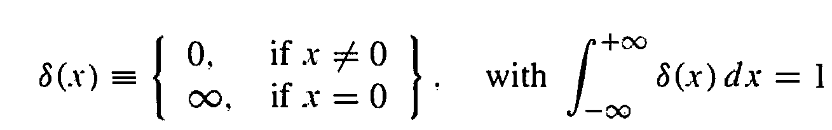
The Delta-Function Well
Taken straight from Griffith’s book

Slide 5
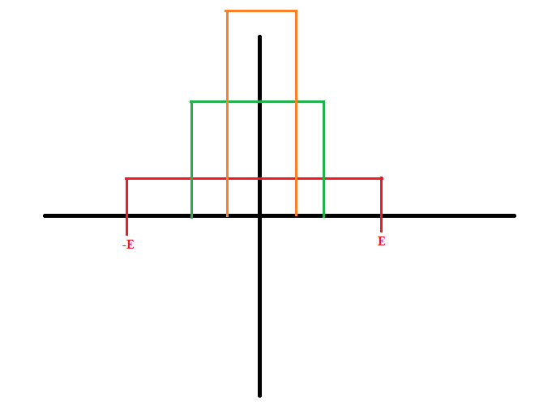
Visualizing the Delta-Function..

Slide 6

Bound States
$$E<0, V\left(x\right)=0$$
$$\frac{d^{2}ψ}{dx^{2}}=−\frac{2mE}{ℏ^{2}}ψ=k^{2}ψ$$
$$k=\frac{\sqrt{−2mE}}{ℏ}$$
Notes:
K is real and positive since E is negative for the bound state.

Slide 7

Bound States
$\frac{d^{2}ψ}{dx^{2}}=k^{2}ψ$
$ψ\left(x\right)=Ae^{−kx}+Be^{kx}$
$ψ\left(x\right)=Fe^{−kx}+Ge^{kx}$
For $x<0$, $A=0$
For $x>0,$ $B=0$
Notes:
For x values approaching –infinity, the left term nears infinity. Thus A is chosen to be 0. The same occurs to the other side for x > 0.

Slide 8
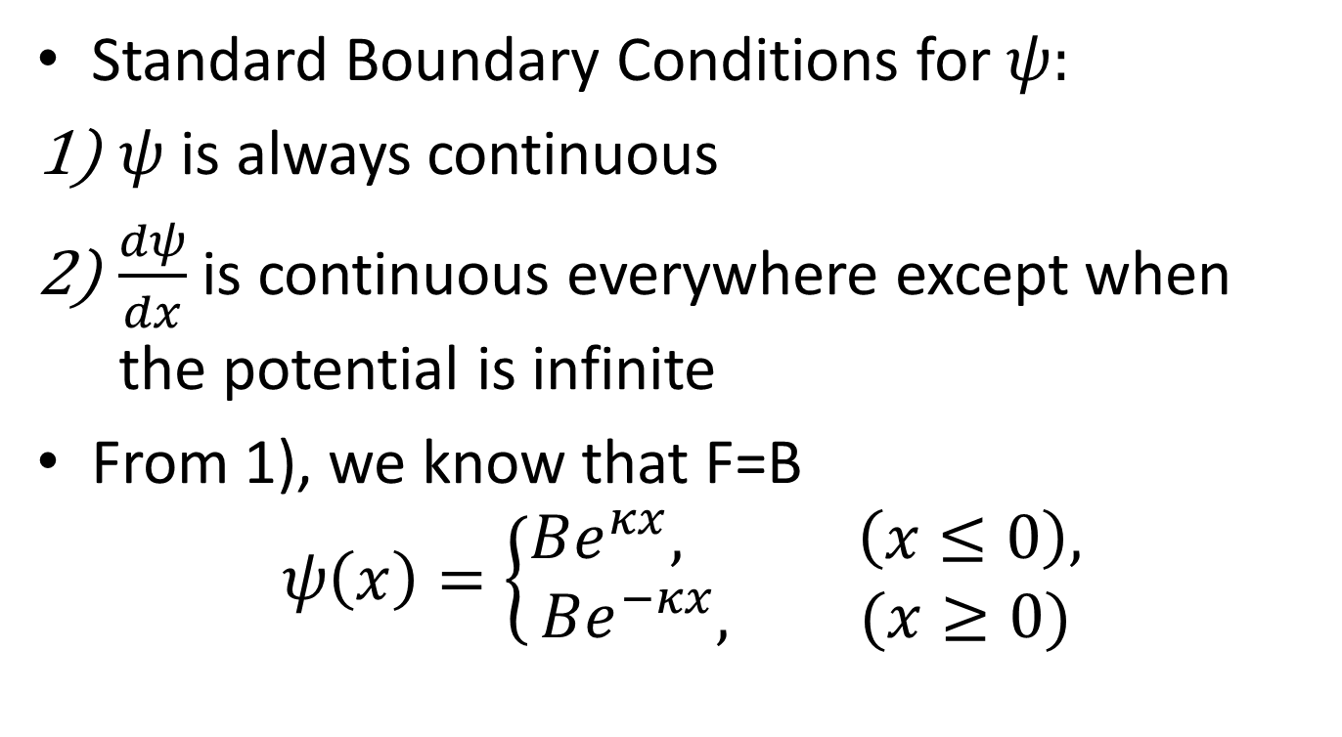
Boundary Conditions
Standard Boundary Conditions for $ψ:$
$ψ$ is always continuous
$\frac{dψ}{dx}$ is continuous everywhere except when the potential is infinite
From 1), we know that F=B
$$ψ\left(x\right)=\left\{\begin{aligned}Be^{κx}, \left(x≤0\right), \\ Be^{−κx}, (x≥0)\end{aligned}\right.$$

Slide 9
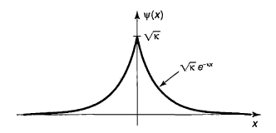

Slide 10
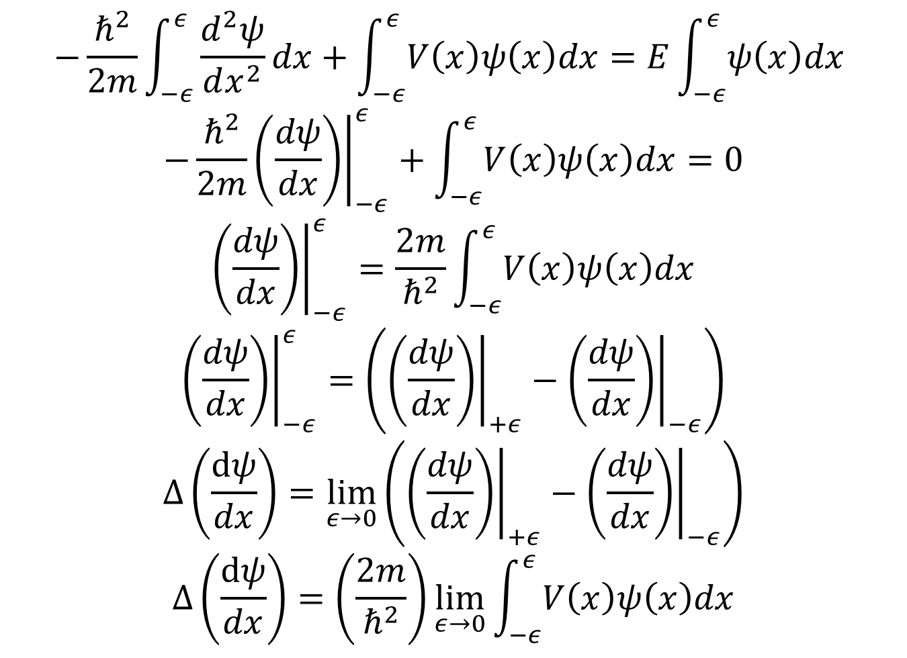
$$−\frac{ℏ^{2}}{2m}\int_{−ε}^{ε}{\frac{d^{2}ψ}{dx^{2}}dx}+\int_{−ε}^{ε}{V\left(x\right)ψ\left(x\right)dx}=E\int_{−ε}^{ε}{ψ\left(x\right)dx }$$
$$−{\left.\frac{ℏ^{2}}{2m}\left(\frac{dψ}{dx}\right)\right|}_{−ε}^{ε}+\int_{−ε}^{ε}{V\left(x\right)ψ\left(x\right)dx}=0$$
$${\left.\left(\frac{dψ}{dx}\right)\right|}_{−ε}^{ε}=\frac{2m}{ℏ^{2}}\int_{−ε}^{ε}{V\left(x\right)ψ\left(x\right)dx}$$
$${\left.\left(\frac{dψ}{dx}\right)\right|}_{−ε}^{ε}=\left({\left.\left(\frac{dψ}{dx}\right)\right|}_{+ε}^{}−{\left.\left(\frac{dψ}{dx}\right)\right|}_{−ε}^{}\right)$$
$$Δ\left(\frac{dψ}{dx}\right)=\lim_{ε→0}\left({\left.\left(\frac{dψ}{dx}\right)\right|}_{+ε}^{}−{\left.\left(\frac{dψ}{dx}\right)\right|}_{−ε}^{}\right)$$
$$Δ\left(\frac{dψ}{dx}\right)=\left(\frac{2m}{ℏ^{2}}\right)\lim_{ε→0}{\int_{−ε}^{ε}{V\left(x\right)ψ\left(x\right)dx}}$$
Notes:
Here we use the delta dirac function to determine the discontinuity
Schrodinger equations
Bottomline is if V(x) has infinite potential at the boundary

Slide 11
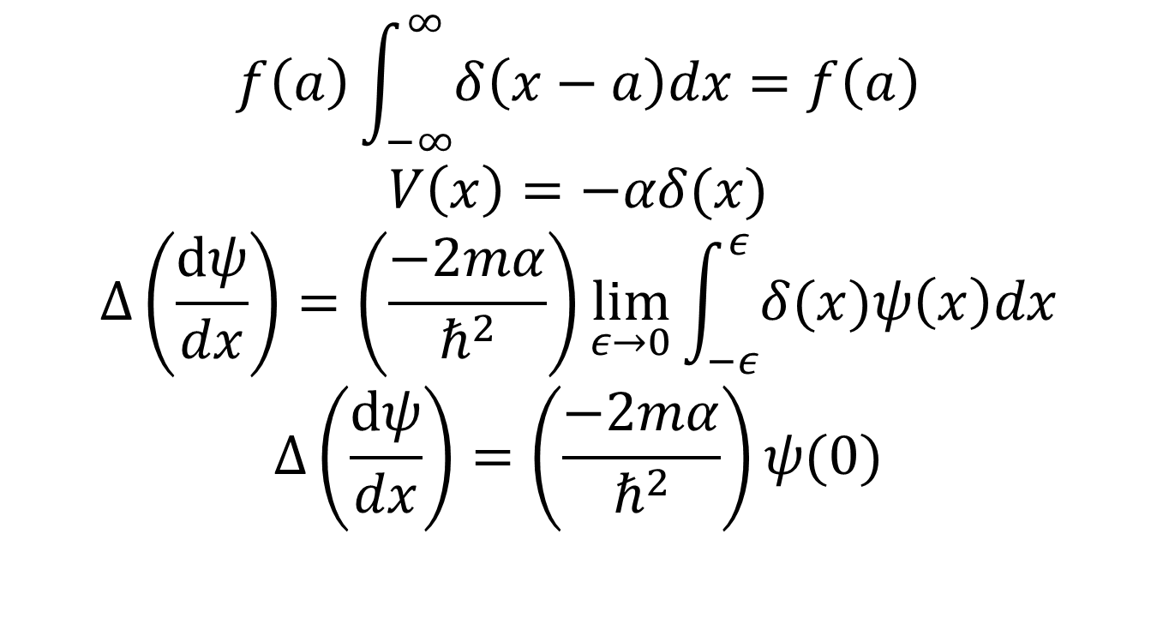
$$f\left(a\right)\int_{−∞}^{∞}{δ\left(x−a\right)dx=f\left(a\right)}$$
$$V\left(x\right)=−αδ(x)$$
$$Δ\left(\frac{dψ}{dx}\right)=\left(\frac{−2mα}{ℏ^{2}}\right)\lim_{ε→0}{\int_{−ε}^{ε}{δ(x)ψ\left(x\right)dx}}$$
$$Δ\left(\frac{dψ}{dx}\right)=\left(\frac{−2mα}{ℏ^{2}}\right)ψ(0)$$

Slide 12
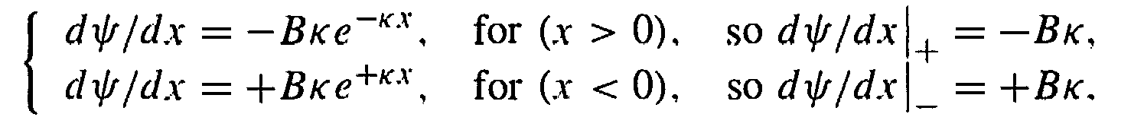
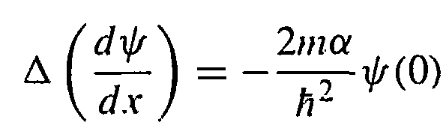
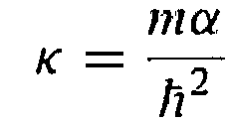

Revisiting The Boundary Cond.
$$Δ\left(\frac{dψ}{dx}\right)=−2Bκ$$
$$ψ\left(0\right)=B$$
Thus
Becomes
Notes:
As the right side approaches the limit x=0, the term becomes –Bk. As the left side (x<0) approaches 0, the term is +Bk.

Slide 13
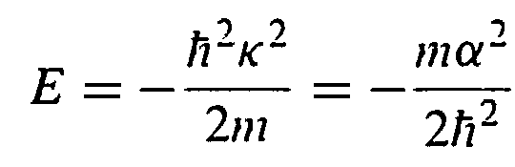
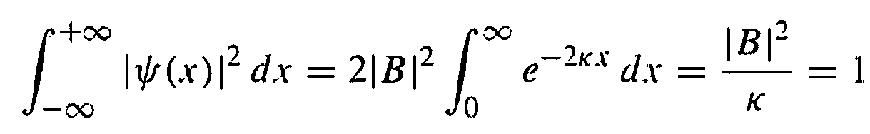
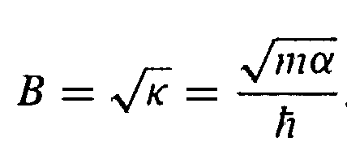
Energy states
Thus,
We can normalize the wave function
Upon solving gives
Notes:
We can replace the k in the energy equation to obtain E.

Slide 14
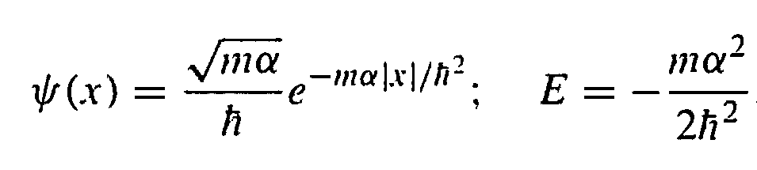
The Delta-function Well Bound State
Thus we obtain a function from the delta-function well, with exactly one bound state

Slide 15
The End
Thanks for listening!

