Slide 1
Formalism Continued
Dylan J. McIntyre and Nicholas C. Jira

Slide 2
Hermitian Operators
Focus on the determinate states of observables (hermitian operators)
Hermitian operators are operator that represent observables
Their spectrum can either be continuous or discrete
Discrete hemritians have eigenvectors that lie in the Hilbert space and have physically realizable states
Continuous hermitians don’t lie in the Hilbert Space and can’t be any possible wave function

Slide 3
Hermitian Operators
Discrete eigenvalues will be separated from one another while continuous eigenvalues are complete a whole range
An operator can discrete, continuous or both
Examples-
Harmonic Oscillators Hamiltonian are discrete
Free Particle Hamiltonians are continuous
The finite square well Hamiltonian is both
Discrete operators have inner products that are guaranteed to exist while continuous cases may not

Slide 4
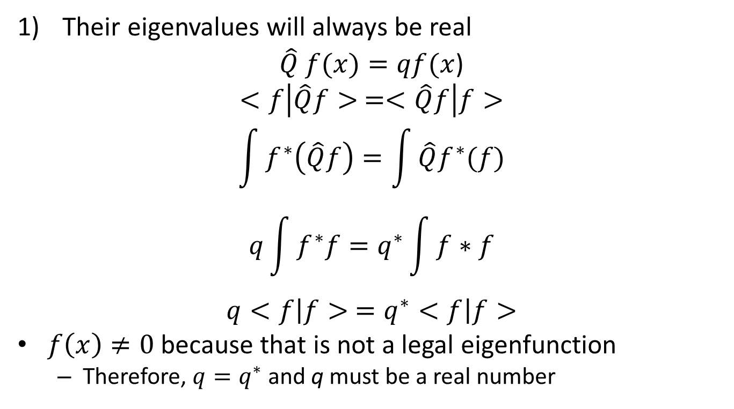
Discrete Spectra Properties
Their eigenvalues will always be real
$\hat{Q} f(x)=qf(x$)
$$<f\left|\hat{Q}f> =<\hat{Q}f\right|f>$$
$$\int{f^{∗}\left(\hat{Q}f\right)}=\int{\hat{Q}f^{∗}(f)}$$
$$q\int{f^{∗}f}=q^{∗}\int{f∗f}$$
$$q<f\left|f> =q^{∗}<f\right|f>$$
$f\left(x\right)≠0$ because that is not a legal eigenfunction
Therefore, $q=q^{∗}$ and q must be a real number

Slide 5
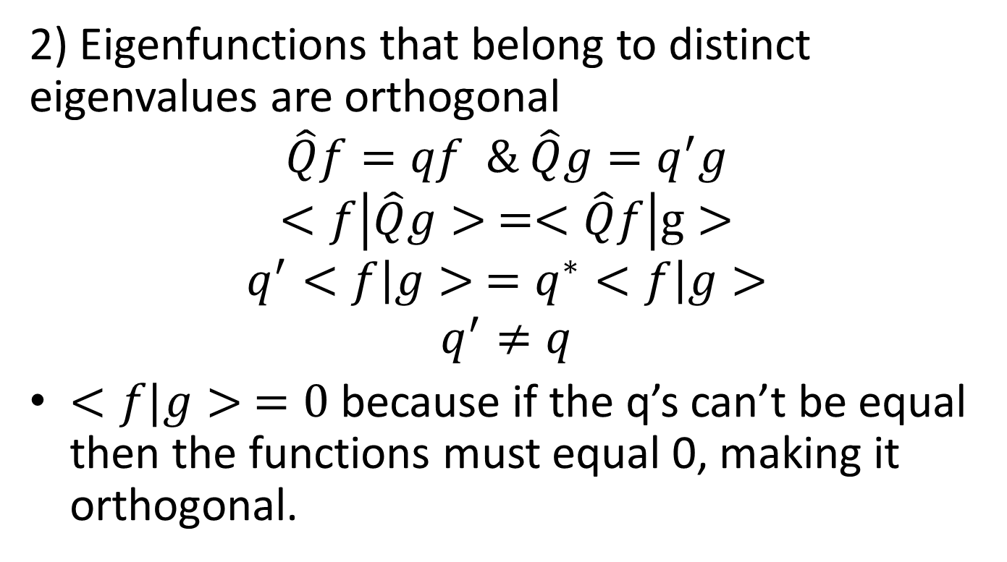
Discrete Spectra Properties
2) Eigenfunctions that belong to distinct eigenvalues are orthogonal
$$\hat{Q}f=qf \& \hat{Q}g=q^{′}g$$
$$<f\left|\hat{Q}g> =<\hat{Q}f\right|g>$$
$$q^{′}<f\left|g> =q^{∗}<f\right|g>$$
$$q^{′}≠q$$
$<f|g> =0$ because if the q’s can’t be equal then the functions must equal 0, making it orthogonal.

Slide 6
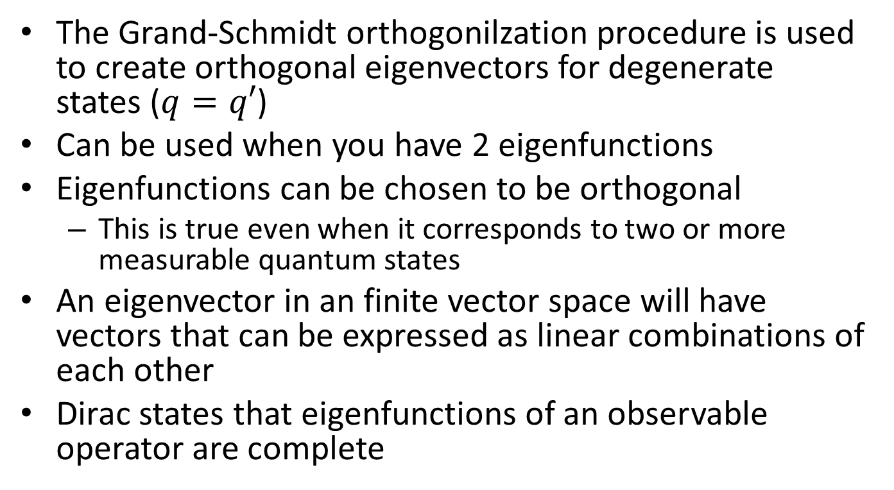
Orthogonality
The Grand-Schmidt orthogonilzation procedure is used to create orthogonal eigenvectors for degenerate states ($q=q′$)
Can be used when you have 2 eigenfunctions
Eigenfunctions can be chosen to be orthogonal
This is true even when it corresponds to two or more measurable quantum states
An eigenvector in an finite vector space will have vectors that can be expressed as linear combinations of each other
Dirac states that eigenfunctions of an observable operator are complete

Slide 7
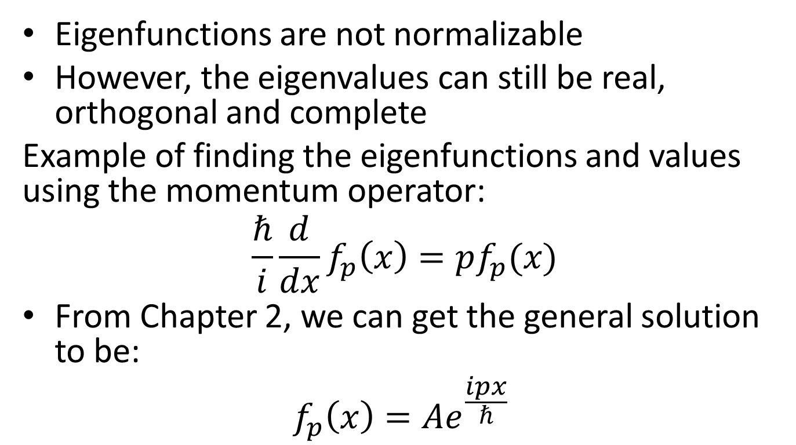
Continuous Spectra
Eigenfunctions are not normalizable
However, the eigenvalues can still be real, orthogonal and complete
Example of finding the eigenfunctions and values using the momentum operator:
$$\frac{ℏ}{i}\frac{d}{dx}f_{p}\left(x\right)=pf_{p}(x)$$
From Chapter 2, we can get the general solution to be:
$$f_{p}\left(x\right)=Ae^{\frac{ipx}{ℏ}}$$

Slide 8
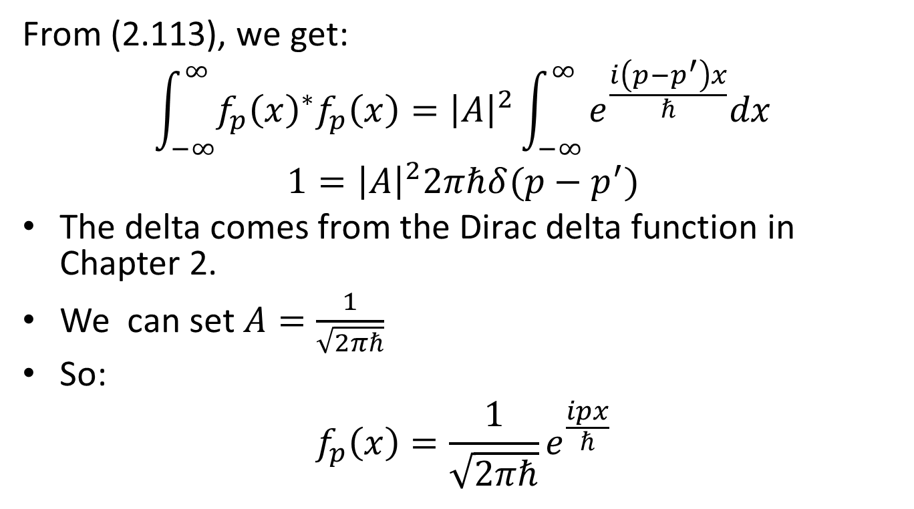
Continuous Spectra
From (2.113), we get:
$$\int_{−∞}^{∞}{f_{p}{\left(x\right)}^{∗}f_{p}\left(x\right)}={\left|A\right|}^{2}\int_{−∞}^{∞}{e^{\frac{i\left(p−p^{′}\right)x}{ℏ}}dx}$$
$$1={\left|A\right|}^{2}2πℏδ(p−p^{′})$$
The delta comes from the Dirac delta function in Chapter 2.
We can set $A=\frac{1}{\sqrt{2πℏ}}$
So:
$$f_{p}\left(x\right)=\frac{1}{\sqrt{2πℏ}}e^{\frac{ipx}{ℏ}}$$

Slide 9
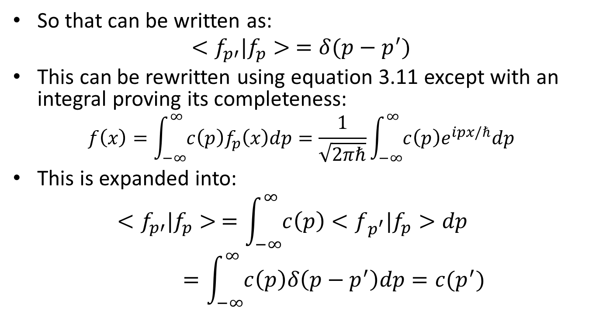
Continuous Spectra
So that can be written as:
$$<f_{p′}|f_{p}> =δ(p−p^{′})$$
This can be rewritten using equation 3.11 except with an integral proving its completeness:
$$f\left(x\right)=\int_{−∞}^{∞}{c\left(p\right)f_{p}\left(x\right)dp}=\frac{1}{\sqrt{2πℏ}}\int_{−∞}^{∞}{c\left(p\right)e^{ipx/ℏ}dp}$$
This is expanded into:
$$<f_{p′}|f_{p}> =\int_{−∞}^{∞}{c\left(p\right)<f_{p^{′}}|f_{p}>dp}=\int_{−∞}^{∞}{c\left(p\right)δ\left(p−p^{′}\right)dp}=c(p^{′})$$

Slide 10
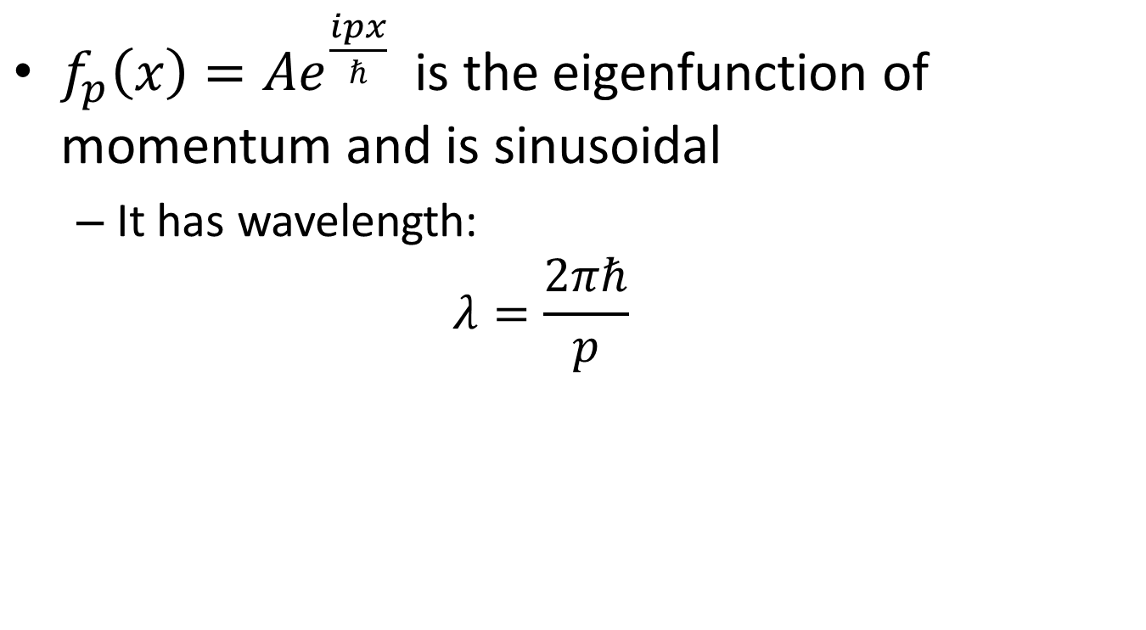
Continuous Spectra
$f_{p}\left(x\right)=Ae^{\frac{ipx}{ℏ}}$ is the eigenfunction of momentum and is sinusoidal
It has wavelength:
$$λ=\frac{2πℏ}{p}$$

Slide 11
Generalized Statistical Interpretation
Chapter 1: Probability of a particle’s position
Chapter 2: Possible energy measurement
Now, generalized statistical interp. allows us to find possible results and probabilities of any measurement
Together with S. Eqn., foundation of Quantum Mechanics

Slide 12
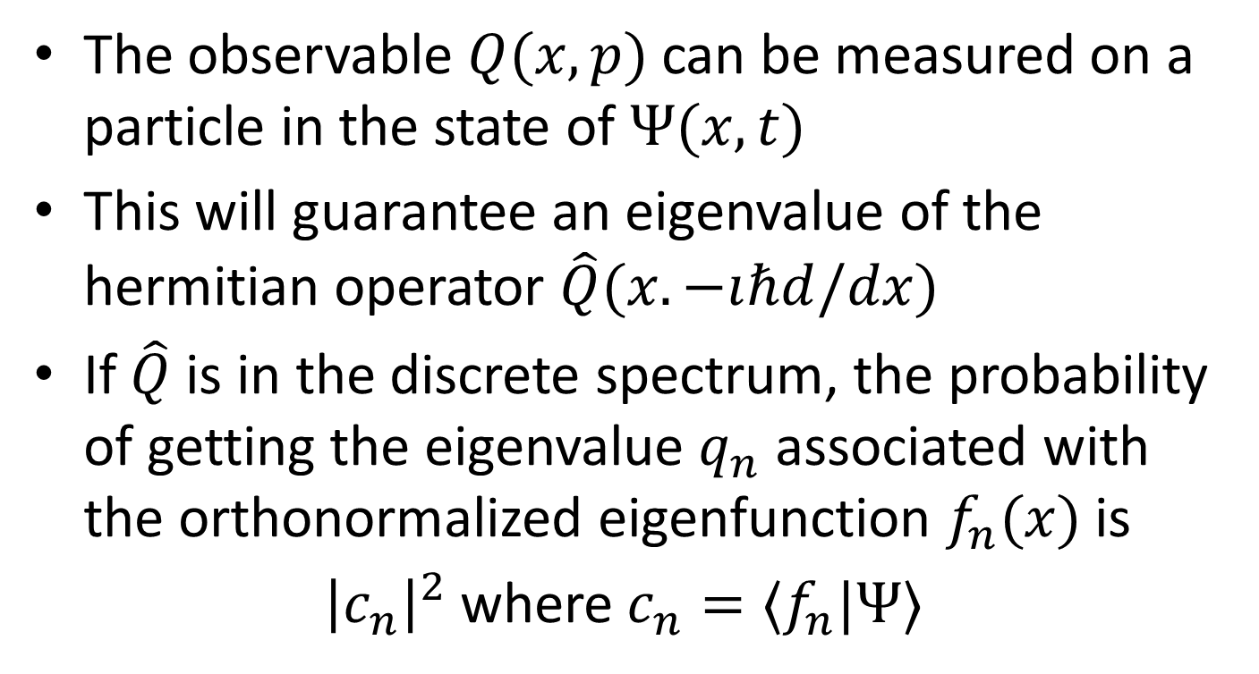
Generalized Statistical Interpretation
The observable $Q(x,p)$can be measured on a particle in the state of $Ψ(x,t)$
This will guarantee an eigenvalue of the hermitian operator $\hat{Q}(x.−ıℏd/dx)$
If $\hat{Q}$ is in the discrete spectrum, the probability of getting the eigenvalue $q_{n}$ associated with the orthonormalized eigenfunction $f_{n}(x)$ is
${\left|c_{n}\right|}^{2}$ where $c_{n}=〈f_{n}|Ψ〉$

Slide 13
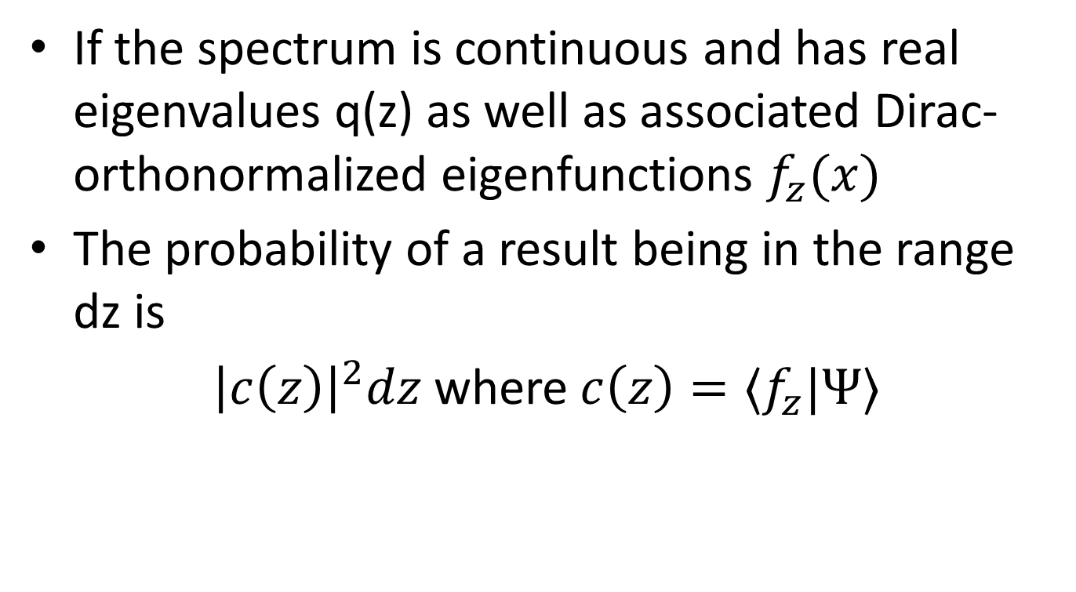
Generalized Statistical Interpretation
If the spectrum is continuous and has real eigenvalues q(z) as well as associated Dirac-orthonormalized eigenfunctions $f_{z}(x)$
The probability of a result being in the range dz is
${\left|c\left(z\right)\right|}^{2}dz$ where $c\left(z\right)=〈f_{z}|Ψ〉$

Slide 14
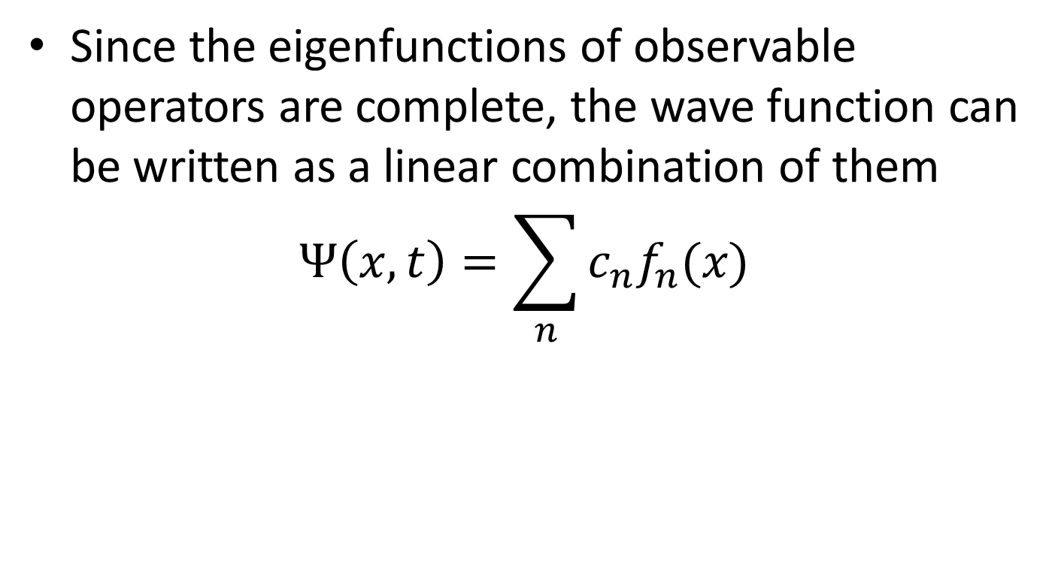
Linear Combination
Since the eigenfunctions of observable operators are complete, the wave function can be written as a linear combination of them
$$Ψ\left(x,t\right)=\sum_{n}{c_{n}f_{n}(x)}$$

Slide 15
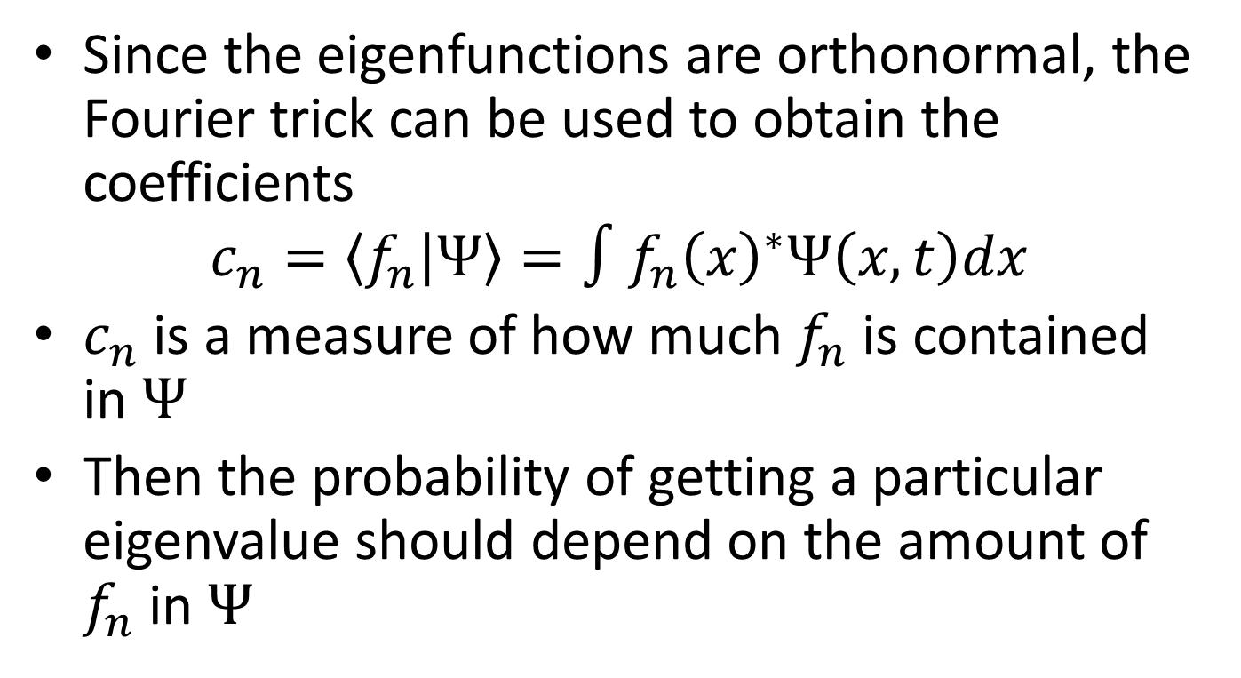
Discrete Probability
Since the eigenfunctions are orthonormal, the Fourier trick can be used to obtain the coefficients
$$c_{n}=〈f_{n} | Ψ〉=∫f_{n}{\left(x\right)}^{∗}Ψ\left(x,t\right)dx$$
$c_{n}$ is a measure of how much $f_{n}$ is contained in $Ψ$
Then the probability of getting a particular eigenvalue should depend on the amount of $f_{n}$ in $Ψ$

Slide 16
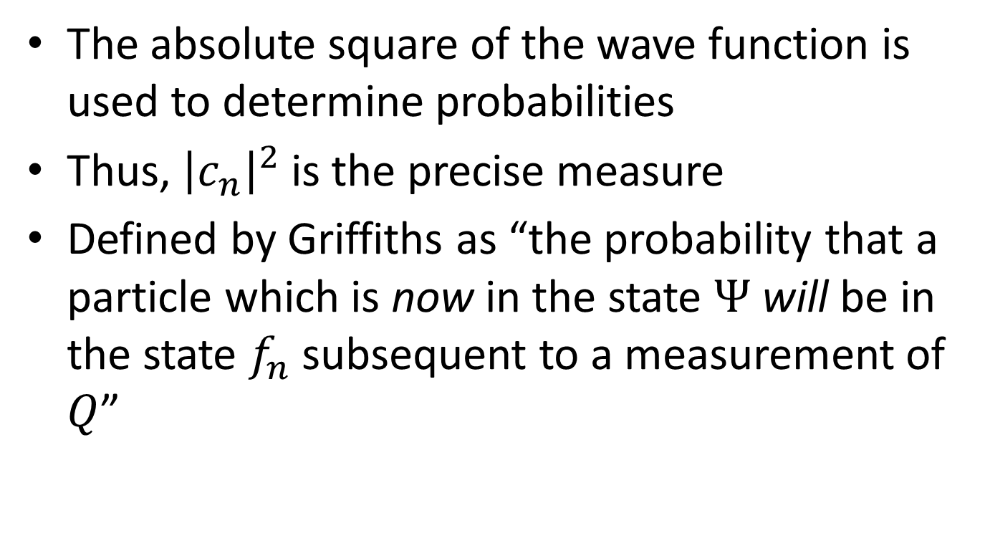
Discrete Probability
The absolute square of the wave function is used to determine probabilities
Thus, ${\left|c_{n}\right|}^{2}$ is the precise measure
Defined by Griffiths as “the probability that a particle which is now in the state $Ψ$ will be in the state $f_{n}$ subsequent to a measurement of $Q$”

Slide 17
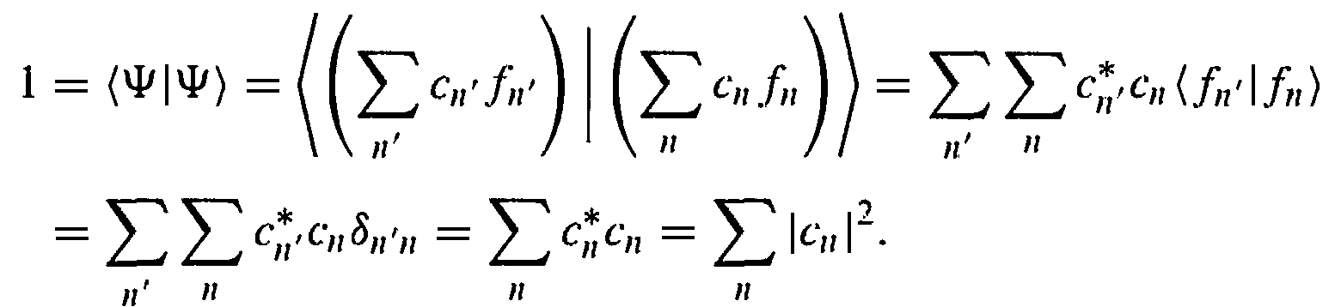
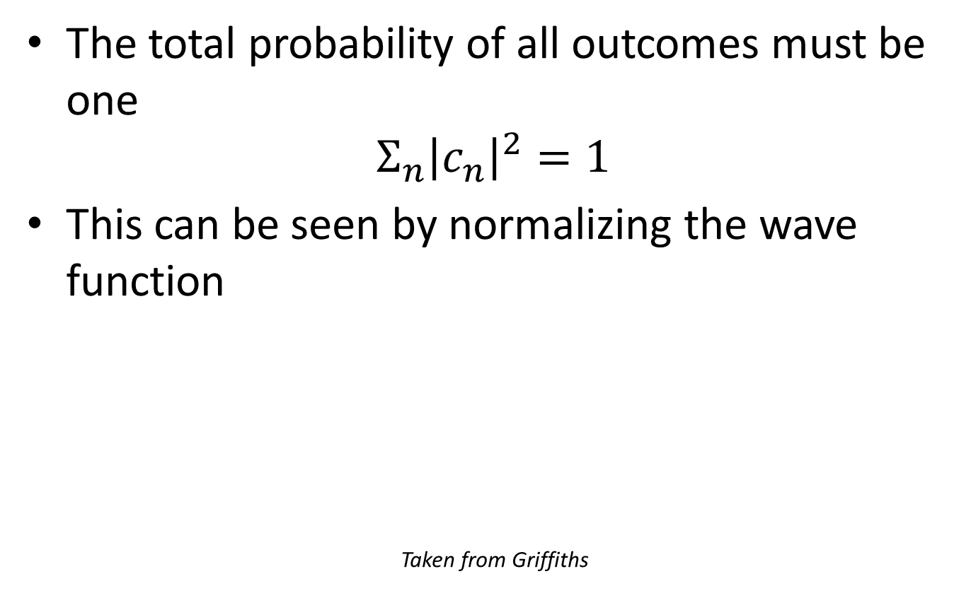
Discrete Probability
The total probability of all outcomes must be one
$$Σ_{n}{\left|c_{n}\right|}^{2}=1$$
This can be seen by normalizing the wave function
Taken from Griffiths

Slide 18
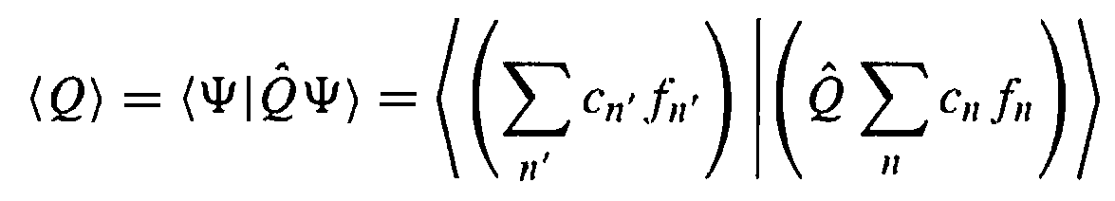
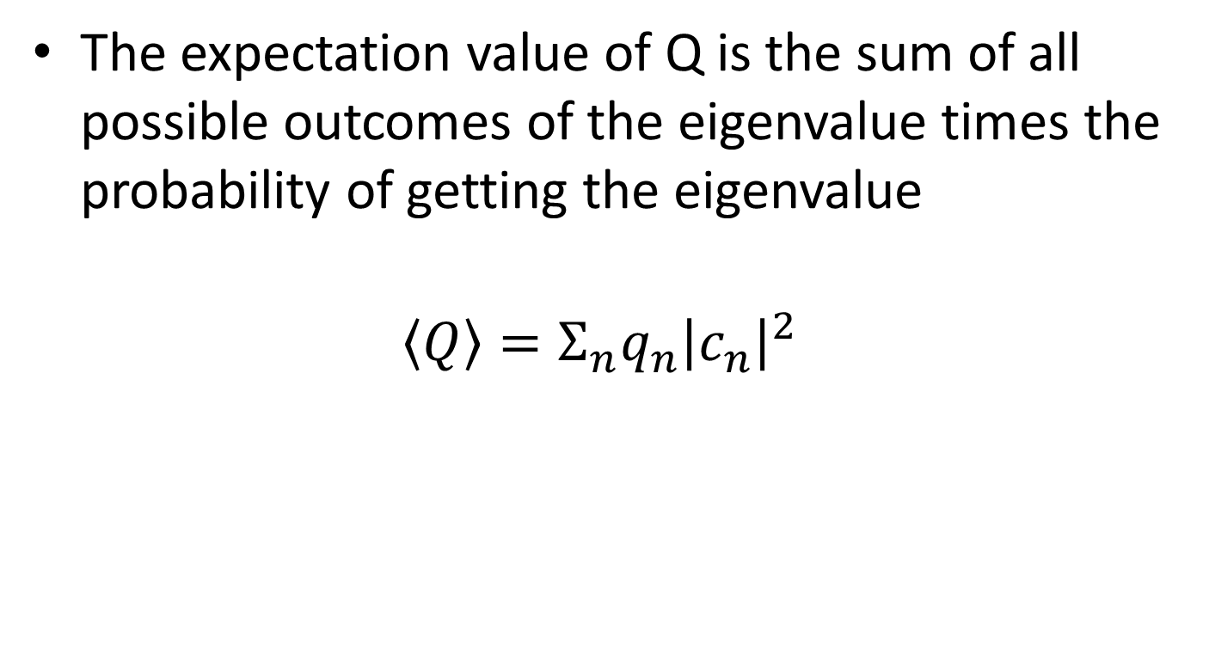
Expectation Value
The expectation value of Q is the sum of all possible outcomes of the eigenvalue times the probability of getting the eigenvalue
$$〈Q〉=Σ_{n}q_{n}{\left|c_{n}\right|}^{2}$$

Slide 19
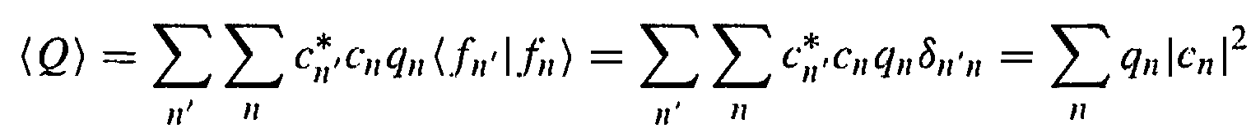

Expectation Value
Since $\hat{Q}f_{n}=q_{n}f_{n}$

Slide 20

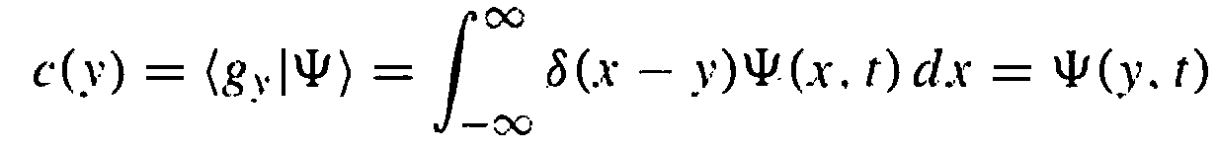
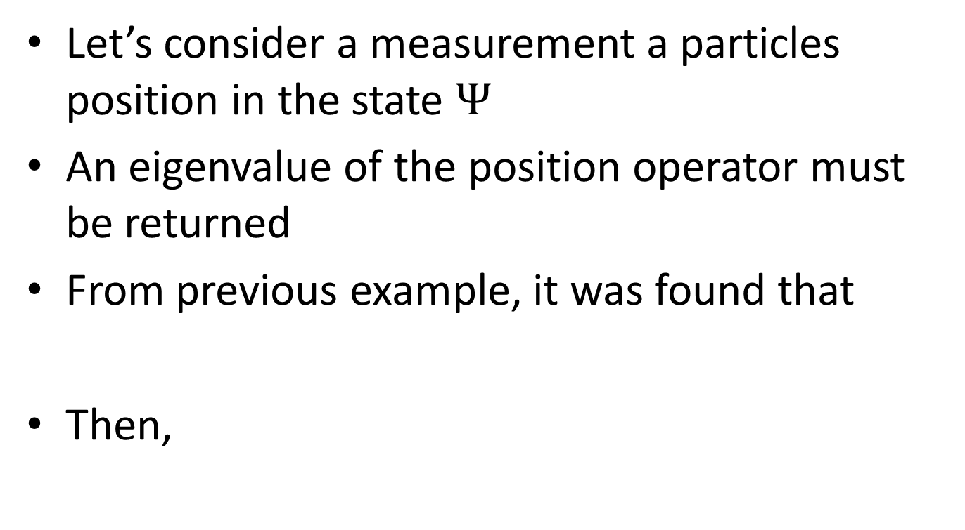
Does this framework check out?
Let’s consider a measurement a particles position in the state $Ψ$
An eigenvalue of the position operator must be returned
From previous example, it was found that
Then,

Slide 21
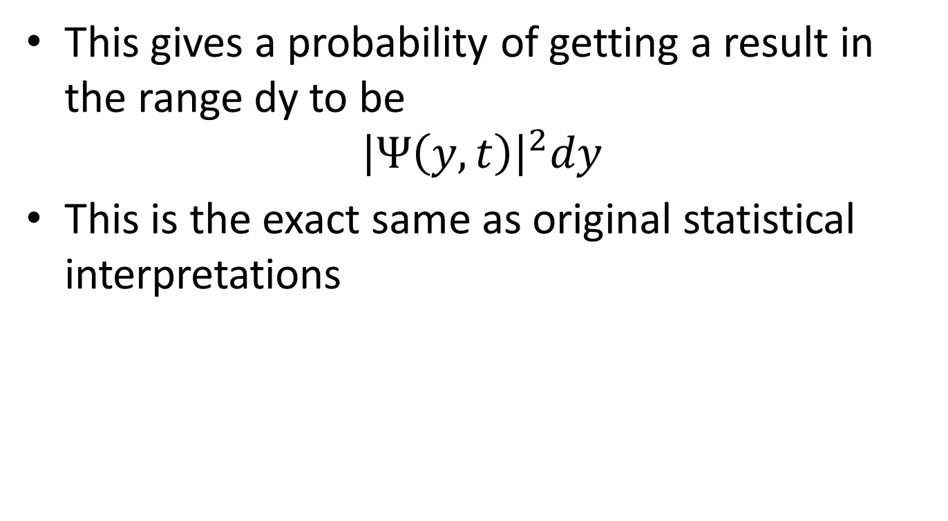
Does this framework check out?
This gives a probability of getting a result in the range dy to be
$${\left|Ψ\left(y,t\right)\right|}^{2}dy$$
This is the exact same as original statistical interpretations

Slide 22
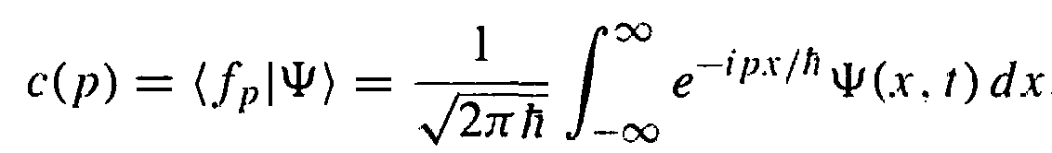
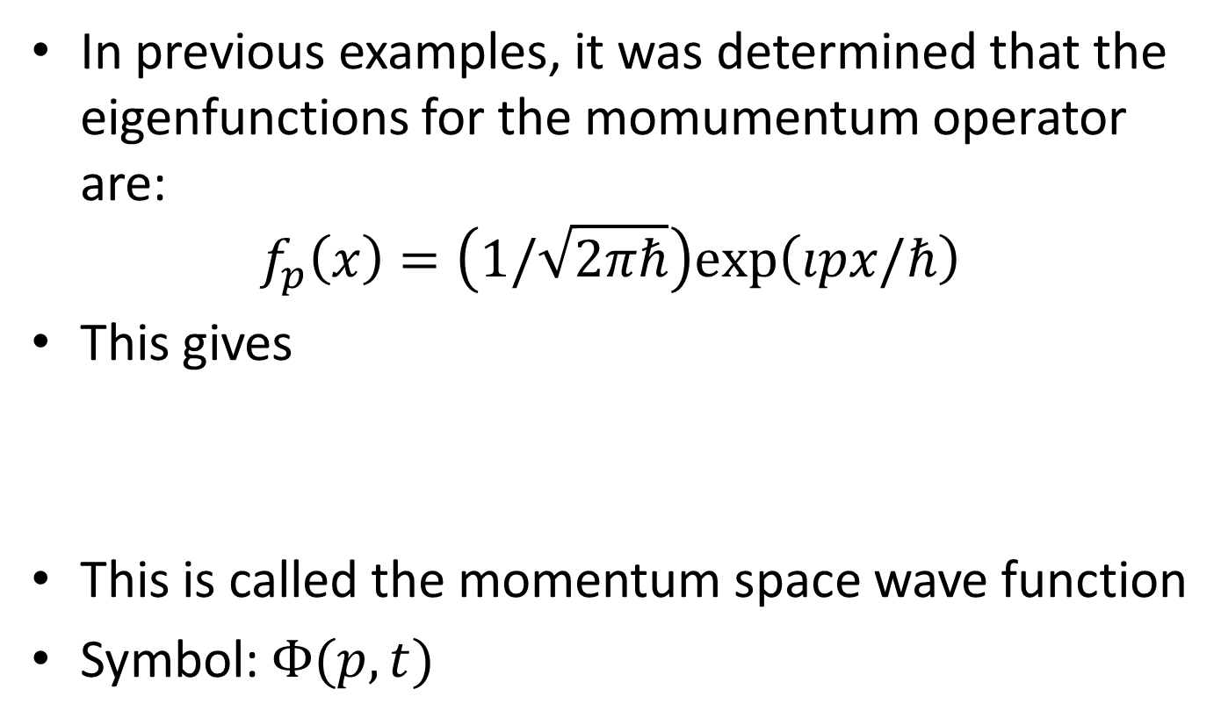
Momentum Space Wave Function
In previous examples, it was determined that the eigenfunctions for the momumentum operator are:
$$f_{p}\left(x\right)=\left(1/\sqrt{2πℏ}\right)exp\left(ıpx/ℏ\right)$$
This gives
This is called the momentum space wave function
Symbol: $Φ(p,t)$

Slide 23
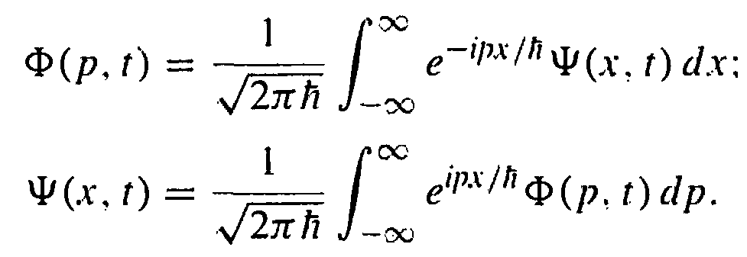
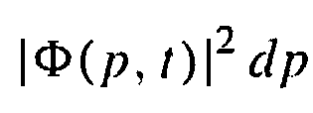

Momentum Space Wave Function
This is the Fourier transform of the wave function $Ψ\left(x,t\right)$
By Plancherel’s theorem, it is the inverse Fourier transform
Probability of momentum measurement yielding a result in the range dp:

Slide 24
Thanks for listening!

