Slide 1
11-dars
Davronbek Malikov

Slide 2

Bugun
Savol Javob
Takrorlash
Algorithm vs Model
Model training bosqichi
Metriklar

Slide 3
Savol Javob

Slide 4
Takrorlash

Slide 5
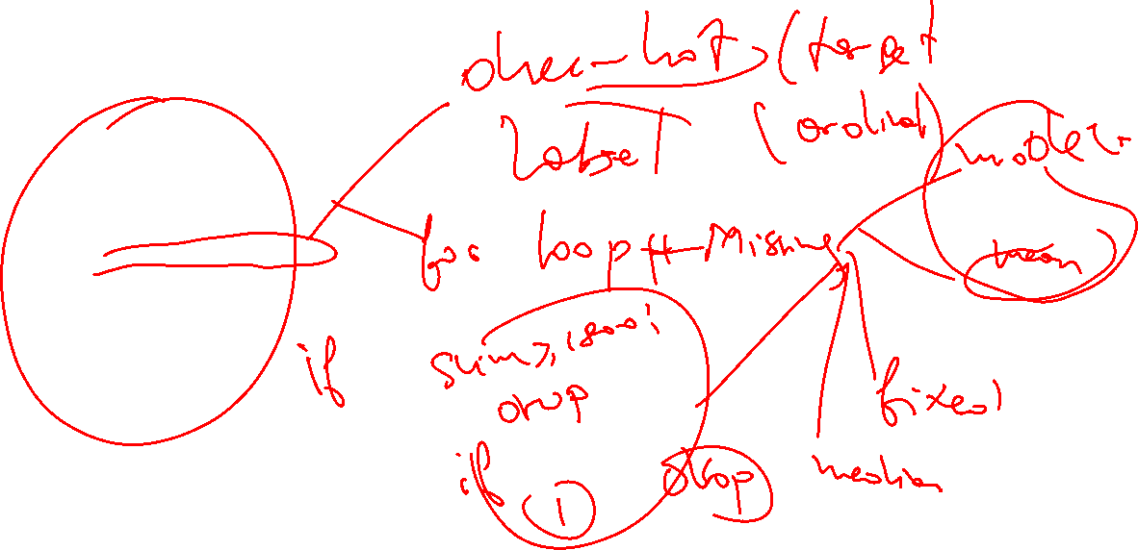
Takrorlash
Savol Javob
Takrorlash
For loop+Encoding
Scaling
Vazifa+Final

Slide 6
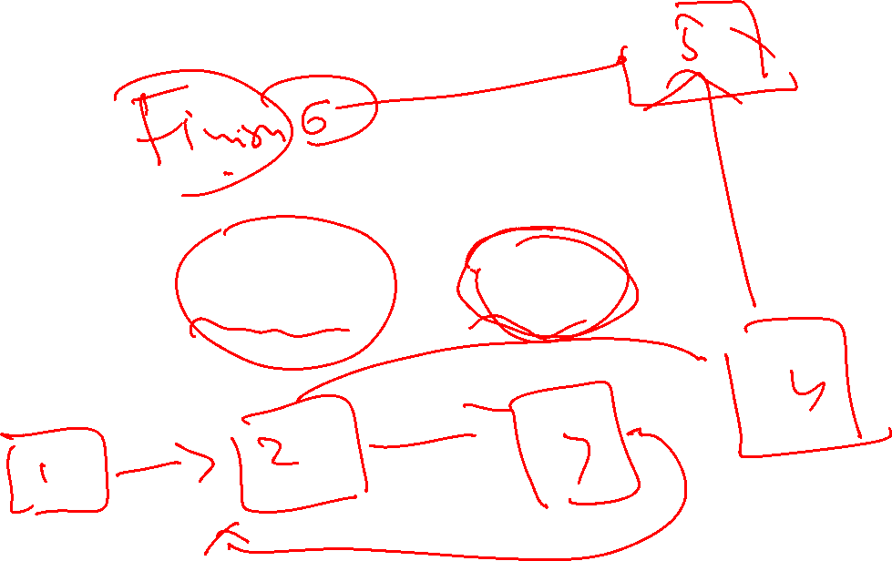
Algorithm vs Model

Slide 7
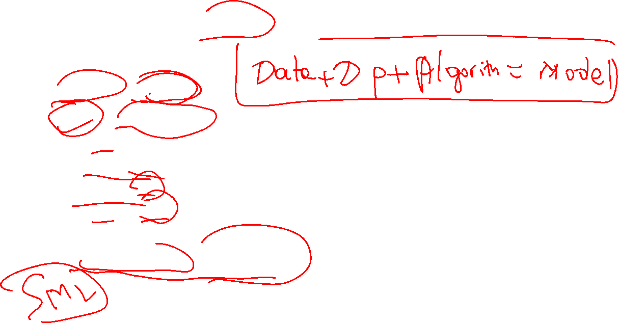
Algorithm vs Model
Algorithm: Retsept
Model: Tayyor ovqat
Algorithms:
Linear Regression
Decision Tree
Random Forest
Models:
House Prediction, Injury detection

Slide 8
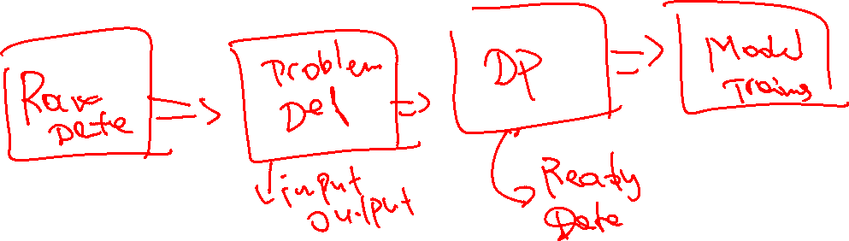
Model training bosqichi

Slide 9
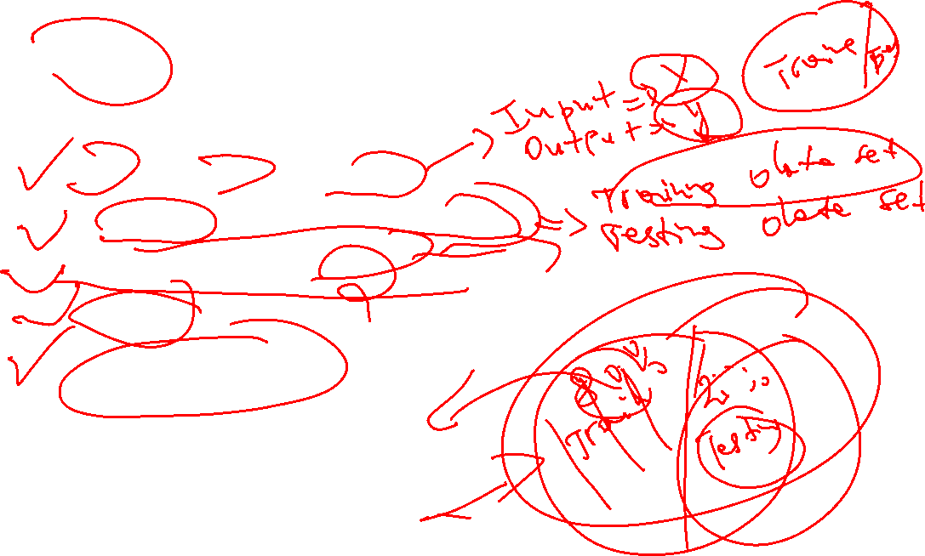
Model training bosqichi
Input va outputni aniqlang
Datasetni kerakli qismlarga ajrating
Traing/testing/validating
Prediction
Aniqligini tekshiring

Slide 10
Metriklar

Slide 11

Metriklar
Classification:
Accuracy score, classification report
Regression:
R2_score, mse, mae, rmse

Slide 12
Vazifa

Slide 13

Vazifa
Kaggle/Githubdan yangi dataset toping va to’liq model yarating(o’tilgan barcha mavzularni qo’llagan xolda)
Vazifalarni topshiring va finalga tayyorgarlik ko’ring

