Slide 1
8-dars
Davronbek Malikov

Slide 2
Bugun
Savol javob
Takrorlash
Encoding nazariy
Encoding amaliy
For Loop

Slide 3
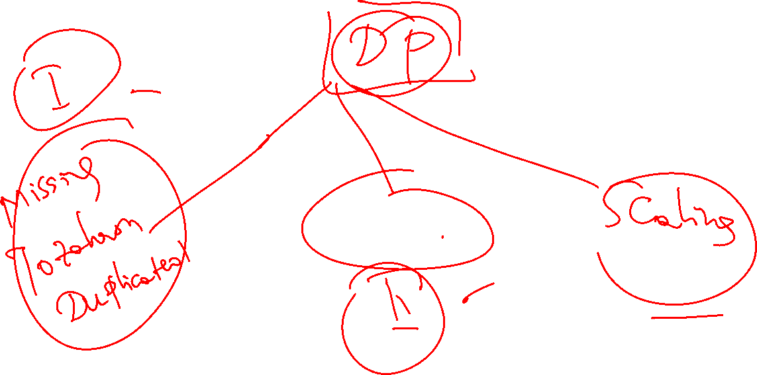
Encoding

Slide 4
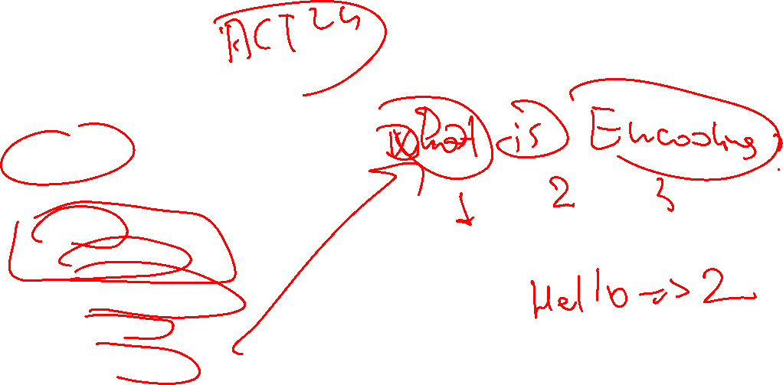
Encoding
Categorical-> Numerical
Turlari
One-Hot
Label Encoding
Frequency encoding
Target Encoding
Ordinal Encoding

Slide 5
One-Encoding

Slide 6
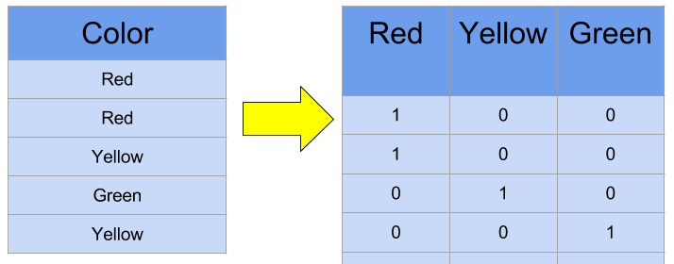
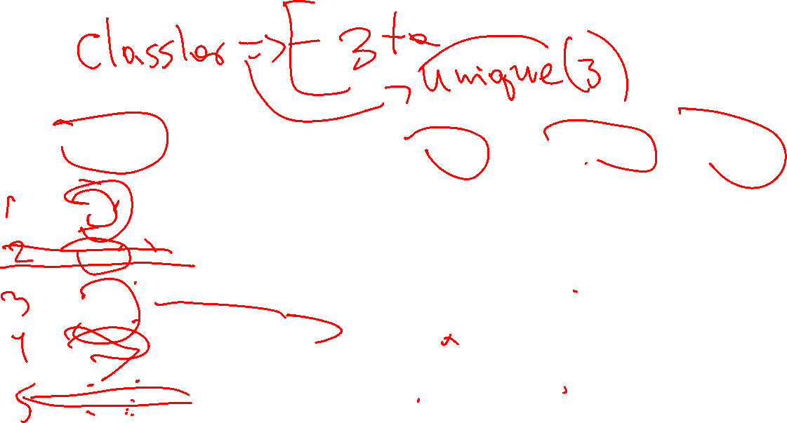

Encoding
One-hot encoding

Slide 7
One-Encoding amaliy

Slide 8
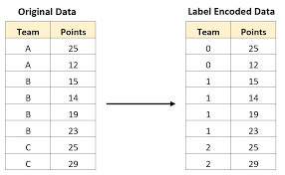

Label encoding
Label

Slide 9
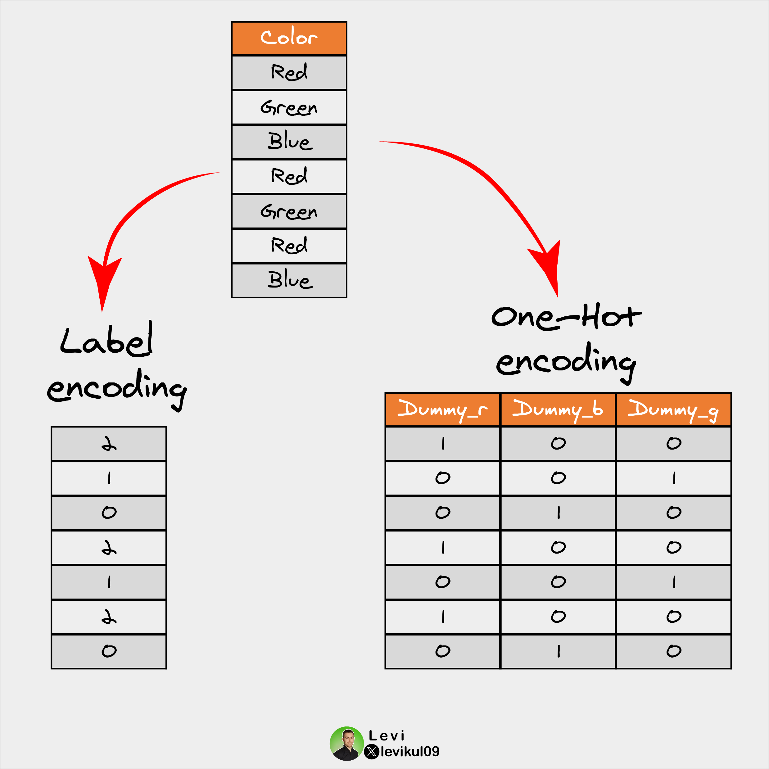
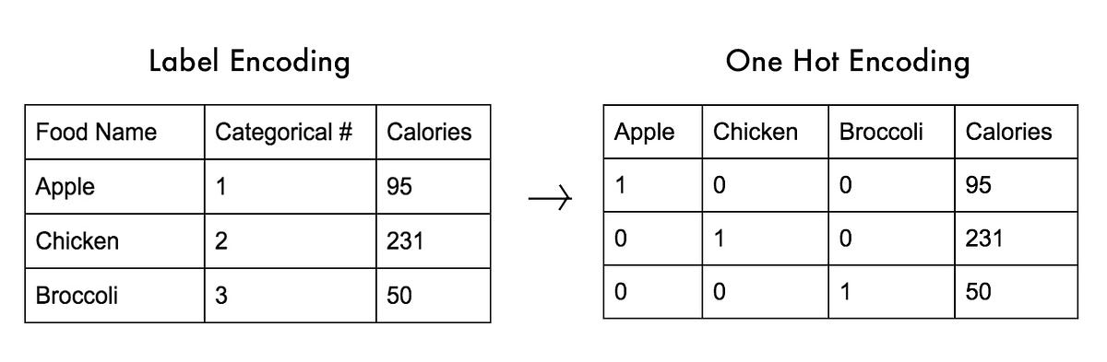

Encoding
Datani bir turdan ikkinchisiga o’tazish
One-hot
Label

Slide 10
Label-Encoding amaliy

Slide 11
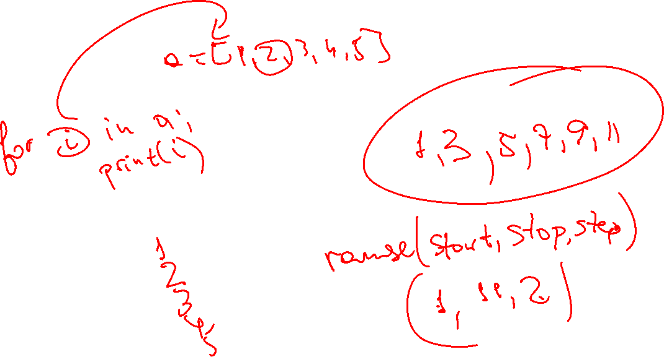
For Loop

Slide 12
Vazifa
Kaggle/githubda yangi dataset toping va 2 ta usul bn enocoding qiling(5 ta missing qiymatlarini toldiring)
For loopga oid misollarni ishlang

