Slide 1
1-dars(2-oy)
Davronbek Malikov

Slide 2


Bugun
1-oy taxlili
2-oy plan
Talablar
Multi-class classification
OvR
OvO
Max-iterations(parametr)
Multi-class amaliy
Project 5
Vazifa

Slide 3
1-oy taxlili

Slide 4

1-oy taxlili
Projectlar:
Ulgurmaslik
Yangilik intilish kamligi
Rang baranglikning kamligi
Final:
Project kam va bir xilda qilganlik
Problem solving
Shoshqoloqlik

Slide 5
2-oy plan

Slide 6
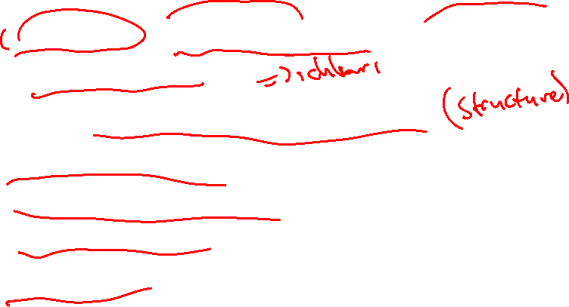
2-oy plan
4 ta Project(data extraction orqali+ Deployment)
Modelni rivojlantirish
Modular Programmingni rivojlantirish
Git bash commands
Multi-class classification
Multi-output models
Deployment

Slide 7
Talablar

Slide 8


Talablar
Darsga o’z vaqtida kiring va barcha qismlarga qatnashing
Deep learning?SML …..
Vazifalarni vaqtida topshiring(17:00 gacha)
Repositoryga 2-oy 1-dars tarzda darslarni yuklang
Asosiy qobiliyatlarni shakllantiring+rivojlantiring:
Problem solving(codewars, leetcode)
To’g’ri va tez yozish(monkeytype)
Logical thinking(kitob o’qish)
Darslarga vijdonan yondashing

Slide 9
Multi-class classification

Slide 10
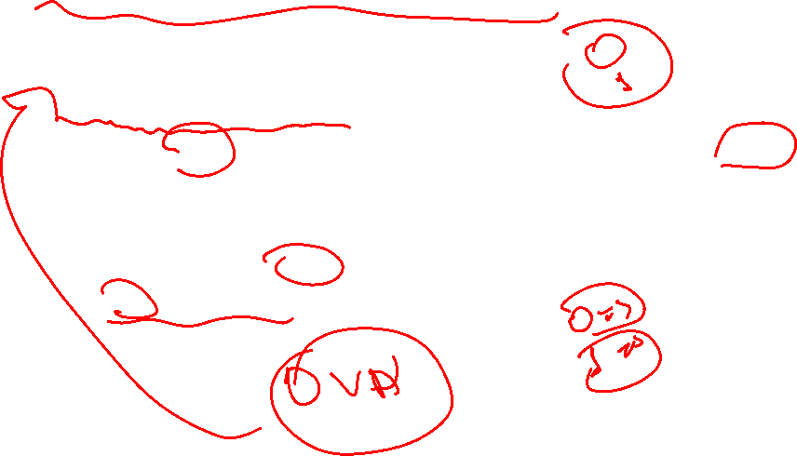
Multi-class classification
Binary Classification(Any idea?)
2 ta class li target qiymat mavjud bolgan dataset kk bdi
Confusion matrixni tushunish oson(0/1)
0/1 ligi uchun modelni tushunish oson
Faqat bitta classifier modelni talab qiladi
One vs another(0/1, yes/no)

Slide 11
Multi-class classification
Multi-class classification(Any idea?)

Slide 12

Multi-class classification
Multi-class classification(Any idea?)
Logistic Regression,SVM→ Binary Classification(DT, RF -> Binary and Multi class)
Xaqiqiy xayotda ko’plab xolatlar multiclass

Slide 13
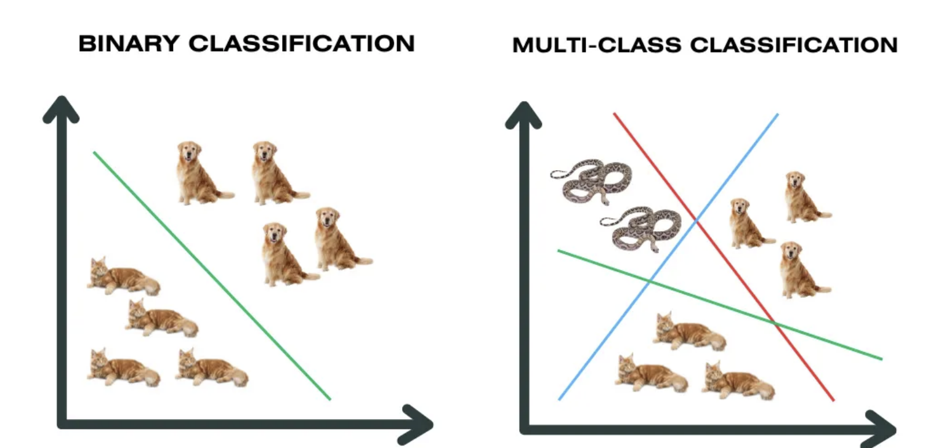
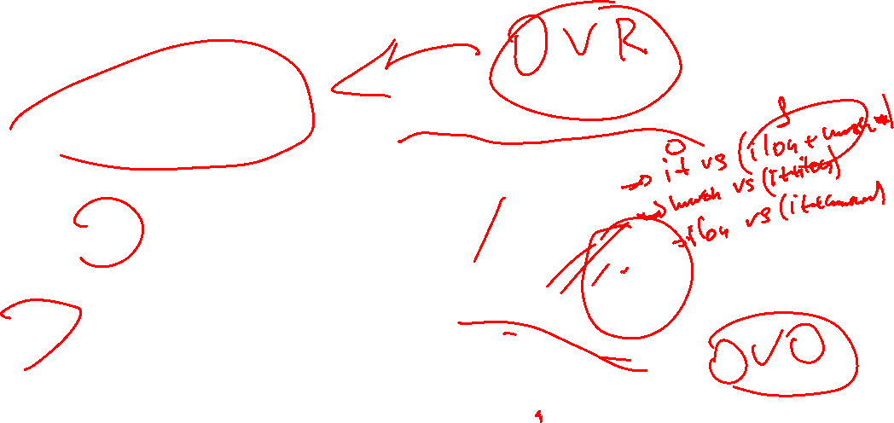
Binary Classification vs Multi-class classification

Slide 14
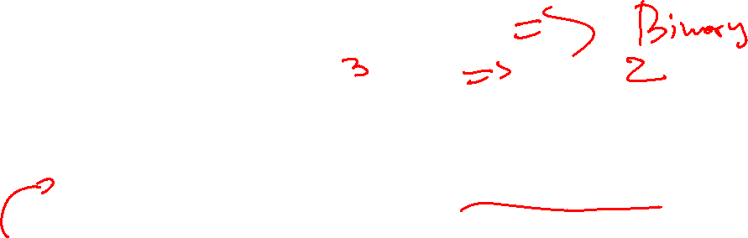
Multi-class classification
Yechim(any idea?):
Multi-classlarni koplab binary xolatlarga bo’lib olish
2 ta asosiy strategiya mavjud:
One-vs-Rest(OvR)
One-vs-One(OvO)

Slide 15

Multi-class classification
OvR
Biz bir classification modelni xar bir class uchun train qilamiz va bu yerda u bir classni qolganlarini yig’ilganidan(rest) farqini o’rganadi
Misol: 3 ta class
Ilon
It
Mushuk
Model1: Ilon vs (It +Mushuk)
Model2: It vs(Ilon + Mushuk)
Model3: Mushuk vs ( It+ Ilon)
Bu yerda biz 3 ta modellarni train qilamiz(1 ta algorithm)

Slide 16

Multi-class classification
OvR
Prediction
Model1: Ilon vs (It +Mushuk)->0.65
Model2: It vs(Ilon + Mushuk)->0.18
Model3: Mushuk vs ( It+ Ilon)->0.25
Predicted class:Ilon

Slide 17
Multi-class classification
OvR +
Sodda va oson ishlatish
Agar classlar ozroq bolsa tez ishlaydi
OvR –
Imbalanced datasetlar bn yaxshi ishlamaydi

Slide 18
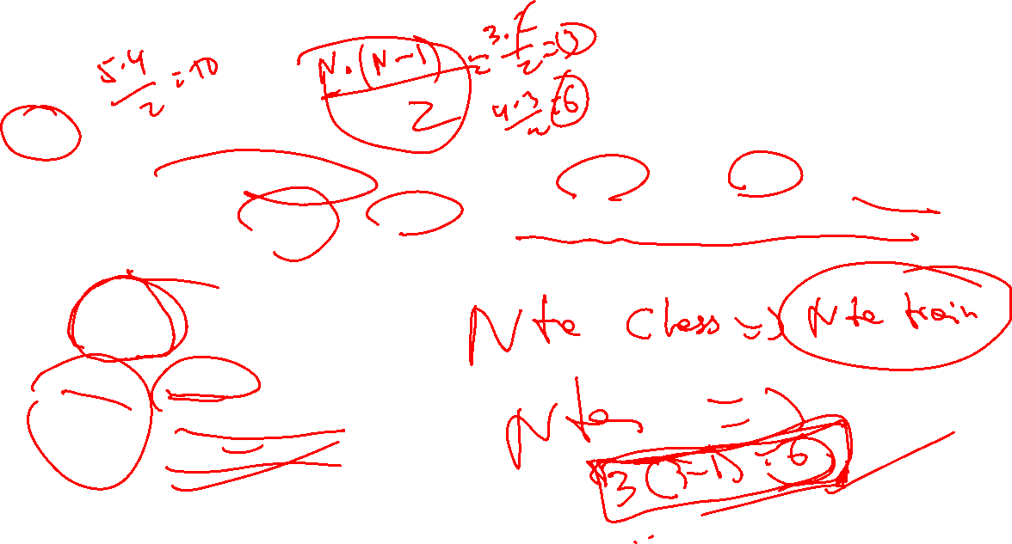
Multi-class classification
OvO
Biz bir classification modelni xar bir class uchun train qilamiz va bu yerda u xar bir classlarni qolganlari bn yakka yakka farqini o’rganadi
Misol: 3 ta class
Ilon
It
Mushuk
Model1: Ilon vs it
Model2: Ilon vs mushuk
Model3: It vs mushuk
Bu yerda biz 3 ta modellarni train qilamiz(1 ta algorithm)-> n(n-1)/2

Slide 19
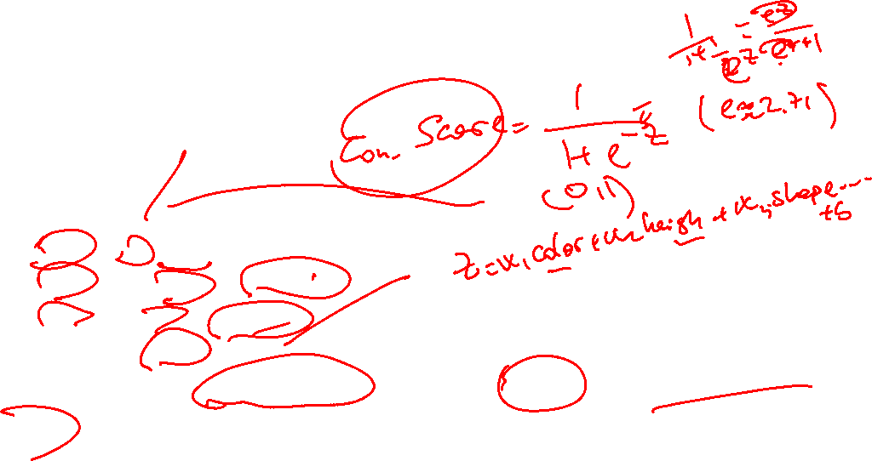
Multi-class classification
OvO
Prediction
Model1: Ilon vs it(ilon)
Model2: Ilon vs mushuk(mushuk)
Model3: It vs mushuk(mushuk)
Predicted class:Mushuk
Agar teng bolib qolsa confidence scorega kora eng yuqori score olgani predict qilinadi
Confidence-Ehtimollar nazariyasi

Slide 20

Multi-class classification
OvO +
Imbalanced datasetlarda ishlatish yaxshi
Meduim classlarda xam yaxshi
OvO–
10 ta class->45models
100 classes->4950 models
Nimaga olib keladi(any idea?)

Slide 21

Multi-class classification
Multi-class classification(Any idea?)
Ko’plab class outputga ega bolgan dataset kk bdi
Multi – class model:
One-vs-Rest(OvR)
Xar bir model bitta classni boshqalaridan ajratib olishga xarakat qiladi(yes yoki no)
Example: Nechta class bolsa shuncha modellarni train qilamiz
One-vs-One(OvO)
Xar bir model bitta classni keying class bn taqqoslab o’rganadi
Example: n(n-1)/2=> 4(4-1)/2=6ta modellar train qilinadi

Slide 22
Max-iterations(parametr)

Slide 23
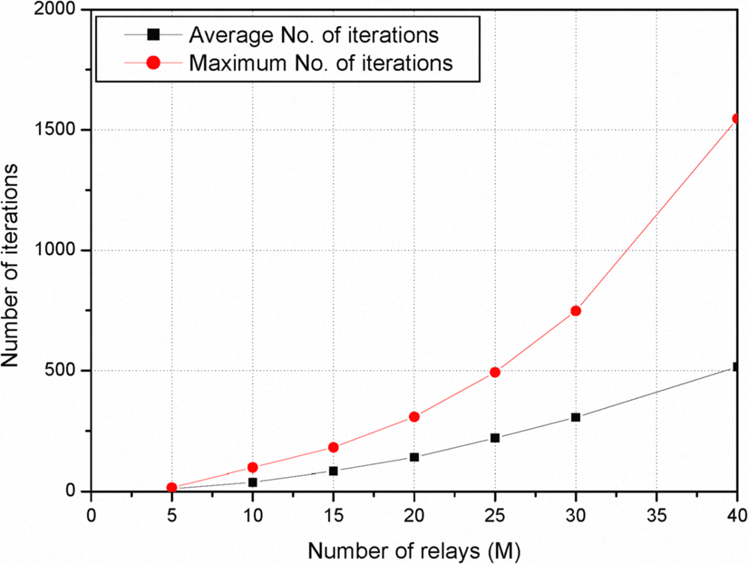

Max-iterations(parametr)
Manzilga qadamma qadam boorish uchun qadam-> best solution
Bazida oz bazida kop qadam kk boladi
Algorithms:
Linear
DL
Clustering

Slide 24
Multi-class amaliy

Slide 25
Project 5

Slide 26
Project 5
Asosiy talablar:
Modular Programming
Data Extraction(kamida 2mingta datarow)
Multi-class classification(OvR vs OvO)

Slide 27
Vazifa

Slide 28

Vazifa
1-dars uchun report yozing
Project 5 uchun Data Extraction qiling(2000mingta)
Modular Structure(git bash, local,vis code, github,venv, folders) tayyorlang

