Slide 1
5-dars
Davronbek Malikov

Slide 2
Bugun
Takrorlash
Savol javob
Tree-Based Algorithms
Imtixon xaqida

Slide 3
Takrorlash

Slide 4
Bugun
Takrorlash
Project o’qish mashqi
Project
Vazifa

Slide 5
Tree-Based Algorithms

Slide 6
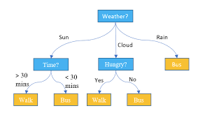
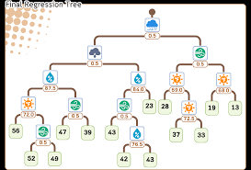
Tree-Based Algorithms
Conditionga ko’ra datasetni kichik qismlarga ajratadi va shunga ko’ra predict qiladigan Algorithm oilalaridan biri

Slide 7
Tree-Based Algorithms
Tree Based algorithm
Decision Tree
https://scikit-learn.org/stable/modules/tree.html
Random Forest
https://scikit-learn.org/stable/modules/generated/sklearn.ensemble.RandomForestClassifier.html
Gradient Boosting Machine
https://scikit-learn.org/stable/modules/generated/sklearn.ensemble.GradientBoostingClassifier.html
AdaBoost
https://scikit-learn.org/stable/modules/generated/sklearn.ensemble.AdaBoostClassifier.html

Slide 8
Tree-Based Algorithms
Linear Modellardan farqi
Non-Linear
Non-linear xolatlarda yuqori natija beradi
Scaling kerak emas

Slide 9
Tree-Based modellar amaliy

Slide 10
Imtixon xaqida

Slide 11
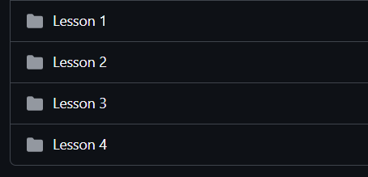
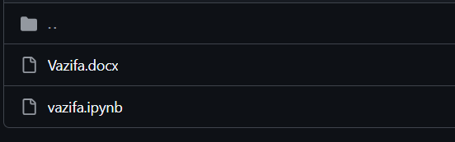
Imtixon xaqida
Kimlar qatnasha oladi
Barcha 5 ta vazifani to’liq bajarganlar
Nimalardan tushadi?
Og’zaki(2 minut)
Python problem solving(4 minut)
ML Coding(5 minut)

