Slide 1
7-dars(Model Building)
Davronbek Malikov

Slide 2

Bugun
Imtixon taxlili
Algorithms
Linear
Linear Regression
Logistic Regression
Tree – Based
Decision Tree
Random Forest

Slide 3
Imtixon taxlili

Slide 4
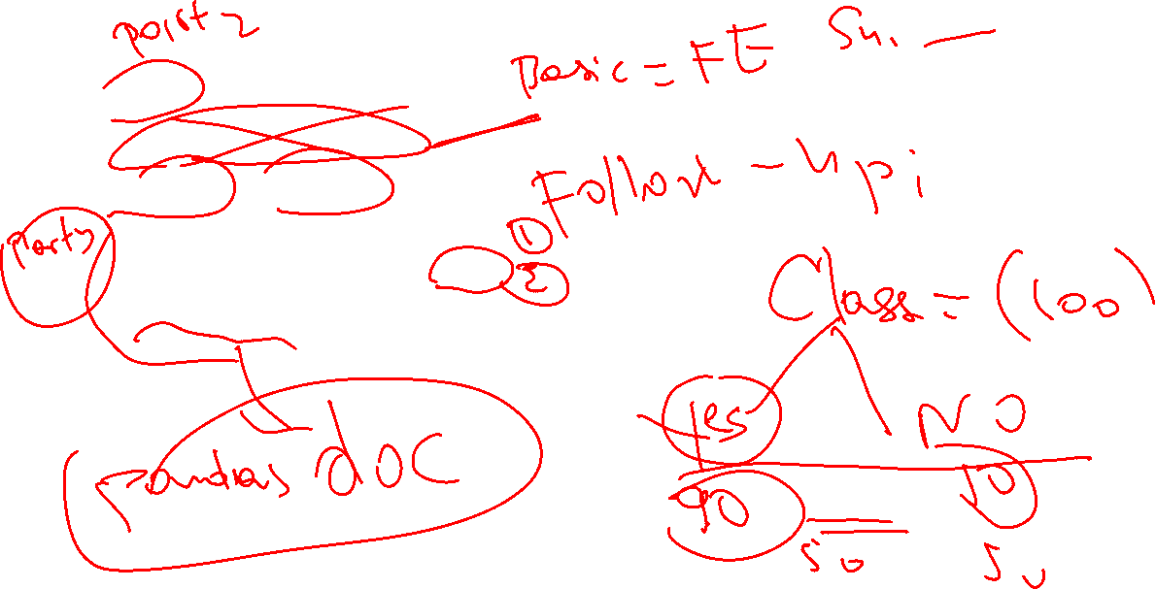

Imtixon taxlili: Og’zaki
Basic
Supervised ML nima?
Follow-up(Behind)
Classification vs Regression
Example of the model (SML)
Data balanced bo’lmasa nima bo’ladi?

Slide 5
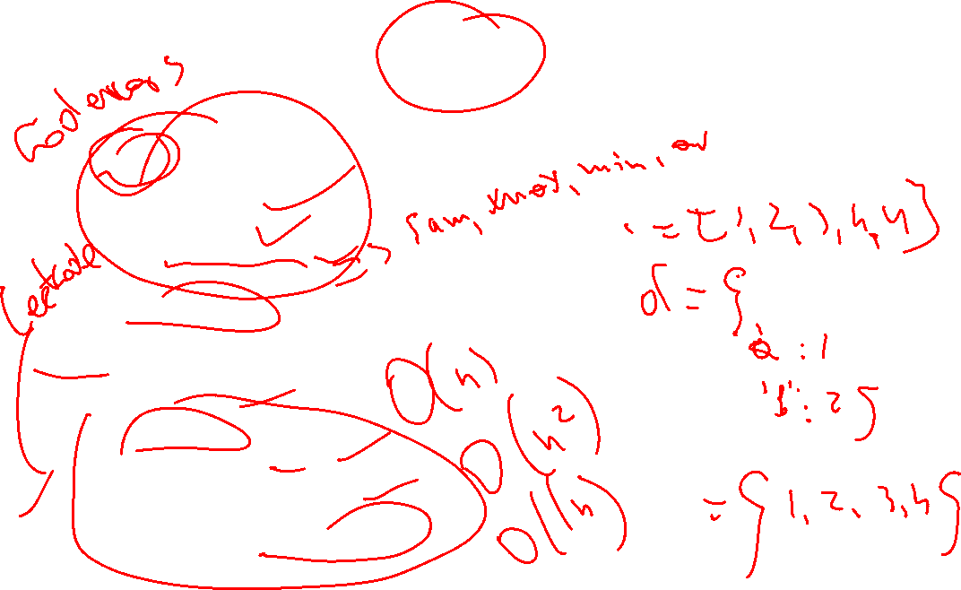
Imtixon taxlili: Python problem solving
Basic
Data types
Functions
Data Structures
Built in functions
Intermediate
Classes
OOP
Files
Advanced
Complexity
Parallel Processing
Advanced data structures

Slide 6
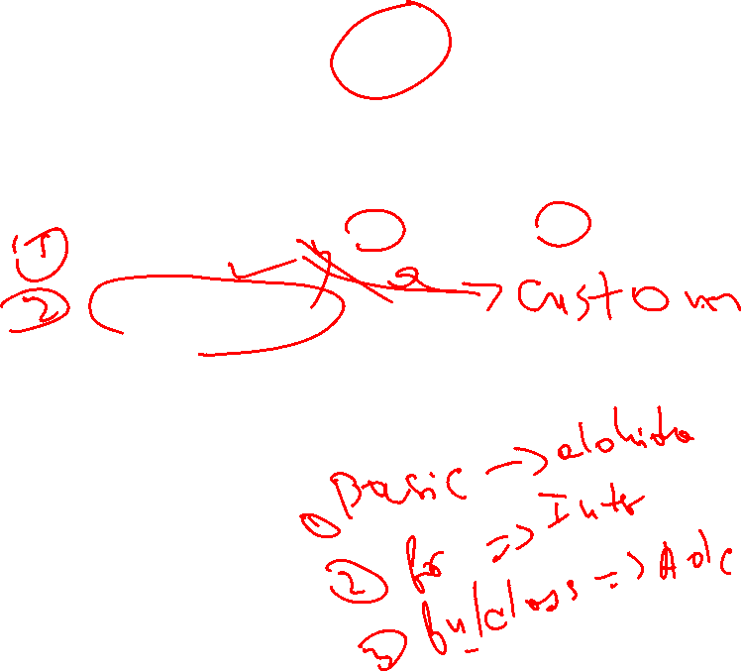
Imtixon taxlili: ML problem solving
Savol:
Data Preprocessing biz o’rgangan 3 ta usuldan tashqari nimalar kirishi mumkin?
Model evaluation

Slide 7
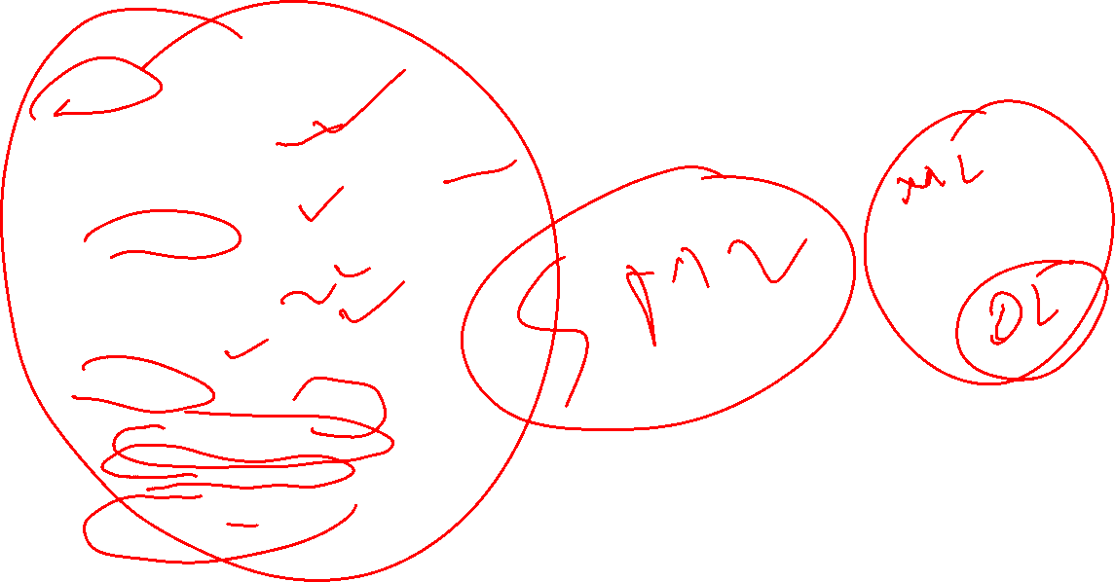
Imtixon taxlili: ML problem solving
Basic
Data Preprocessing
Data splitting
Training with simpler Algorithms
Basic Visualization
Intermediate
Feature Engineering
Cross validation
Different Algorithms
Tuning
Advanced
Handle with large datasets
Custom evaluation metrics
Custom Transformers
Basic Deep learning

Slide 8

Imtixon taxlili: ML problem solving
Savol:
Data Preprocessing biz o’rgangan 3 ta usuldan tashqari nimalar kirishi mumkin?--O’zimiz yangi DP yarata olamiz---Custom Transformers
Model evaluation---O’zimiz yangi metric yarata olamiz—Custom metrics

Slide 9

Linear Regression

Slide 10
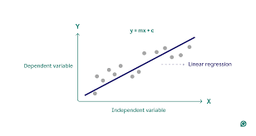
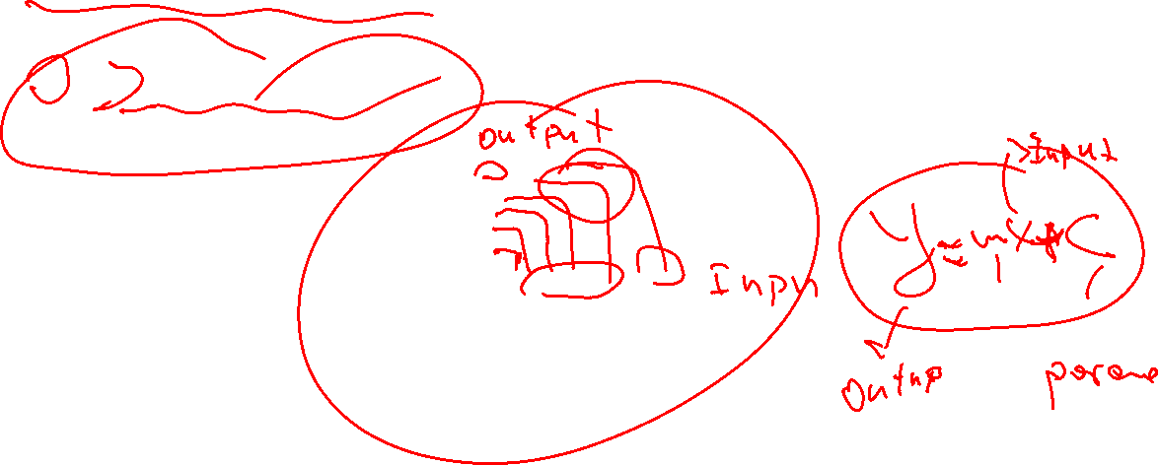
Linear Regression
X va y chiziqli bog’langan

Slide 11
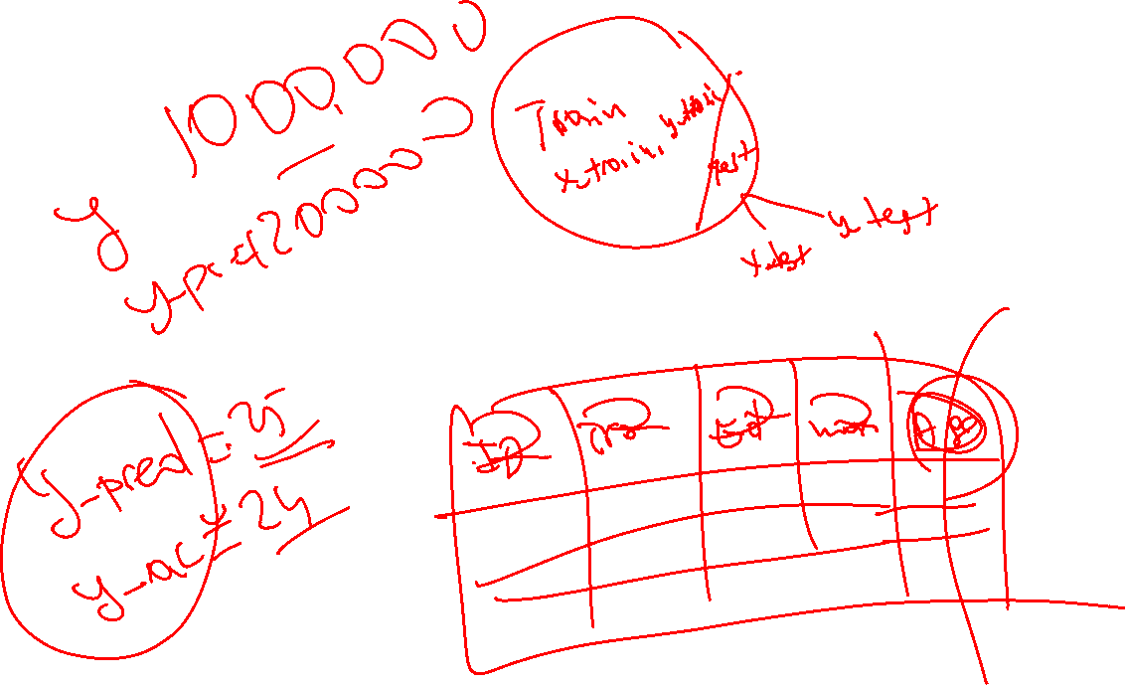
Linear Regression(Amaliy)

Slide 12
Logistic Regression

Slide 13
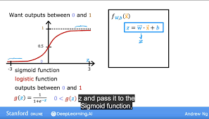
Linear Regression
Mantiq funksiyasi orqali classlarga ajratadi(Sigmoid function)

Slide 14
Logistic Regression(Amaliy)

Slide 15
Decision Tree

Slide 16
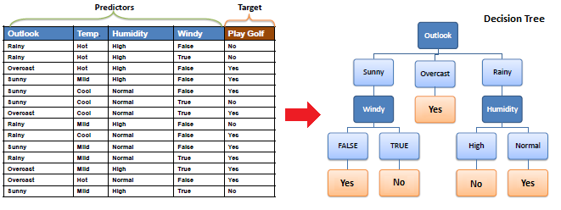
Decision Tree
Tree data structures orqali ishlaydi
Asosiy farqlari:
Ikkala xolda
Uzoqroq vaqt ketadi

Slide 17
Decision Tree(Amaliy)

Slide 18

Nimalar o’rgandik?
Interview+Imtixon taxlili
Og’zaki
Problem solving
Model coding
3 ta algorithm
Linear Regression
Logistic Regression
Decision Tree

Slide 19

Uyga vazifa
Kaggledan dataset toping va 2 ta algorithm orqali Modellar yasang
Problem solvingga tayyorlaning(codewars)
Nazariy(interview og’zaki) mavzularni takrorlang

