Slide 1
CLASS IMBALANCE PROBLEM
Why rare classes get ignored, and what to do about it
Sampling Techniques · Oversampling · Undersampling · Case Study
Otabek · ML Engineering Notes

Slide 2




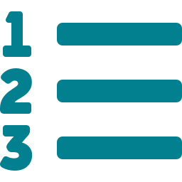
What we'll cover
1
What is class imbalance
Why real-world data rarely arrives evenly split
2
Why it breaks models
Accuracy lies; minority classes get ignored
3
Sampling techniques
Oversampling and undersampling, six methods total
4
Case study
Smart Grid Stability dataset, real results
5
Choosing the right fix
Decision framework + a free alternative

Slide 3
01
What is the
class imbalance problem?

Slide 4
A simple definition
Class imbalance happens when one class (majority) vastly outnumbers another (minority) in your target variable — sometimes 100:1, sometimes 1000:1.
It shows up almost everywhere in real-world data:
~0.1%
~2-5%
~5-15%
~3-8%
Fraud detection
Disease screening
Spam filtering
Layoff risk
fraudulent transactions
patients with the condition
spam emails in an inbox
employees actually laid off

Slide 5
Why a model can be “accurate” and useless
The lazy model
Minority classes get ignored
99% of transactions are legit.
A model that always predicts “legit” — never even looking at the data — gets:
The model has no incentive to learn their patterns.
Poor minority-class performance
Low recall/precision exactly where it matters most.
99% accuracy
0% fraud caught
Biased, overfit behavior
High overall score hides a model that learned almost nothing useful.
The loss function barely notices the minority class, because getting it all wrong costs almost nothing on average.
Use precision, recall, F1, or per-class ROC-AUC — never accuracy alone.

Slide 6
02
Two ways to fix the balance:
Oversampling & Undersampling

Slide 7
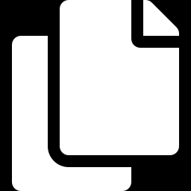
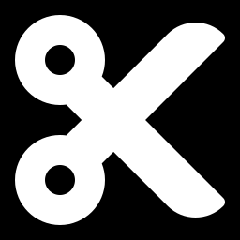
The sampling toolkit
Rebalance the training data BEFORE training — always split train/test first, resample only the training set.
OVERSAMPLING — add minority samples
UNDERSAMPLING — remove majority samples
Random Oversampling
Random Undersampling
SMOTE
ClusterCentroids
ADASYN
NearMiss
Goal: improve generalization and fairness across classes, not just raw accuracy.

Slide 8


Random Oversampling
Oversampling
Duplicates random rows from the minority class until both classes have equal counts.
from imblearn.over_sampling import RandomOverSampler
Pros
ros = RandomOverSampler(random_state=42)
X_res, y_res = ros.fit_resample(
X_train, y_train
)
Simple and fast to apply
No assumptions about data structure
Before: 1,125 stable / 28,710 unstable
After: 28,710 stable / 28,710 unstable
Cons
Exact duplicates risk overfitting — model can memorize repeated rows
No new information added
Exact duplicates — same rows repeated many times

Slide 9
SMOTE
Oversampling
Synthetic Minority Oversampling Technique
Instead of duplicating, SMOTE creates NEW synthetic points along the line between a minority sample and its nearest minority neighbors.
neighbor
from imblearn.over_sampling import SMOTE
smote = SMOTE(random_state=42, k_neighbors=5)
X_res, y_res = smote.fit_resample(X_train, y_train)
minority point
new synthetic
point
Pros
Cons
Adds variety instead of exact copies
Lower overfitting risk than random oversampling
Can create unrealistic points if minority data is spread out or near majority clusters
Numeric features only (use SMOTENC for categorical)

Slide 10
ADASYN
Oversampling
Adaptive Synthetic Sampling
A refinement of SMOTE: generates MORE synthetic points where the minority class is hardest to learn (near the boundary), and FEWER where it's already easy.
from imblearn.over_sampling import ADASYN
adasyn = ADASYN(random_state=42, n_neighbors=5)
X_res, y_res = adasyn.fit_resample(X_train, y_train)
Pros
Cons
Focuses effort where the model actually struggles
Often improves classification right at the decision boundary
More sensitive to noise — an outlier surrounded by majority points gets oversampled too

Slide 11
Random Undersampling
Undersampling
Drops random rows from the majority class until both classes are equal in size.
from imblearn.under_sampling import RandomUnderSampler
Pros
rus = RandomUnderSampler(random_state=42)
X_res, y_res = rus.fit_resample(
X_train, y_train
)
Fast — smaller dataset trains quicker
Simple and easy to apply
Before: 1,125 stable / 28,710 unstable
After: 1,125 stable / 1,125 unstable
Cons
Throws away potentially useful majority-class information
Can hurt performance if majority class wasn't actually redundant
Training set shrinks dramatically — a lot of majority-class data is simply thrown away

Slide 12
ClusterCentroids
Undersampling
Clusters the majority class with K-Means, then replaces each cluster with its centroid — a synthetic representative point — instead of picking real rows.
from imblearn.under_sampling import ClusterCentroids
cc = ClusterCentroids(random_state=42)
X_res, y_res = cc.fit_resample(X_train, y_train)
centroid
(synthetic point)
majority
cluster
Pros
Cons
Retains the overall shape of the majority class distribution better than random dropping
Centroids are synthetic — real data points are lost entirely
Computationally heavier (runs K-Means)

Slide 13
NearMiss
Undersampling
A surgical approach: keeps the majority points CLOSEST to the minority class (near the boundary) and removes the “easy”, far-away majority points.
from imblearn.under_sampling import NearMiss
nm = NearMiss(version=1, n_neighbors=3)
X_res, y_res = nm.fit_resample(X_train, y_train)
Pros
Cons
Keeps the majority samples that actually define the decision boundary
Often the best balance among undersampling methods in practice
Sensitive to noisy points right at the boundary
Slower than random undersampling

Slide 14
03
Case study:
Smart Grid Stability dataset
60,000 rows · Logistic Regression · Manufactured 96% / 4% imbalance

Slide 15
Results: minority-class F1 by method
Same untouched test set for every method. Higher isn't always “better” — see precision/recall on the next slide.

Slide 16
The real story: precision vs. recall
Baseline (no resampling)
After resampling (SMOTE / oversampling)
21%
94%
79%
13%
Recall
Precision
Recall
Precision
Catches very few real “stable” cases — but when it does flag one, it's almost always right.
Catches almost all real “stable” cases — but also wrongly flags many “unstable” rows.
Resampling isn't free improvement — it shifts the precision/recall tradeoff. Which direction is “better” depends on which mistake costs more in your use case.

Slide 17
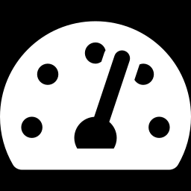
Choosing the right fix for your problem
Use case | What matters more | Prefer
Fraud detection | Catching fraud (recall) | Oversampling / NearMiss
Spam filtering | Not blocking real emails (precision) | Baseline or mild techniques
Medical screening | Recall — missing a disease is costly | Oversampling
Recommendation flags | Precision — false positives erode trust | Baseline / careful undersampling
Try this first — it's free
class_weight='balanced' — available on LogisticRegression, SVC, RandomForest, and more. Reweights the loss function to penalize minority misclassification more heavily. No data manipulation, no synthetic rows, no extra training time.

Slide 18
Key takeaways
1
Accuracy lies on imbalanced data — always check precision, recall, and F1 per class.
2
Resample the TRAINING set only, after the train/test split — never before.
3
Oversampling adds data (risk: overfit); undersampling removes data (risk: underfit).
4
There's no universal “best” technique — match the method to which mistake costs more.
5
Try class_weight='balanced' before reaching for resampling — it's free.
Thank you

