Slide 1
4-dars
Davronbek Malikov

Slide 2
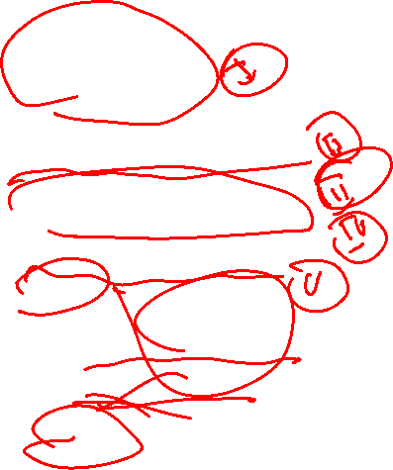
Bugun
Savol javob
Takrorlash
Project ketma ketligi
Data Preprocessing
Library(Kutubxona)
Data
Conditions(davomi)
Qo’shimcha dars
Vazifa

Slide 3
Savol javob

Slide 4
Takrorlash

Slide 5
Takrorlash
Savol javob
Takrorlash
ML model yaratish
Kaggle/Github
Data bilan ishlash
Conditions

Slide 6
Project ketma ketligi

Slide 7
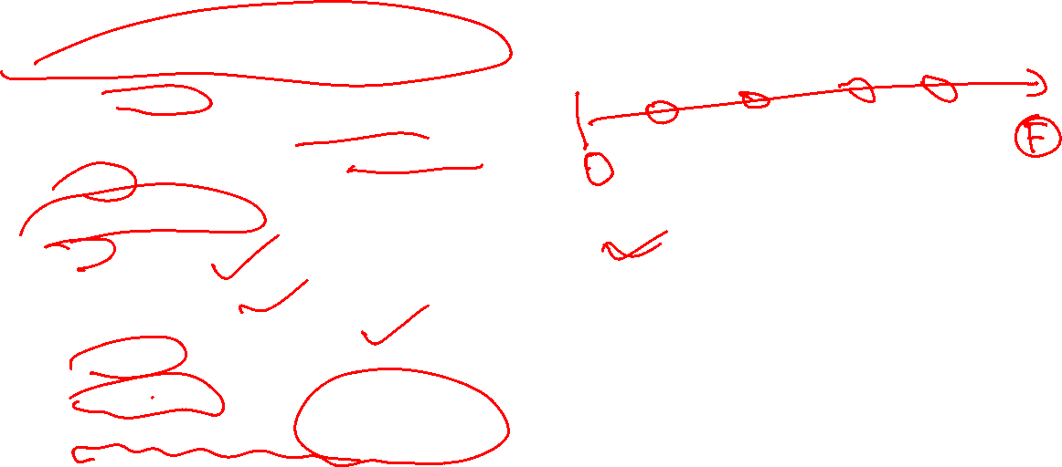
Ml project ketma ketligi(1)
Data Collection(Malumot to’plash)
So’rovnoma
Web sitelardan olish(web scraping)
Tayyor datasetni topish(github,Kaggle)
Mijoz
Data bn tanishuv
Fayl va datasetni bir xil joyga qo’yish(yonma-yon)
Pandas install
Pandas import
Datani o’ng tomonfga olish
head/tail
Input/output
Keraksiz malumotlarni tashlab yuborish

Slide 8

Ml project ketma ketligi(2)
Data Preprocessing(Malumot tayyorlash)
Model selection(Model tanlash)
Model training(datani o’qitish) ---70%
Model prediction(bashorat qilish)
Model evaluation(Baxolash)---15%
Model testing(test qilish)—15%
Model deployment
Model maintaining/Monitoring

Slide 9
Data Preprocessing

Slide 10
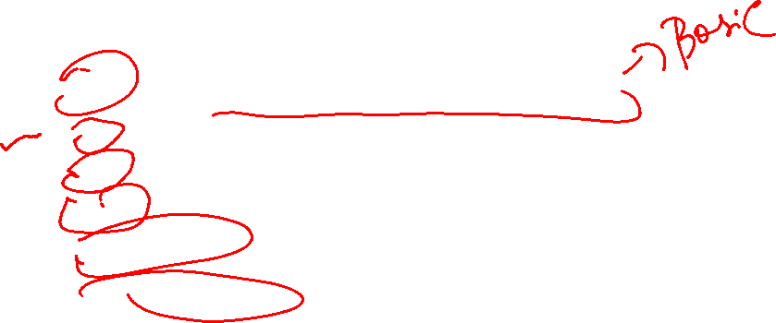
Data Preprocessing
Tushirib qoldirilgan qiymatlarni to’ldirish
Mean(o’rta arifmeik qiymat bn to’ldiring)(raqamli ustunlar u-n)
Mode(‘eng ko’p takrorlangan element bn to’ldirish)(ikkalasi xam)
Median(‘eng o’rtasidagi element bn toldirish)(raqamli)
Fixed qiymat bn (O’zimiz xoxlagan qiymat bn toldirish)
Tashlab yuborish

Slide 11
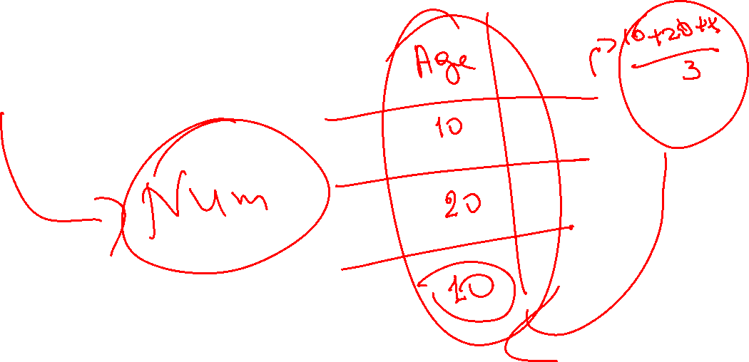
Data Preprocessing
Mean

Slide 12
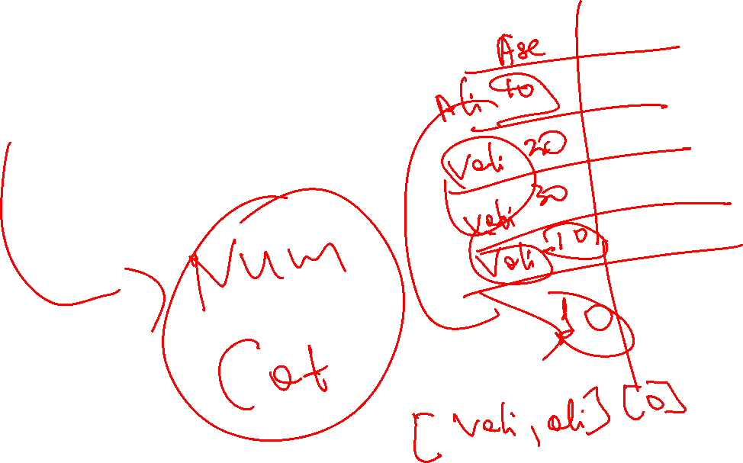
Data Preprocessing
Mode

Slide 13
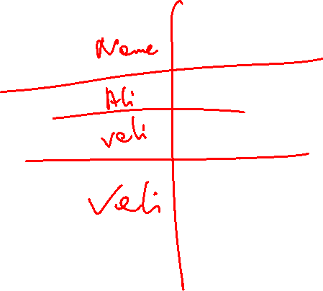
Data Preprocessing
Median

Slide 14
Data Preprocessing
Fixed

Slide 15
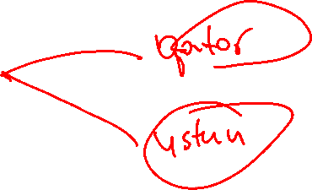
Data Preprocessing
Drop

Slide 16

Library(Kutubxona)

Slide 17
Kutubxonalar

Slide 18
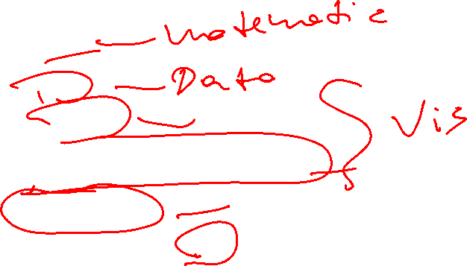
Kutubxonalar
Kutubxonalar:
Numpy
Pandas
Matplotlib
Seaborn(documentation)
Scikit-learn
Kutubxonalar(doc)

Slide 19
Pandas

Slide 20

Pandas
Malumotlarni kirgazish
Malumotlar bilan tanishish
Malumotlarni o’zgartirish, tozalash
Malumotlarni taxlil qilish

Slide 21
Numpy

Slide 22


Numpy
Statistika va matematik boshqaruv
Matematik taxlil va xisob kitoblar

Slide 23
Matplotlib

Slide 24
Matplotlib
Grafiklar
Dizaynlar

Slide 25
Seaborn

Slide 26
Seaborn
Statistik malumotlarni turli xil yo’llar bn ko’rsatish(visual korinishda)

Slide 27
Scikit-learn

Slide 28

Scikit-learn
Ml o’qitish
Ml project bosqichlarini bajarish

Slide 29
Data

Slide 30

Data
Data:
Structured
To’liq
Katta
Soxaga aloqador
Ishonchli

Slide 31

Nimalar o’rgandik?
Project ketma ketligi
Data Preprocessing
Missing qiymatlarni 5ta usulda to’ldirish
Library(Kutubxona)
Data

Slide 32

Vazifa
4-dars uchun report yozing
Data Types+ Operations+Conditionsga problem solving
Yangi data toping va 5 ta usulda tushirib qoldirilgan qiymatlarni to’ldiring

