Slide 1
8-dars
Davronbek Malikov

Slide 2


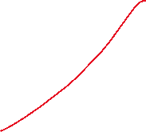

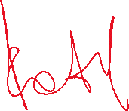



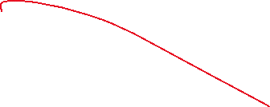
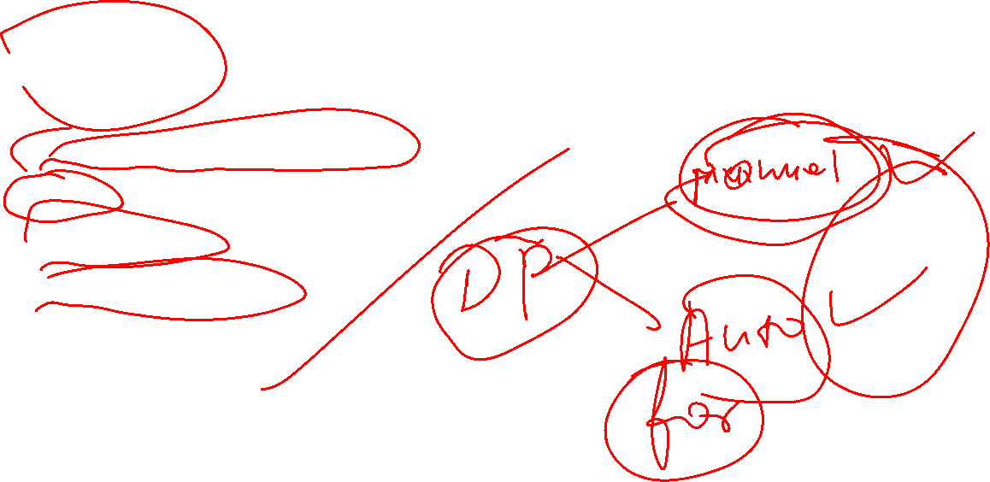

Bugun
Savol javob
Takrorlash
Data Preprocessing: Review
Scaling
Scaling amaliy
For Loop + Scaling
Vazifa

Slide 3
Savol javob

Slide 4
Takrorlash

Slide 5

Takrorlash
Savol javob
Takrorlash
Data Preprocessing: Review
Encoding: davomi
For loop
For loop + Missing qiymatlarni to’ldirish/Encoding
Vazifa

Slide 6
Data Preprocessing: Review

Slide 7
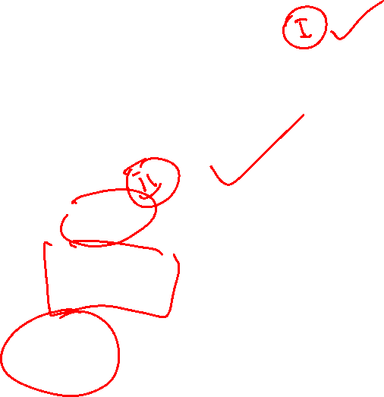
Data Preprocessing: Review
Handling missing values
Mean
Mode
Median
Fixed
Drop
Encoding
One-hot
Label
Frequency
Target
Ordinal
Scaling

Slide 8

For loop + Encoding

Slide 9
For loop + Encoding
Qisqaroq va umumiy yondashuv
Vaqtdan yutish va toza kod

Slide 10
Scaling

Slide 11
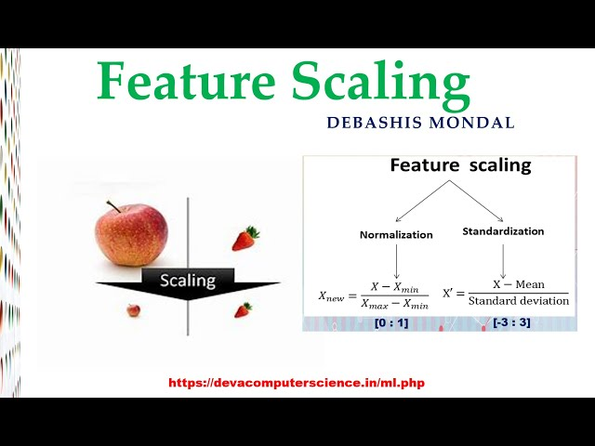
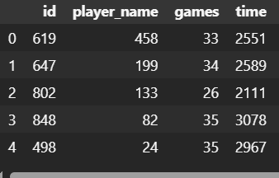
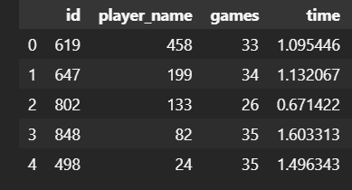
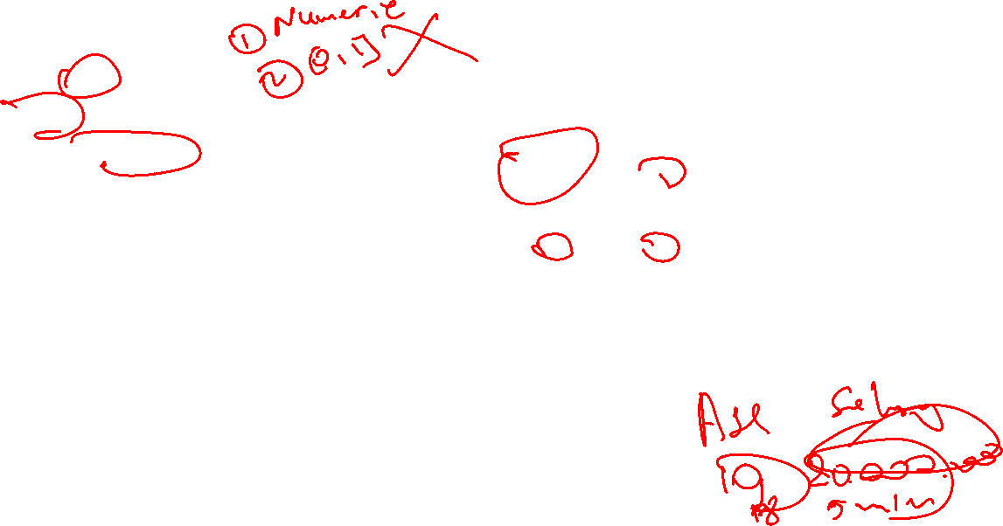
Scaling
Juda katta va juda kichkina qiymatlarni balanslashtirish uchun ishlatilinadigan Data Preprocessing bo’limi

Slide 12
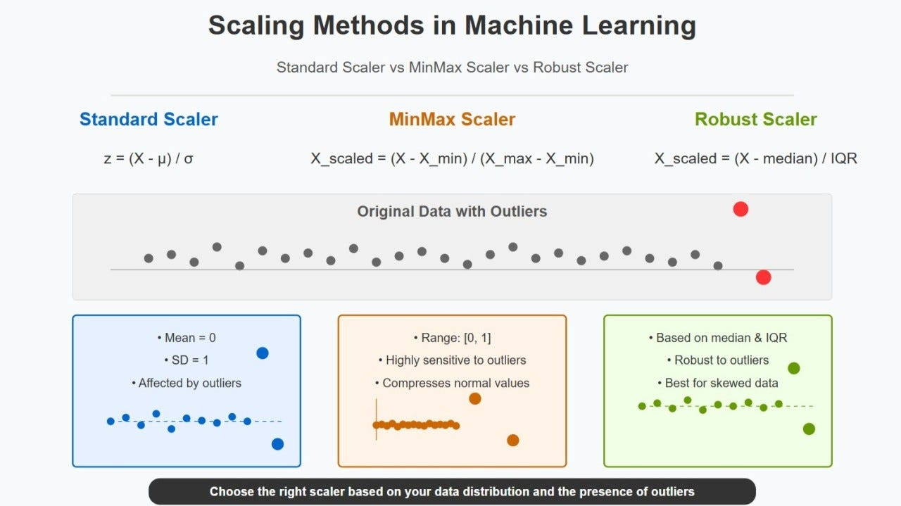
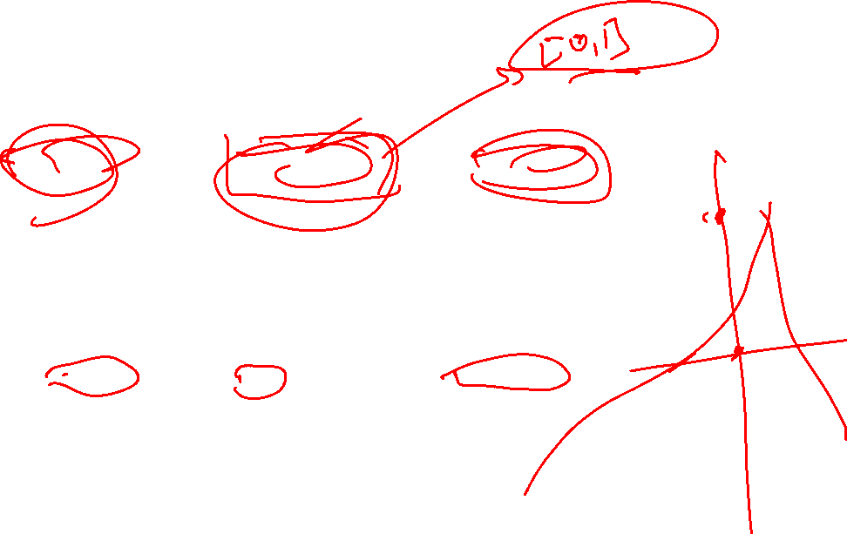
Scaling

Slide 13
Scaling amaliy

Slide 14
For Loop + Scaling

Slide 15
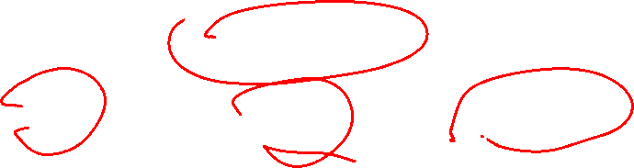
For Loop + Scaling
Jarayonni avtomatlashtirish uchun ishlatilinadi
Umumiy yoki gruppalarga bolib scaling qilish uchun ishlatilinadi

Slide 16































Structure

Slide 17
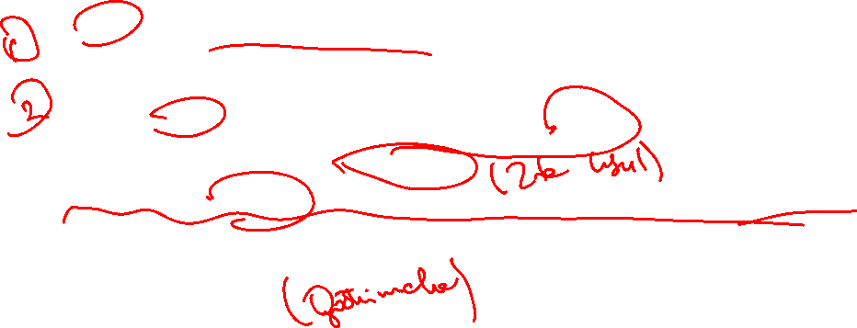
Vazifa
8-dars uchun report yozing
Kaggle/Githubdan dataset toping
For loop orqali missing qiymatlarni tozalang(5 tasini ishlatishga xarakat qiling)
For loop orqali encoding qiling
For loop orqali Scaling qiling(barcha numeriklarni 3 ta usulda)
For loopga oid misol ishlang va problem solvingni kuchaytiring
Edabit.com

