Slide 1
8-dars(2-oy)
Davronbek Malikov

Slide 2


Bugun
Savol javob– Final Project xolati
Takrorlash
Feature Importance
Shap Values
Feature Importance vs Shap values
Shap Values amaliy
Multi-output models

Slide 3





Takrorlash

Slide 4

Takrorlash
Project 6 taxlili
Takrorlash
Feature Analysis Amaliyot to’liq
Shap values
Plotly studio
Project 7
Vazifa

Slide 5
Feature Importance

Slide 6
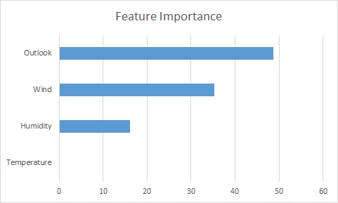
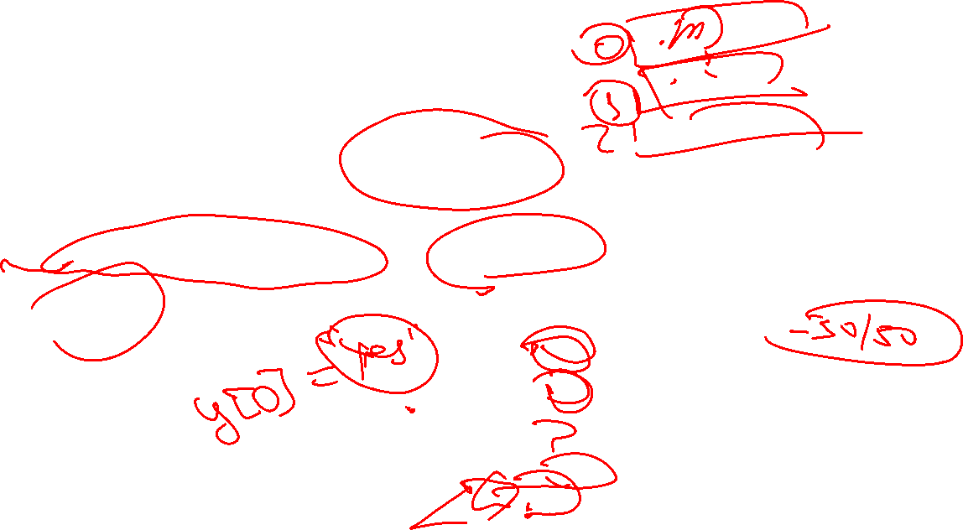
Feature Importance
FI xar bir feature umumiy model predictionga xissa qoshganligini o’lchaydi
model.feature_importances_-------tree based
Coefficients-----linear models

Slide 7

Feature Importance
Limitations:
Feature qanday tasir qildi(positive yoki negative)
Qaysi qiymat yoki qatorda(sample) outputga tasir qilganini korsatmaydi
Correlationda kerakli notogri ishlaydi

Slide 8
Shap values

Slide 9
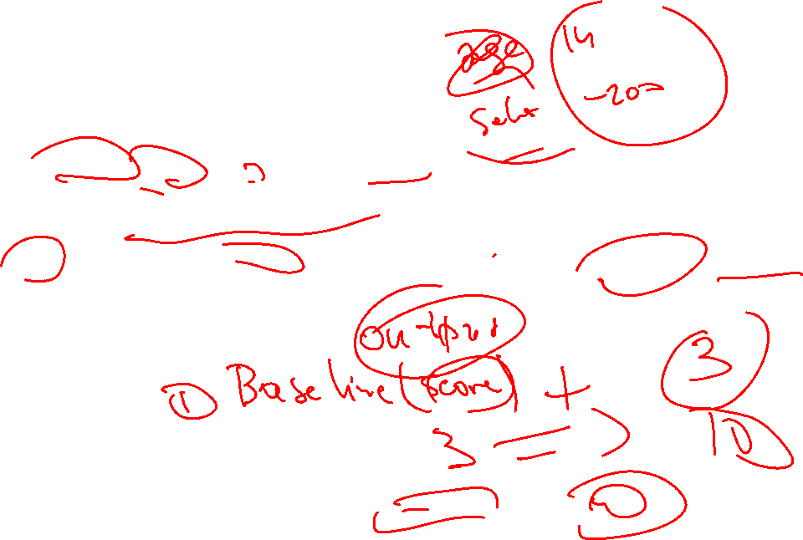
Shap values
SHAP (SHapley Additive exPlanations)
Shap value---Global feature importance
Shap value– input qiymatlarni qanchalik model predictionni baseline qiymatdan qaysi tomonga sura olishga qoshgan xissalarini o’lchaydi

Slide 10
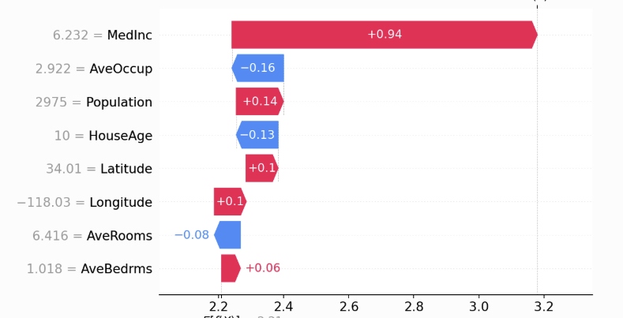




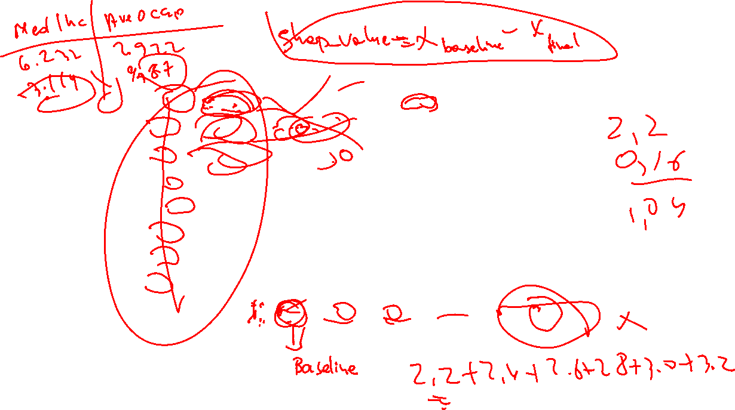




Slide 11
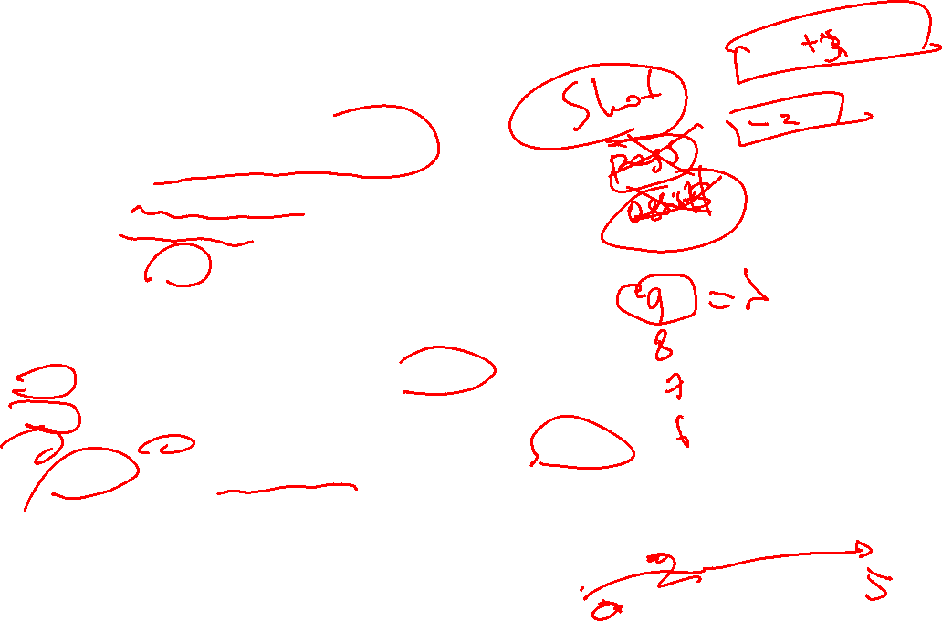

Shap values
Shap(SHapley Additive exPlanations)
explanatory, not evaluative.
Example(player rating)
+3-----yaxshi shot
-2------yomon pass
0------ assists
Positive SHAP → feature pushes rating up.
Negative SHAP → feature pushes rating down.
Yaxshi yoki yomon feature maqsadga kora aniqlanadi:
high rating → positive influence is helpful.
find weaknesses → negative influence is informative.

Slide 12
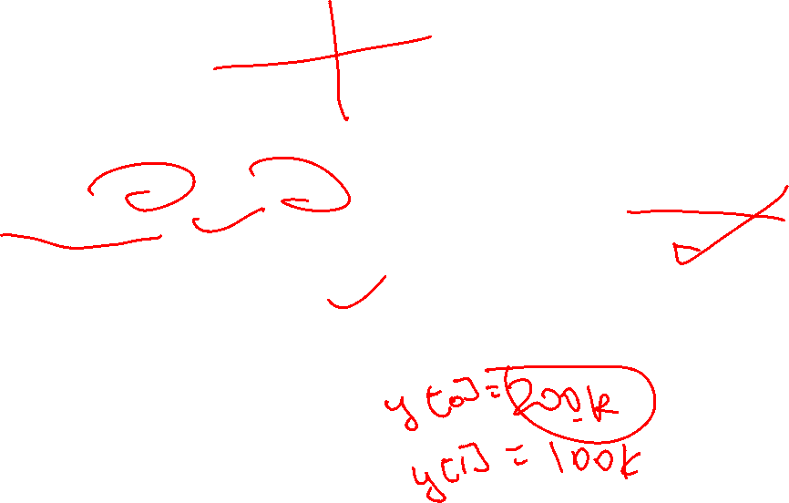
Shap values
Nima uchun foydali:
Feature engineeringdagi yaratilgan featurelarni qanchalik foydali/foydasiz ekanligini kora olamiz
Local explanations-nima uchun model bunday prediction qildi
Barcha modellar bn ishlay oladi

Slide 13

Feature Importance vs Shap values(any idea?)

Slide 14
Shap value amaliy

Slide 15

Multi-output models

Slide 16
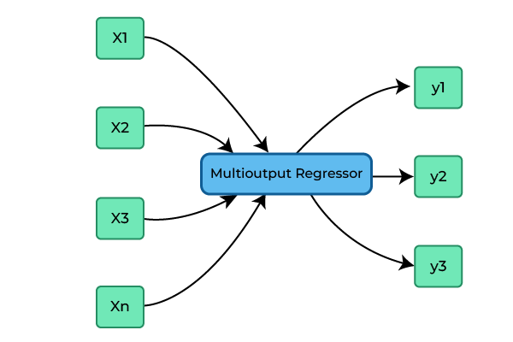


Slide 17
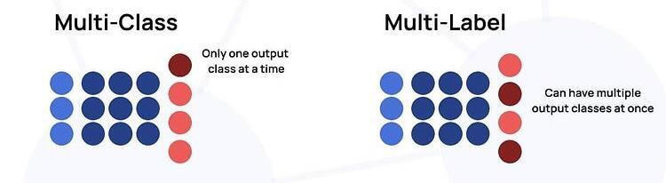
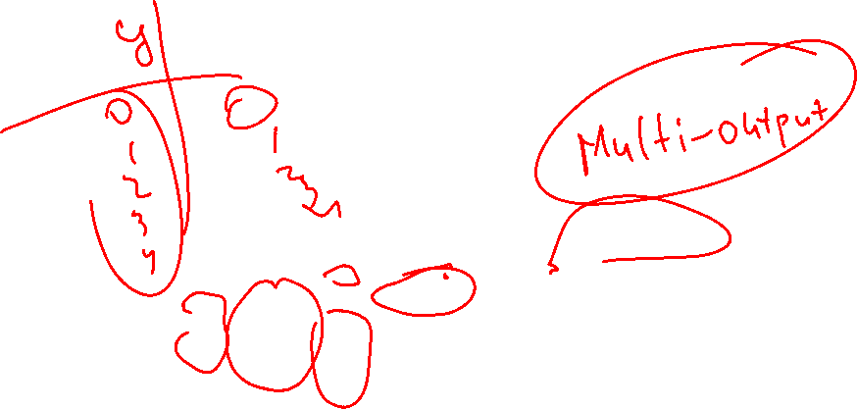

Slide 18
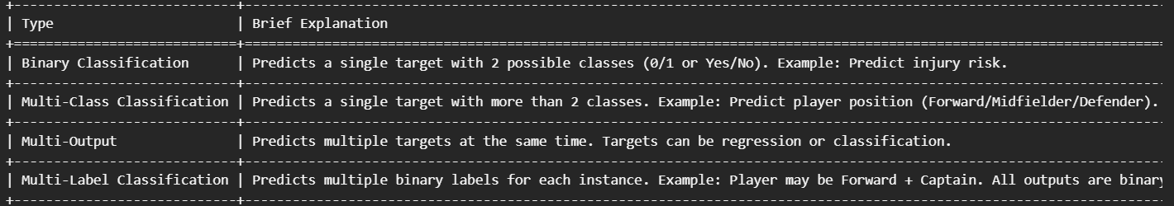

Multi-output models
Multi-outputga idea?

Slide 19

Multi-output models
Multi-Output Regression
Targets: Continuous (numeric) values
Example: Predict a soccer player’s:
Gollari
Assistlari
Scikit-learn: Use MultiOutputRegressor
Notes:
Each target is numeric.
The model can capture correlations between targets to improve predictions.

Slide 20
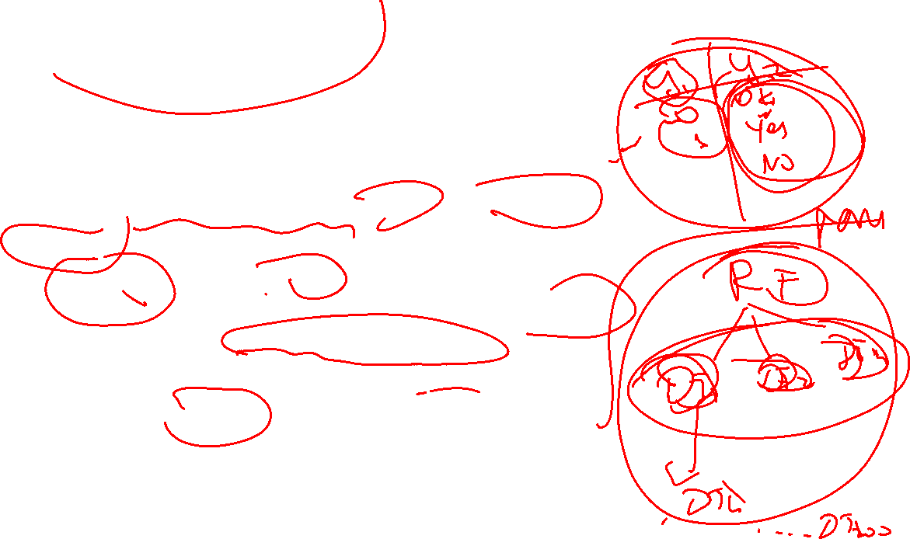
Multi-output models
Multi-Output Classification
Targets: Categorical values (binary or multi-class)
Example: Predict a player’s:
Injury risk (Yes/No → binary)
Player role (Forward/Midfielder/Defender → multi-class)
Scikit-learn: Use MultiOutputClassifier
Notes:
Each target can have different numbers of classes.
If all outputs are binary, it is also called multi-label classification (special case).

Slide 21








Vazifa
8-dars uchun Report yozing
Final Projectni Data Preprocessing(src-notebook, src-scripts) tugating
Kichik dataset bn Model yasang(Not modular):
Multi-output
Shap

