Slide 1
11-dars(Foundation)
Davronbek Malikov

Slide 2
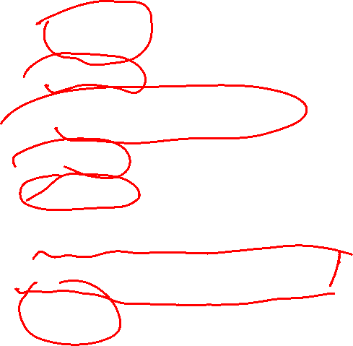
Bugun
Savol Javob
Takrorlash
Model Structure Review
Prediction
Evaluation
Linear Models Review(Amaliy)
Oy tahlili: Nimalar o’rgandik
Imtixon

Slide 3
Savol javob

Slide 4
Takrorlash

Slide 5
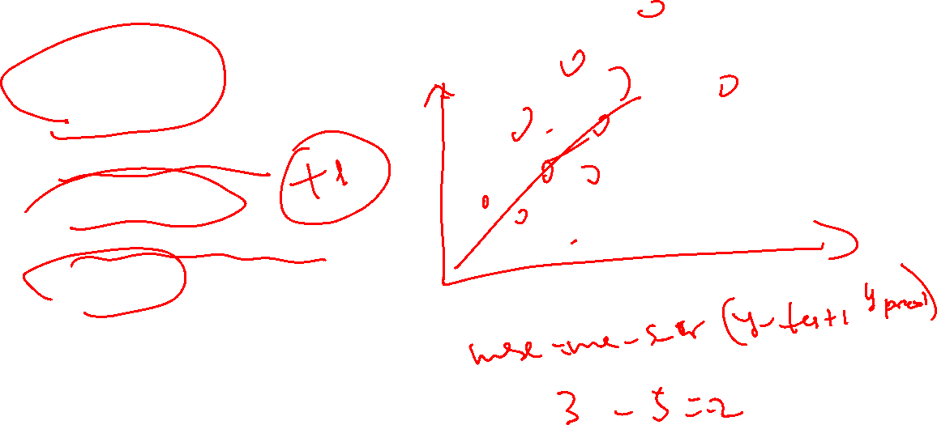
Takrorlash
Savol Javob
Takrorlash
ML model structure
Linear Regression
Linear Regression: amaliy
Evaluation
Vazifa

Slide 6
ML model structure

Slide 7
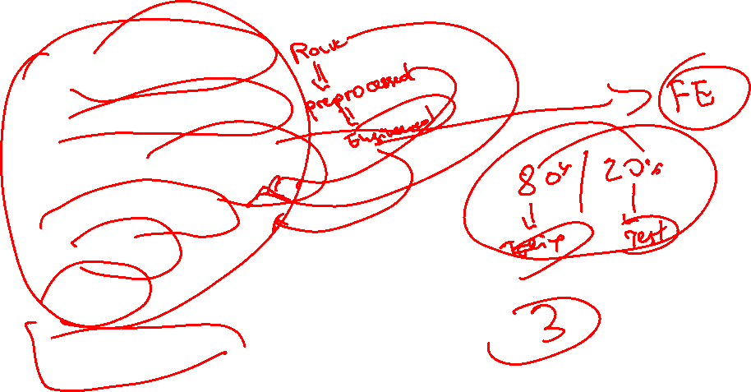
ML model structure
Data Collection
Data Preprocessing
Model(Algorithm) selection
Model Training
Evaluation
Testing
Deployment

Slide 8
Prediction

Slide 9
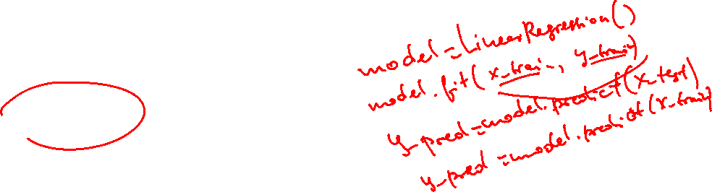


Prediction
Trained Model (example: Robot)
Unseen data

Slide 10
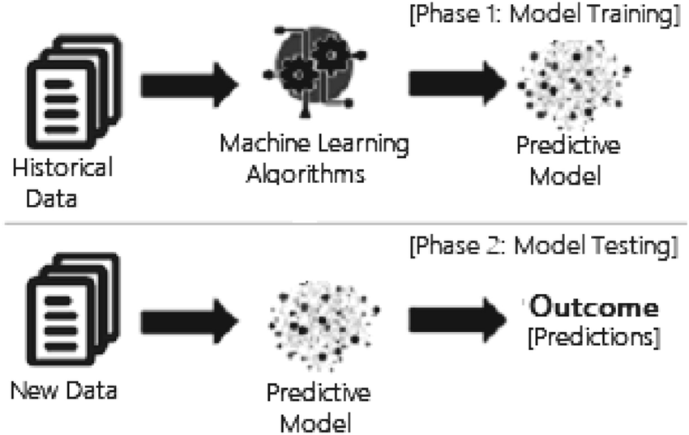
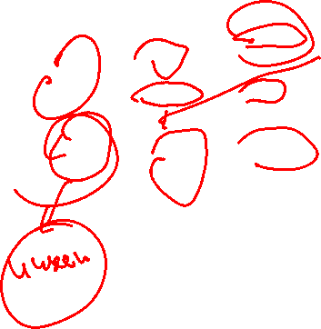
Prediction

Slide 11
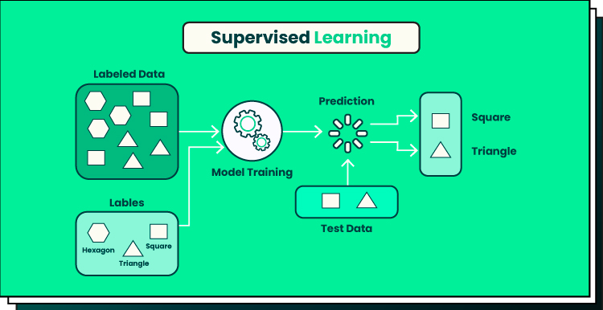
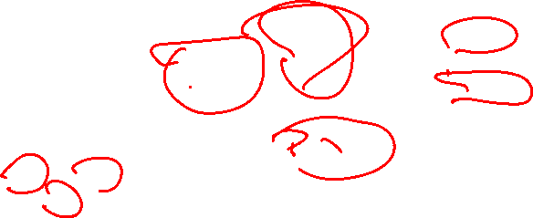
Prediction

Slide 12
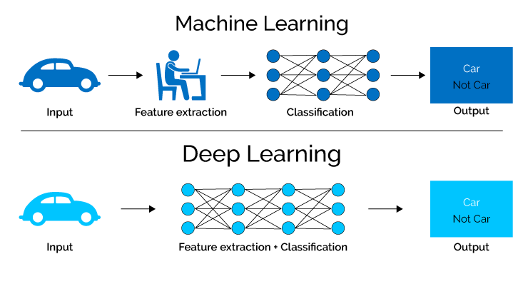
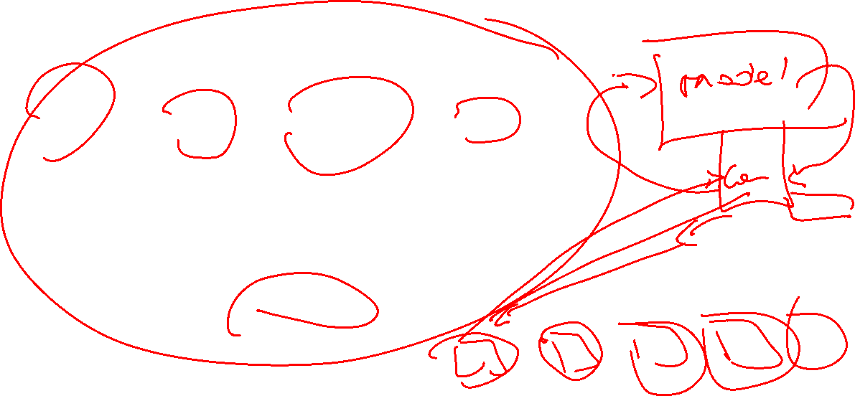
Prediction

Slide 13
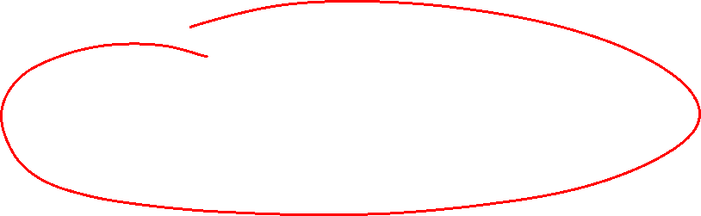
Linear Models Review(Amaliy)

Slide 14
Oy tahlili: Nimalar o’rgandik

Slide 15
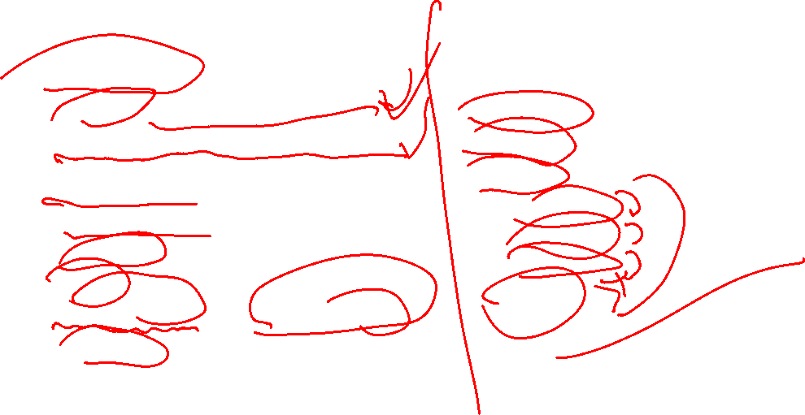
Oy tahlili: Nimalar o’rgandik
Machine Learning
Python va boshqalar
AI nima? Machine Learning nima?
Supervised ML nima va uning turlari
Project tayyorlash va uning tartibi , ketma ketligi
Data Preprocessing
Algorithm
Model
Linear Regression, Logistic Regression
Prediction
Evaluation
Github
Vs code
Kaggle
Data types
Operations
Conditions
For loop

Slide 16
Imtixon

Slide 17
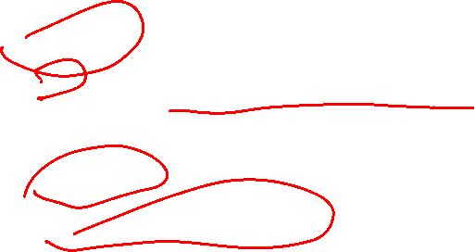
Imtixon
Asosiy shart:
  To’liq vazifalarni bajargan bolishi shart
Yo’nalishlar
  ML og’zaki
  Python problem solving

Slide 18
Vazifa
1-oyimiz uchun report(Sof o’rganilgan mavzularni qamrab olgan xolda)
Imtixonga tayyorlanish

