Slide 1
10-dars(Foundation)
Davronbek Malikov

Slide 2


Bugun
Savol Javob
Takrorlash
ML model structure
Linear Regression
Linear Regression: amaliy
Evaluation
Vazifa

Slide 3
Savol javob

Slide 4
Takrorlash

Slide 5
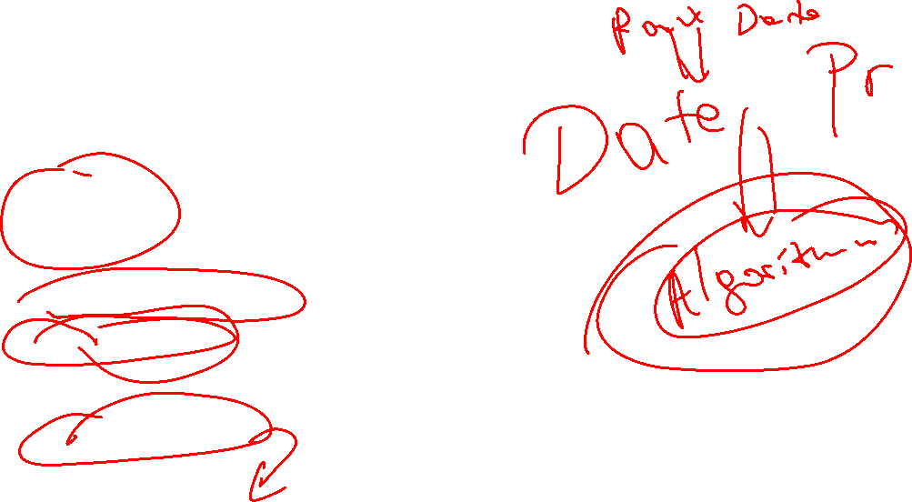
Takrorlash
Savol javob
Takrorlash
ML model structure
ML algorithms
ML algorithms family
Logistic Regression
Model Training

Slide 6
ML model structure

Slide 7
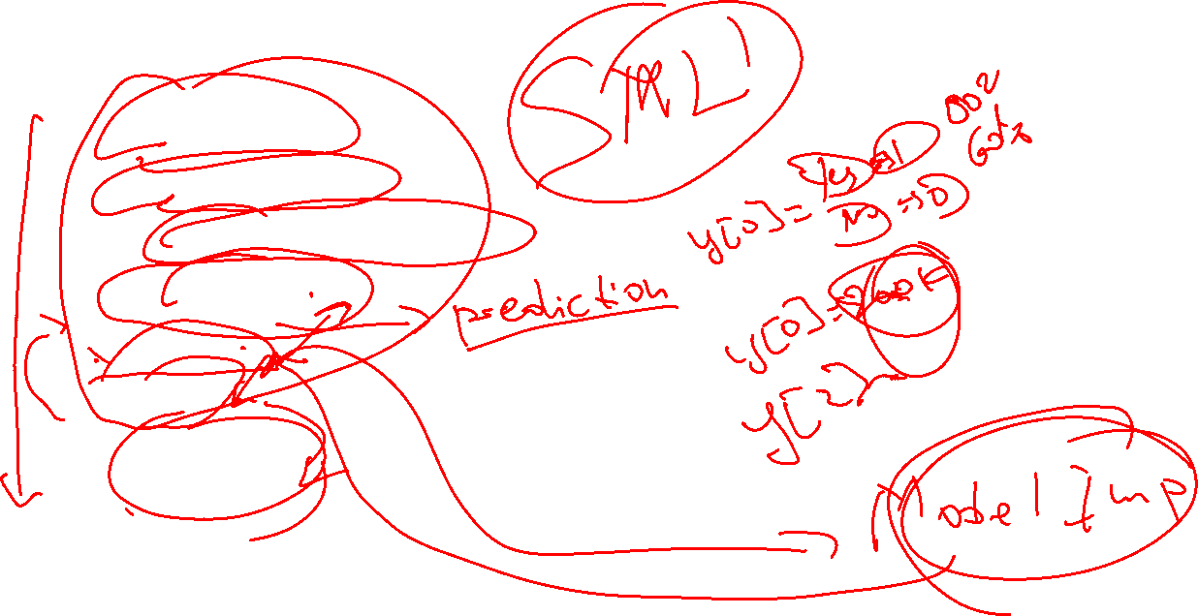
ML model structure
Data Collection
Data Preprocessing
Model(Algorithm) selection
Model Training
Evaluation
Testing
Deployment

Slide 8

Linear Regression

Slide 9
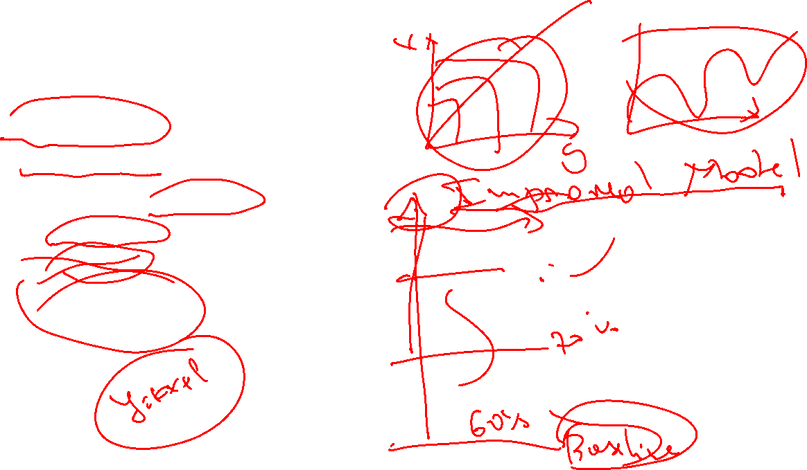
Linear Regression
Linear family
Baseline model
Regression(Continues)
Players goals
Not injury
Linear equation

Slide 10
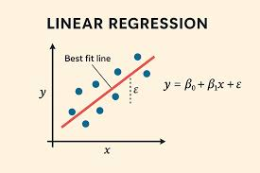
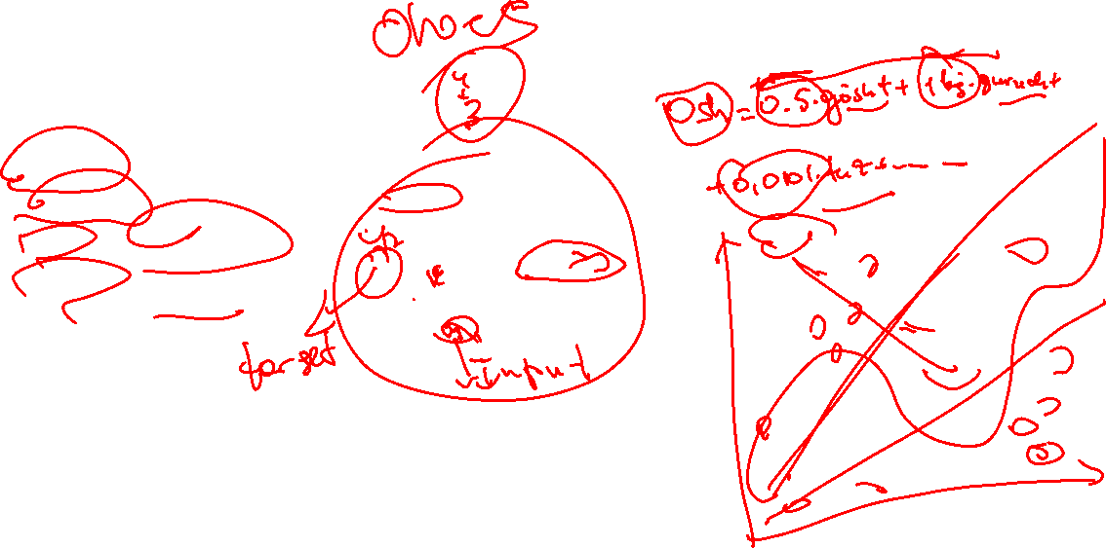
Linear Regression
Linear equation
x-input
Y-output
Betta– parameter
epsilon--ERROR

Slide 11
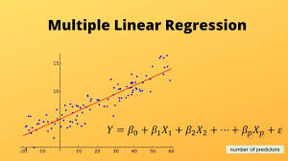
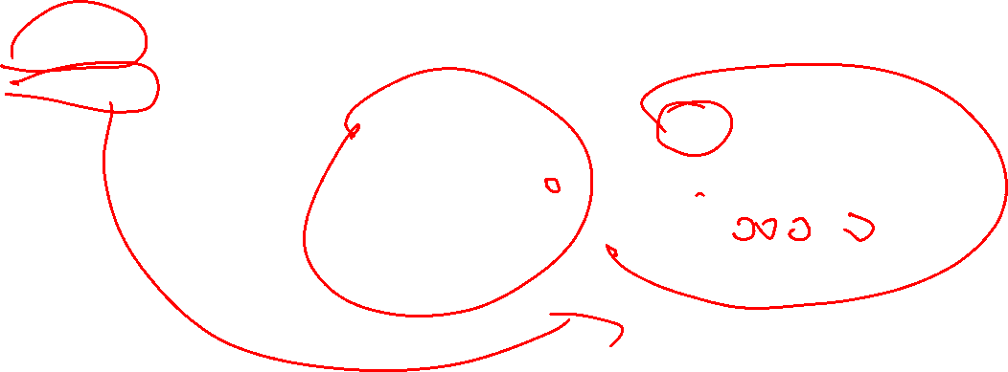
Linear Regression
Linear Regression
Simple LR
Multiple LR

Slide 12
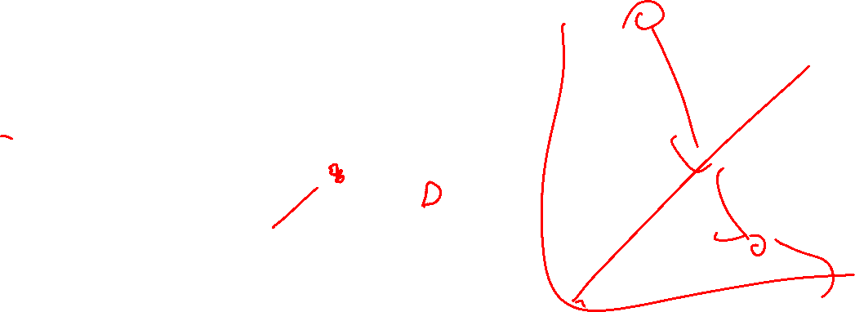
Linear Regression
Qo’shimcha
Epsilon!=0

Slide 13
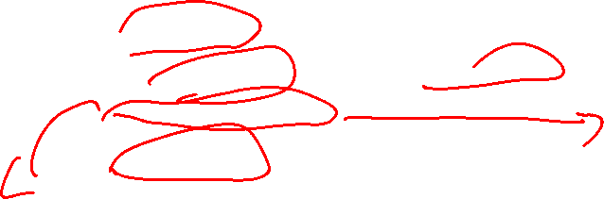
Linear Regression
Kuchli tomonlari
Tez va soda
Kichikroq datalar bn ishlashda oson
Baseline model
Kam chiqim

Slide 14
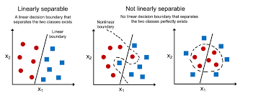
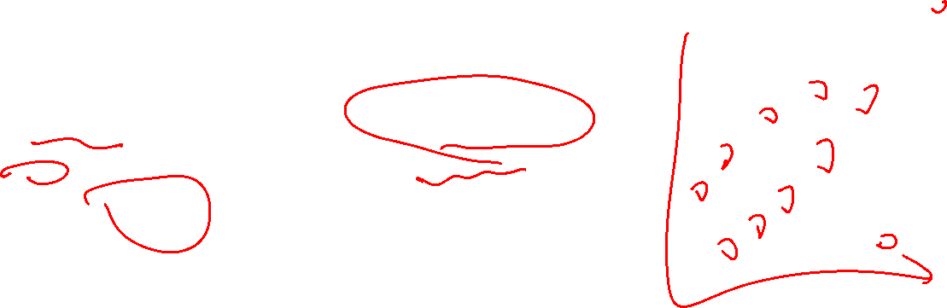
Linear Regression
Kuchsiz tomonlari
Compex(non-linear) xolarlarni o’rgana olmaydi
Yot elementlarda tez o’zgaruvchan(stabil emas)
Katta datasetlarda yaxshi ishlamaydi

Slide 15
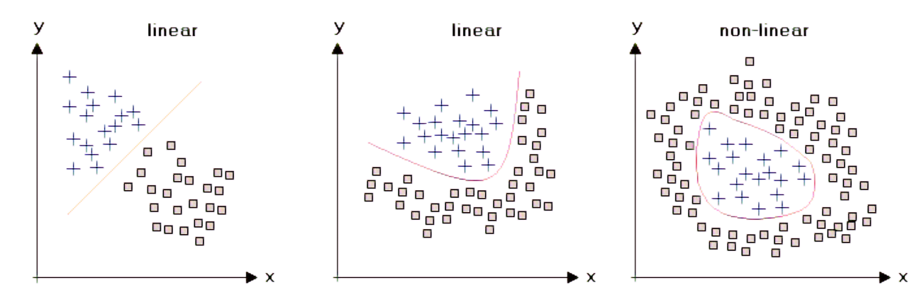
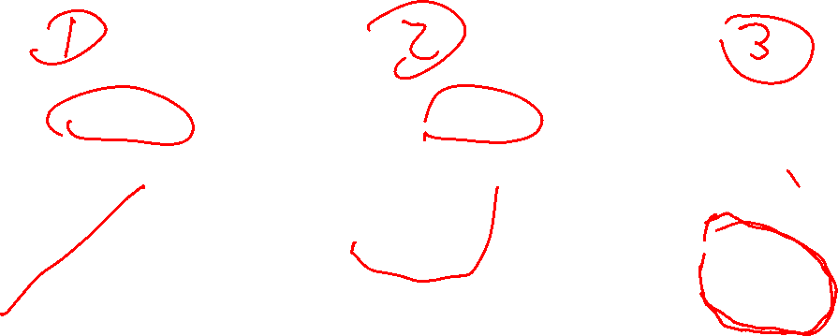
Linear Regression

Slide 16
Linear Regression amaliy

Slide 17
Evaluation

Slide 18
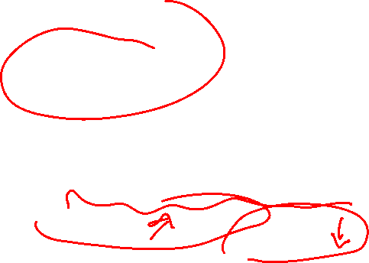
Evaluation
Quyidagilarni baxolaydi:
Prediction qanchalik yaxshi?
Model ishonalarmi?
Generilization? Overfitting?

Slide 19
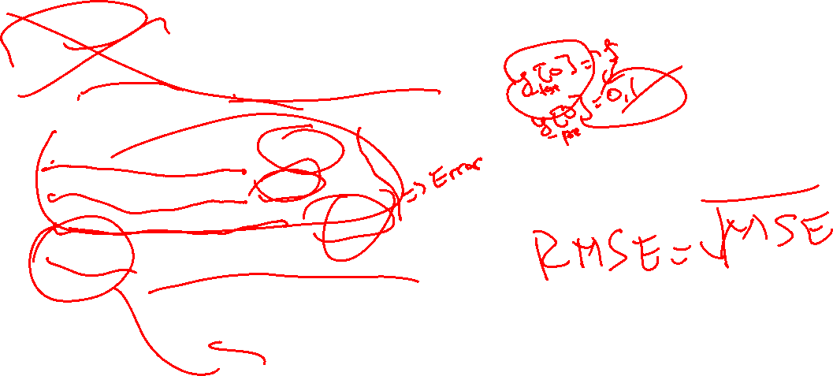
Evaluation
Quyidagi bo’limlari bor:
Classification
Accuracy score, Classification Report
Regression
Mean Absolute Error (MAE)
Mean Squared Error (MSE)
Root Mean Squared Error (RMSE)
R² Score (Coefficient of Determination)

Slide 20
Vazifa

Slide 21
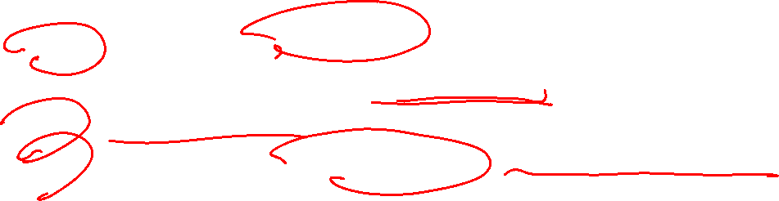
Vazifa
12-dars uchun projectni boshlang(plan+data bn tanishuv)
Regression ustun tanlagan xolda(erkin target)
10-dars uchun report
Kichik dataset orqali Linear regression kichik model yasang

