Slide 1
5-dars
Davronbek Malikov

Slide 2

Bugun
Savol javob
Takrorlash
Data Preprocessing: Review
Encoding
Imtixon
Vazifa

Slide 3
Savol javob

Slide 4
Takrorlash

Slide 5
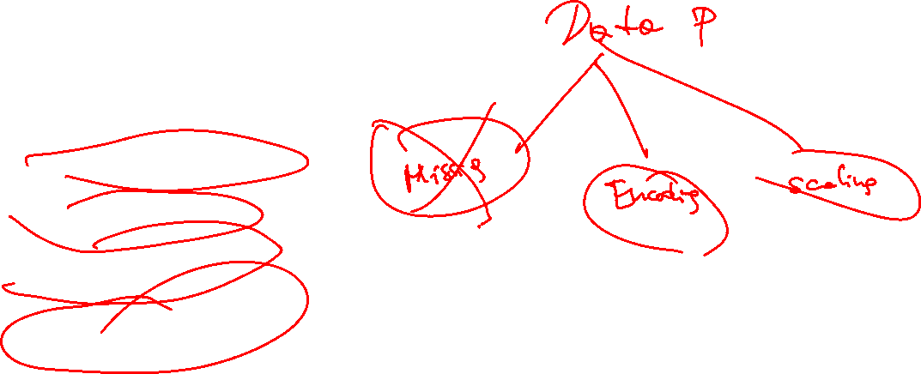
Takrorlash
Savol javob
Takrorlash
Project ketma ketligi
Data Preprocessing
Library(Kutubxona)
Data
Conditions(davomi)
Qo’shimcha dars
Vazifa

Slide 6
Data Preprocessing: Review

Slide 7
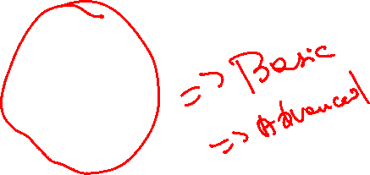
Data Preprocessing: Review
Handling missing values
Mean
Mode
Median
Fixed
Drop
Encoding
Scaling

Slide 8

Encoding

Slide 9

Encoding
Categorical-> Numerical
Turlari
One-Hot
Label Encoding
Frequency encoding
Target Encoding
Ordinal Encoding

Slide 10
One hot -Encoding

Slide 11
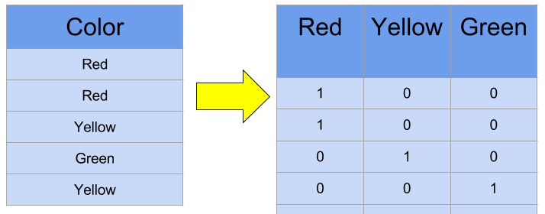
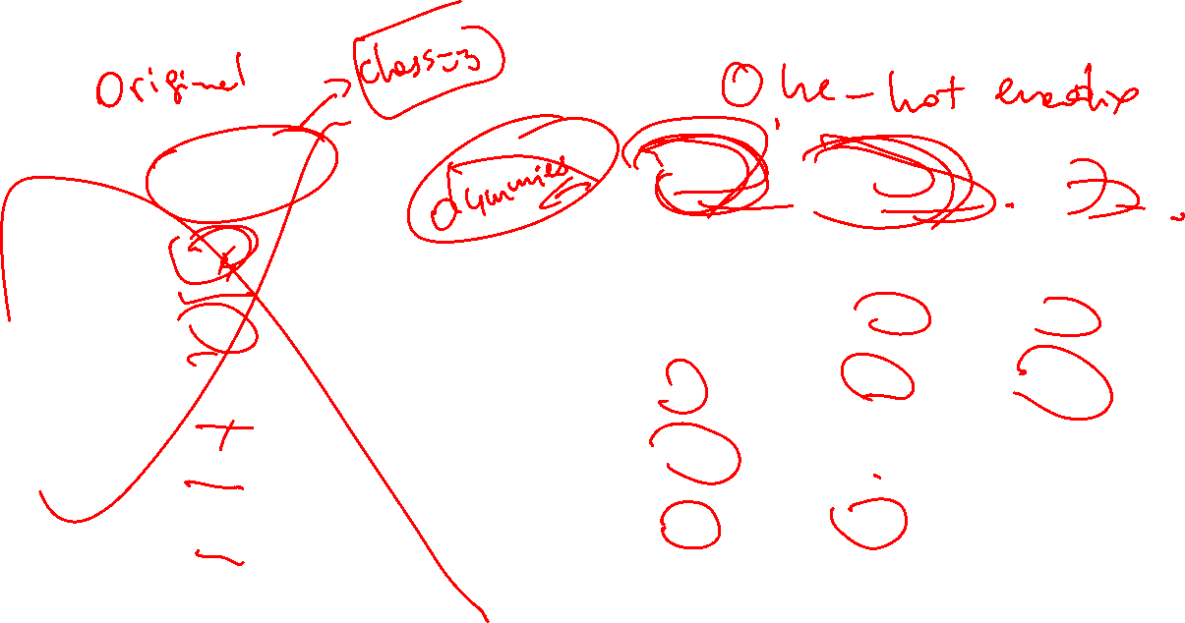
Encoding
One-hot encoding

Slide 12
One-Encoding amaliy

Slide 13
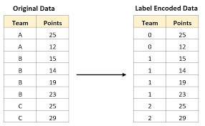

Label encoding
Label

Slide 14
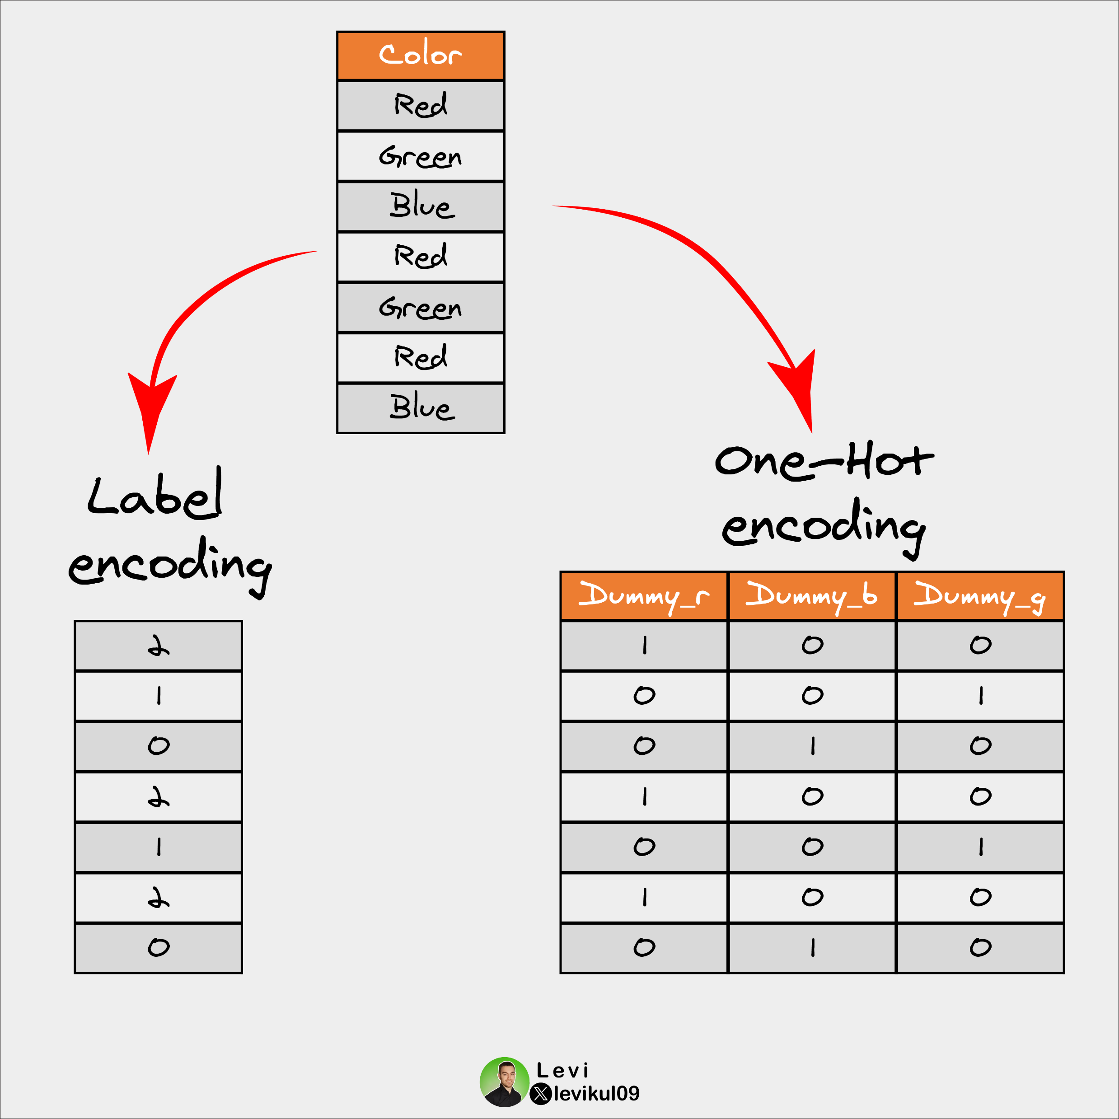
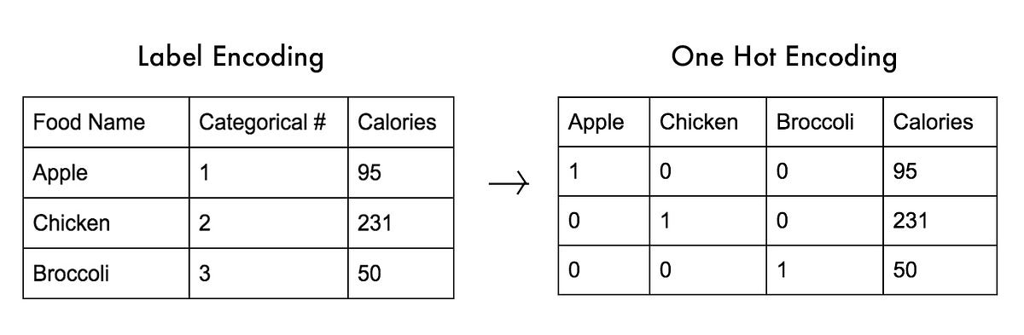
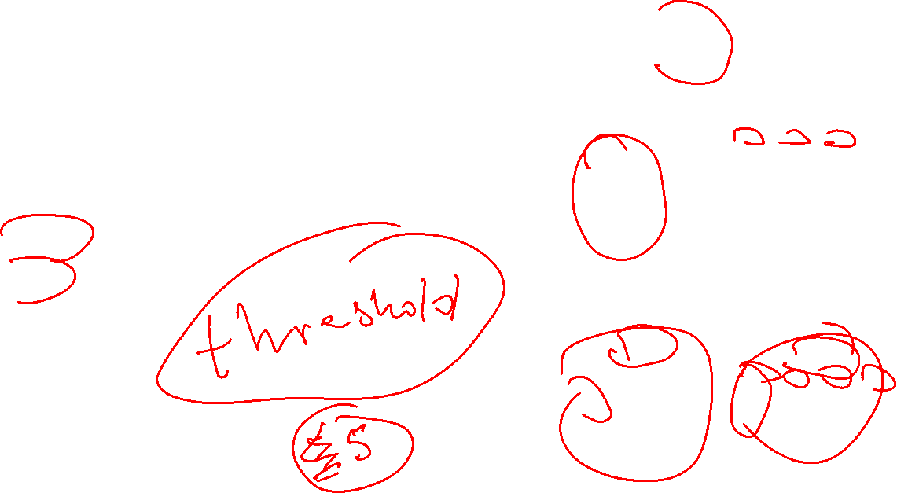
Encoding
Datani bir turdan ikkinchisiga o’tazish
One-hot
Label

Slide 15
Label-Encoding amaliy

Slide 16

For Loop

Slide 17
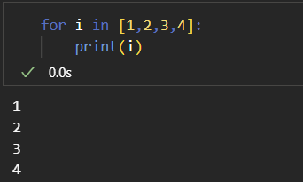
For loop
Jarayonni avtomatlashtirish uchun ishlatilinadi

Slide 18
Imtixon

Slide 19
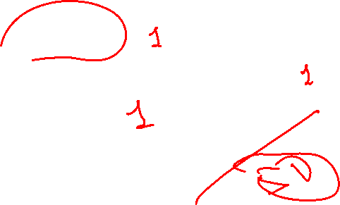
Imtixon
Nazariy
Python problem solving
ML task

Slide 20

Vazifa
5-dars uchun report yozing
Github yoki kaggledan dataset toping:
5 ta usulda tushirib qoldirilgan qiymatlarni to’ldiring
2 ta usulda encoding qiling

