Slide 1
3-dars
Davronbek Malikov

Slide 2


Bugun
Savol javob
Takrorlash
ML model yaratish
Kaggle/Github
Data bilan ishlash
Conditions

Slide 3
Takrorlash

Slide 4

Takrorlash
Savol javob
Takrorlash
Vis code va Githubda ishlash
Ml turlari tadbiqlari(Ml applications)
Qo’shimcha material
Python:Malumot turlari(Data Types), operations

Slide 5
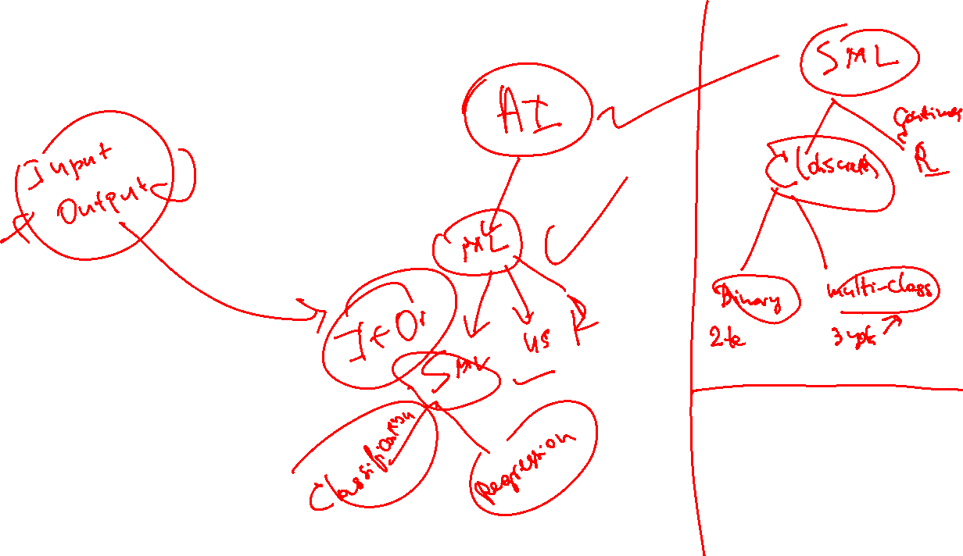
Supervised ML

Slide 6

ML model yaratish

Slide 7
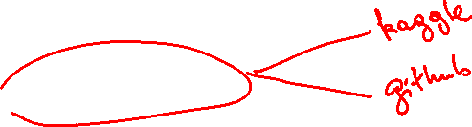
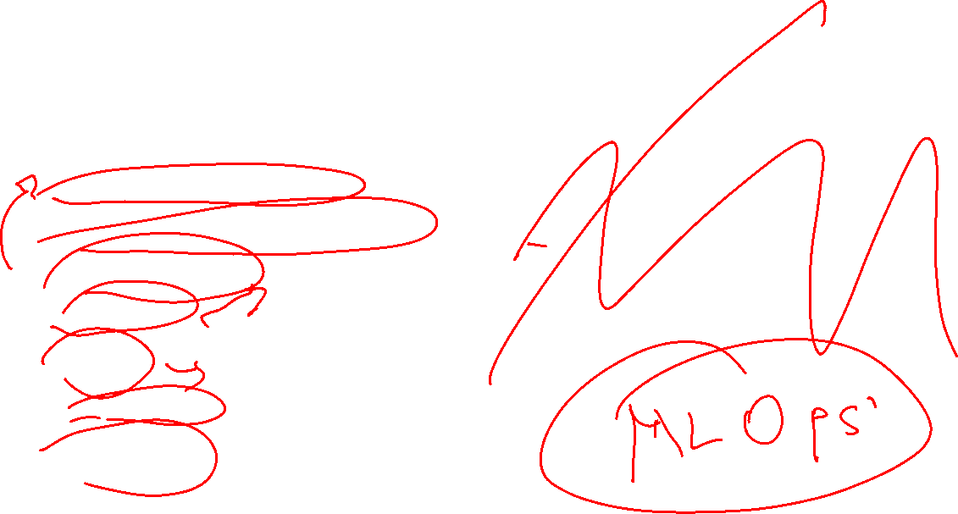
ML model yaratish
Data Collection
Data Preprocessing
Algorithm(model) selection
Model training
Evaluation
Testing
Deployment
Monitoring

Slide 8

ML model yaratish(1)
Data collection(github, Kaggle)
Data bilan tanishuv
Data Preprocessing
1-qism
  Tozalash
  Tushirib qoldirilgan qator/ustunlarni to’ldiring
  Duplicated qator / ustinlarni tashlab yuborishimiz
  2-qism:
  Encoding
  3-qism:
  Scaling

Slide 9
ML model yaratish(2)
Input va outputni aniqlash
Datalarni (train,test qismlarga ajrating)
Algorithmlar tanlang(Linear regression, Logistic regression, DT)
Train qiling
Test qiling
Model Improvement
Deployement

Slide 10
Kaggle/Github

Slide 11
Data bilan ishlash

Slide 12
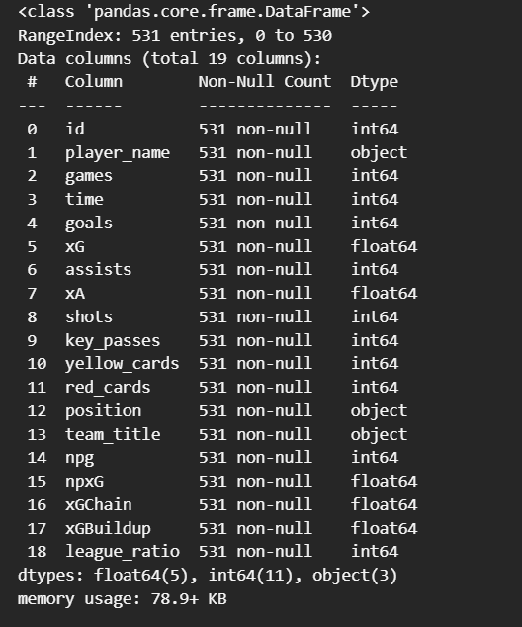
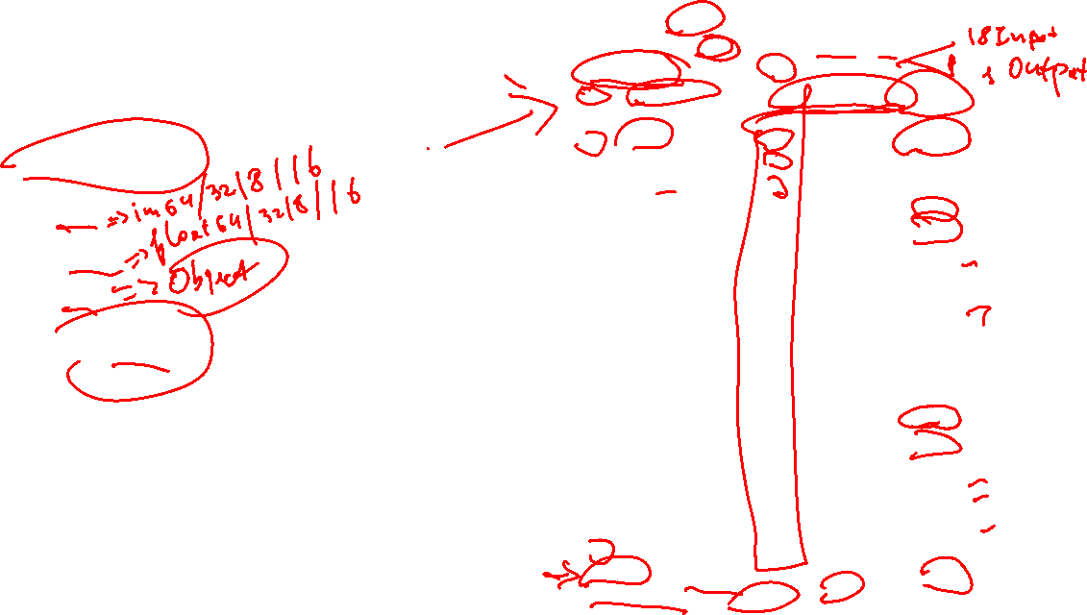
Data bilan ishlash
Data types:
  Int
  Float
  Str
  Boolean

Slide 13

Conditions

Slide 14

Conditions
Malumotlarni boshqarish , nazorat qilish va filterlash uchun ishlatilinadigan kodlar bloki bu Conditions
IF->Then

Slide 15

Vazifa
3-darsimiz uchun report yozing(qisqa va tushunarli)
Kaggle/Githubdan dataset toping va darsimizdagi kodlarni yozib koring
Fayldagi misollarni ishlang
O’tilganlarni takrorlang

