Slide 1
4-dars
Davronbek Malikov

Slide 2
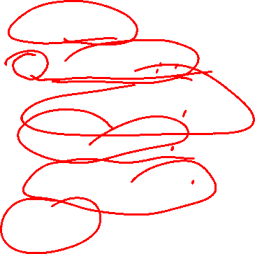
Bugun
Takrorlash
Os - kutubxonasi
Datasetlarni saqlash
Oraliq: Project
Ridge Regression
Vazifa

Slide 3
Takrorlash

Slide 4
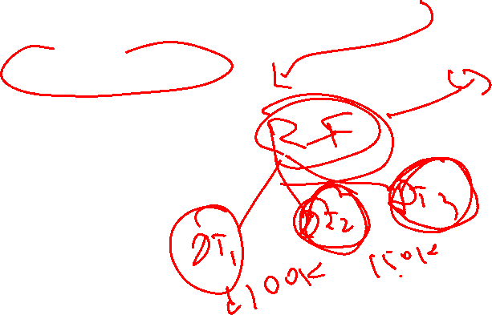
Takrorlash
Takrorlash
Qo’shimcha: Visual Kutubxonalar
Built-in functions
Project1
Vazifa

Slide 5
Datasetlarni saqlash

Slide 6
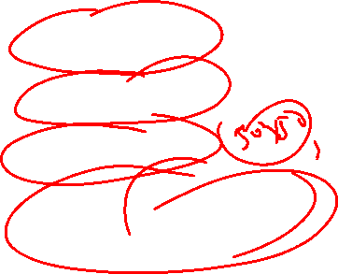
Datasetlarni saqlash
Raw dataset
Preprocessed
Engineered
Predictions(results)

Slide 7
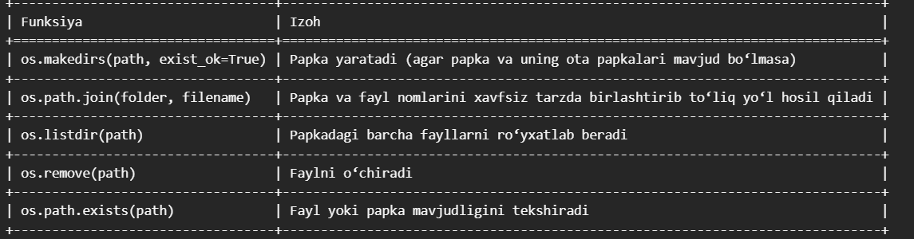

Datasetlarni saqlash
Python kutubxonasi---OS

Slide 8
Oraliq: Project

Slide 9
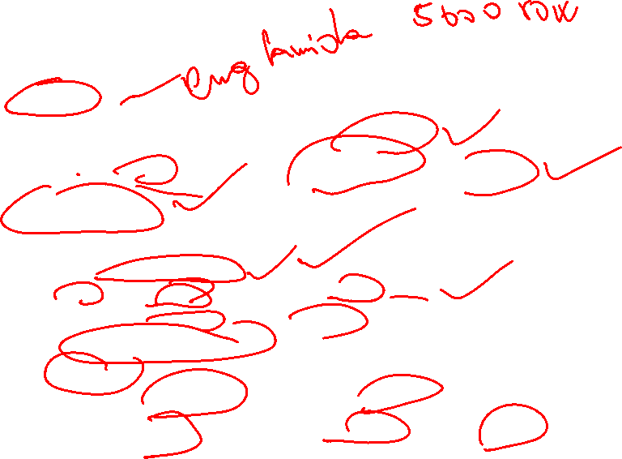
Project
Tartibli
Natijalarni alohida papkada saqlang
Alohida projectlar uchun github profile oching
Qiziqarli idea
Talab qilinadigan qismlar:
Problem Statement
Feature va output xaqida malumot
Data preprocessing va datasetni saqlang
Data Analysis va report
Funksiya
Turli xil algorithmlar va ularni qiyoslang
Eng zor modelni tabulateda korsating va uni saqlang

Slide 10

Project
Topshiriladi va yuklanadi:
Data
raw
Preprocessed
Data analysis
Model
Best model

Slide 11

Project
Maximim ball: 50
Oxirgi sana: 28.08.2025

Slide 12

Ridge Regression

Slide 13
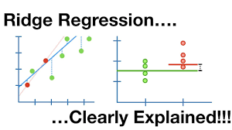
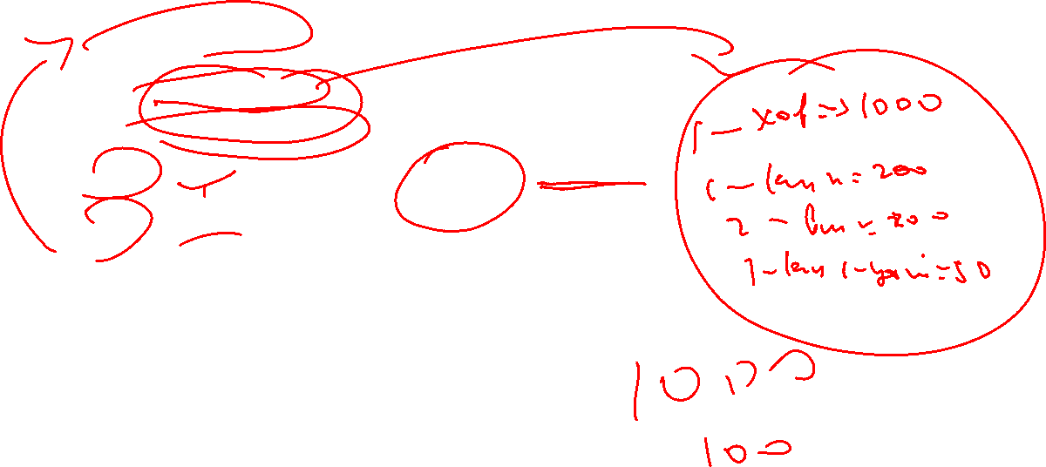
Ridge Regression
Linear Regression
Highly correlated
Too many features
Ridge (L2)
Lasso(L1)

Slide 14
Vazifa
Projectni boshlang
Nazariy bilimlarni qaytaring
Codewars: Problem solving (20 ta misol ishlang)

