Slide 1
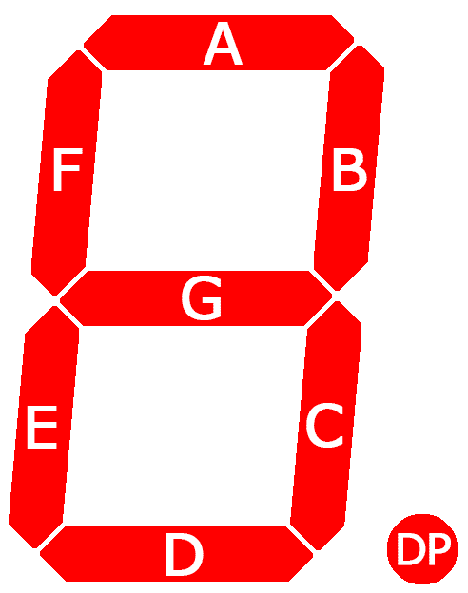
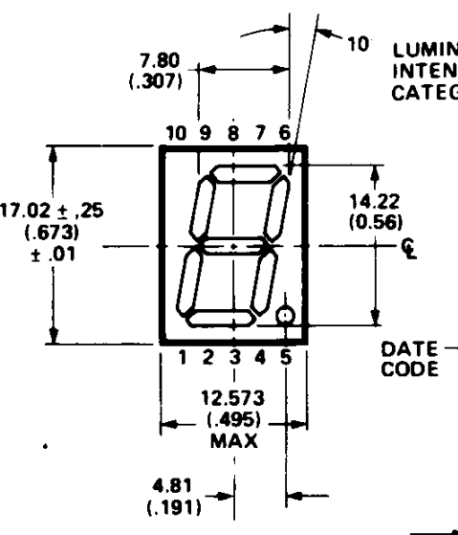
f
a
b
(klick for source)
draft
(klick for source)
g
d
b
dp
c
Notes:
http://www.circuitbasics.com/wp-content/uploads/2017/05/Arduino-7-Segment-Display-Tutorial-Segment-Layout-Diagram-237x300.png
https://docs.rs-online.com/b51e/0900766b801bf827.pdf

Slide 2
