Slide 1
DialType.emitPS()
W
wp
y
w
PV
v = f(m)
P = f(v)
d2
T‘1
nrm‘
t‘1
X
t‘2
p‘t
T‘2
pos‘
d1
baselineAltGeom
nrm
T1
t1
P
m+1
t2
T2
pt
m
m-1
baselineNatGeom
pos
0
x

Slide 2
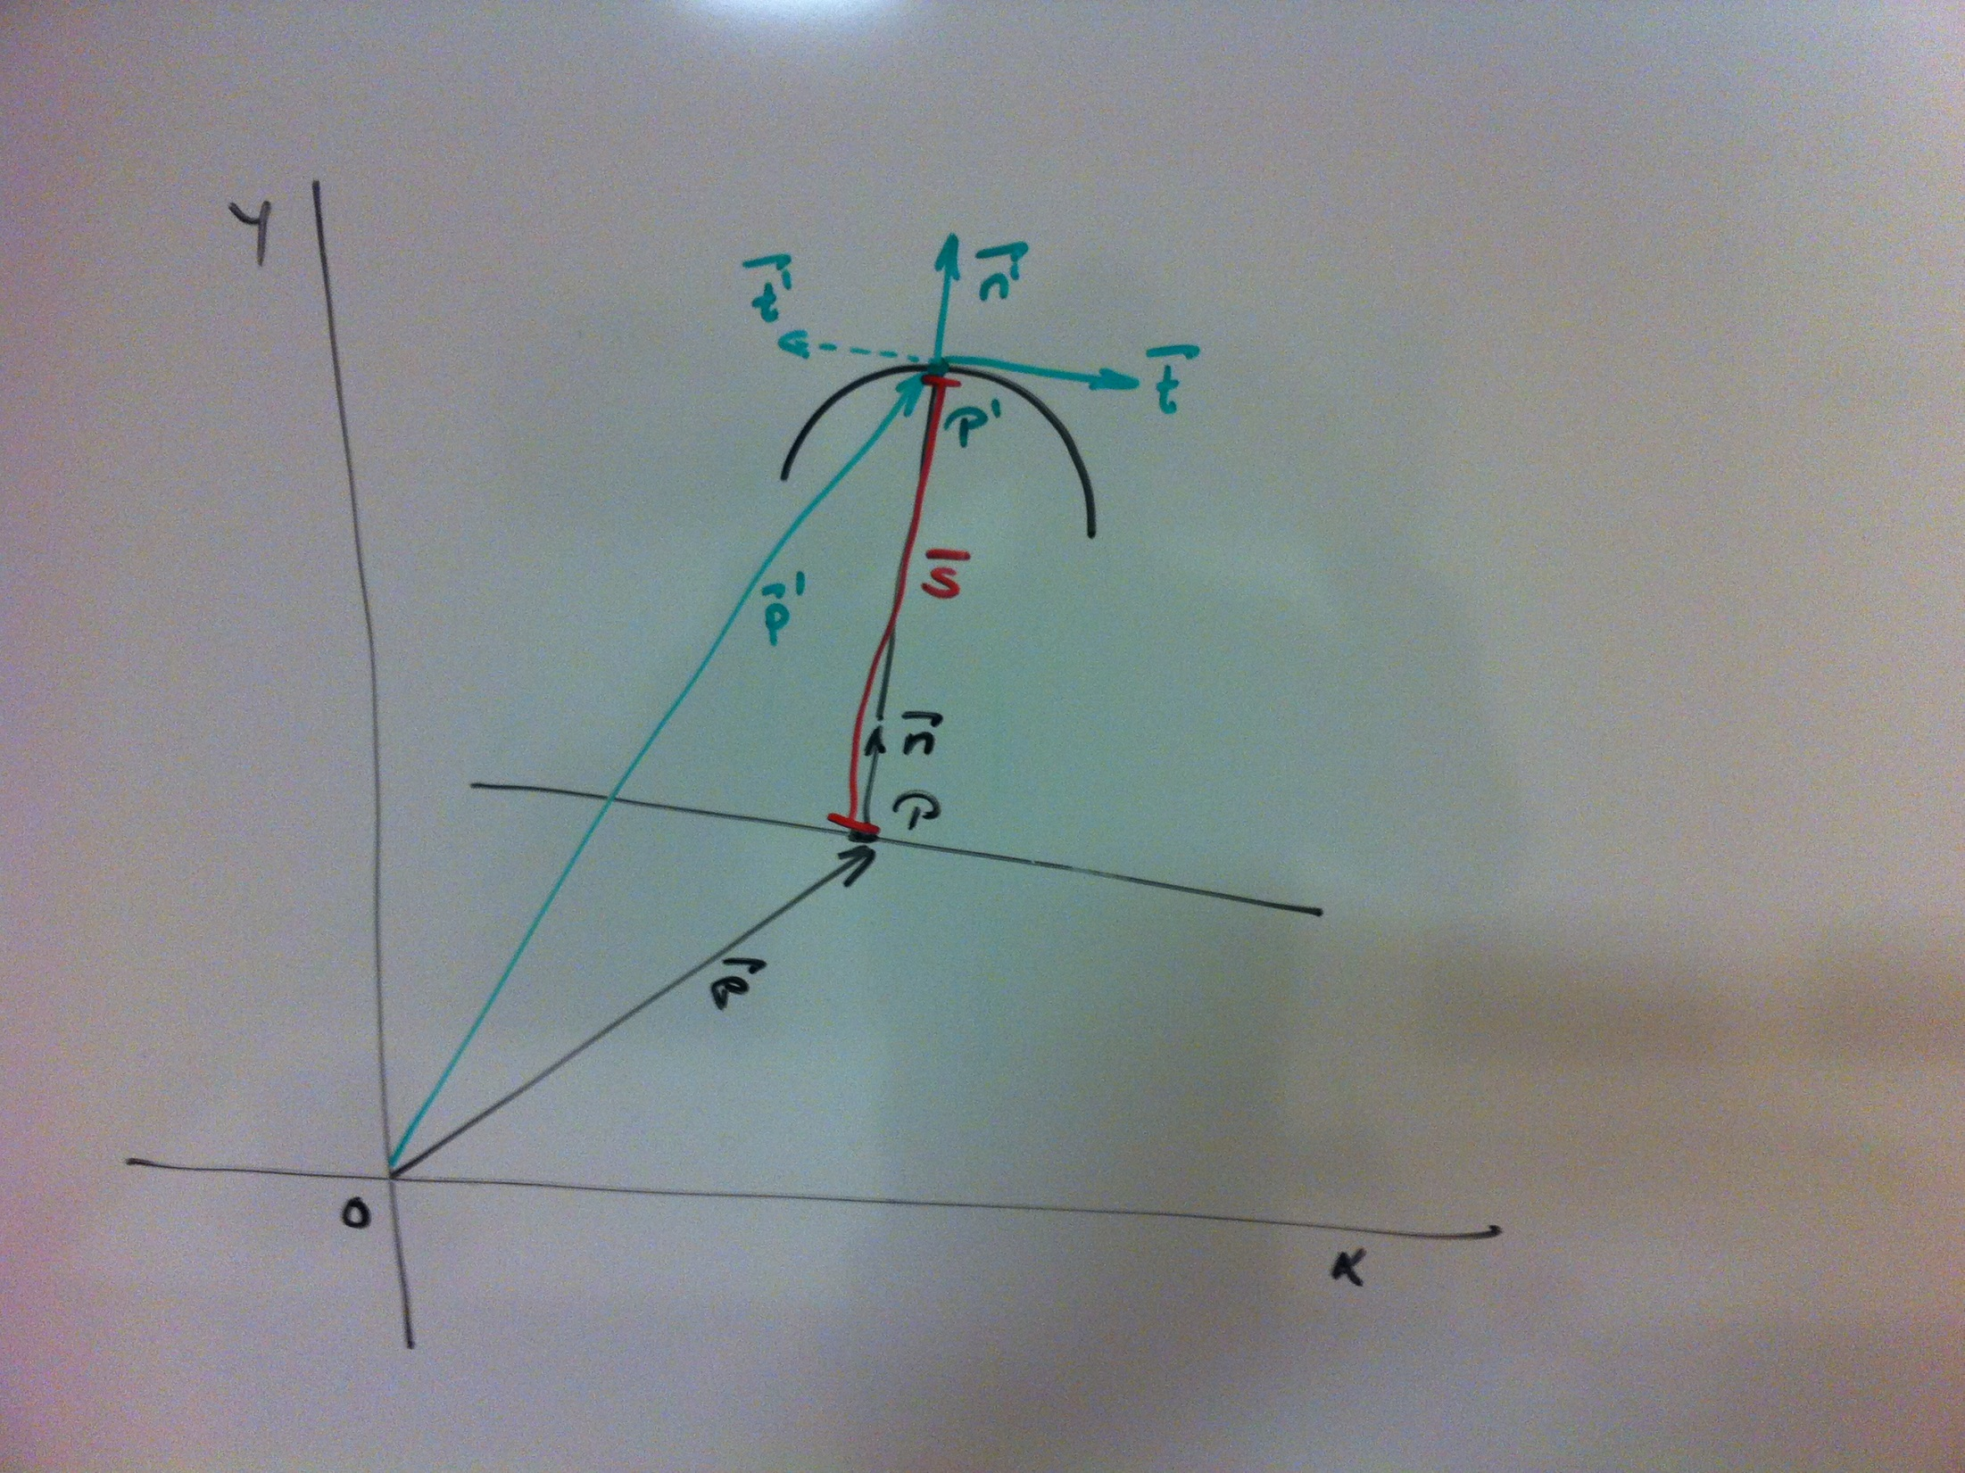
DialType.emitPS()

Slide 3
DialType.emitPS()
calc pos norm
(use 2nd last mark n case of last mark)
get FOV
FOV
body.list()
calc mark
return
baseline attribute set
get baseline
(Constructor parameter or attribute)
set
baseline segment(s)
(Geometry)
find baseline segment
scale norm to infinity (dir from pos away from origin)
fov.intersection(baseline.list())
update
prefs: seggap
check segment requirements
norm.intersection (seg) (use 1st pnt of 1st Geometry)
Intersection point
prefs: segmin
check/ adjust baseline segments
update
…
no intersection
next mark
rotate norm 180°
n segments == 0
last mark
return
return
return
intersection
calc pos norm
(use 2nd last mark n case of last mark)
return
.
CircleType
.
BodyOrbitalType

Slide 4
test concept
definitions
id | element | case | … | log
01 | BodySun | body inside fov
02 | BodySun
03 | …
test file
create test file
name convention:
tf-<definition-id>.xml
example:
tf-0001.xml
run test
update log/ todo list in case of errors

Slide 5
horizontal coordinates
(A, a)
ecliptical coordinates
(λ, β)
galactical coordinates
(l, b)
equatorial coordinates
(α, δ)
equatorial coordinates (2)
(h, δ) → (Θ-α, δ)
Celestial coordinate systems.
cartesian coordinates
(x, y, z)
spherical coordinates
(ϕ, θ, r)
Intermediate coordinate systems.
texture coordinates
(o, p)
projection coordinates
(u, v)
Cartesian coordinate systems for different purposes.
pixel coordinates
(s, t)

Slide 6
P1
P1‘
T2
S2
P2
P3
S1
T1
P2‘
P3‘

Slide 7
Definition Fehler:
Zustand möglicher Abweichung vom vorgesehenen
Programmablauf, festgestellt durch Prüfung.
Definition Ausnahme:
Unerwartete Abweichung vom Programmablauf
(Perspektive Catcher, Checked Exception),
Fehlermeldung durch Rückgabewert nicht möglich
(Perspektive Thrower, Checked Exception),
Fortsetzung des Programmablaufs unmöglich
(Unchecked Exception)
Direction type
<class>[.<instance>].substitute[.<path>].<key> : \
<substitute>
Ein Wert ist in der Registry mit dem Schlüssel <substitute> gespeichert.
Indirection type
<class>[.<instance>].substitute[.<path>].<indirection> : \
<substitute>
Der Wert des Property-Eintrags
<class>[.<instance>].message[.<path>].<indirection>[.<value>] ist in
der Registry mit dem Schlüssel <substitute> gespeichert.
Redirection type
<class>[.<instance>].substitute[.<path>].<key> : \
<key substitute>
<class>[.<instance>].substitute[.<path>].<redirection> : \
<redirection substitute>
Der Wert des Property-Eintrags <class>[.<instance>].message[.<path>].{<key substitute>}.<redirection> ist in der Registry mit dem Schlüssel
<redirection substitute> gespeichert.
ApplicationConstant
Class<?>
Calling class, ApplicationMessage if null
SubstituteCatalog
MessageCatalog
Fehler/
Ausnahme
.properties
AstrolabeResource
Locale
(Implizit)
Y
N
Fortsetzung möglich?
<application>[<locale>].properties
Korrektur möglich?
ParameterNotValidError
ParameterNotValidException
msg
log.info
Y
N
ModelNotValidError
ModelNotValidException
Fortsetzung
Fehlerrückgabe möglich?
Exception
msg
log.warn
Y
N
Rückgabe zusätzlicher Daten notwendig?
Aufwärtskorrektur möglich?
Korrektur/
Fortsetzung
N
Y
Y
N
<path> : <element>(\.<element>)*
<element> : [^\.]+
<class> : <path>
<instance> : <path>
<key> : <element>
<redirection> : <element>
<indirection> : <element>
<value> : <element>
return EV
msg
throw E
(checked)
throw E
(unchecked)
msg
Prämissen:
Keine Fehlerprüfung auf null und leere Zeichenkette
(Programmierfehler)
Keine Parameterprüfung in Methoden mit Access Modifier
private, keine Prüfung des Rückgabewerts
Ende

Slide 8

O
p1
RA, de
p2
p1‘
p2‘
Vb
spanDe
b
p3
a
p0
de0
p0‘
p3‘
Va
sde
a/2
E
p
α
RA, de
sra
spanRA
a
ra0

Slide 10
astrolabe Dial
DialAngle (unit 1°),
DialTime (unit 1^{h}/15°),
DialDateOccidental (unit 1^{d}, half 7^{d}_{0=Su}, full 30^{d}₀₌₁₅),
DialDateJewish,
DialDateMoslem
linewidth
linelength
span
subspan
ns
ns+1
Graduation
nss
nss+1
space
linewidth
s
segment
thickness
begin
end
space
Dial
s
segment
C
C
CircleMeridian,
CircleParallel

Slide 11
astrolabe Glyph
0, 0

Slide 12
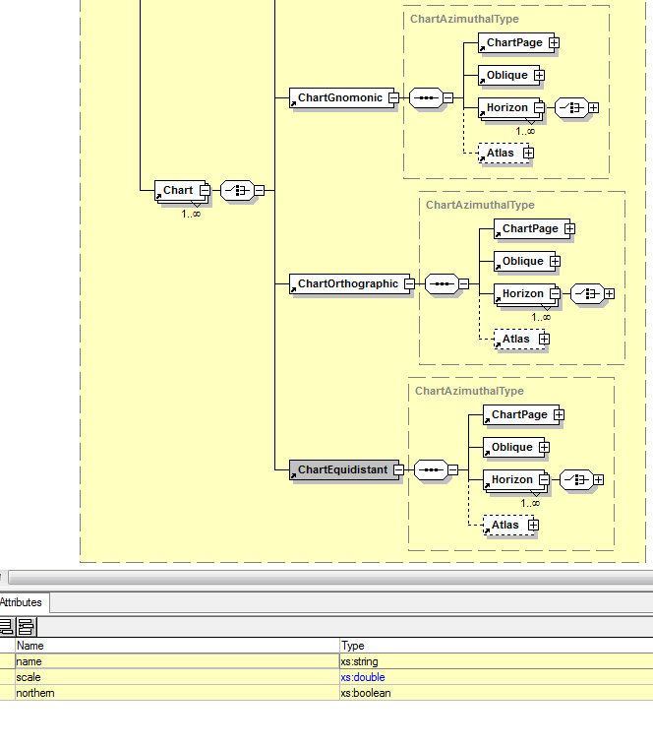
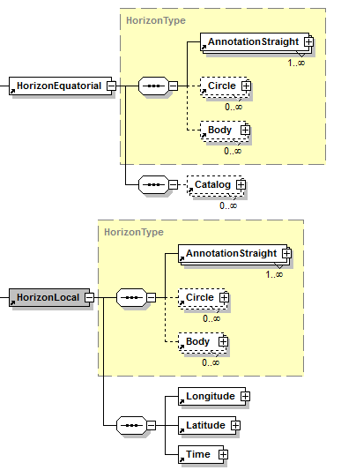
Choice of elements mit
gleichen complexType
ohne elementspezifische Erweiterungen
ohne elementspezifische Attribute
public class <element> extends astrolabe.model.<complexType> …
Beispiel:
public class ChartGnomonic extends astrolabe.model.ChartAzimuthaType …
Choice of elements mit
gleichen complexType
mit elementspezifische n Erweiterungen
Mit elementspezifischen Attribute
public class <element> extends astrolabe.model.<complexType> {
public <element>( <peer> ) …
}
Beispiel:
public class HorizonLocal extends astrolabe.model.HorizonType {
public HorizonLocal( astrolabe.model.HorizonLocal peer ) …
}

Slide 13
./astrolabe.xsd,
./astrolabe.preferences,
./AtlasHTML.xsl
./chartacaeli_${LANG}.properties
(default ./chartacaeli.properties)
create or update atlas mapping file¹⁾
create atlas model file
run make <atlas model pdf> (e.g. make atlas-stereographic.pdf)
create or update atlas definition transform
run prepAtlas.sh (e.g. see comments at beginning of file)
e.g.
lib/AtlasAzimuthalType.map
e.g.
./atlas-stereographic.xml
e.g.
./atlas-stereographic.pdf,
./atlas-stereographic-northern.xml,
./atlas-stereographic-southern.xml²⁾
e.g.
./atlas-stereographic-northern.xsl,
./atlas-stereographic-southern.xsl
e.g.
./_XXXX_atlas-stereographic-northern_picker.pdf
./_XXXX_atlas-stereographic-northern_poster.pdf
./_XXXX_atlas-stereographic-northern_picker.png
./_XXXX_atlas-stereographic-northern_poster.png
./_XXXX_atlas-stereographic-northern.html
./_XXXX_atlas-stereographic-northern.xml
./atlas-stereographic-northern.png
./_XXXX_atlas-stereographic-southern_picker.pdf
./_XXXX_atlas-stereographic-southern_poster.pdf
./_XXXX_atlas-stereographic-southern_picker.png
./_XXXX_atlas-stereographic-southern_poster.png
./_XXXX_atlas-stereographic-southern.html
./_XXXX_atlas-stereographic-southern.xml
./atlas-stereographic-southern.png
¹⁾ possibly update preferences file
²⁾ due to configuration in model file
Legend:
create or update atlas html file(s)
run pdfsplit.sh (e.g. see comments at beginning of file)
run make <atlas pages pdf> (e.g. make _XXXX_atlas-stereographic-southern.pdf _XXXX_atlas-stereographic-northern.pdf)
next step
creates
refers to
./mapper.js
e.g.
home.html
e.g.
<dir>/atlas-stereographic-page%03d.pdf
e.g.
./_XXXX_atlas-stereographic-northern.pdf,
./_XXXX_atlas-stereographic-southern.pdf

