Slide 1
Programming 4
Lecture 13: Finite State Machine
& Inheritance
Semester 1, 2020
Kaiako: Grayson Orr
Te Kura Matatiniki Otago, O ̄tepoti, Aotearoa
Wednesday, 22 April

Slide 2
FSM: state, actions and events
States and events
Sleeping
Neighbour cat in yard
Becomes
hungry
Neighbour
Cat gone
Full
Eating
Chasing neighbour cat

Slide 3
FSM: state, actions and events
Actions
When in state... | Action...
Sleeping | Lie down with eyes closed Drool Roll over with ROLL_PROB Update Hunger
Chasing | OrientTo(NeighbourCat) Move Hiss
Eating | Gobble food Update Fullness

Slide 4
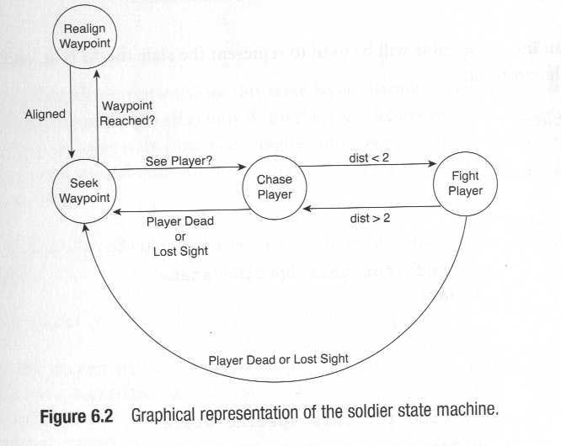
FSM in games

Slide 5
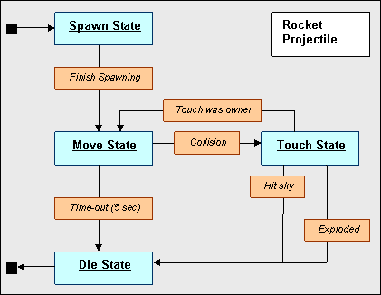
FSM in games

Slide 6
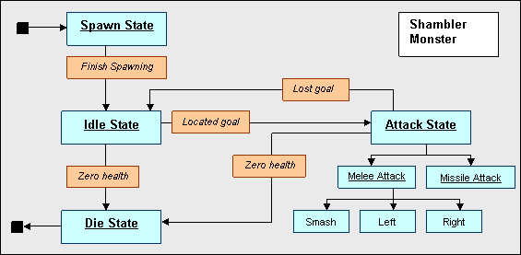
FSM in games

Slide 7
FSM in games
Quake II NPCs have nine states:
Standing
Walking
Running
Dodging
Attacking
Melee
Seeing the enemy
Idle
Searching

Slide 8
Coding an FSM
To code an FSM, you need two primary methods:
Update state
Perform actions

Slide 9
Coding an FSM
Update state
switch (catState)
case Sleeping:
if (cat in yard)
CatState = Chasing;
else if (has not eaten for 15 minutes)
CatState = Eating;
Break;
case Chasing:
if (neighbour cat gone)
CatState = Sleeping;
break;
…..

Slide 10
Coding an FSM
Perform actions
switch (catState)
case Sleeping:
Drool();
if (rGen->Next(100) > ROLLPROB) Rollover();
Haven’tEatenCount++
break;
case Chasing:
TargetAction(NeighbourCat);
Hiss();
break;
…..

Slide 11
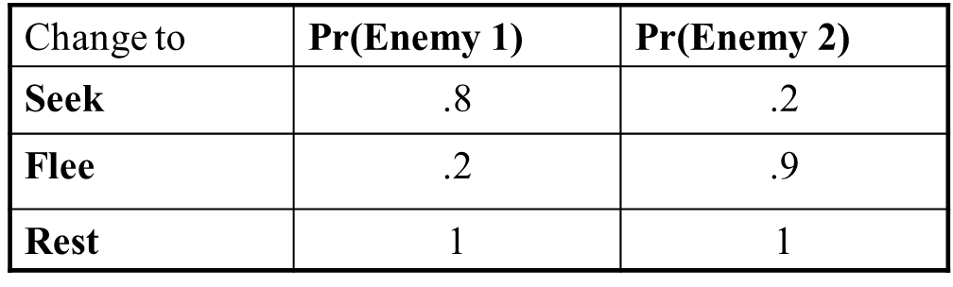
Probabilistic FSM
Seek
Flee
Rest

Slide 12
Inheritance in OO - review
A group of classes are related in that they have a common core of shared functionality and/or data
Child classes extend parent (base classes) by descent
Child classes contain all public or protected data and methods of their ancestors
Inheritance promotes code reuse and reduces code duplication
Child classes contain additional data, additional functionality or polymorphic implementations
The parent-child relationship must be an “is-a” relationship, not a “has-a” relationship

Slide 13
Inheritance in OO - review
Inheritance for extension
Base Class: Common Core
Child Class: + Specialised

Slide 14
Inheritance in OO - review
Inheritance for polymorphism
Base Class – Common Core
Including ImportantJob()
Child Class1
Implements ImportantJob() with algorithm 1
Child Class2
Implements ImportantJob() with algorithm 2

Slide 15
Dangers of inheritance
Cumbersome hierarchies – confusing to use
Single hierarchical structure not a good match for information architecture.
Hidden functionality in ancestors

Slide 16
Don’t use inheritance
...when it isn’t a true “is-a” relationship

Slide 17
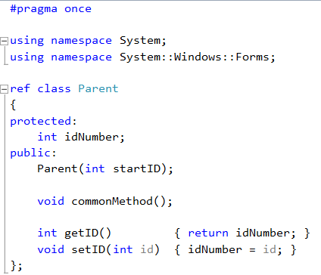
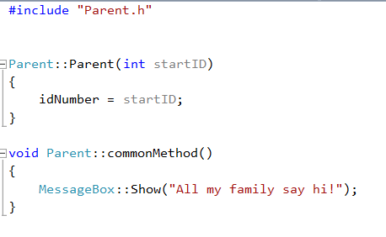
Inheritance syntax in C++

Slide 18

Inheritance syntax in C++
In Child1.h

Slide 19
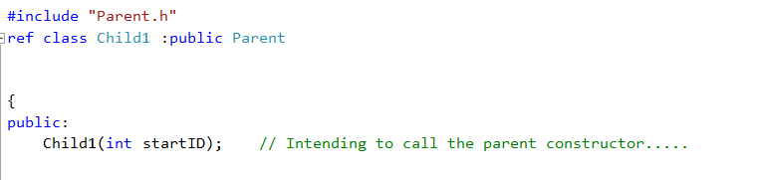
Inheritance syntax in C++
In Child1.h
If you want to call the parent constructor, make sure the child constructor contains at least all
the input arguments that the parent constructor contains

Slide 20
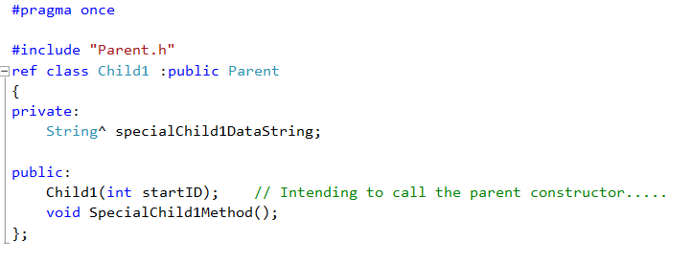
Inheritance syntax in C++
In Child1.h

Slide 21
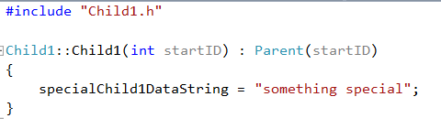
Inheritance syntax in C++
In Child1.cpp

Slide 22
Inheritance syntax in C++
Overriding
virtual
The parent provides a default code body (may be empty)
Children have the option of overriding with their own code, or using the parent’s default version
abstract
The parent provides no code body
All children must provide their own code
Instances of the parent class cannot be instantiated
Notes:
=

Slide 23
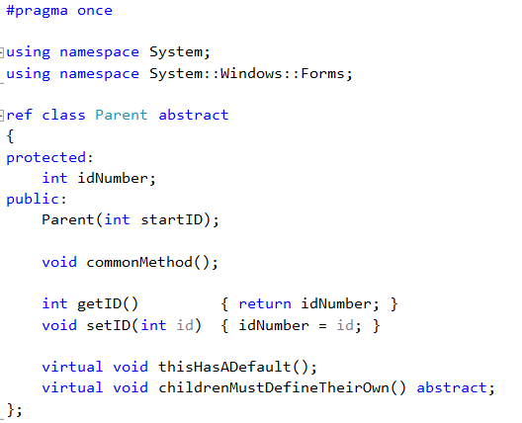
Inheritance syntax in C++

Slide 24
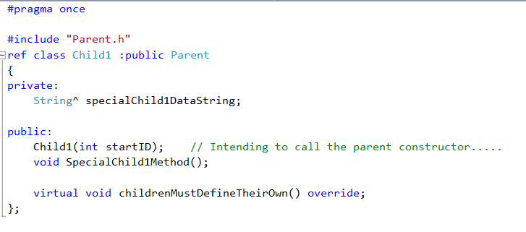
Inheritance syntax in C++
In Child1.h

Slide 25
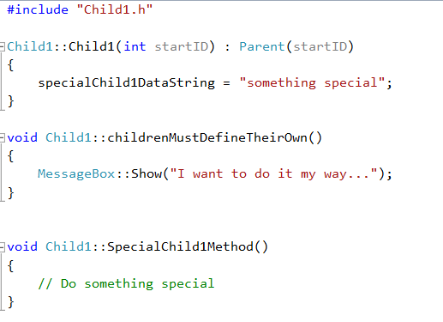
Inheritance syntax in C++
In Child1.cpp

Slide 26
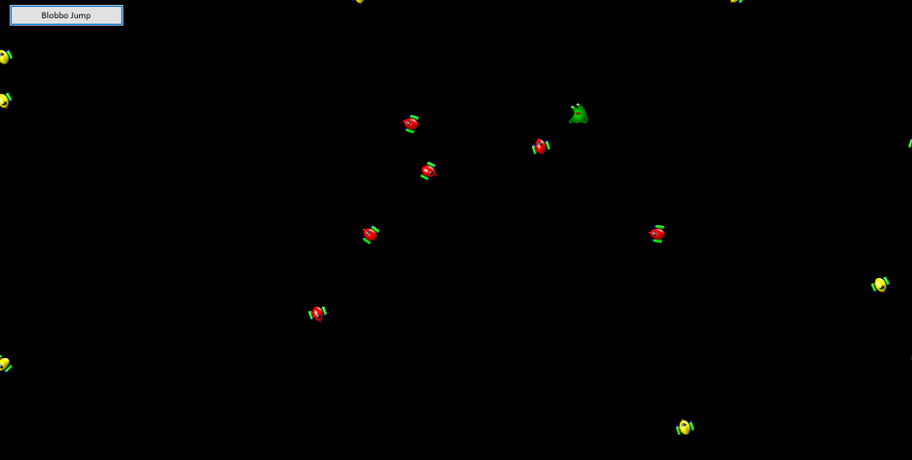
Practical
Approach-avoid

Slide 27
Practical
Use Inheritance InheritanceApproachAvoid Skeleton
Carefully study the existing classes, SimpleSprite, SpriteList and Form1. Read the comments in Form1.h
Add two new classes Approacher and Avoider, both descended from SimpleSprite, so that your
application runs as in the demo
Before creating your new child classes, decide:
What data members and methods do they inherit from their parent?
What additional data members (if any) do they each need?
What additional methods (if any) do they each need?
What inherited methods (if any) do they each need to override?
If you are going to add methods or override inherited methods, what is the logic for each one?

Slide 28
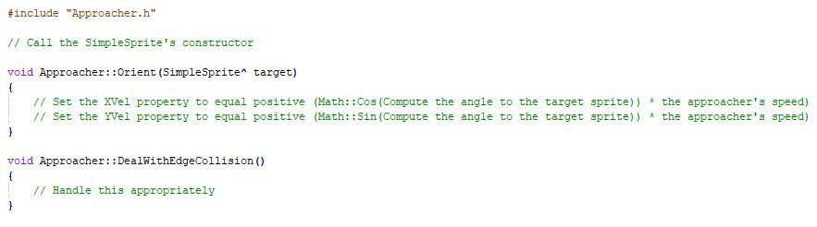
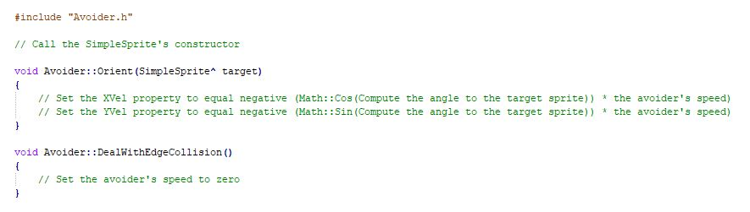
Practical – code examples

